Slide 1
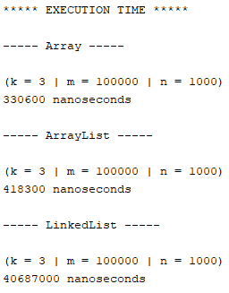
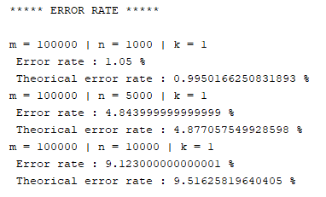

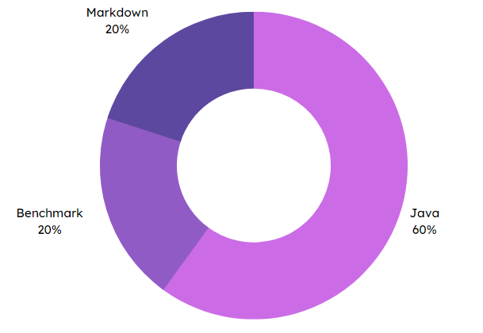


Specifications
Final rendering
Implementation of Bloom's filter in 3 forms (array, ArrayList, LinkedList).
Benchmarking and comparison of item search times.
Error rate benchmarking (false positives).
Benchmark report in Markdown.
Execution time
Error rate analysis
Bloom filter
Methodes and technologies
Skills
Markdown
20 %
Markdown
Benchmark
20 %
Java
60 %
NetBeans
THÉRON Evan

