Slide 1
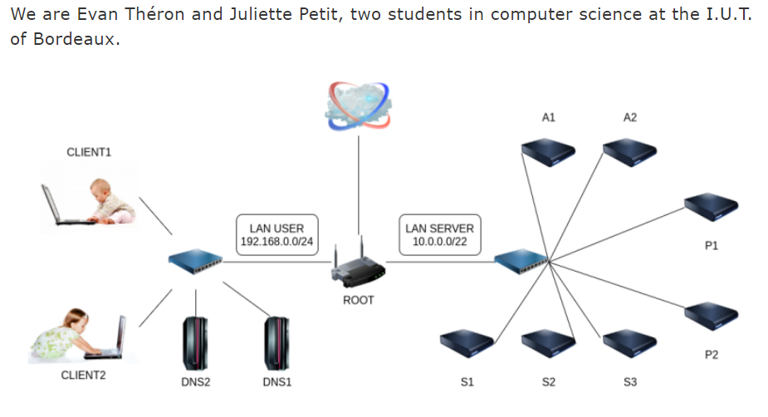
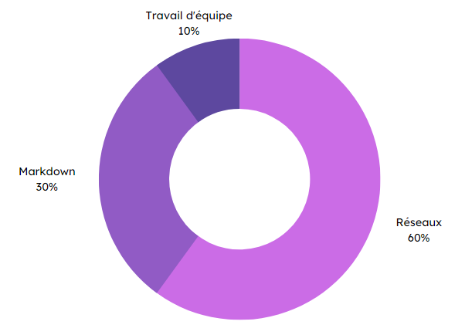


Specifications
Final rendering
In pairs:
Create/configure DNS servers in a NEmu virtual machine.
Simulate interactions between clients and DNS servers.
Understand how DNS zones work.
Produce a complete Markdown report/user guide.
Extract from the report
DNS servers
Methodes and technologies
Skills
Teamwork
10 %
Markdown
30%
Markdown
Networking
60%
THÉRON Evan

