Slide 1
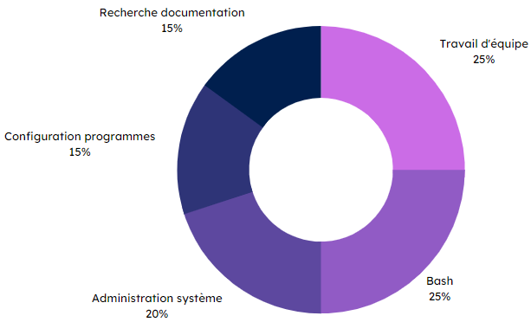



Specifications
Final rendering
In pairs:
Create a Linux virtual machine with VMWare
Install the XFCE desktop
Configure machine in English (French keyboard)
Create 2 users (an admin. & a developer)
Install the Rust language in nightly version
Install and configure VSCode for use with Rust
Install Git
Configure the Bash prompt with information from the current Git directory
Virtual machine installation
Methodes and technologies
Skills
Literature search
15 %
Teamwork
25 %
System administration
15 %
Program configuration
20 %
Bash
25 %
THÉRON Evan

