Slide 1
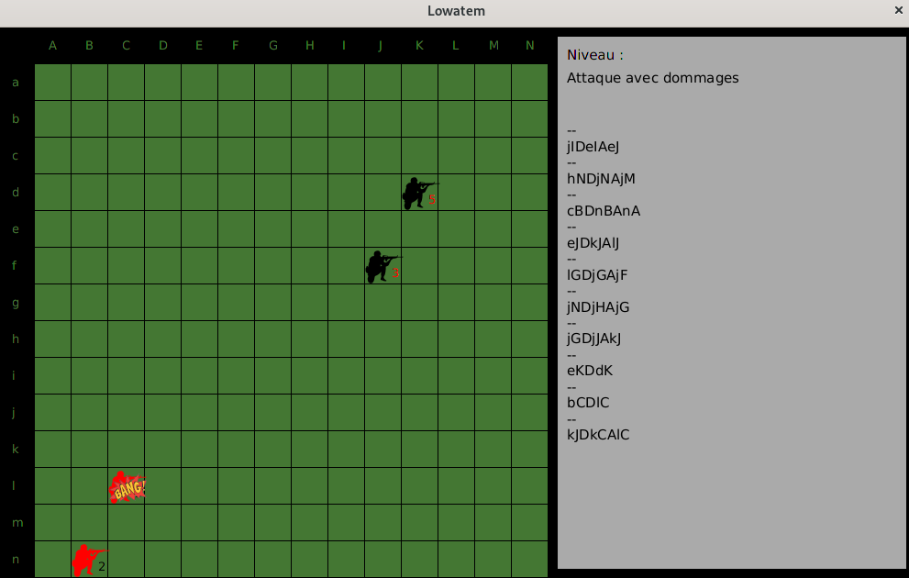

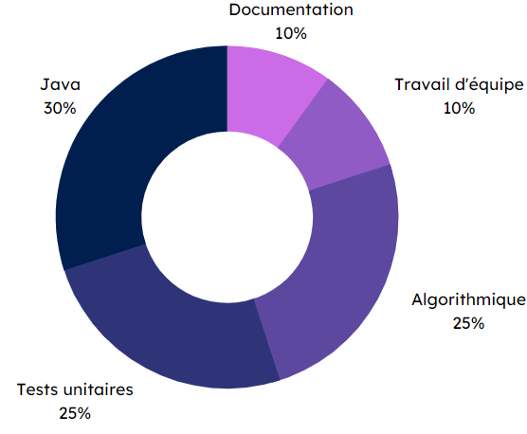

Specifications
Final rendering
Alone :
Coding the rules of a strategic board game, level by level
Create unit tests
In pairs :
Development of 2 AIs for this game (different strategies)
Game graphics mode (undeveloped)
Lowatem
Methodes and technologies
Skills
Documentation
10 %
Java
30 %
Teamwork
10 %
NetBeans
Algorithms
25 %
Unit tests
25 %
THÉRON Evan

