Slide 1
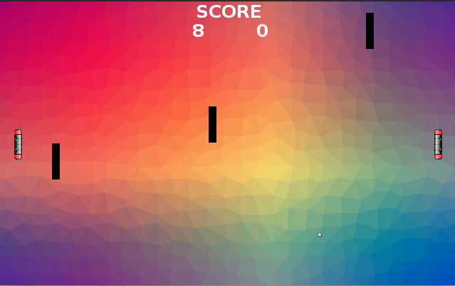
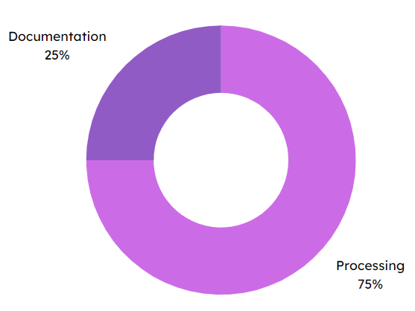

Specifications
Final rendering
Display and move 2 rackets
Pause function
Collision management
Score management
Edit images and fonts
Game menu
Exit the game with a button
Play mode with 4 balls
Implement obstacles
Code documentation
Pong project
Methodes and technologies
Skills
Documentation
25 %
Processing
Processing
75 %
THÉRON Evan

