Slide 1
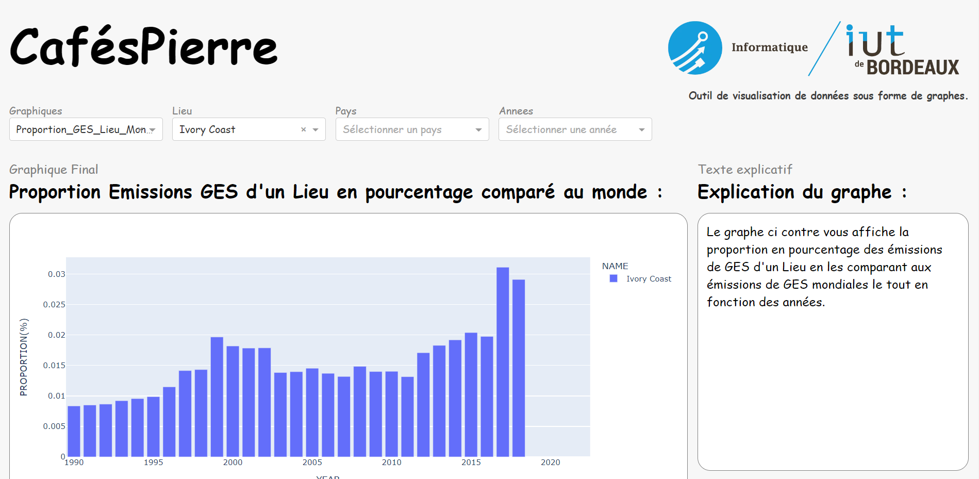

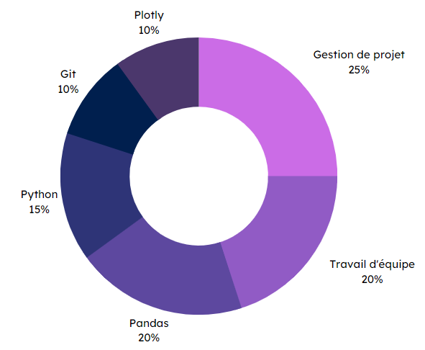



Specifications
Final rendering
In a group of 4 people:
Create an application to visualize climate data for different regions of the world.
Create a database that can be used to create graphics.
Version code with Git.
Project monitoring (Gantt charts, steering committees, etc.).
Data visualization
Methodes and technologies
Skills
Plotly
10 %
Project management
25 %
Git
10 %
Python
15 %
Teamwork
20 %
Pandas
20 %
THÉRON Evan

