Slide 1
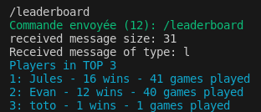
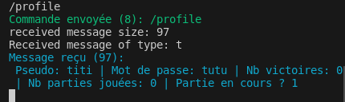
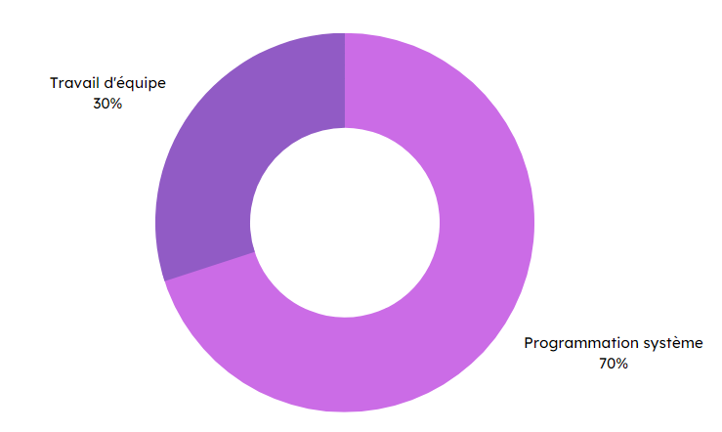

Specifications
Final rendering
In pairs:
Create a online multiplayer Tic-Tac-Toe in C.
Use socket-related system calls.
Create a server that handles multiple connections at the same time.
Create a client (can be instantiated several times).
Establish a communication protocol.
Manage multiple parties simultaneously.
Leaderboard
Multiplayer
Tic-Tac-Toe
User profile
Methodes and technologies
Skills
Teamwork
30%
System programming
70%
THÉRON Evan – All Rights Reserved

