Slide 1
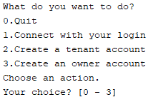
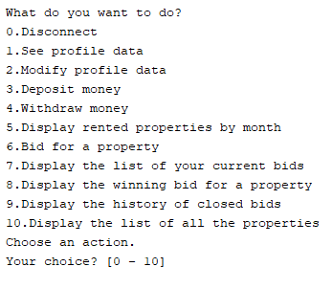
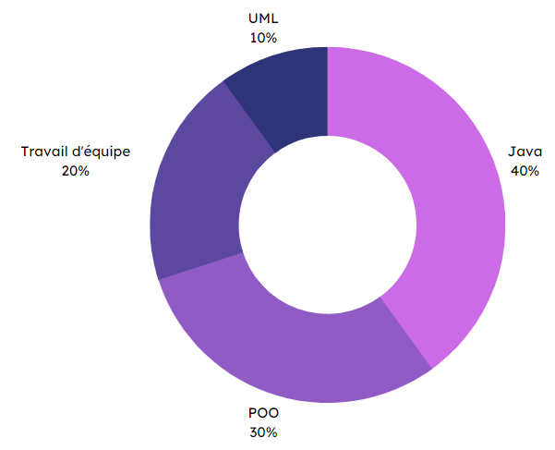


Specifications
Final rendering
In pairs
Create a text-based property rental application.
Manage multiple user types (owner, tenant and administrator) and their specific actions.
Setting up an auction system.
Time management in reservations.
Creation of various UML diagrams based on specifications.
Application screens
Rental
software
Methodes and technologies
Skills
UML
10 %
Teamwork
20 %
Java
40 %
NetBeans
OOP*
30 %
THÉRON Evan
*Object-oriented programming

