Slide 1
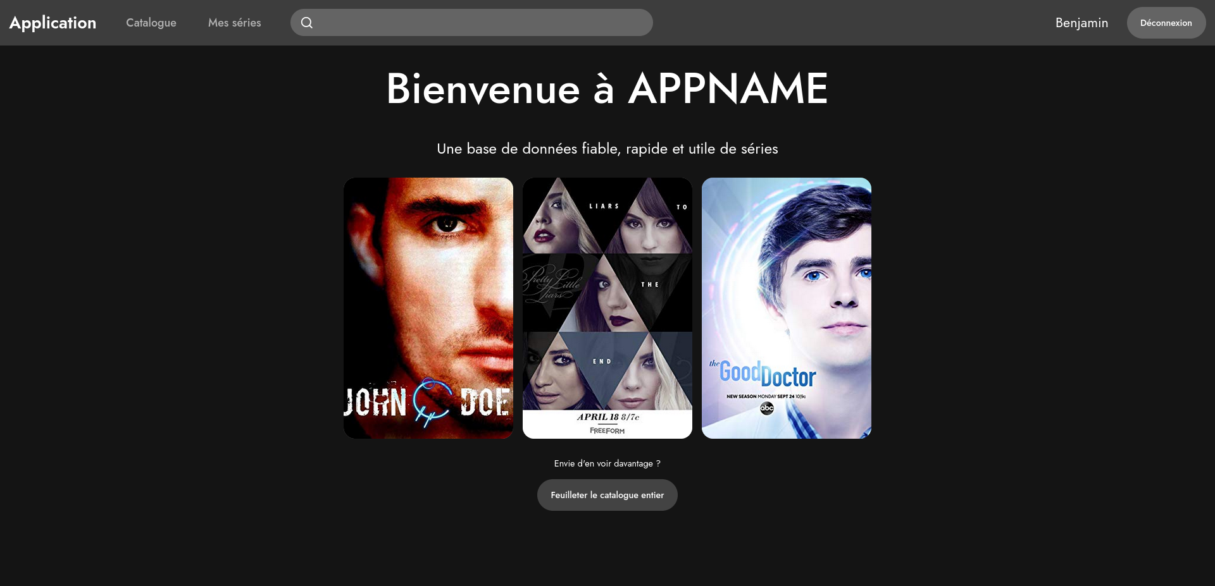



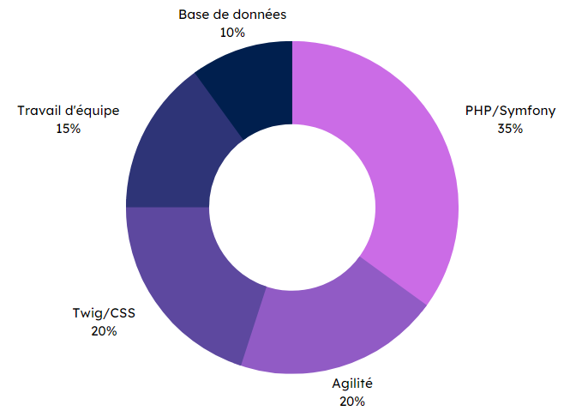


Specifications
Final rendering
In a group:
Use of Scrum methodology.
List series.
Series information page.
User management (login/registration).
Series tracking.
Homepage
TV series application
Methodes and technologies
Skills
Databases
10 %
Teamwork
15 %
Symfony
PHP/Symfony
35 %
Scrum (agility)
Twig/CSS
20 %
THÉRON Evan
Agilité
20 %

