Slide 1
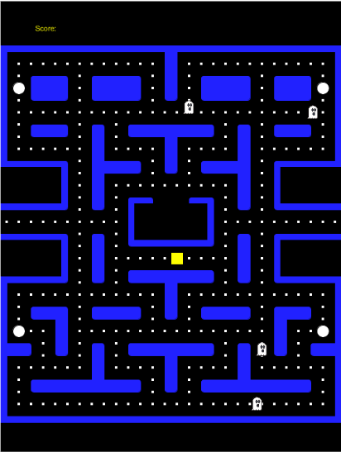
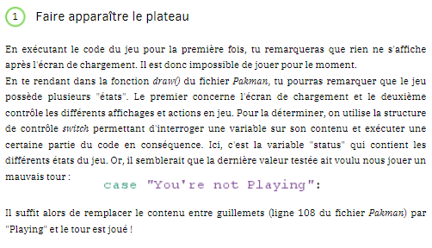

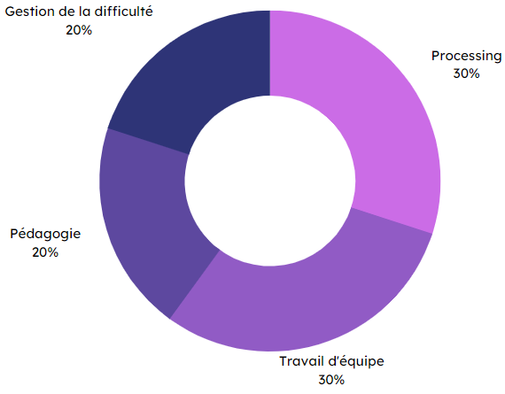
Specifications
Final rendering
In a group:
Creation of an introductory Processing language workshop
Coding a game (in this case, a Pac-Man-like game)
Comment code for initiation
Adapting the code to the exercises
Create an exercise document
Introductory
workshop
Methodes and technologies
Skills
Difficulty management
20 %
Processing
30 %
Processing
Pedagogy
20 %
Teamwork
30 %
THÉRON Evan

