Slide 1
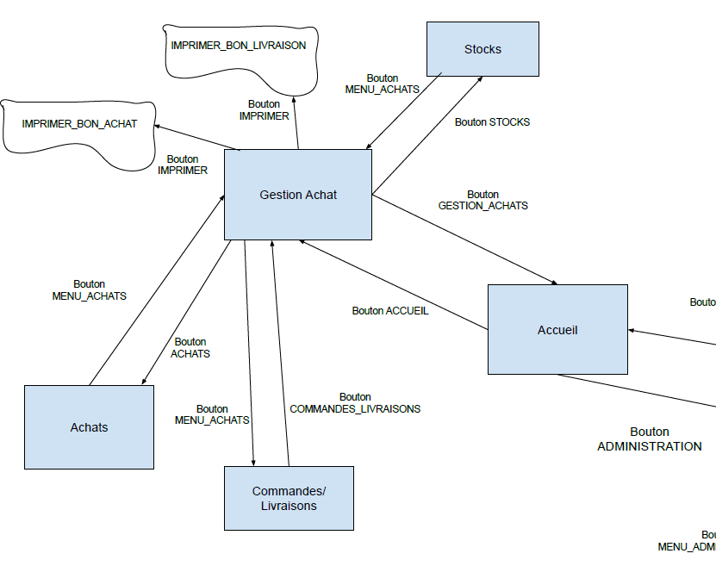
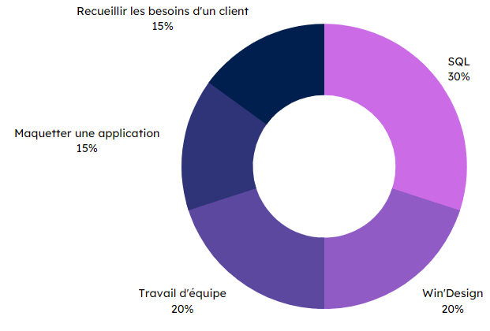


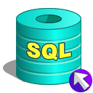
Specifications
Final rendering
In pairs:
Create a Conceptual Data Model (CDM) based on a concrete subject.
Create a filling script corresponding to the database created.
List the functionalities that a linked application could offer, and the corresponding SQL queries.
Mock-up this application.
Extract from the application architecture
Creating a database
Methodes and technologies
Skills
Gathering customer needs
15 %
SQL
30 %
Mock-up an application
15 %
Teamwork
20 %
Win’Design
20 %
THÉRON Evan

