Slide 1
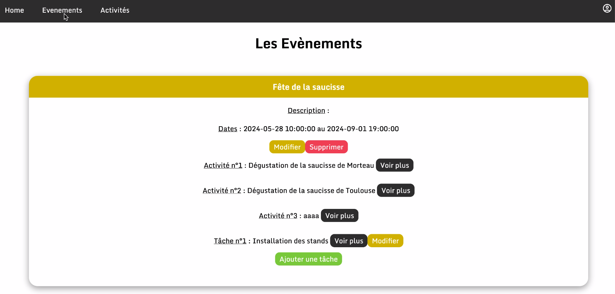

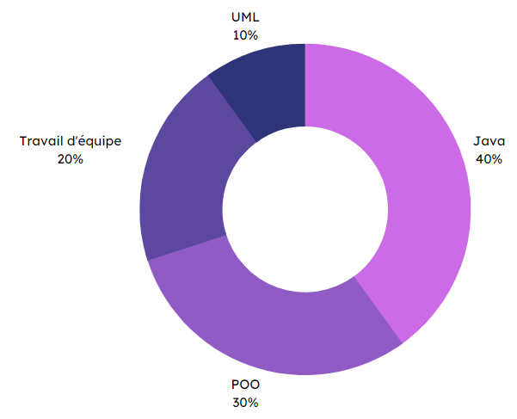




Specifications
Final rendering
In pairs
User management (authentication/back office).
Create, read, update and delete events.
Create/delete activities related to an event.
Add tasks to activities/events and assign volunteers to them.
Add a comment to a specific event.
Create a PostgreSQL database to store the events.
Event manager
V1
Events list interface
Methodes and technologies
Skills
Databases
10 %
Teamwork
20 %
PHP
40 %
Frontend 30 %
THÉRON Evan – All rights reserved

