Slide 1



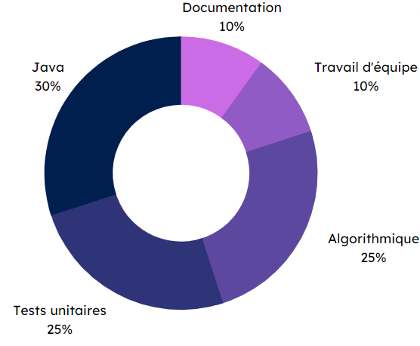


Specifications
Final rendering
In pairs
Get the event’s weather forecast as a GIF thanks to an external API.
Create an API (Express.js) to create, read, update and delete events.
Handle user authentication.
Add an event to favorites.
Search for a specific event.
Create a populate an SQLite database with events data.
Event details interface
Event manager
V2
Methodes and technologies
Skills
Databases
10 %
Vue.js 30 %
ElementPlus 10 %
Vue.js
ElementPlus
Teamwork
25 %
Express.js 25 %
THÉRON Evan – All rights reserved

