Slide 1

Survey of Methods for Model Order Reduction For Seminar High Dimensional Methods in Scientific Computing
Evgeni Todorov
Technical University of Munich
Department of Informatics
Munich, June 2021

Slide 2
Contents
Introduction
– What is MOR and why we do it?
Example
– Illustration of using MOR in structural mechanics
Highlights
– Overview of some important or up-and-coming methods
Application
– Wide selection of interesting recent examples
Conclusion
– The way forward

Slide 3
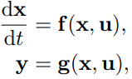
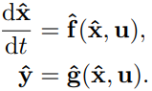

Model Order Reduction
Model: Useful representation of reality
Order: For mathematical models, the number of degrees of freedom
– Closely related to computational intensity
Reduction: Describe the same reality with less effort

Slide 4


Model Order Reduction - Future
Measure
Fit
Simulate
Predict
Effect
Classically for large-scale simulation (weather, physics, etc.)
Increasingly applied to efficient simulation:
Real-time:
– Control systems
– Internet of Things
Many-query:
– Design optimization
– Parameter estimation
Outer-loop:
– Uncertainty quantification
– Advanced metrology

Slide 5
Example: Structural Mechanics

Slide 6
Example: Component Mode Synthesis
Typical industry-standard reduction method for mechanical systems
Implemented in commercial packages (e.g. NASTRAN and ANSYS)
Example of a hybrid modal reduction method
Projection along physical and modal coordinate basis vectors
Substructuring = Superelements

Slide 7
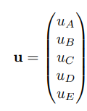
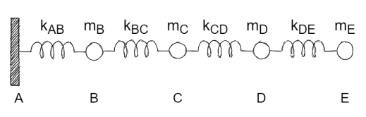
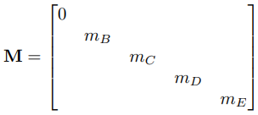
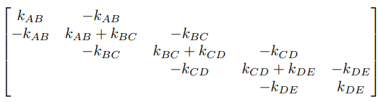

Example: Component Mode Synthesis

Slide 8
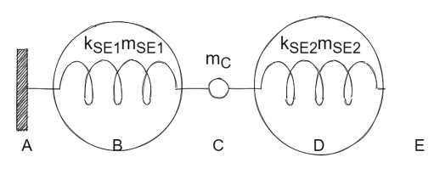
Example: Substructuring

Slide 9






Example: Craig-Bampton transformation
interior
boundary
Constraint modes
eigenvector
Fixed boundary modes
eigenvectors matrix

Slide 10
Highlights: Algorithm and Data-driven

Slide 11
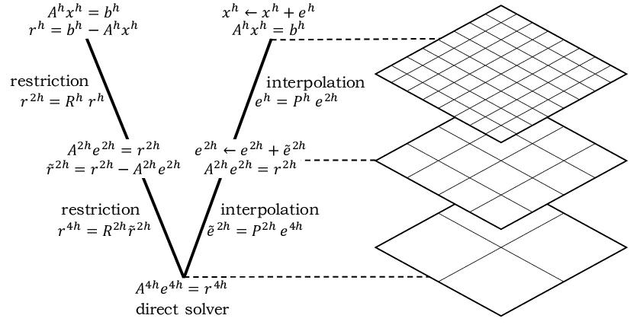

Algorithm-driven methods
Multigrid (and algebraic multigrid) methods
Adaptive mesh (and algorithm) control
Multiscale modelling
Subject of multiple CSE courses
Proper Generalized Decomposition (PGD)
Ibeid, Huda & Olson, Luke & Gropp, William. (2018). FFT, FMM, and Multigrid on the Road to Exascale: performance challenges and opportunities. https://arxiv.org/abs/1605.01522

Slide 12
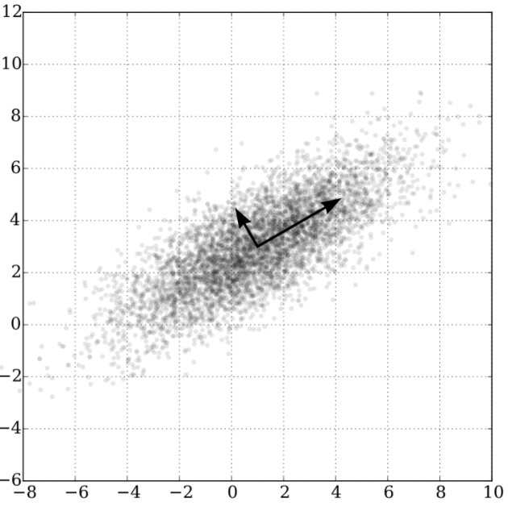







Data-driven methods
Proper Orthogonal Decomposition (POD)
(closely related to Principal Component Analysis)
SVD
CC-BY
Wikimedia/ File:GaussianScatterPCA.svg

Slide 13




Data-driven methods
Empirical Interpolation method (EIM)
– Computing non-linear component with POD is expensive
– Interpolate it instead
– Discrete EIM (DEIM) uses greedy algorithm to find permutation matrix P
1. Start with the column maximum of (non-orthogonal space) U
2. Compute a residual from the decomposition
3. Get the maximum index of the residual
4. Repeat from 2. until done
– More efficient for the non-linear component

Slide 14
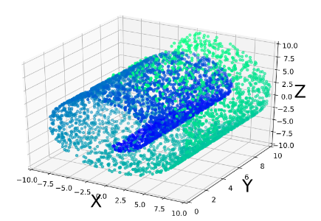
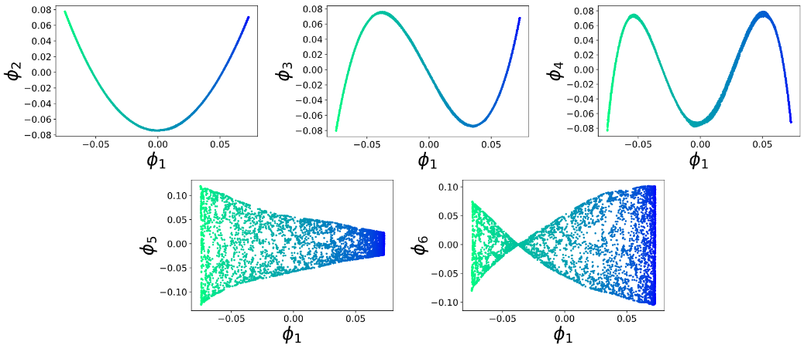

Data-driven methods
Non-linear machine learning approaches
– Diffusion maps and other manifold learning
– Neural networks
Koopman Operator-based methods
– Observable
– Spectral decomposition for MOR (e.g. DMD)

Slide 15
Applications

Slide 16

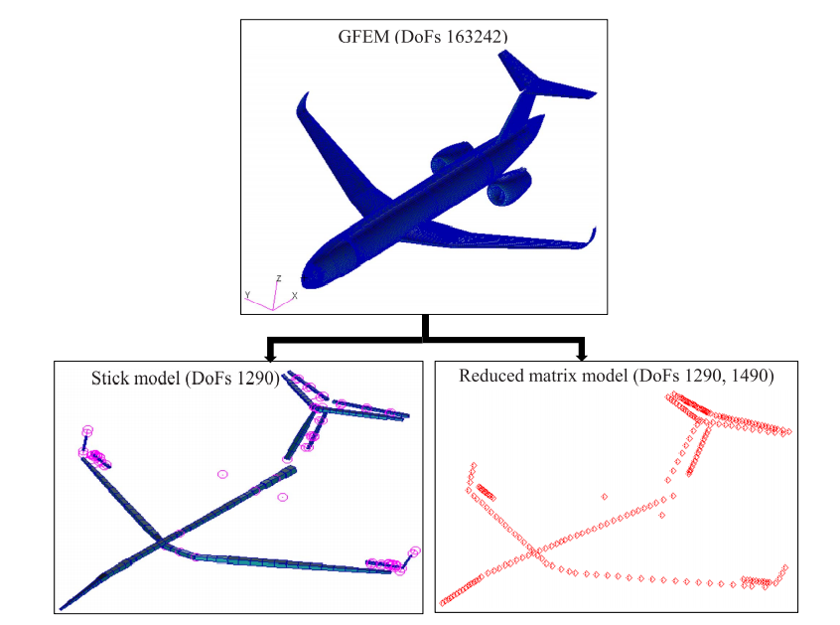
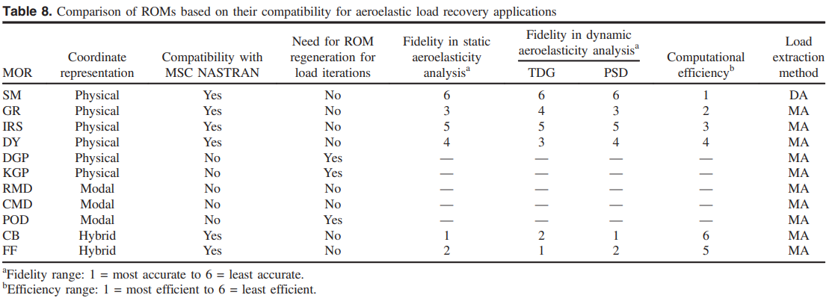
Application – Aeroelastic Analysis
Coupling of aerodynamic effects to the structural response
Obtain loads
GFEM vs stick model vs ROM
N/A: Galerkin projection, modal decomposition, POD
Parametric techniques:
Aero-structural design loop

Slide 17

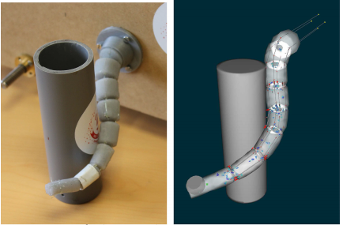
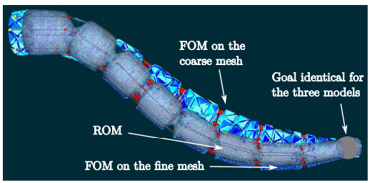
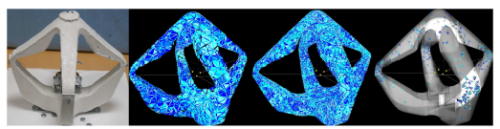
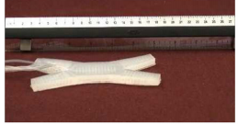
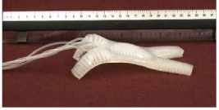
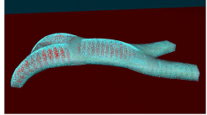
Application: Control of Soft Robots
Heavy offline stage
Real-time interaction for control system design
Real-time calculation in the control loop
ROM – more efficient than coarse mesh

Slide 18

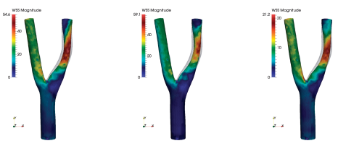
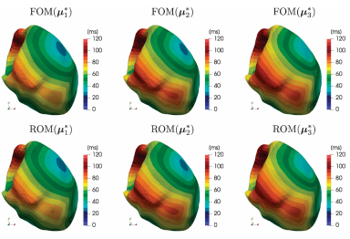
Application: Cardiovascular System Modeling
CC-BY-NC-ND
Shear stress in carotid artery bifurcation
– POD + DEIM
– Parametrized Navier-Stokes
– Stensosis (obstruction)
– Input flow rate
Cardiac electrophysiology activation map
– POD + DEIM
– 9 parameters:
electrical conductivity and ionic dynamics

Slide 19
Conclusion
Very robust methods for dealing with linear systems
Parametric modelling relevant to real-time, many-query, outer-loop:
multidisciplinary optimization
digital twins
autonomous control systems
augmented reality
data rich measurements
Data-driven and non-linear MOR – active research field related to machine learning
Gap between scientific advancement and industrial practice

Slide 20
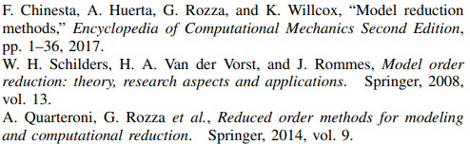
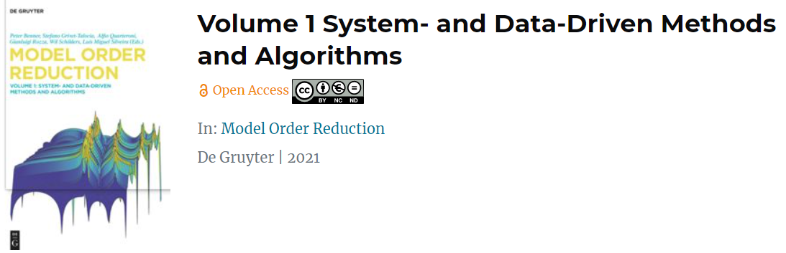

Further reading
Expected soon

Slide 21
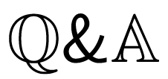

Slide 22
Extra Slides

Slide 23



Proper Orthogonal Decomposition (POD)
SVD

Slide 24
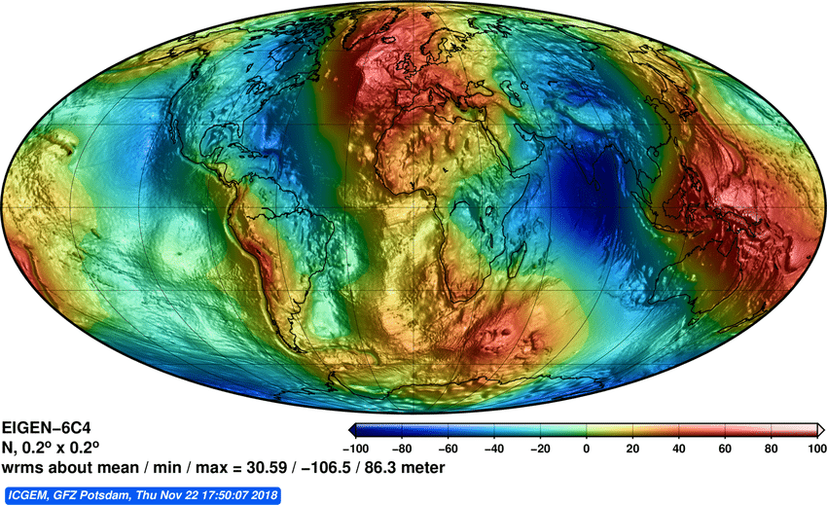
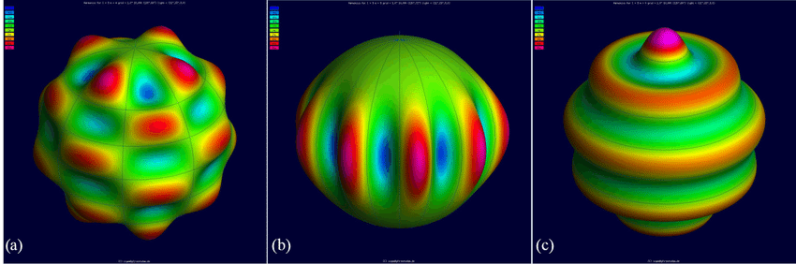
Data-driven example: Earth Geopotential Model
Model the Earth gravitational field
In terms of spherical harmonics
Based on very large number of data-points
(actually series of models)
CC-BY Ince, E. S., Barthelmes, F., Reißland, S., Elger, K., Förste, C., Flechtner, F., and Schuh, H.: ICGEM – 15 years of successful collection and distribution of global gravitational models, associated services, and future plans, Earth Syst. Sci. Data, 11, 647–674, DOI:10.5194/essd-11-647-2019

Slide 25

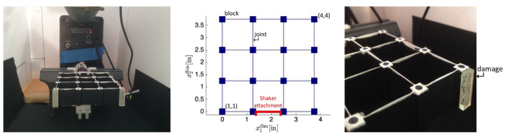
Application: Structural Health Monitoring
Parametric Reduced Order Model
Model situation for damage identification from photographs
Reduced order model used to train a Machine Learning classifier

