Slide 1
IBM University Engagement Project Submission
“Exploring the Power of Agentic AI with IBM Granite and LangFlow”

Slide 2

Project Tile – Power System Fault Detection and Classification
Domain of Project – Electrical Engineering
Student Name | Recent Passport Photo | Email ID | Mobile number [WhatsApp]
Ernapati Venkata Udayasree |  | evudayasree@gmail.com | 8019284473

Slide 3
Problem Statement -
Problem Statement : Power System Fault Detection and Classification
The Challenge
Power distribution systems are critical infrastructure that must operate continuously and reliably. However, faults such as line breakages, transformer failures, overheating, and other equipment malfunctions can lead to power outages, equipment damage, increased maintenance costs, and reduced grid stability. Traditional fault monitoring methods often rely on manual inspection and rule-based systems, which may not provide rapid or accurate fault identification. Additionally, electrical parameters, environmental conditions, and component health indicators generate large volumes of data that are difficult to analyze in real time.
The Objective
Build an AI-powered Power System Fault Detection and Classification System that leverages machine learning and electrical measurement data to accurately identify and classify power system faults in real time. The solution should:
Fault Detection: Detect abnormal operating conditions and distinguish them from normal system behavior.
Fault Classification: Classify faults into categories such as: Transformer Failure, Overheating, Line Breakage
Electrical Data Analysis: Analyze system parameters including: Voltage, Current, Power Load, Fault Duration, System Downtime
Environmental Awareness: Incorporate external factors such as: Temperature, Wind Speed, Weather Conditions
Asset Health Monitoring: Utilize: Maintenance Status, Component Health Indicators. To improve fault prediction accuracy and support preventive maintenance.
Intelligent Decision Support: Provide real-time fault classification results, and maintenance recommendations to system operators.

Slide 4
Technology Used
I used IBM watsonx.ai with IBM Granite Models
Technology Used:
Python, Pandas, Scikit-Learn, XGBoost, IBM Granite Model.
XGBoost Classifier:
XGBoost is used as the core classification algorithm in this project. It analyzes electrical parameters, environmental conditions, and equipment health data to learn fault patterns from historical records. I selected XGBoost because it provides high accuracy, handles complex relationships between features, offers feature importance analysis, and performs efficiently on structured datasets. The model classifies faults into categories such as Transformer Failure, Line Breakage, and Overheating, helping operators quickly identify fault conditions and improve power system reliability.

Slide 5
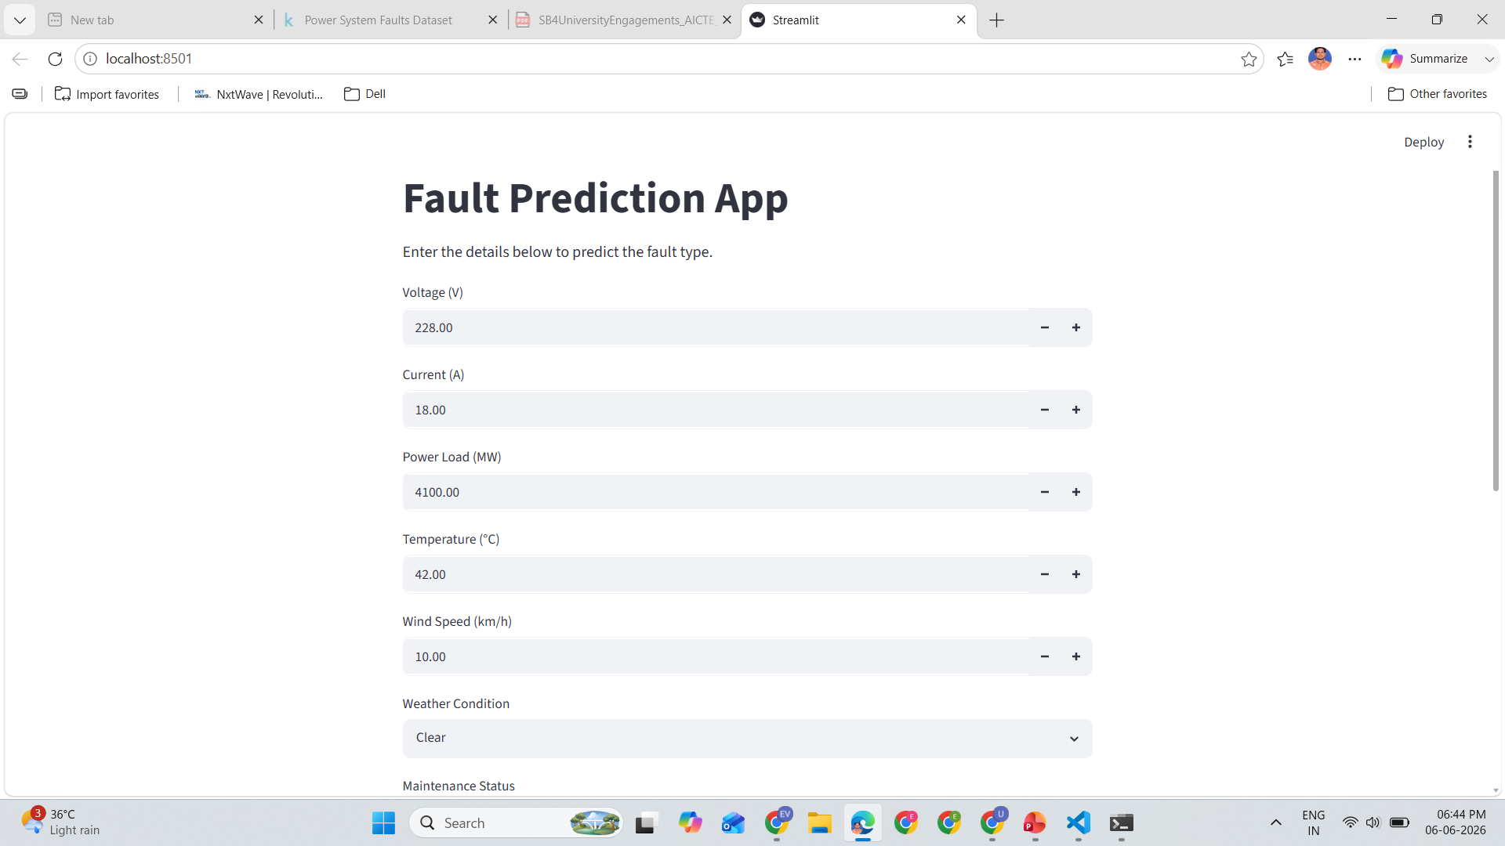
Output

Slide 6
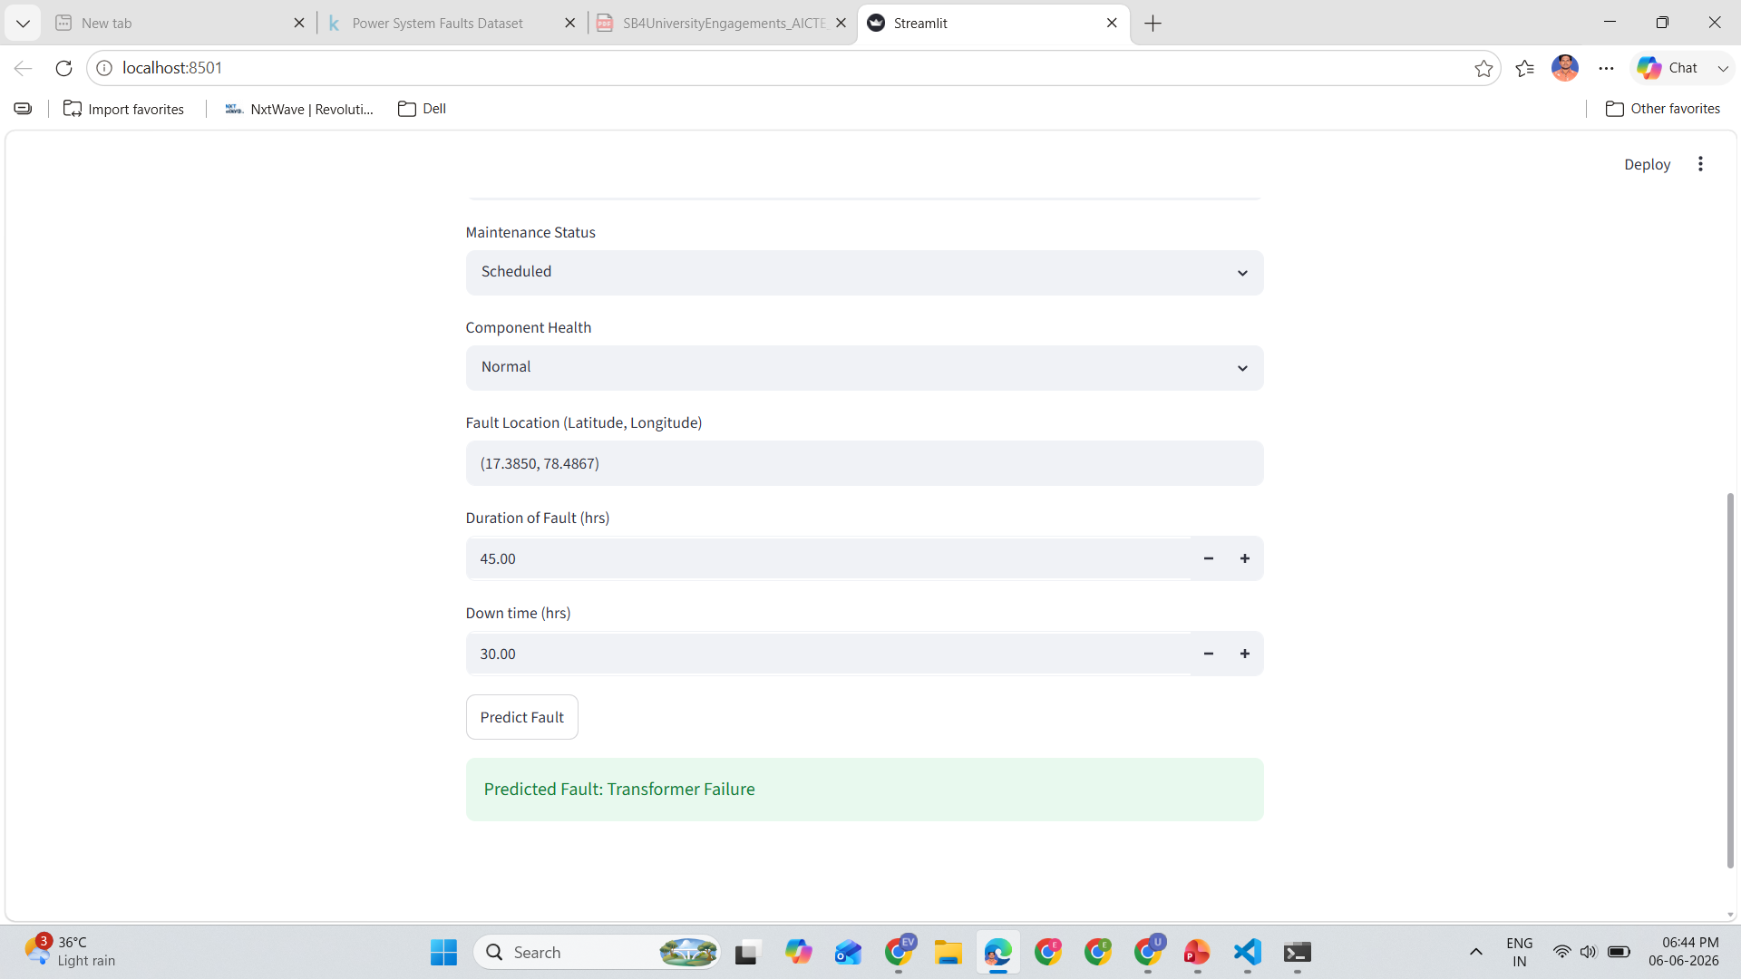

Slide 7
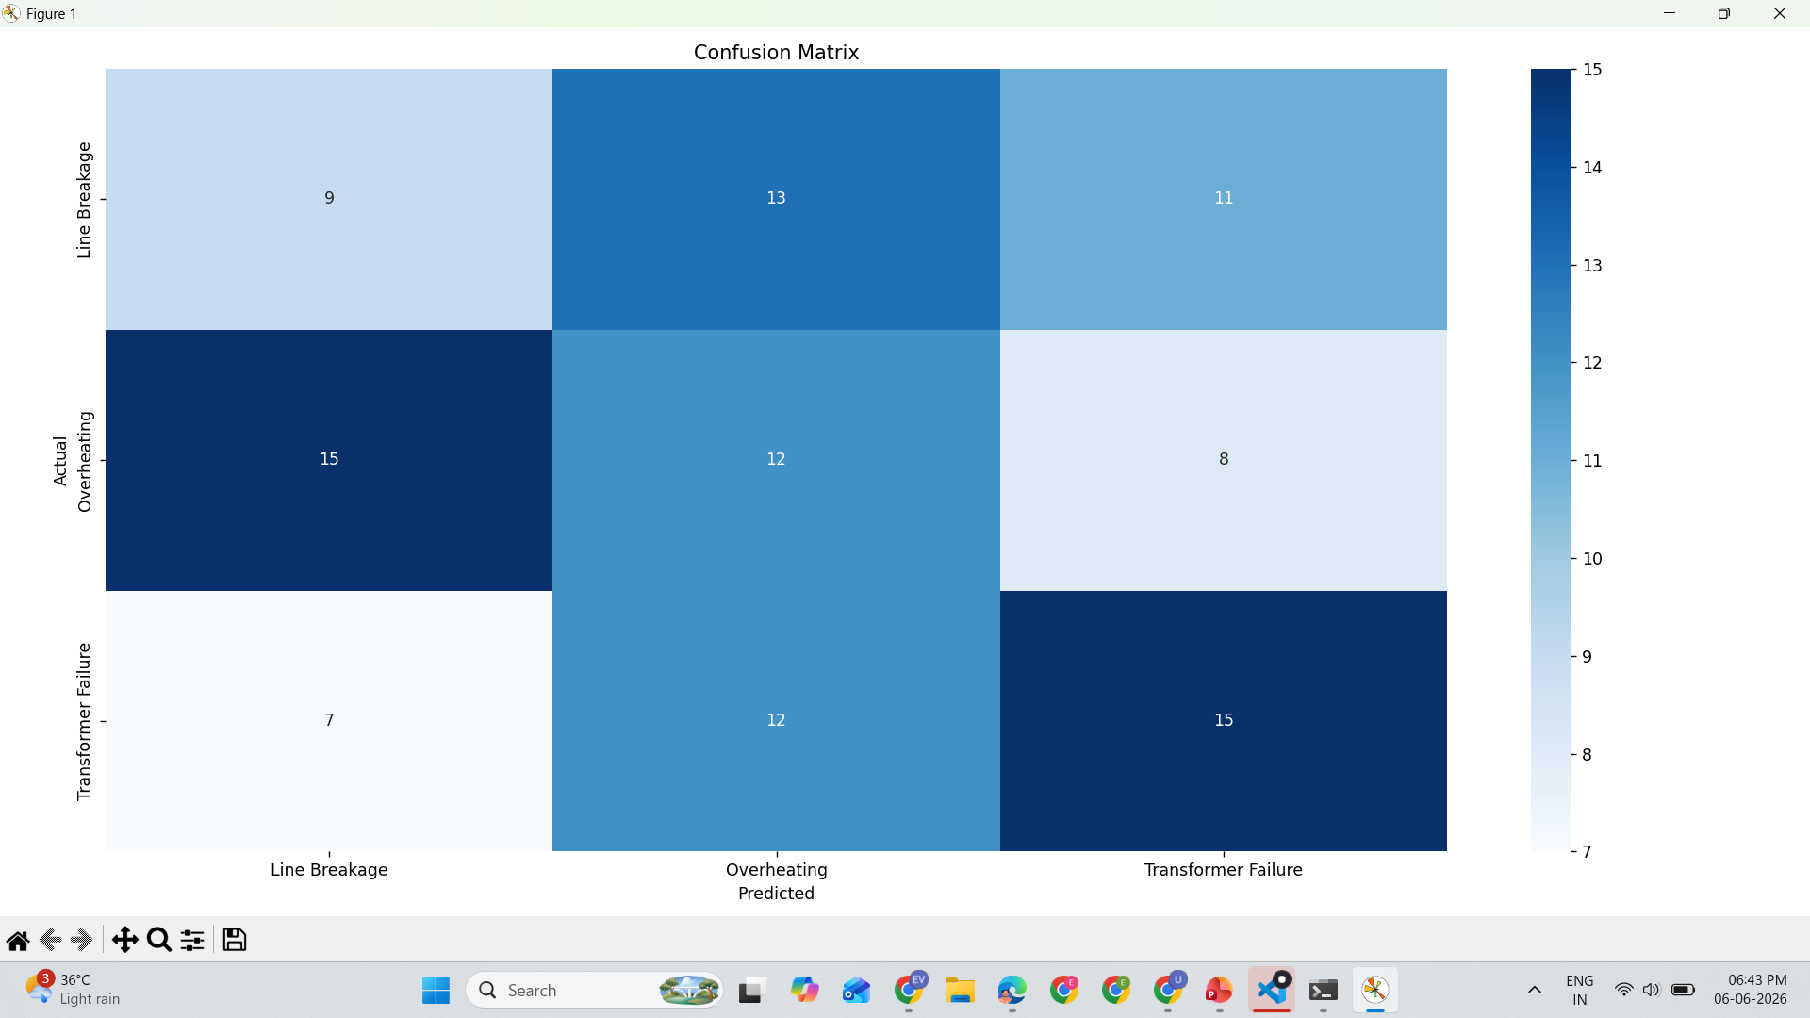
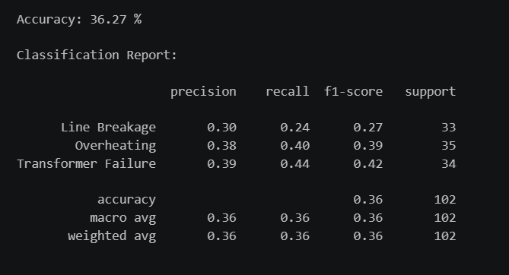
Confusion Matrix

Slide 8
Proposed Solution -
Proposed Solution: Power System Fault Detection and Classification
The proposed solution is a Machine Learning-based Fault Detection and Classification System designed to identify and classify power system faults using electrical measurements, environmental conditions, and component health indicators.
The system utilizes historical fault data containing voltage, current, power load, temperature, weather conditions, maintenance status, component health, fault duration, and downtime information. The collected data undergoes preprocessing, feature engineering, and encoding before being used to train machine learning models.
The solution employs the XGBoost Classification Algorithm to detect patterns associated with different fault categories and accurately classify faults into: Transformer Failure, Line Breakage, Overheating
The workflow consists of the following stages:
Data Preprocessing
1. Missing value handling
2. Categorical feature encoding
3. Feature scaling and normalization
Feature Engineering
1. Voltage-Current Ratio
2. Load-Current Ratio
3. Temperature-Load Relationship
4. Downtime Severity Metrics
Fault Classification Model
1. XGBoost Classifier
2. Feature Importance Analysis
Prediction & Monitoring
1. Real-time fault prediction
2. Automated fault classification

Slide 9
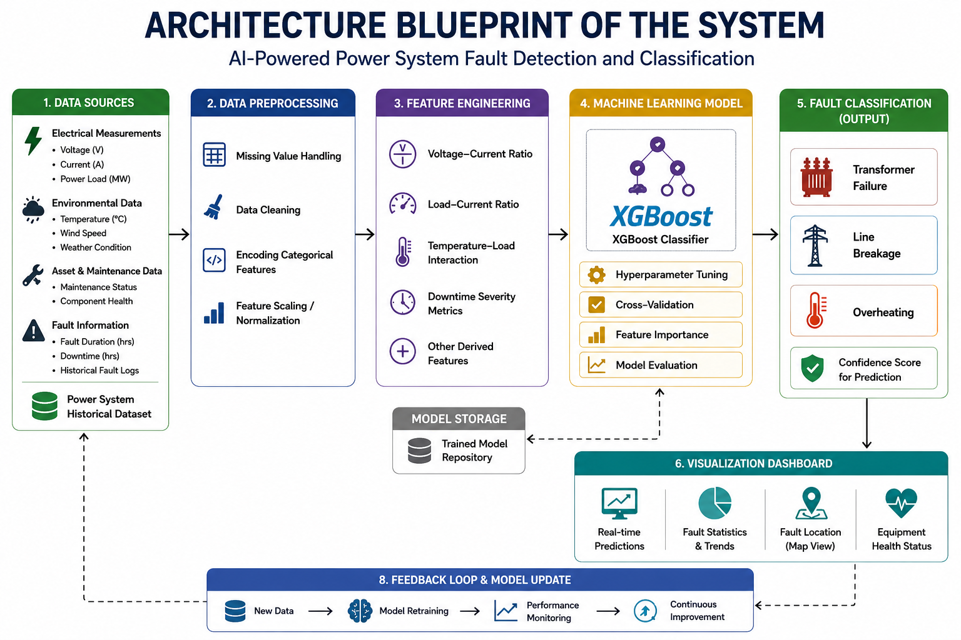
Architecture blueprint

Slide 10
Novelty and Uniqueness
The proposed AI-Powered Power System Fault Detection and Classification System introduces an intelligent and data-driven approach to fault monitoring by combining machine learning with power system analytics.
Intelligent Fault Classification - Uses machine learning algorithms to automatically identify and classify different power system faults with minimal human intervention.
Multi-Parameter Analysis - Analyzes electrical parameters, environmental conditions, and equipment health data simultaneously for improved prediction accuracy.
Real-Time Fault Identification - Enables rapid fault detection and classification, helping operators respond quickly and reduce outage duration.
Feature Engineering-Based Insights - Utilizes derived features such as voltage-current ratio, load-current relationship, and downtime severity metrics to enhance model performance.
Predictive Maintenance Support - Incorporates maintenance status and component health indicators to support proactive maintenance and reduce unexpected failures.
Explainable AI - Provides feature importance analysis to help operators understand the key factors influencing fault predictions.
Scalable and Practical Solution - Can be integrated with smart grids, SCADA systems, and IoT-based monitoring infrastructure for large-scale deployment.
Key Uniqueness
Unlike traditional rule-based fault monitoring systems, this solution leverages Machine Learning and intelligent analytics to provide faster, more accurate, and scalable fault classification, enabling utilities to improve power system reliability and minimize downtime.

Slide 11
Git Hub Link
Git Hub Link: evudayasree03/Power-System-Fault-Detection-and-Classification
·
·
·

Slide 12
Future Scope
1. Integration with Smart Grid and IoT Sensors
The system can be integrated with real-time IoT devices and smart grid infrastructure to continuously monitor electrical parameters and detect faults instantly. Future versions can predict potential equipment failures before they occur by analyzing historical fault patterns, maintenance records, and component health data.
2. Advanced Deep Learning Models
Deep learning techniques such as LSTM, CNN, and Transformer-based models can be used to improve fault detection accuracy and handle complex power system data.
3. SCADA and Utility System Integration
The solution can be integrated with SCADA and utility management systems to enable automated fault monitoring, reporting, and decision support.
4. Fault Localization and Root Cause Analysis
Future enhancements can identify the exact fault location and determine the root cause of failures, helping utilities reduce restoration time and maintenance costs.
·
·

Slide 13


