Slide 1
ClassLine
Mentoring:
Yechiel Kimchi
Presenting:
Dvir Mizrachi
Evyatar Pelleg

Slide 2
Concept
ClassLine is an audience-aid system that
Provides a new take on Note keeping
and Study materials management
in the contemporary lecturing environment.

Slide 3
Concept background
The ClassLine idea is derived from the manner in which frontal lectures are being conducted in the computerized classroom.
?

Slide 4
Concept background
While the minority of today’s lectures consist solely of a presenter and a white-board,
The use of software-based visual aids becomes more and more frequent.

Slide 5
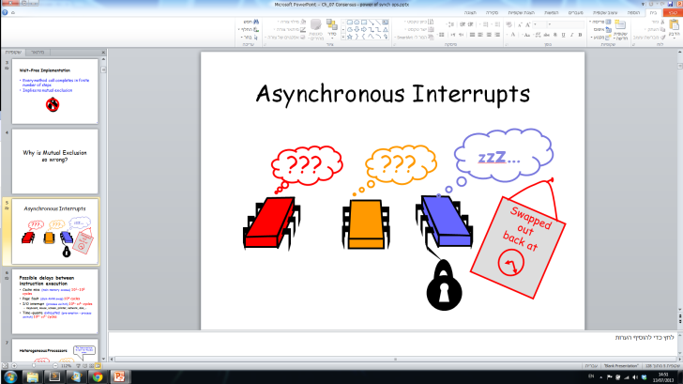
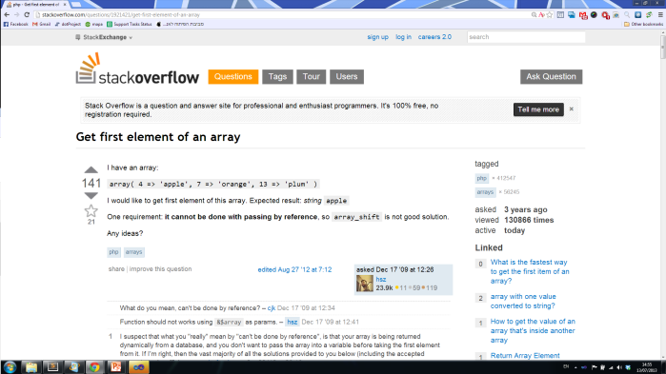
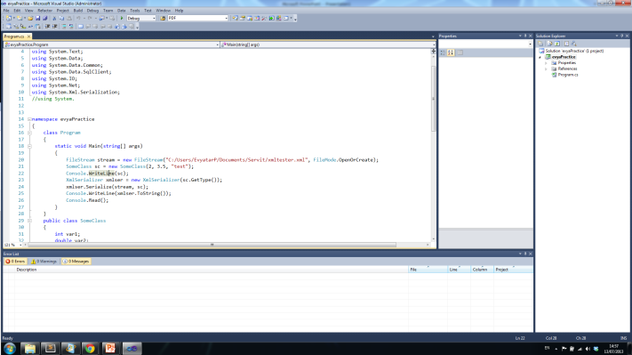
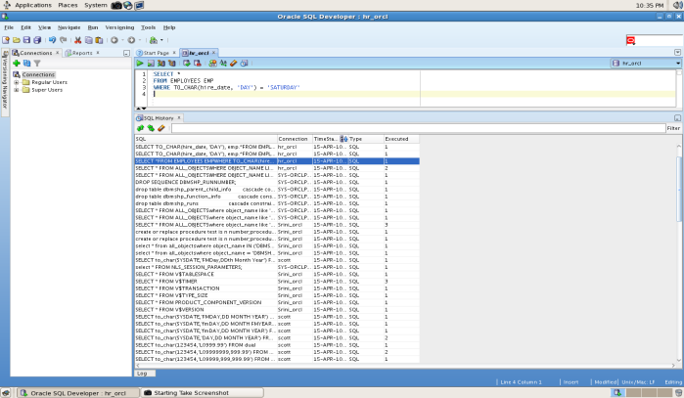
Concept background
Visual aids such as:
presentations
web sites
code
Professional SW
And more…

Slide 6
Concept background
More often then not
The natural flow and referential meaning
of the lecture
is lost…

Slide 7
Goals
ClassLine attempts to preserve that flow long after the lecture is over by offering
a simple to use content capturing device.
!

Slide 8
demo

Slide 9
Technologies & Architecture
The ClassLine system consists of a two sides operation
server
client
LAN

Slide 10
Technologies & Architecture
The server side (the Host) runs two parallel engines
Logic engine
Server API
API
System synchronizer
Screen capturing mechanism
File-system manager
Application Programing Interface

Slide 11
Technologies & Architecture
Logic Engine
System synchronizer –
A relative system clock to which all participants sync to.
The synchronizer starts upon session start and is responsible for three timely aspects
- Generating time stamps
- Maintaining the joint index table
- A clockwork invocation of the screen capture mechanism
Screen capturing mechanism –
Using a Windows-native library, this mechanism is responsible for - Snap shooting the screen’s display area
- Saving the image files in association with the relevant time stamp
File-system manager –
Responsible for all the different aspects of FS accessibility

Slide 12
Technologies & Architecture
Server API
API
Application Programing Interface –
The system provides a necessary API to the Client side in order
to fulfill it’s various functional needs such as
- Session affiliation
- System synchronization
- Screen captures requests

Slide 13
Technologies & Architecture
The Client side is a Chrome extension supporting:
Logic Engine
User Interface
UI
Server Communicator
ClassLine R/W Manager
File-system manager
An HTML-based UI

Slide 14
Technologies & Architecture
Logic Engine
Server Communicator –
The communicator is in charge of all communications with the server’s API including
- Session affiliation & authentication
- Sending the ‘Capture’ request
- Downloading the image files
ClassLine R/W Manager –
- The R/W Manager is in charge of maintaining the ClassLine format
- It handles data formatting from its raw state to its designated one
- It is also in charge of presenting it to the UI controllers
File-system manager –
Responsible for all the different aspects of FS accessibility

Slide 15
Technologies & Architecture
User Interface
UI
An HTML5-based UI
The user interface provides access to the following functionalities:
- Join session
- Capture screen image
- Add comments
- Save / Discard

Slide 16
Issues and Problems
!
Client-side FS access
Network security
Copy rights

Slide 17
Technologies used
Technologies used
C#
JavaScript
AngularJs
Bootstrap UI
HTML5

Slide 18
Future Work
ClassLine Editor
ClassLine Sharing capabilities
Cloud-based service

Slide 19
Summery
The ClassLine system is more a concept then it is a piece of software.
It’s open-source implementation stands as an invitation to improve the way audiences experience their academic lives.

