Slide 1
$π$ Shift Bragg Grating for Acousto Optic Sensing: Research Overview
Maximizing $Q$ at a fixed 20 $μ$m mode and $−3$ dB insertion loss, November 2025 to September 2026
Evyatar Rubin
Research Overview
September 13, 2026

Slide 2
Only cavity local changes escape the loss versus width trade
Goal: a $π$ shift Bragg grating with a fixed 20 $μ$m mode, maximizing $Q$ at $−3$ dB. Materials are lossless, so every lever manages radiation.
Teeth: apodization, tooth shifts and tooth shapes all reduce loss and widen the mode. Only cavity local changes, new scatterers and the lab's overshoot apodization escape.
TE and TM plain gratings tie at the operating point (13k). TM radiates in the propagation plane and responds to lateral structures (trench +35 %, circle rows +30 %); TE does not.
Inverse design (25 free teeth per side, width held fixed) is the largest measured gain: $Q=88.9$k, 6.4$×$ plain. Still below the lab's TE overshoot (projected $2$ to $3.4×{10}^{5}$); in progress.
Dead ends, all measured: reflectors of every kind, in core hole lattices, BIC and Kerker scatterers, a second cavity, shaped trenches, exotic teeth.

Slide 3
At 20 $μ$m and $−3$ dB the inverse design leads by 6.4$×$
device | pol | corr / N | T | Q | gain | mode
plain grating | TE | 250 / 166 | 0.492 | 12,903 |  | 20.5
plain grating | TM | 325 / 165 | 0.491 | 13,930 |  | 20.0
+ circle row, 57 posts, r 80 | TM | 325 / 169 | 0.496 | 16,203 | +16 % | 19.9
+ air trench, half depth | TM | 325 / 168 | 0.502 | 16,942 | +22 % | 19.7
+ circle row, 61 posts, r 110 | TM | 325 / 171 | 0.506 | 17,557 | +26 % | 19.8
+ circle pair, 31 + 31 posts | TM | 325 / 172 | 0.500 | 18,093 | +30 % | 19.8
+ air trench, full depth | TM | 325 / 170 | 0.502 | 18,777 | +35 % | 19.6
lab overshoot apodization | TM | lab / 189 | 0.528 | 34k to 36k | 2.6 × | 20.3
inverse design + circles | TM | 358 / 220 | 0.499 | 88,868 | 6.4 × | 19.9
lab overshoot (projected) | TE | lab profile | — | 2.0 to 3.4 × 10⁵ | 15 to 26 × | 19.7
SiN 1.97 / SiO₂ 1.444, 350 nm core, corrugation in nm, $λ≈1560$ nm; each device lengthened until $T=0.5$ at 20 $±$ 1 $μ$m, where $Q(−3dB)≈0.29Q_{i}$ is set by radiation alone. Overshoot rows are the lab's profile: TM interpolated to $T=0.5$, TE projected from measured $Q_{i}$.

Slide 4
Three tiers: lateral structures, inverse design, TE overshoot
Loaded $Q$ at the operating point. The two overshoot bars are the lab's profile, not ours: TM interpolated to $T=0.5$, TE the midpoint of the projected $2.0$ to $3.4×{10}^{5}$ range, never measured at $−3$ dB.

Slide 5
TE: apodization cuts loss most and widens the mode most
lever (TE) | peak T | mode width | remark
linear apodization | up strongly | up strongly | 10 apodized periods per side: mode 15 to 20 𝜇m
tanh apodization | same as linear | up, less | same T for a tighter mode
apodized period count | saturates | saturates | 5 ≈ 10; 20 to 40 add nothing; slight resonance shift
overshoot apodization (lab's model) | set by period count | set by amplitude | not a taper: overshoots to ∼ 2.4 × bulk, dips, settles; Q_{i} ∼ 15 × ours in TE, 2.6 × in TM
Directions at equal period count. Apodization removes the abrupt envelope corner at the cavity, which radiates like an antenna; the far field drops one to two orders of magnitude with 10 apodized periods. The overshoot profile is the strongest lever on the table and we did not invent it.

Slide 6
TE: the innermost tooth shift cuts loss at no width cost
lever (TE) | peak T | mode width | verdict
innermost pair shifted outward (100 to 140 nm plateau) | up | unchanged | loss down at no width cost; Q rises modestly
shift + one tooth apodization | up further | unchanged | most of a full apodization's T at a much tighter mode
two teeth + cavity width, PSO (5 parameters) | best per width | slightly wider | gradient not needed; experiment confirms the shift range, Q 1.3 to 1.5 × simulation
exotic innermost tooth shapes | ∼ flat | — | ceiling ΔT ≈ +0.001 to +0.006 beyond the shift
The shift tunes the innermost reflection to the cavity round trip, $arg(r)+k_{0}n_{eff}L_{cav}=0$, redirecting light that would leak at the cavity corner into the mode. A $k$ space budget sets the ceiling: only $\sim$15 % of the radiated power originates within one tooth of the cavity.

Slide 7
TE and TM tie at the operating point but radiate differently
comparison | TE | TM
same length (80 periods) | more lossy, higher Q, narrower | 3 × weaker coupling: less lossy, lower Q, wider
matched peak T | 80 periods | 132 periods, and then Q 2.9 × TE's
matched mode width | 300 nm corrugation, 15.5 𝜇m | 400 nm corrugation
20 𝜇m / − 3 dB point | Q = 12,903 | Q = 13,930 (+8 %)
radiation direction | upward, broad cone | ∼ 60 % in the propagation plane, sharp lobe 11 to 12∘ off axis
lateral structures | null | Q +22 to +35 %
The TM mode has half the TE margin in $k$ space to the cladding light line ($n_{eff}−n_{clad}$ smaller), so envelope changes radiate more easily; the 350 $×$ 800 nm core is past the aspect ratio where the TM bandgap weakens.

Slide 8
TM: tooth level detuning always widens; narrowing is under 1 %
lever (TM) | loss | mode width | verdict
linear / tanh apodization | down | up a lot | +15 % (5), +26 % (10), +49 % (20 apodized periods); tanh widens less
large innermost tooth shift | down | up (+5 %) | no optimum; the loss lives in the arms
𝜋 shift spread over many gaps | up | — | 20 to 40 % worse than the lumped shift
wider cavity (800 to 1050 nm) | − 30 % | +0.6 % | cheapest loss lever
+ see saw on the two inner teeth | − 31 % | +0.8 % | fancier cavity shapes null or worse; mirror symmetry is optimal
The envelope decays as $exp(−∫qdx)$ with $q=\sqrt{κ^{2}−δ^{2}}≤κ$: any tooth level detuning $δ$ can only lower $q$ and widen the mode. Narrowing needs $κ$ raised near the centre, which only cavity local changes or new scatterers can do; every measured narrowing is under 1 % (trench $−$0.9 %, circle row $−$0.4 %).

Slide 9
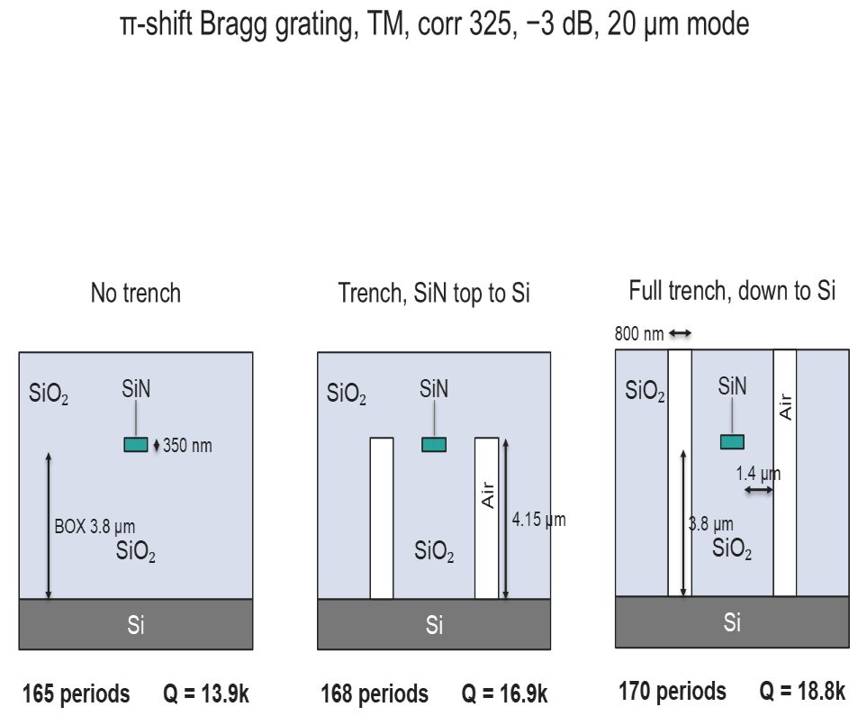
TM: an air trench raises $Q$ by 35 % without widening the mode
A trench 1.8 $μ$m from the guide is the first lever that raises $T$ with the mode width unchanged or slightly narrower ($−$0.9 %): $Q$ +35 % (full depth) or +22 % (stopping at the core top, single lithography).
Total internal reflection at the oxide to air wall (lobe at $\sim$79∘, critical angle $\sim$44∘) shrinks the in plane light cone; a metal wall at the same place gives an equal loss, so it is the low index wall, not a mirror.
A straight wall is optimal; shaped trenches measured worse. TE null. The deep etch conflicts with the PDMS acoustic cover, which motivated the circles.

Slide 10
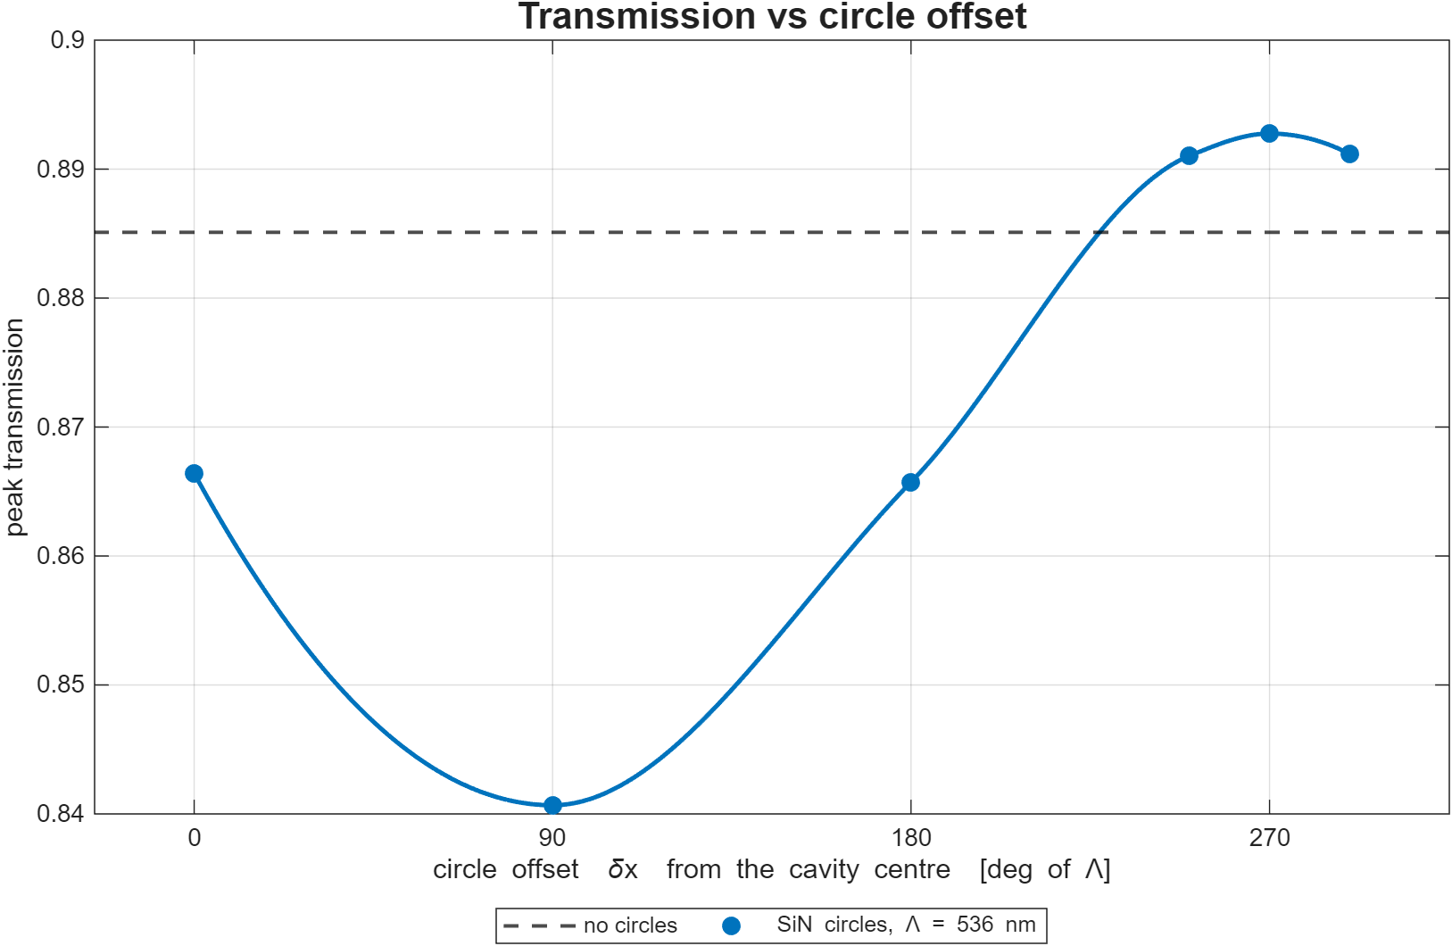
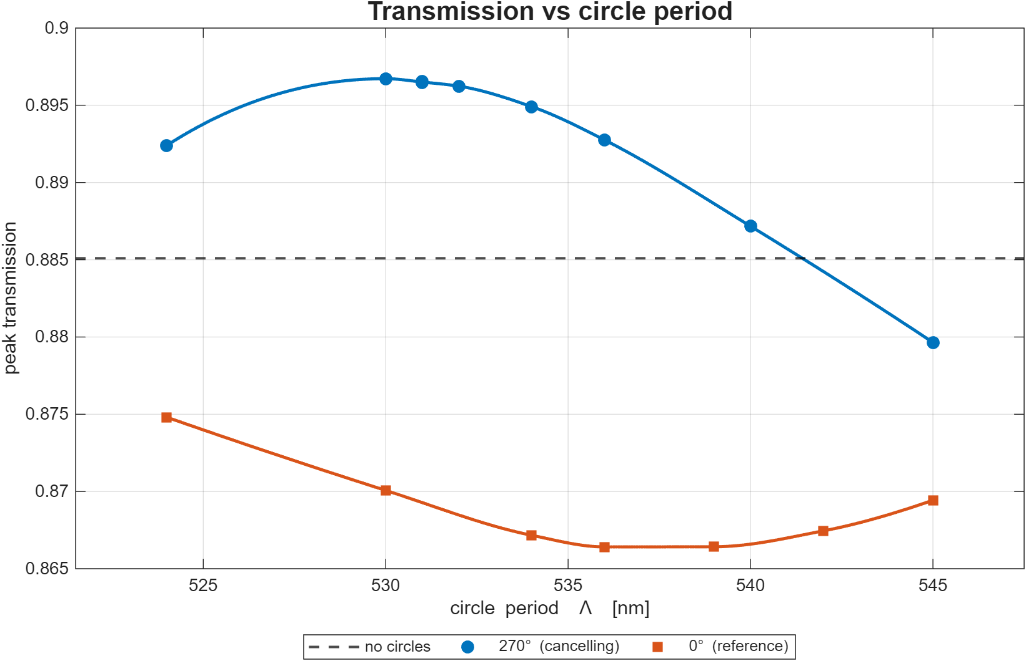
TM: a SiN post row matches the trench in one lithography step
The post row ($r≈80$ to 110 nm, 1.8 $μ$m from the guide) is a weak grating for the guided carrier and out couples a beam at $n_{clad}sinθ=n_{eff}−λ/Λ$; at the cutoff $Λ_{c}=λ/(n_{eff}+n_{clad})≈531$ nm it lands on the lobe, and sliding the row along $x$ sets the phase $φ={360}^{∘}δx/Λ$. Left: $T$ follows a sinusoid in $φ$ (lobe $×$2.2 at 90∘, $×$0.45 at 270∘); at 0∘, where we started, the row hurts. Right: at 270∘ the period sweep peaks near 530 nm; an air hole version flips the sign.

Slide 11
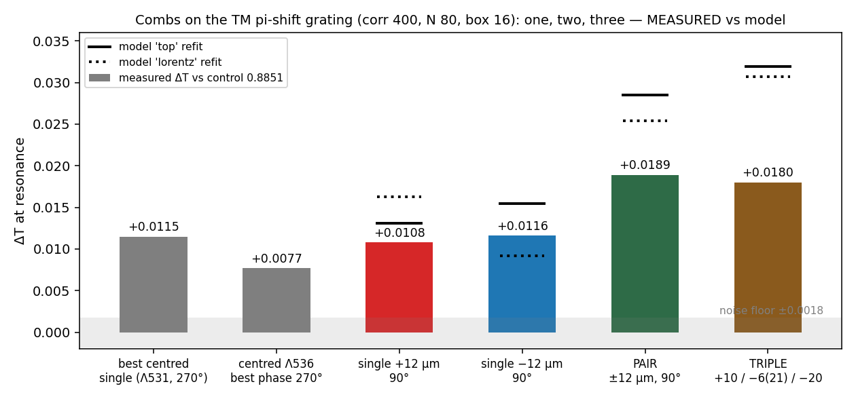
TM: a second post row adds 3 %; rows are designed analytically
At the operating point: +16 % (57 posts, $r$ 80), +26 % (61 posts, $r$ 110), +30 % (pair at $±$12 $μ$m), on par with the full trench; width $−$0.4 %.
A row's cost is set by its two ends, its gain by the carrier it sees: the pair is nearly additive at $N=80$ (figure) but only +3 % over one long row at the operating point; a third row adds nothing. Stacked rows, more rows in $y$, radius apodization: null or worse.
Circles do not stack with apodization, which already removes the lobe, but do stack with the inverse design. Freed there, they drifted under 1 nm: their optimum is separable from the teeth.

Slide 12
Only the phase set post row cancels; every reflector fails
concept | outcome | why
phase controlled SiN circle row | works | first phase controlled far field cancellation
air trench | works | light cone shrinking, not interference
2 post SiN pair (Green's function placed) | dropped | near field cavity widening, +0.02 in T only
period matched retro reflecting combs | null | transparent, ± 0.001
metal / PEC mirrors | harmful | equal magnitude loss at the trench position
SiN DBR / photonic crystal walls | harmful | partial gap; reflected light never re couples
in core SiO₂ hole lattices | harmful | kill the resonance
Huygens / Kerker scatterers, BIC pairs | harmful | all raise loss
second parallel cavity | harmful | drains, never recycles

Slide 13
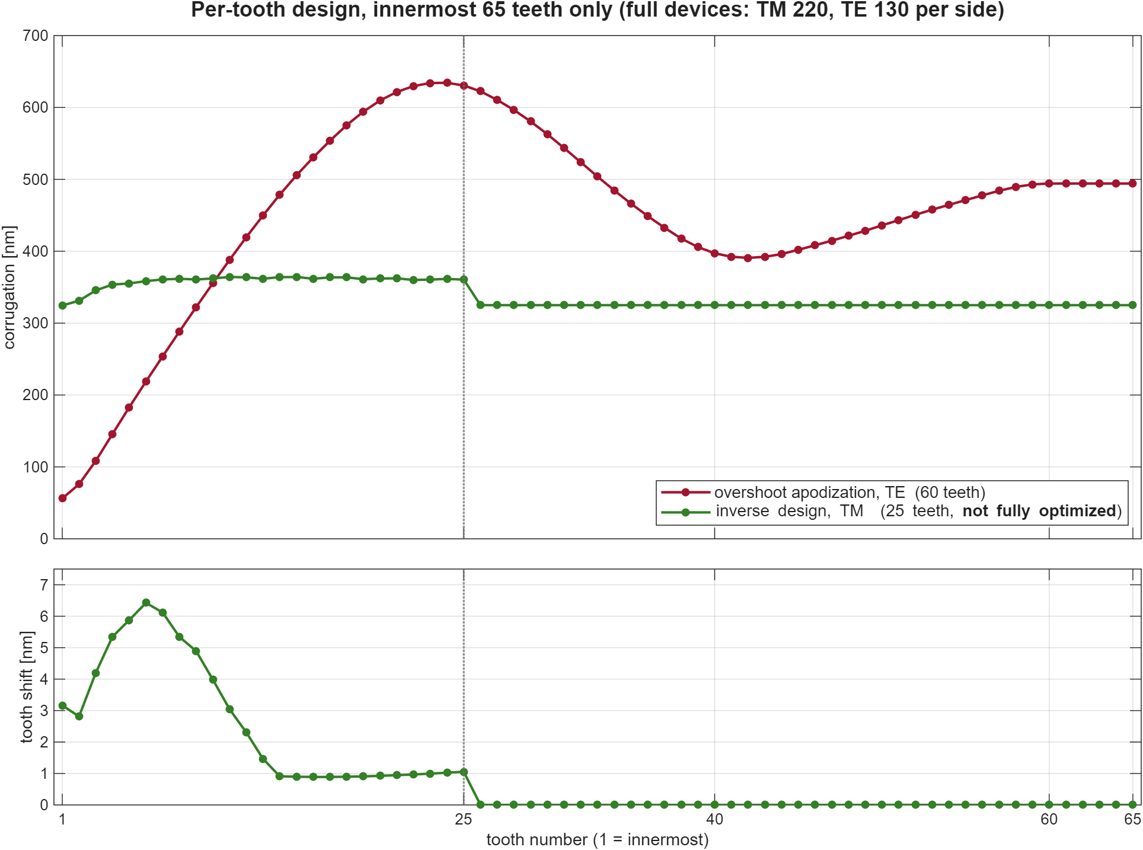
Inverse design: 25 free teeth per side at a fixed mode width
3D adjoint optimization (lumopt2) on a 100 period per side TM surrogate. 191 parameters: depth, width and shift of the 25 innermost teeth per side (mirrored), cavity width, and the circle row (frozen in practice).
Cost: peak transmission. Hard constraints: mode width inside a $±$2 % band and a fixed resonance; the gradient step is projected so it changes neither. $Q$ is never in the cost: at fixed width the loaded $Q$ is pinned, so every $T$ gain is a radiation $Q$ gain.
The optimized profile rises gently over the 25 free teeth (325 to $\sim$364 nm), a mild version of the lab's overshoot.

Slide 14
Inverse design: projecting on width and resonance works
attempt | outcome
𝜎 (second moment) width proxy | failed silently: true FWHM grew 15 % while 𝜎 held
penalty only cost | failed twice: width drifts to the band edge
projection on width alone | failed: the resonance drifted and dragged the width
projection on width and resonance | works: seed T 0.90 to 0.964 (hand re trim) to 0.968 machine driven, resonance held, Q_{i} 110k to 124k
0.964 class design at 20 𝜇m / − 3 dB | Q = 88,868 at N = 220, 6.4 × plain TM (3 samples per linewidth)
status | paused: optimizer housekeeping bugs, not physics; fixes written, not yet redeployed
Ranked next: restart; free 60 teeth instead of 25; free the circle row as a separate arm; a TE lane seeded from the overshoot profile, since TM $Q_{i}$ is capped near 150k to 250k by its light cone margin and the lab's TE $Q_{i}$ is 7 to 13$×$ ours. The optimizer's mesher reads the width band as $\sim$18.3 $μ$m, $\sim$20 $μ$m in the standard mesher; never mix them.

Slide 15
Status: lateral levers closed, inverse design is the open lane
direction | pol | status | verdict
linear / tanh apodization | TE, TM | done | works; widens the mode; tanh widens less
overshoot apodization (lab's model) | TE, TM | not ours | strongest known lever, TE ≫ TM
innermost tooth shift | TE, TM | done | TE: loss down, width constant; TM: widens
2 tooth inverse design (PSO) | TE | closed | best T per width at the time; 5 parameters
cavity width + inner see saw | TM | closed | − 30 % loss at under 1 % width
air trench | TM | closed | Q +35 % (full) / +22 % (half); TE null; fab conflict
SiN circle row(s) | TM | closed | Q +30 %, same litho step; ties the full trench
reflectors, mirrors, hole lattices, BIC / Kerker, second cavity, exotic teeth | TM | closed | all null or harmful
25 tooth adjoint inverse design, width constrained | TM | paused | Q 88.9k, 6.4 × plain; below the lab's TE overshoot
predictive engine (CMT calibrated) | both | validated | one confirmation run replaces tuning ladders

