Slide 1
$π$ Shift Bragg Grating for Acousto Optic Sensing: Research Overview
What raises $Q$ at a fixed 20 $μ$m mode, and what does not
Evyatar Rubin
Research Overview
September 13, 2026

Slide 2
The question: highest $Q$ at a fixed 20 $μ$m mode
Device: a $π$ shift Bragg grating in SiN (350 nm core), simulated in 3D FDTD.
Spec: a 20 $μ$m spatial mode. Each device is lengthened until its peak transmission is $−3$ dB, and $Q$ is compared there.
Materials are lossless, so every gain in $Q$ is a reduction of radiation.
Both polarizations were studied; the useful levers differ between them.

Slide 3
Bottom line
Plain TE and TM gratings reach the same $Q$ at the operating point.
Every change to the teeth trades loss against mode width; only the cavity and lateral structures escape that trade.
TM radiates in the propagation plane, so an air trench or a row of SiN posts beside the guide raises its $Q$ by about a third. TE does not respond.
Inverse design of the innermost teeth at a fixed width gives about 6$×$; it is in progress and still below the lab's overshoot apodization.

Slide 4
TE: apodization and tooth shifts
Linear apodization cuts loss but widens the mode; tanh apodization widens less for the same gain.
The lab's overshoot apodization is a different regime: the corrugation overshoots, then settles. It is the strongest lever known; only its amplitude sets the mode width.
Shifting the innermost teeth outward cuts loss with the mode width unchanged: the shifted teeth recycle light that would leak at the cavity, and the far field collapses to one lobe.
Two tooth inverse design (particle swarm on the two innermost teeth and the cavity) gave the best transmission per unit width; a gradient method was not needed. Fabricated devices confirmed the shift range.

Slide 5
TE versus TM
At equal length TM couples more weakly to the corrugation: less loss, lower $Q$, wider mode.
TM can therefore be made longer; at equal peak transmission its $Q$ is about three times higher.
At the operating point the two plain gratings tie.
TM radiates in the propagation plane, TE upward. That is why the lateral levers below work only for TM.

Slide 6
TM: the teeth behave as in TE, with one difference
Apodization cuts loss and widens the mode, as in TE.
A large innermost tooth shift raises transmission but widens the mode, with no optimum: TM does not recycle at the cavity.
Small shifts spread over many teeth do help, but only inside the width constrained inverse design.
A wider cavity cuts loss without widening the mode; fancier cavity shapes add nothing.

Slide 7
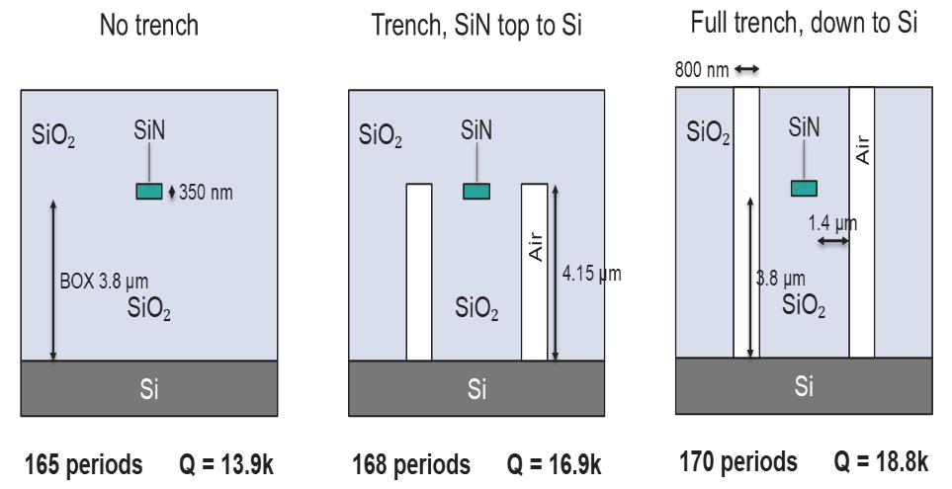
TM: an air trench raises $Q$ by a third
An air trench beside the guide returns the in plane radiation by total internal reflection. Transmission and $Q$ rise; the mode width is unchanged.
A trench stopping at the core top keeps about 60 % of the gain in a single lithography step.
A deep trench conflicts with the PDMS cover of the acoustic sensor, which motivated the post rows.

Slide 8
TM: a row of SiN posts does the trench's job
A periodic row of posts in the cladding is a weak grating for the guided light; its period sets the angle of the beam it sends out, $n_{clad}sinθ=n_{eff}−λ/Λ$.
With the period chosen so that beam lands on the radiation lobe, sliding the row along the guide sets the interference phase: at one phase the lobe is cancelled, at the opposite phase it grows.
At the first phase we tried the row hurt; sweeping the phase found the cancelling one, and there the row matches the trench.
A second row on the other side of the cavity adds only a few percent, and a third adds nothing: the guided power far from the cavity is too weak to cancel with.

Slide 9
$Q$ at the operating point
Every device at a 20 $μ$m mode and $−3$ dB peak, 350 nm SiN core, $λ≈1560$ nm. The lab's TE overshoot is projected from its measured intrinsic $Q$ (2 to 3.4$×{10}^{5}$), not simulated at $−3$ dB.

Slide 10
What does not work
Reflectors of every kind: SiN Bragg walls, photonic crystal walls, metal mirrors, retro reflecting post rows.
Holes inside the core; Huygens and Kerker scatterers; bound state pairs.
A second cavity beside the first; shaped trenches; exotic innermost teeth; spreading the $π$ shift over many gaps.
All measured, all null or harmful. Radiation in TM is spread along the arms, so nothing local to the cavity can remove it.

Slide 11
Inverse design: in progress
3D adjoint optimization of the 25 innermost teeth per side (depth, width, shift) and the cavity, TM, with the post row included.
Cost: peak transmission at a fixed mode width and a fixed resonance. Both are held by projecting each gradient step, after simpler width penalties failed.
It improves steadily; the design so far is a gentle rise in corrugation toward the arms, and the posts do not move.
About 6$×$ the plain grating at the operating point, still below the lab's TE overshoot. Next: more free teeth, then a TE run seeded from the overshoot profile.

Slide 12
Status
direction | status | verdict
apodization, tooth shifts | closed | work, at a cost in width
two tooth inverse design (TE) | closed | best transmission per width
cavity width (TM) | closed | cuts loss, width unchanged
air trench (TM) | closed | Q up a third, deep etch
SiN post rows (TM) | closed | Q up a third, same litho
reflectors, holes, scatterers | closed | null or harmful
25 tooth inverse design (TM) | in progress | about 6 × , below lab overshoot

