Slide 1
$π$ Shift Bragg Grating for Acousto Optic Sensing: Research Overview
What raises $Q$ at a fixed 20 $μ$m mode, and what does not
Evyatar Rubin
Research Overview
September 13, 2026

Slide 2
Bottom line
Benchmark: a 20 $μ$m mode lengthened to a $−3$ dB peak; compare $Q$.
Changing the teeth trades loss against mode width; cavity and lateral structures do not.
TM radiates sideways: a trench or SiN post row raises $Q$ by a third; TE does not respond.
Inverse design at fixed width: about 6$×$, in progress, below the lab's overshoot.

Slide 3
Everything tried, and what it does
direction | pol. | loss | mode width | status
linear apodization | TE, TM | down | up a lot | closed
tanh apodization | TE, TM | down | up | closed
overshoot apodization (lab) | TE, TM | down a lot | by amplitude | reference
innermost tooth shift | TE | down | unchanged | closed
innermost tooth shift | TM | down | up | closed
two tooth inverse design | TE | down | slightly up | closed
wider cavity | TM | down | unchanged | closed
air trench | TM | down | unchanged | closed
SiN post row | TM | down | unchanged | closed
25 tooth inverse design | TM | down a lot | held | in progress

Slide 4
What does not work
direction | pol. | result
SiN Bragg or crystal walls | TM | loss up
metal mirrors | TM | loss up
retro reflecting post rows | TM | no effect
holes inside the core | TM | resonance lost
Huygens or Kerker scatterers | TM | loss up
a second cavity alongside | TE, TM | power drains
shaped trenches | TM | worse than straight
exotic innermost teeth | TE, TM | no effect
𝜋 shift spread over gaps | TM | loss up
trench or post row | TE | no effect

Slide 5
$Q$ at the operating point
All at a 20 $μ$m mode and $−3$ dB peak, 350 nm SiN core. The TE overshoot bar is projected from its intrinsic $Q$, not simulated at $−3$ dB.

Slide 6
Details
TE, TE versus TM, TM levers, inverse design

Slide 7
TE: apodization cuts loss and widens the mode
Linear apodization: loss down, mode much wider. Tanh: same gain, less widening.
A few apodized periods are enough; more add nothing.
The lab's overshoot apodization is stronger by far: only its amplitude sets the mode width.

Slide 8
TE: shifting the innermost teeth recycles the leak
Shifting the innermost teeth outward cuts loss; the mode width stays.
Light that would leak at the cavity is redirected into the mode; the far field collapses to one lobe.
A two tooth particle swarm design gave the best transmission per width; fabricated devices confirmed the shift range.

Slide 9
TE versus TM
Same length: TM couples more weakly, so less loss, lower $Q$, wider mode.
Same peak transmission: TM is longer and its $Q$ is about three times higher.
At the operating point the plain gratings tie. TM radiates in the propagation plane, TE upward.

Slide 10
TM: the teeth behave as in TE, except the shift
Apodization: loss down, mode wider.
A large innermost shift widens the mode with no optimum; TM does not recycle at the cavity.
A wider cavity cuts loss with the mode width unchanged.

Slide 11
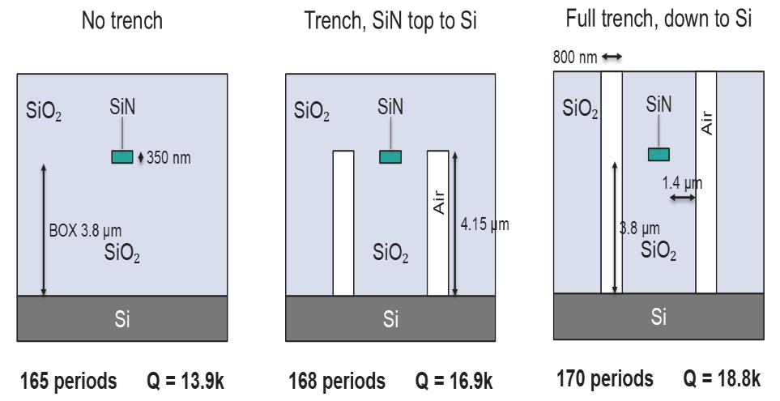
TM: an air trench raises $Q$ by a third
The trench returns the in plane radiation by total internal reflection; the mode width is unchanged.
A trench stopping at the core top keeps most of the gain in one lithography step.
A deep etch conflicts with the PDMS cover, hence the post rows.

Slide 12
TM: a row of SiN posts does the trench's job
The row is a weak grating: its period sets the beam angle, $n_{clad}sinθ=n_{eff}−λ/Λ$.
Aimed at the radiation lobe, sliding the row sets the phase: one phase cancels the lobe, the opposite grows it.
A second row on the other side adds a few percent; a third adds nothing.

Slide 13
Inverse design: in progress
Adjoint optimization of the 25 innermost teeth per side and the cavity, TM.
Peak transmission is maximized with the mode width and the resonance held fixed.
About 6$×$ the plain grating so far. Next: more free teeth, then a TE run seeded from the overshoot profile.

