Slide 1
Research Overview
𝜋 shift Bragg grating cavities for acousto optic sensing
Evyatar Rubin
September 14, 2026

Slide 2
Main conclusions
Changing the teeth trades loss against mode width.
Structures beside the cavity reduce loss and leave the mode width unchanged.
TM radiates in the propagation plane: a trench or a SiN post row reduces its loss; TE does not.
Inverse design at fixed width beats every hand tuned lever, still below the lab's overshoot.
Reflectors, scatterers and in core structures do not help.

Slide 3
Every lever reduces loss; only a few leave the mode width unchanged
direction | polarization | loss | mode width | comments
linear apodization | TE, TM | reduced | strongly increased
tanh apodization | TE, TM | reduced | increased | less than linear
overshoot apodization | TE, TM | strongly reduced | set by amplitude | lab's model
innermost tooth shift | TE | reduced | unchanged | recycles the leak
innermost tooth shift | TM | reduced | increased | no optimum
distributed small shifts | TM | reduced | unchanged | in inverse design
two tooth design | TE | reduced | wider | particle swarm
wider cavity | TM | reduced | unchanged
air trench | TM | reduced | unchanged | deep etch needed
SiN post row | TM | reduced | unchanged | same lithography
inverse design | TM | strongly reduced | unchanged | in progress

Slide 4
Reflectors, scatterers and in core structures do not help
direction | polarization | result | comments
Bragg or crystal walls | TM | loss increased | light never re couples
metal mirrors | TM | loss increased | same, plus absorption
retro reflecting post rows | TM | no effect | beam misses the lobe
holes inside the core | TM | resonance lost | bandgap destroyed
Kerker scatterers | TM | loss increased | extra scattering only
a second cavity alongside | TE, TM | power drains | drains to the neighbour
shaped trenches | TM | worse than straight | straight wall is optimal
exotic innermost teeth | TE, TM | no effect | the leak is not local
𝜋 shift spread over gaps | TM | loss increased | lumped shift is optimal
trench or post row | TE | no effect | TE radiates upward

Slide 5
Q at a 20 𝜇m mode and a -3 dB peak
Each device lengthened until its peak is -3 dB at a 20 𝜇m mode. Lateral structures give about a third more Q, inverse design about 6×; the TE overshoot bar is projected.

Slide 6
Details
TE, TE versus TM, TM levers, inverse design

Slide 7
TE: apodization reduces loss and widens the mode
Linear apodization: loss reduced, mode much wider. Tanh: the same gain with less widening.
A few apodized periods are enough; more add nothing.
The lab's overshoot apodization is far stronger, and only its amplitude sets the mode width.

Slide 8
TE: shifting the innermost teeth recycles the leak
Shifting the innermost teeth outward reduces loss with the mode width unchanged.
Light that would leak at the cavity is redirected into the mode; the far field collapses to one lobe.
A two tooth particle swarm design gave the best transmission per width; fabricated devices confirmed the shift range.

Slide 9
TE versus TM
Same length: TM couples more weakly, so lower loss, lower Q, wider mode.
Same peak transmission: TM is longer and its Q is about three times higher.
At the operating point the plain gratings tie. TM radiates in the propagation plane, TE upward.

Slide 10
TM: the teeth behave as in TE, but the shift works differently
Apodization reduces loss, widens the mode, and saturates.
A large shift of the innermost teeth widens the mode and shows no optimum; TM does not recycle at the cavity.
Once apodization saturates, small shifts on many teeth add further gain at fixed width; the inverse design uses this.

Slide 11
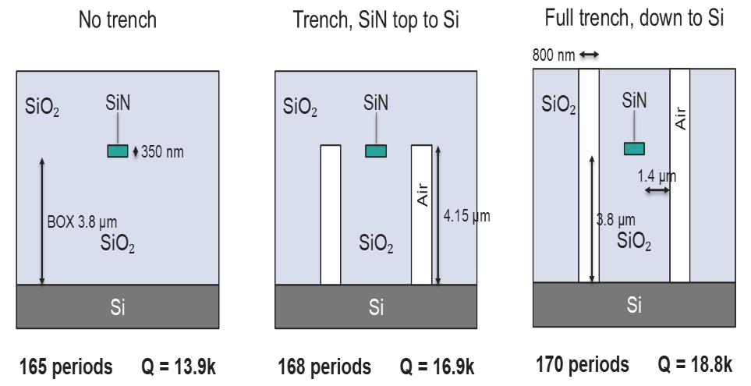
TM: a trench reduces loss, a third more Q at the benchmark
The trench returns the in plane radiation by total internal reflection; the mode width is unchanged. A trench stopping at the core top keeps most of the gain in one lithography step.

Slide 12
TM: a row of SiN posts does the same, one lithography step
The row is a weak grating: its period sets the beam angle, n_{clad} sin𝜃 = n_{eff} − 𝜆/Λ.
Aimed at the radiation lobe, sliding the row sets the phase: one phase cancels the lobe, the opposite grows it.
A second row on the other side adds a few percent; a third adds nothing.

Slide 13
Inverse design: what is optimized
3D adjoint optimization of the 25 innermost teeth per side (depth, width, shift), the cavity width and the post row, TM.
Objective: peak transmission. Constraints: the mode width and the resonance wavelength are held fixed.
Width penalties and second moment proxies failed; projecting each gradient step onto both constraints works.

Slide 14
Inverse design: what it found so far
Transmission rises steadily with the resonance and the mode width held.
The design is a gentle rise in corrugation toward the arms, a mild overshoot.
The post row does not move when freed: its optimum is separable and set analytically.
About 6× the plain grating at the operating point, still below the lab's TE overshoot.

Slide 15
Next steps
Restart the inverse design with more free teeth.
Adapt the overshoot apodization model to TM and use it as the starting point.
A TE lane seeded from the overshoot profile, where the larger gains are.

