Slide 1
Research Overview
Radiation loss engineering of 𝜋 shift Bragg grating cavities
Evyatar Rubin
September 14, 2026

Slide 2
Main conclusions
Apodization and tooth shift trade loss against mode length.
Structures beside the cavity reduce loss and leave the mode length unchanged.
TM radiates in the propagation plane, so an air trench or a SiN cylinder row reduces its loss. TE does not.
At fixed width, inverse design does better than any of the hand tuned levers, though it is still below the lab's overshoot.
Reflectors, scatterers and SiO₂ cylinders inside the core do not help.

Slide 3
What worked
direction | polarization | loss | mode length | comments
linear apodization | TE, TM | reduced | strongly increased
tanh apodization | TE, TM | reduced | increased | less widening
overshoot apodization | TE, TM | strongly reduced | set by amplitude | lab's model
wider cavity | TE, TM | reduced | unchanged
innermost tooth shift | TE | reduced | unchanged | recycles the leak
innermost tooth shift | TM | reduced | increased | no optimum
distributed small shifts | TM | reduced | unchanged | in inverse design
two tooth design | TE | reduced | wider | particle swarm
air trench | TM | reduced | unchanged | deep etch needed
SiN cylinder row | TM | reduced | unchanged | same lithography
inverse design | TM | strongly reduced | unchanged | in progress
All the levers reduce loss; apodization is the only one that lengthens the mode.

Slide 4
What did not work
direction | polarization | result | comments
SiO₂ or air holes in core | TM | resonance lost | every hole radiates
Bragg or crystal walls | TM | loss increased | light never re couples
metal mirrors | TM | loss increased | same, plus absorption
shaped trenches | TM | worse than straight | straight wall optimal
single scatterers | TM | no improvement | acts like a wider cavity
retro reflecting rows | TM | no effect | beam misses the lobe
second cavity alongside | TE, TM | power drains | leaks to the neighbour
exotic innermost teeth | TE, TM | no effect | the leak is not local
trench or cylinder row | TE | no effect | TE radiates upward
Holes in the core radiate and kill the resonance. Everything else here either adds loss of its own or never reaches the leaky lobe.

Slide 5
Q factor at a 20 𝜇m mode and a -3 dB peak
Each device lengthened until its peak is -3 dB at a 20 𝜇m mode. Lateral structures give about a third more Q, inverse design about 6×; the TE overshoot bar is projected.

Slide 6
Details
TE, TE versus TM, TM levers, inverse design

Slide 7
TE: apodization reduces loss and widens the mode
Linear apodization: loss reduced, mode much wider.
Tanh gives the same gain with less widening.
A few apodized periods are enough; more add nothing.
The lab's overshoot apodization is far stronger, and only its amplitude sets the mode length.

Slide 8
TE: shifting the innermost teeth recycles the leak
Shifting the innermost teeth outward reduces loss with the mode length unchanged.
Light that would leak at the cavity is redirected into the mode; the far field collapses to one lobe.
A two tooth particle swarm design gave the best transmission per width.
In fabrication: devices matched the same optimum, with slightly stronger coupling.

Slide 9
TE versus TM
At the same length TM couples more weakly, so lower loss, lower Q, wider mode.
At the same peak transmission TM is longer and its Q is about three times higher.
At the operating point The plain gratings tie. TM radiates in the propagation plane, TE upward.

Slide 10
TM: the teeth behave as in TE, but the shift works differently
Apodization reduces loss, widens the mode, and saturates.
A large shift of the innermost teeth widens the mode and shows no optimum; TM does not recycle at the cavity.
Once apodization saturates, small shifts on many teeth add further gain at fixed width; the inverse design uses this.

Slide 11
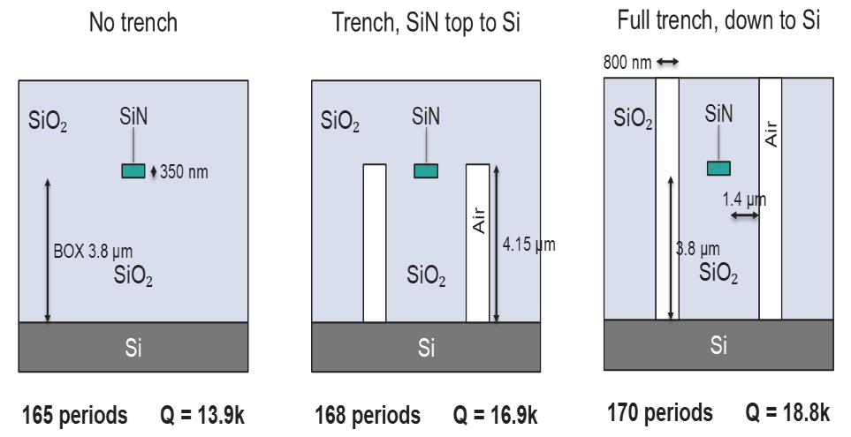
TM: a trench reduces loss, a third more Q at the benchmark
The trench returns the in plane radiation by total internal reflection; the mode length is unchanged. A trench stopping at the core top keeps most of the gain in one lithography step.

Slide 12
TM: a row of SiN cylinders does the same, one lithography step
The row is a weak grating: its period sets the beam angle, n_{clad} sin𝜃 = n_{eff} − 𝜆/Λ.
Aimed at the radiation lobe, sliding the row sets the phase: one phase cancels the lobe, the opposite grows it.
A second row on the other side adds a few percent; a third adds nothing.

Slide 13
Inverse design: what is optimized
3D adjoint optimization of the 25 innermost teeth per side (depth, width, shift), the cavity width and the cylinder row, TM.
Objective peak transmission.
Constraints the mode length and the resonance wavelength are held fixed.
Width penalties and second moment proxies failed; projecting each gradient step onto both constraints works.

Slide 14
Inverse design: what it found so far
Transmission rises steadily with the resonance and the mode length held.
The design is a gentle rise in corrugation toward the arms, a mild overshoot.
The cylinder row does not move when freed: its optimum is separable and set analytically.
About 6× the plain grating at the operating point, still below the lab's TE overshoot.

Slide 15
Next steps
Restart the inverse design with more free teeth.
Adapt the overshoot apodization model to TM and use it as the starting point.
Open a TE lane seeded from the overshoot profile, where the larger gains are.

