Slide 1
Radiation Cancellation
A multipole model of the leak from 𝜋 shift Bragg grating cavities
Evyatar Rubin
Research Update
October 12, 2026

Slide 2
Main conclusions
The leak splits into electric and magnetic harmonics.
A small geometry change shifts each harmonic linearly, so several knobs are set by one linear solve.
The plain TE leak is mostly beyond the dipole.
Dipoles carry 14 % of it; 95 % lies in the first five orders.
Plain TE: ten cancelled harmonics could raise Q at -3 dB from 12 900 to about 10⁵.
Overshoot (Q ≈ 2 × 10⁵): twenty harmonics would add about 20 %.
Radiation is only part of its loss; removing all of it gives ×1.4 to ×1.9.

Slide 3
Part I: The model
How a geometry change alters the radiated leak.

Slide 4
Johnson et al. cancelled one dominant harmonic with one knob
Johnson et al., APL 2001
This cavity
One knob swept until Q peaks.
One harmonic carries almost all the loss.
Cancellation confirmed afterwards.
The loss is spread over several harmonics.
The model predicts what each knob can remove.
Several knobs are set together.
Johnson's 2D example has one field component, E_{z}, so each order has one coefficient. Our 3D field has two polarizations, so each (l,m) has two.

Slide 5
The leak is a sum of electric and magnetic harmonics
Far field. Everything that differs from the oxide radiates:
$$A(\hat{r})=(I−\hat{r}\hat{r})∫ΔεEe^{−ik\hat{r}·r}d^{3}r$$
Harmonics. The same coefficients from the far field, or from the source:
$$α_{lm}=∮X_{lm}^{*}·AdΩ=4π(−i)^{l}∫Δεj_{l}(kr)X_{lm}^{*}·Ed^{3}r$$
$$β_{lm}=∮(\hat{r}×X_{lm})^{*}·AdΩ=\frac{4πi(−i)^{l}}{k}∫ΔεE·∇×\left[j_{l}(kr)X_{lm}^{*}\right]d^{3}r$$
X_{lm}: vector spherical harmonic, the angular pattern of order (l, m); j_{l}: spherical Bessel function. 𝛼 magnetic, 𝛽 electric.
Notes:
A: far-field amplitude in direction r-hat; Delta-epsilon = epsilon - n_ox^2; E: cavity field at resonance; k: wavenumber in oxide. X_lm: vector spherical harmonic (Jackson ch. 9). alpha_lm: magnetic coefficient, beta_lm: electric coefficient. Equivalently alpha_lm = 4 pi (-i)^l Int Delta-epsilon j_l(kr) X*_lm . E d^3r, the source form used to see how a local change moves a harmonic.
Equation (LaTeX source): \mathbf{A}(\hat{\mathbf{r}}) = (\mathrm{I}-\hat{\mathbf{r}}\hat{\mathbf{r}})\int \Delta\varepsilon\,\mathbf{E}\,e^{-ik\hat{\mathbf{r}} {\cdot} \mathbf{r}}\,d^3r
Equation (LaTeX source): \alpha_{lm}=\oint \mathbf{X}^*_{lm} {\cdot} \mathbf{A}\,d\Omega=4\pi(-i)^l\int\Delta\varepsilon \, j_l(kr) \, \mathbf{X}^*_{lm} {\cdot} \mathbf{E} \, d^3r
Equation (LaTeX source): \beta_{lm}=\oint (\hat{\mathbf{r}}\times\mathbf{X}_{lm})^* {\cdot} \mathbf{A}\,d\Omega=\frac{4\pi i(-i)^l}{k}\int\Delta\varepsilon \, \mathbf{E} {\cdot} \nabla\times\left[j_l(kr)\,\mathbf{X}^*_{lm}\right]d^3r

Slide 6
A feature adds its own coefficients to those of the leak
Leak: its coefficients c = (𝛼_{lm}, 𝛽_{lm}), per unit stored energy.
Feature: strength q (for example a tooth width); adds b per unit q, measured.
$$c(q)=c+qb,P(q)∝{\left|c + qb\right|}^{2}$$
Linear while the feature is small: runs at ± h give equal and opposite changes.
Notes:
c: list of all alpha_lm and beta_lm of the cavity leak, normalized per unit stored energy, so ||c||^2 is proportional to 1/Q_rad (a feature that only lowers the coupling then cannot look like cancellation). b: change of all coefficients per unit knob strength q; it contains the feature's own radiation, the change of the cavity field and the resonance shift, so it is measured (two runs, +h and -h). Validity: the feature holds a small part of the mode energy.
Equation (LaTeX source): c(q)=c+q\,b,\qquad P(q)\propto\left|c+q\,b\right|^2

Slide 7
One knob: the best strength follows from dP/dq = 0
1. Expand. write out the square:
$$P(q)∝{\left|c\right|}^{2}+2qRe⟨b,c⟩+q^{2}{\left|b\right|}^{2}$$
$$2. Lowest loss where the slope is zero: \frac{dP}{dq}=0⇒q_{*}=−\frac{Re⟨b,c⟩}{{\left|b\right|}^{2}}$$
3. Insert. put q* back:
$$\frac{P(q_{*})}{P_{c}}=1−η^{2},η^{2}=\frac{{\left(Re⟨b,c⟩\right)}^{2}}{{\left|b\right|}^{2}{\left|c\right|}^{2}}$$
𝜂²: the fraction of the leak this knob can remove. Set too strong, at 2q* the loss is back at its original value.
Notes:
eta^2 is computed from a knob's measured response b and the measured leak c. No knob has been measured yet; the Part II tables assume ideal knobs, whose eta^2 equals the share of the harmonics they cancel.
Equation (LaTeX source): P(q)\propto\left|c\right|^2+2q\,\mathrm{Re}\langle b,c\rangle+q^2\left|b\right|^2
Equation (LaTeX source): \text{2. Lowest loss where the slope is zero: }\frac{dP}{dq}=0\;\Rightarrow\;q_{*}=-\frac{\mathrm{Re}\langle b,c\rangle}{\left|b\right|^2}
Equation (LaTeX source): \frac{P(q_{*})}{P_c}=1-\eta^2,\qquad \eta^2=\frac{(\mathrm{Re}\langle b,c\rangle)^2}{\left|b\right|^2\left|c\right|^2}

Slide 8
Several knobs: one linear problem
unknowns | q = (q₁, …, q_{n})
zero the targets | c_{S} + B_{S}q = 0
hold the width | w · q = 0
hold the resonance | v · q = 0
solution | Mq = − r, so q = − M ⁺ r
K target harmonics; B_{S}, w, v: their response, two runs per knob. Exact with 2K + 2 knobs, least squares with fewer.

Slide 9
Part II: Can it be done?
Measured harmonic content, and what ideal knobs would gain.

Slide 10
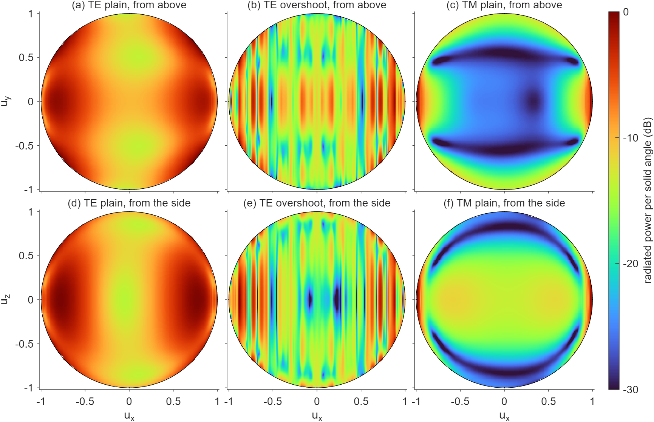
Each device leaks in a different angular pattern
Radiated power per solid angle at resonance, dB relative to the peak; u_{x} runs along the waveguide. Computed from E and H on a closed surface around the cavity, projected to the far field.

Slide 11
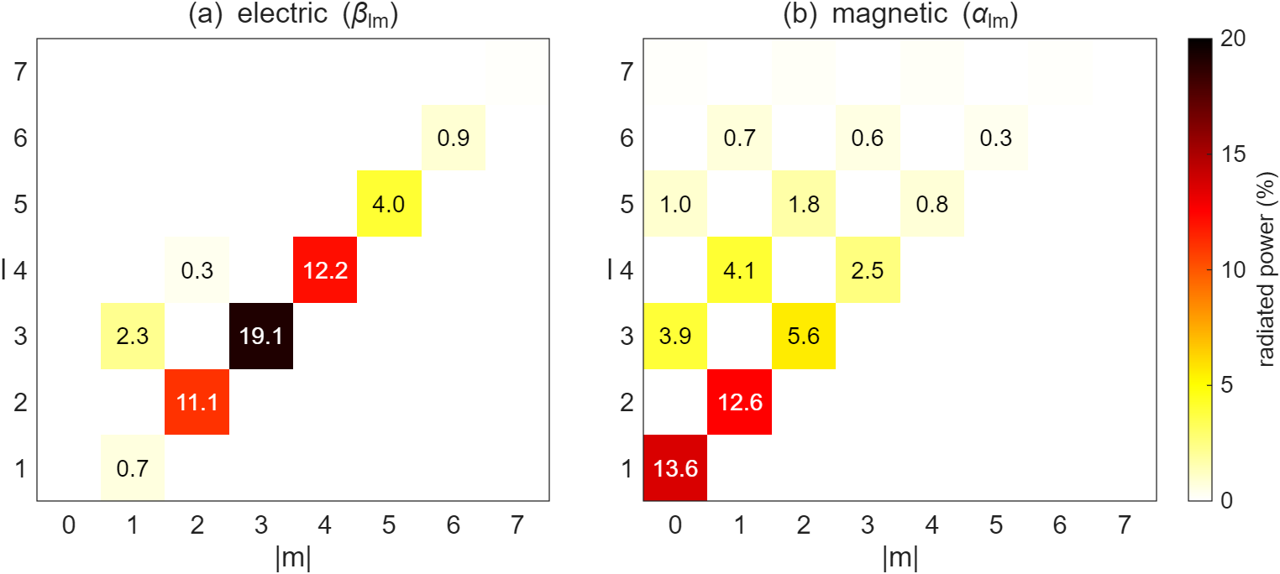
Plain TE: the leak sits in low order harmonics
Share of the radiated power per harmonic; +m and -m are equal (mirror symmetry in y), so each cell is their sum. N = 98, T = 0.912, mode 19.1 𝜇m.

Slide 12
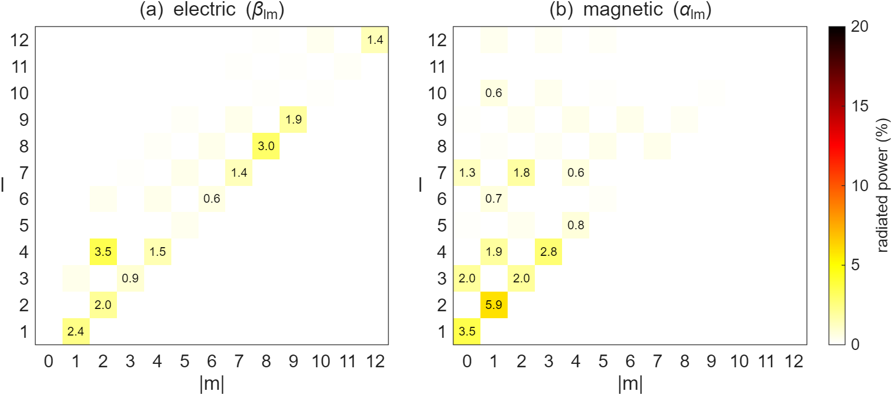
Overshoot apodization: the leak is spread over many orders
N = 98, T = 0.973, mode 19.6 𝜇m. Dipoles hold 6 %; half of the power is above l = 12.

Slide 13
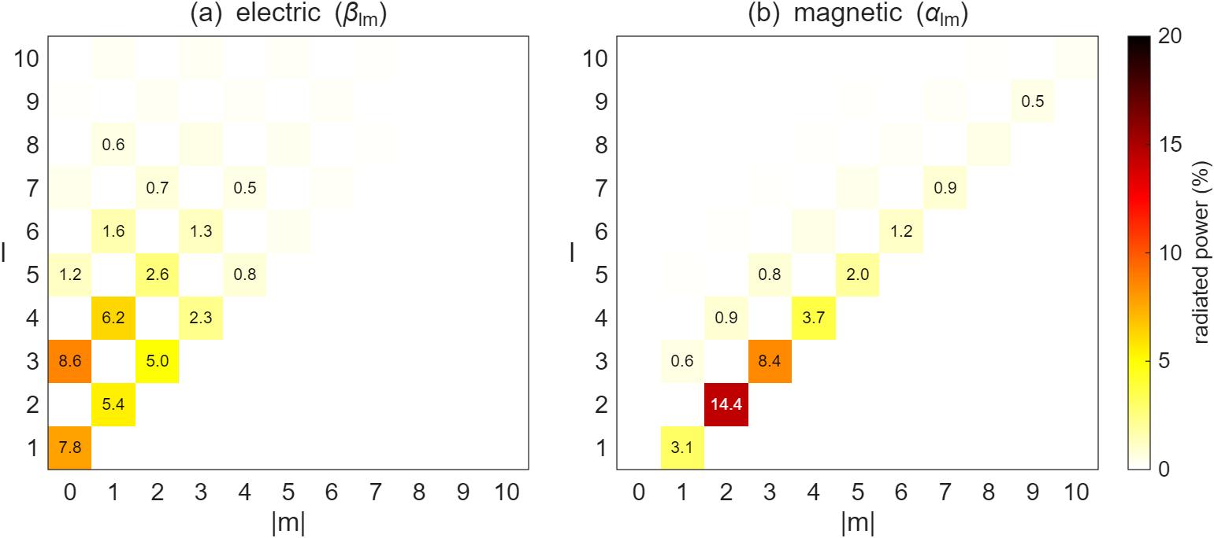
Plain TM at the same mode width
Corrugation 325 nm, N = 98, T = 0.915, mode 19.2 𝜇m. Dipoles hold 11 %; 74 % is in l ≤ 5, with a tail along the waveguide axis.

Slide 14
Plain TE: cancelling ten harmonics could raise Q up to ×9
harmonics cancelled | knobs | radiation loss | estimated Q at -3 dB
none |  | 7.3 % | 12 900
largest 𝛽 | 4 | 5.9 % | 16 000
largest 𝛽 and 𝛼 | 6 | 4.9 % | 19 000
5 largest | 12 | 2.3 % | 41 000
10 largest | 22 | 0.8 % | 113 000
Estimated for ideal knobs (𝜂² equal to the cancelled share f): Q at -3 dB = 12 900/(1 - f). Example, 5 largest: 12 900/0.31 = 41 000.

Slide 15
Overshoot: cancellation reaches only part of its loss
harmonics cancelled | knobs | radiation loss | estimated Q at -3 dB
none |  | 0.69 % | 198 000
largest 𝛼 | 4 | 0.65 % | 201 000
5 largest | 12 | 0.56 % | 210 000
10 largest | 22 | 0.48 % | 218 000
20 largest | 42 | 0.37 % | 230 000
Estimated for ideal knobs. Radiation (Q_{rad} = 2.2 × 10⁶) is a third of the internal loss, so 1/Q_{i} = (1 - f)/Q_{rad} + 1/Q_{other}.

Slide 16
Conclusions
Model: harmonics, the linear effect of a feature, one linear solve for all knobs.
Plain TE: a compact leak; about ten harmonics would have to cancel for a large gain.
Overshoot: a spread leak, and radiation is only part of its loss: tens of percent.
Open question: does radiation dominate the overshoot's loss? That sets how far cancellation can go.

Slide 17
Next steps
Decide: measure the overshoot's own loss budget and Q at -3 dB at a fixed simulation time; continue only if radiation dominates.
Choose the perturbation: the geometry change near the junction that reaches the largest harmonics, with its response measured.
Optimize: solve for the knob settings at fixed width and resonance, then validate with one run.

