Slide 1

[Logic Flow]
[Smart Agriculture Assistant, 4]
[An AI-powered agriculture assistant that combines soil, weather and historical crop data to help farmers make smarter decisions on
crop selection, irrigation and fertilizer usage.]
[Evyavan Anirudh Kasa] · [Hackathon / 2026]
[C Sai Sachin] [Hackathon / 2026]
[T Ashish Reddy] [Hackathon / 2026]
[Kotturi Nikileshwar] [Hackathon / 2026]

Slide 2
[THE PROBLEM]
Farmers often make critical decisions using fragmented information about
soil, weather, crops and past yields.
Changing environmental conditions make it difficult to determine:
Which crop is suitable?
When irrigation is required?
How much fertilizer is appropriate?
How historical performance can guide current decisions?
Fragmented agricultural data — Soil, weather and historical crop information are often available separately, making combined
analysis difficult.
Changing environmental conditions— Rainfall, temperature and soil moisture can change rapidly, affecting irrigation and crop
suitability.
Limited decision support— Farmers need actionable recommendations rather than raw agricultural data.
The challenge is not lack of data — it is turning agricultural data into timely, understandable decisions.
02

Slide 3
[YOUR SOLUTION]
Smart Agriculture Assistant helps farmers turn agricultural data into
actionable farm recommendations.
01
02
03
Farm & Environmental Data
AI + Data Analysis
Actionable Farm Decisions
Users provide:
Nitrogen (N)
Phosphorus (P)
Potassium (K)
Soil pH
Rainfall
Soil moisture
Temperature
AgriSense combines:
MongoDB agricultural data
PostgreSQL farm information
Historical crop performance
Weather and soil information
RAG-based agricultural knowledge
It then analyzes the conditions to generate recommendations.
The system provides:
Recommended Crop
Irrigation Recommendation
Fertilizer Recommendation
Historical Crop Insights
AI Agriculture Chatbot
“A farmer can enter current farm conditions and receive understandable recommendations
for the next farming decision.”
[Moonshot idea] — A continuously learning agricultural copilot that combines real-time farm conditions, historical patterns and agricultural knowledge to support every major farming decision.
03

Slide 4
TECHNOLOGY & AI FEATURES
Key Features / USPs
Technology Stack
AI Agriculture Assistant
Provides recommendations for crop selection, irrigation and fertilizer usage based on farm conditions.
RAG Knowledge Retrieval
Retrieves relevant agricultural knowledge from MongoDB before answering user questions.
Data-Driven Insights
MongoDB aggregation analyzes historical yield, rainfall, fertilizer usage and production.
Polyglot Data Architecture
PostgreSQL + MongoDB allows structured farm information and flexible agricultural data to work together.
Frontend: Responsive web dashboard for farm analysis, historical insights and AI chat.
Backend: Python, FastAPI, Rest APIs
Handles recommendations, historical insights and chatbot requests.
Database: MongoDB, PostgreSQL, PyMongo, MongoDB Agression
MongoDB → dynamic agricultural/environmental data
PostgreSQL → structured farm/master data
Aggregation → crop performance analysi
AI/ML: Rag-based Knowledge Retrieval, recommendation engine, AI ChatBot. Agricultural knowledge is retrieved from MongoDB to generate relevant responses.
Infrastructure: Local Development, VS Code, Python Virtual Environment
Other tools: Mongosh, MongoDB Atlas Charts, Github
04

Slide 5
[HOW IT WORKS]
[PART 1]
[PART 2]
Enter Farm Conditions
AI Recommendation Engine
The farmer enters soil and environmental parameters through
the AgriSense dashboard.
The system analyzes soil, rainfall, moisture and temperature
conditions to generate farm recommendations.
[PART 3]
[PART 4]
MongoDB + PostgreSQL + Knowledge Base
Actionable Agriculture Insights
The system uses:
Soil data
Weather data
Historical crop data
Agricultural knowledge
Farm information
The farmer receives:
Crop recommendation
Irrigation advice
Fertilizer guidance
Historical insights
AI chatbot answers
[Flow: Farm Input → Data Processing → AI + RAG Analysis → Recommendation → Farmer Decision
05

Slide 6
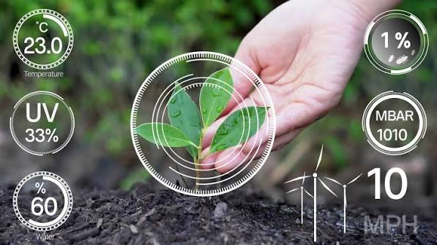

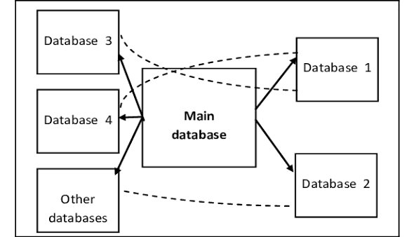
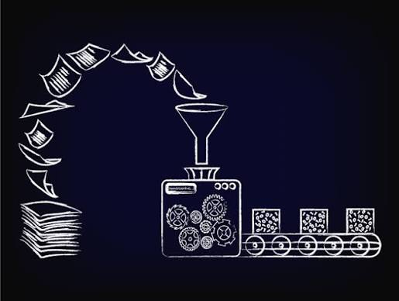

[DATA FLOW]
[01 · INPUT]
[02 · PROCESSING]
[03 · STORAGE]
[04 · RETRIEVAL]
[05 · OUTPUT]
Farm &
Environmental
Data:
Data
Analysis & AI:
Dual Database
Architecture:
Intelligent
Data Retrieval:
Actionable
Results:
→
→
→
→
Validate farm inputs
Analyze environmental conditions
Apply recommendations rules
Analyze historical crop performance
Retrieve relevant agricultural knowledge
PostgreSQL
→ Farm/master information
MongoDB
→ Soil, weather, historical data, recommendations & knowledge base
The system retrieves:
Relevant historical records
Crop performance patterns
Agricultural knowledge
Environmental information
RAG retrieves knowledge relevant to the farmer's question.
Crop Recommendation
Irrigation Recommendation
Fertilizer Recommendation
Historical Insights
AI Chatbot Response
N
P
K
pH
Rainfall
Soil Moisture
Temperature
06

