Slide 2
The Count-Min Sketch and Its Applications
Introduction and Problem Statement
Count-Min Sketch construction and updates
Point Queries: algorithm and bounds for the cash-register case
Inner Product Queries: algorithm and bounds
Range Queries: algorithm and bounds
Selected Application: Heavy-Hitters

Slide 3

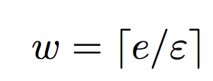
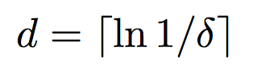
Count Min Sketch Construction
picked independently and uniformly from a 2-universal hash family
h₁
0 0 0 0 0 0 0 0 0
h₂
0 0 0 0 0 0 0 0 0
h₃
0 0 0 0 0 0 0 0 0
h₄
0 0 0 0 0 0 0 0 0
h₅
0 0 0 0 0 0 0 0 0

Slide 4
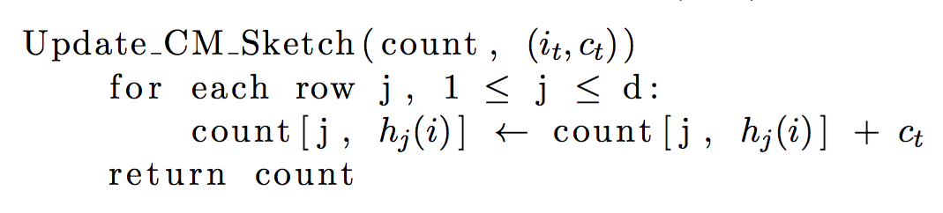
Count-Min Sketch Updates

Slide 5
Count-Min Sketch Updates
(i_{t} , c_{t})
h₁(i_{t})
c_{t}
h₂(i_{t})
0 0 0 0 0 0 0 0 0
c_{t}
0 0 0 0 0 0 0 0 0
h₃(i_{t})
0 0 0 0 0 0 0 0 0
c_{t}
0 0 0 0 0 0 0 0 0
h₄(i_{t})
c_{t}
0 0 0 0 0 0 0 0 0
c_{t}
h₅(i_{t})

Slide 6
The Count-Min Sketch and Its Applications
Count-Min Sketch construction and updates
Point Queries: algorithm and bounds for the cash-register case
Inner Product Queries: algorithm and bounds
Range Queries: algorithm and bounds
Selected Application: Heavy-Hitters

Slide 7
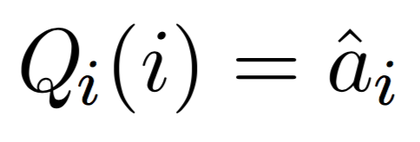
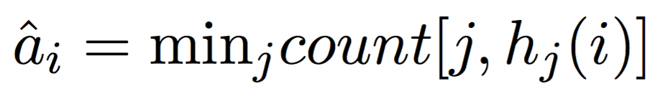
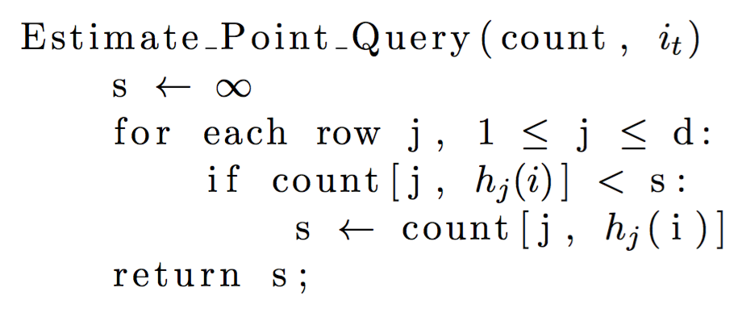
Point Queries Algorithm

Slide 8
Point Queries Algorithm
count[1, h₁(i)] = 35
count[2, h₂(i)]= 19
23 18 35 1 48 90 63 27 3
count[2, h₂(i)]= 19
35
19 20 73 15 19 9 84 36 11
19
count[3, h₃(i)] = 25
98 2 8 52 0 37 25 17 7
25
73 26 22 32 14 88 78 31 12
count[4, h₄(i)] = 12
12
19 21 68 66 42 80 95 4 18
21
count[5, h₅(i)] = 21

Slide 9
The Count-Min Sketch and Its Applications
Count-Min Sketch construction and updates
Point Queries: algorithm and bounds for the cash-register case
Inner Product Queries: algorithm and bounds
Range Queries: algorithm and bounds
Selected Application: Heavy-Hitters

Slide 10


Range Query
Possible to estimate via a sum of individual point queries
Dyadic ranges reduce time complexity and appropriate error bounds

Slide 11
Dyadic Ranges
1 2 3 4 5 6 7 8
1 2 3 4
5 6 7 8
1 2
3 4
5 6
7 8
1
2
3
4
5
6
7
8

Slide 12
Range Queries Algorithm: updates
TODO: insert pseudocode once ready

Slide 13
Dyadic Ranges
1 2 3 4 5 6 7 8
CM₀
1 2 3 4
5 6 7 8
CM₁
1 2
3 4
5 6
7 8
CM₂
1
2
3
4
5
6
7
8
CM₃

Slide 14
Range Queries Algorithm: updates
TODO: insert pseudocode once ready

Slide 15
Range Query: Update
Insert 2
1 2 3 4 5 6 7 8
CM₀: Update r(1,8)
1 2 3 4
5 6 7 8
CM₁:Update r(1,4)
1 2
3 4
5 6
7 8
CM₂: Update r(1,2)
1
2
3
4
5
6
7
8
CM₃: Update r(2)

Slide 16
Range Queries Algorithm: Estimation
TODO: insert pseudocode once ready

Slide 17
Range Query: Update
Estimate: a[2,7]
1 2 3 4 5 6 7 8
Nothing from this level
1 2 3 4
5 6 7 8
Nothing from this level
1 2
3 4
5 6
7 8
Query for r[3,4] + r[5,6]
1
2
3
4
5
6
7
8
Query for r[2] + r[7]

Slide 18
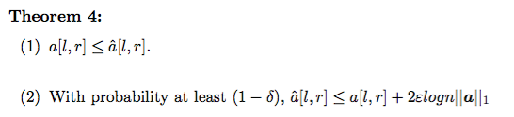
Range Query: Error bounds

Slide 19
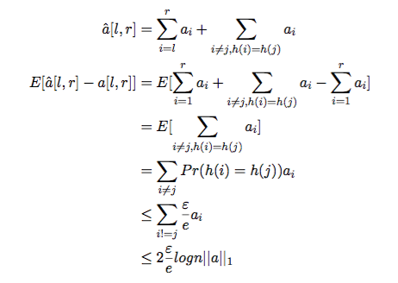
Error bounds proof

Slide 20
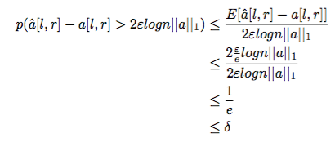
Error bounds proof

