Slide 2
The Count-Min Sketch and Its Applications
Introduction and Problem Statement
Count-Min Sketch construction and updates
Point Queries: algorithm and bounds for the cash-register case
Inner Product Queries: algorithm and bounds
Range Queries: algorithm and bounds
Selected Application: Heavy-Hitters

Slide 3

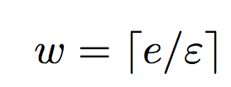
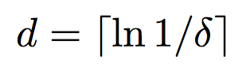
Count Min Sketch Construction
picked independently and uniformly from a 2-universal hash family
h₁
0 0 0 0 0 0 0 0 0
h₂
0 0 0 0 0 0 0 0 0
h₃
0 0 0 0 0 0 0 0 0
h₄
0 0 0 0 0 0 0 0 0
h₅
0 0 0 0 0 0 0 0 0

Slide 4
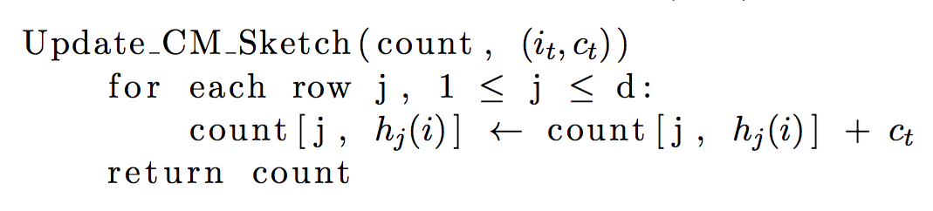
Count-Min Sketch Updates

Slide 5
Count-Min Sketch Updates
(i_{t} , c_{t})
h₁(i_{t})
c_{t}
h₂(i_{t})
0 0 0 0 0 0 0 0 0
c_{t}
0 0 0 0 0 0 0 0 0
h₃(i_{t})
0 0 0 0 0 0 0 0 0
c_{t}
0 0 0 0 0 0 0 0 0
h₄(i_{t})
c_{t}
0 0 0 0 0 0 0 0 0
c_{t}
h₅(i_{t})

Slide 6
The Count-Min Sketch and Its Applications
Count-Min Sketch construction and updates
Point Queries: algorithm and bounds for the cash-register case
Inner Product Queries: algorithm and bounds
Range Queries: algorithm and bounds
Selected Application: Heavy-Hitters

Slide 7
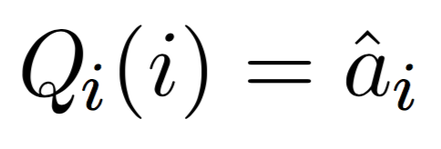
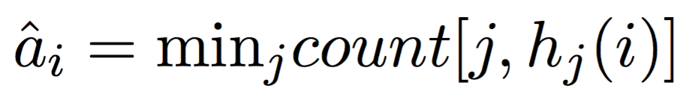
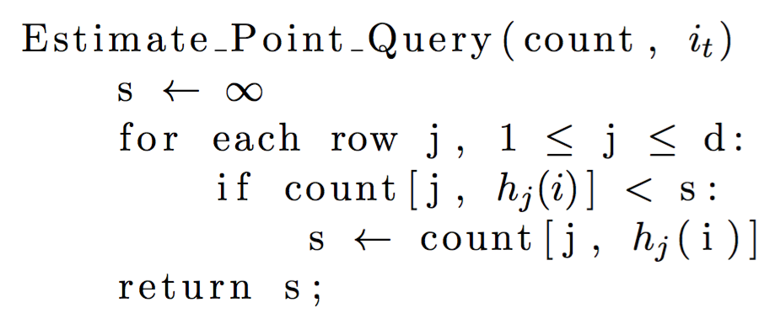
Point Queries Algorithm

Slide 8
Point Queries Algorithm
count[1, h₁(i)] = 35
count[2, h₂(i)]= 19
23 18 35 1 48 90 63 27 3
count[2, h₂(i)]= 19
35
19 20 73 15 19 9 84 36 11
19
count[3, h₃(i)] = 25
98 2 8 52 0 37 25 17 7
25
73 26 22 32 14 88 78 31 12
count[4, h₄(i)] = 12
12
19 21 68 66 42 80 95 4 18
21
count[5, h₅(i)] = 21

