Slide 2

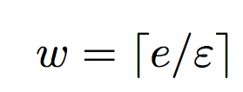
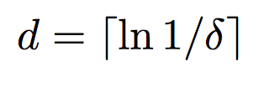
Count Min Sketch Construction
0 0 0 0 0 0 0 0 0
h₁
0 0 0 0 0 0 0 0 0
h₂
0 0 0 0 0 0 0 0 0
h₃
0 0 0 0 0 0 0 0 0
h₄
0 0 0 0 0 0 0 0 0
h₅

Slide 3
Count Min Sketch Updates
(i_{t} , c_{t})
h₁(i_{t})
c_{t}
h₂(i_{t})
0 0 0 0 0 0 0 0 0
c_{t}
0 0 0 0 0 0 0 0 0
h₃(i_{t})
0 0 0 0 0 0 0 0 0
c_{t}
0 0 0 0 0 0 0 0 0
h₄(i_{t})
c_{t}
0 0 0 0 0 0 0 0 0
c_{t}
h₅(i_{t})

Slide 4
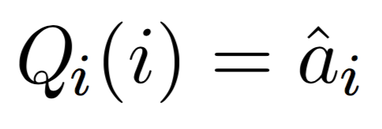
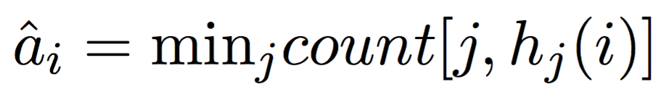
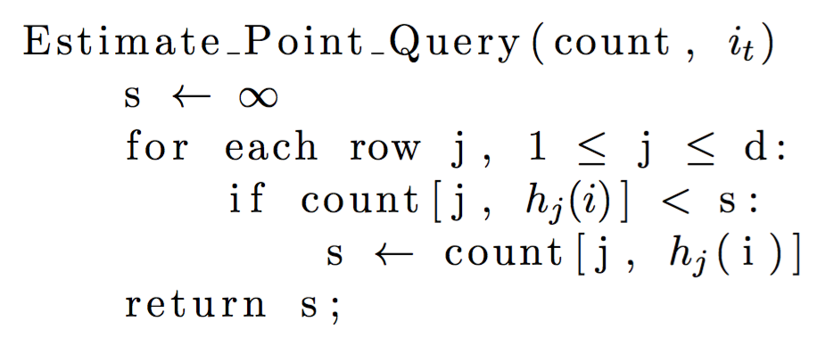
Point Queries

Slide 5
Count Min Sketch Updates
(i_{t} , c_{t})
h₁(i_{t})
c_{t}
h₂(i_{t})
0 0 0 0 0 0 0 0 0
c_{t}
0 0 0 0 0 0 0 0 0
h₃(i_{t})
0 0 0 0 0 0 0 0 0
c_{t}
0 0 0 0 0 0 0 0 0
h₄(i_{t})
c_{t}
0 0 0 0 0 0 0 0 0
c_{t}
h₅(i_{t})

