Slide 2
The Count-Min Sketch and Its Applications
Introduction, Problem Statement, and Related Work
Count-Min Sketch construction and updates
Point Queries: algorithm and bounds for the cash-register case
Inner Product Queries: algorithm and bounds
Range Queries: algorithm and bounds
Selected Application: Heavy-Hitters

Slide 3
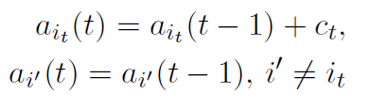
Problem
Suppose we have a vector a that evolves with time with updates:
(i_{t}, c_{t})
Then update the vector such that
We wish to represent this in sublinear space, while supporting 3 main queries.

Slide 4
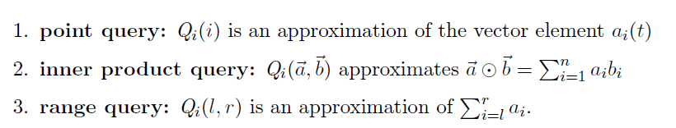
Problem: Query Types
Query Cases:
Cash Register: Only positive updates
Turnstile: Updates are allowed to be positive or negative
General: a[i] can become negative
Non-negative: Updates can be negative such that a[i] >= 0

Slide 5
Related Works
Sketches have been used to analyze large streams of data
Many sketches use order 1/ε² space (AMS sketch, Count sketch, Random subset-sums)
Linear, with respect to the size of the sketch, update times (AMS sketch, Random subset-sums)
Requires p-wise independent hash functions (AMS Sketch)

Slide 6
Count-Min Sketch Improvement
Uses 1/ε space (log(n)/ε for range queries)
Update time independent from ε; O(log(1/δ)) update time
Pairwise independent hash functions

Slide 7
The Count-Min Sketch and Its Applications
Introduction, Problem Statement, and Related Work
Count-Min Sketch construction and updates
Point Queries: algorithm and bounds for the cash-register case
Inner Product Queries: algorithm and bounds
Range Queries: algorithm and bounds
Selected Application: Heavy-Hitters

Slide 8

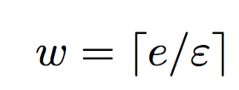
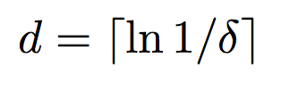
Count Min Sketch Construction
picked independently and uniformly from a 2-universal hash family
h₁
0 0 0 0 0 0 0 0 0
h₂
0 0 0 0 0 0 0 0 0
h₃
0 0 0 0 0 0 0 0 0
h₄
0 0 0 0 0 0 0 0 0
h₅
0 0 0 0 0 0 0 0 0

Slide 9
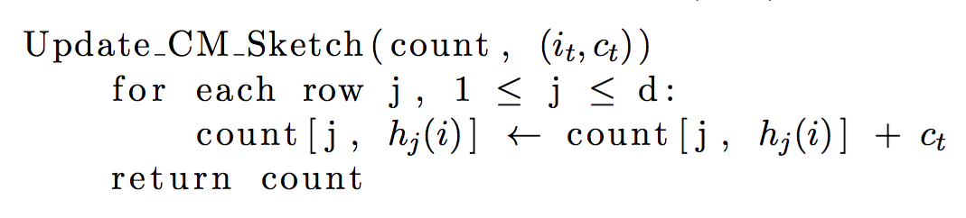
Count-Min Sketch Updates

Slide 10
Count-Min Sketch Updates
(i_{t} , c_{t})
h₁(i_{t})
c_{t}
h₂(i_{t})
0 0 0 0 0 0 0 0 0
c_{t}
0 0 0 0 0 0 0 0 0
h₃(i_{t})
0 0 0 0 0 0 0 0 0
c_{t}
0 0 0 0 0 0 0 0 0
h₄(i_{t})
c_{t}
0 0 0 0 0 0 0 0 0
c_{t}
h₅(i_{t})

Slide 11
The Count-Min Sketch and Its Applications
Introduction, Problem Statement, and Related Work
Count-Min Sketch construction and updates
Point Queries: algorithm and bounds for the cash-register case
Inner Product Queries: algorithm and bounds
Range Queries: algorithm and bounds
Selected Application: Heavy-Hitters

Slide 12
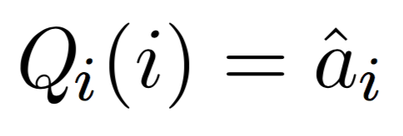
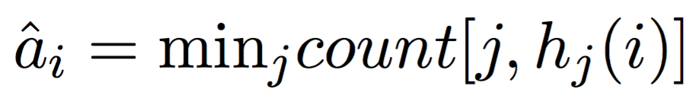
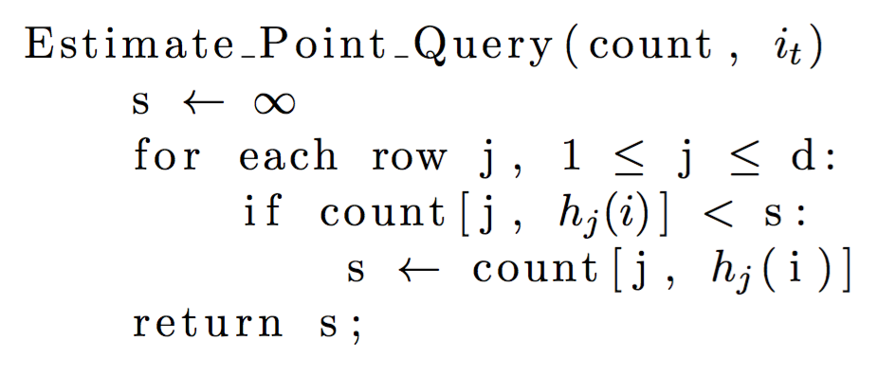
Point Queries Algorithm

Slide 13
Point Queries Algorithm
count[1, h₁(i)] = 35
count[2, h₂(i)]= 19
23 18 35 1 48 90 63 27 3
count[2, h₂(i)]= 19
35
19 20 73 15 19 9 84 36 11
19
count[3, h₃(i)] = 25
98 2 8 52 0 37 25 17 7
25
73 26 22 32 14 88 78 31 12
count[4, h₄(i)] = 12
12
19 21 68 66 42 80 95 4 18
21
count[5, h₅(i)] = 21

Slide 14
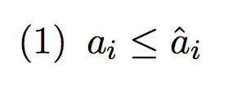
Point Queries Error Bounds

Slide 15
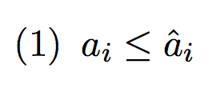
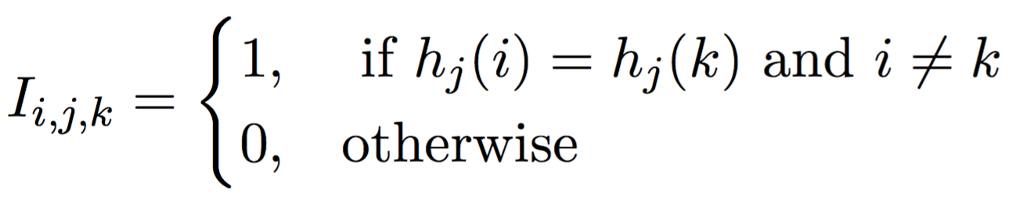
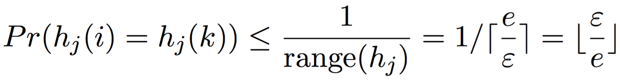
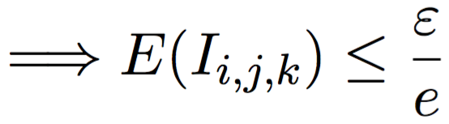
Point Queries Error Bounds

Slide 16
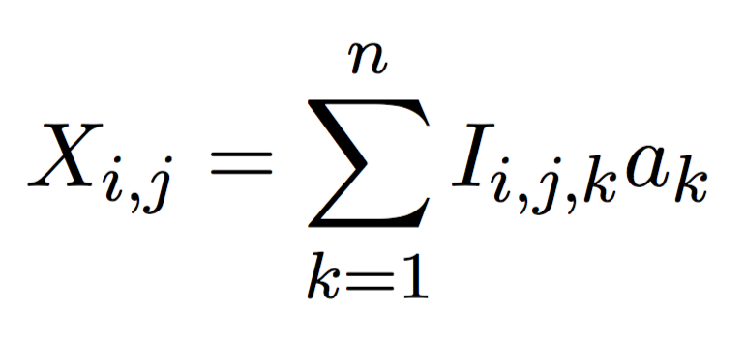
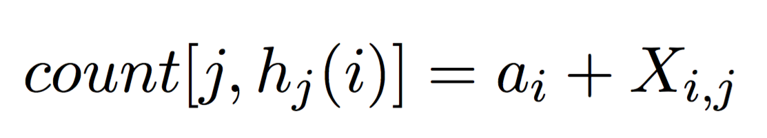
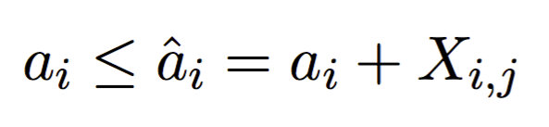
Point Queries Error Bounds

Slide 17
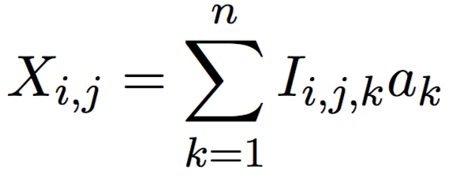
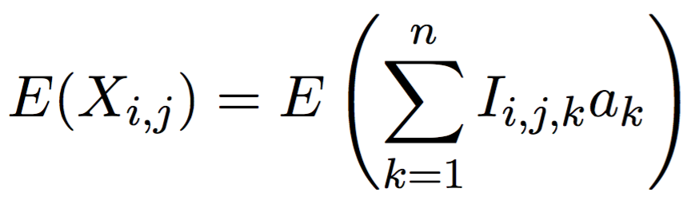
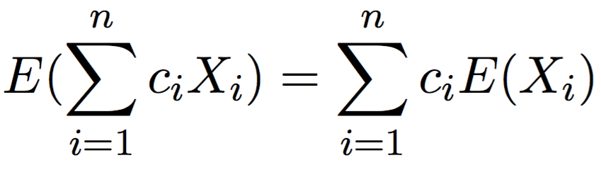
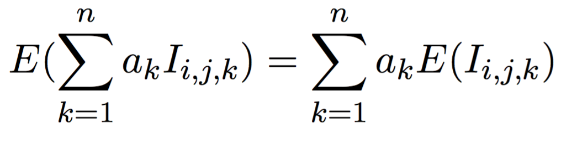
Point Queries Error Bounds

Slide 18
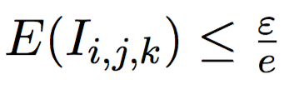
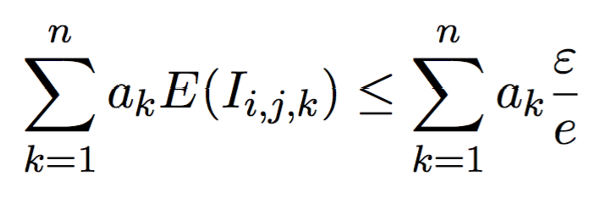

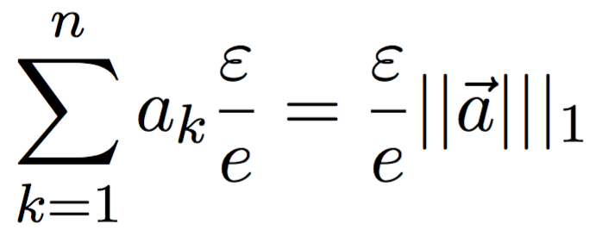
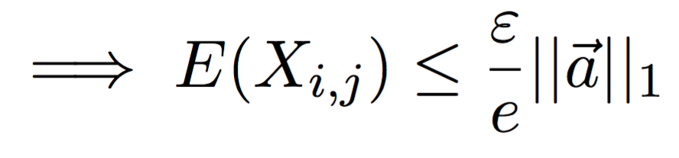
Point Queries Error Bounds

Slide 19
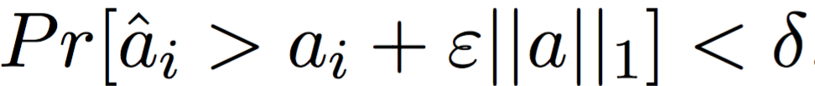
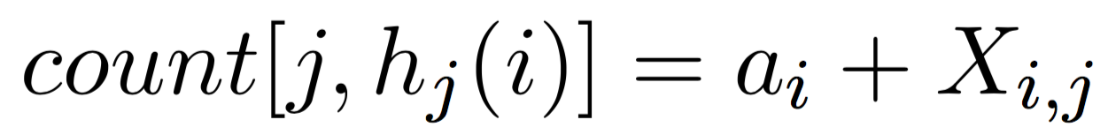
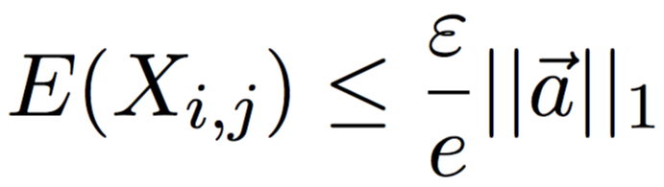
Point Queries Error Bounds
Want to show:

Slide 20
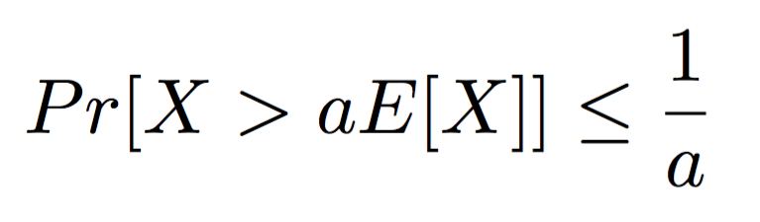
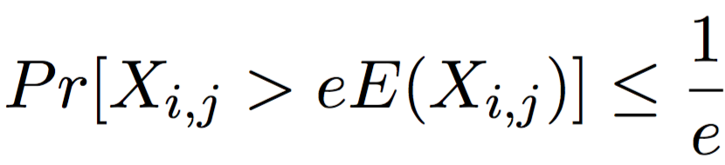
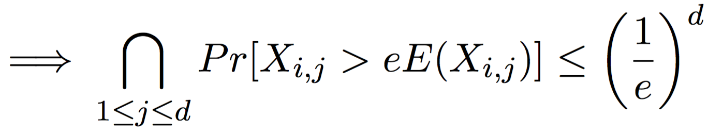
Point Queries Error Bounds

Slide 21
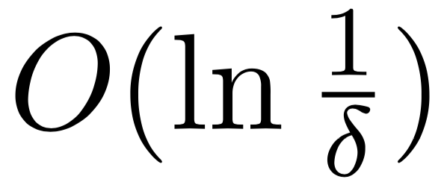
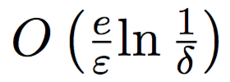
Point Queries Space and Time Complexity
Time complexity for CMS updates:
Time complexity for point queries:
Space complexity for CMS:
h₁
0 0 0 0 0 0 0 0 0
h₂
0 0 0 0 0 0 0 0 0
h₃
0 0 0 0 0 0 0 0 0
h₄
0 0 0 0 0 0 0 0 0
h₅
0 0 0 0 0 0 0 0 0

Slide 22
The Count-Min Sketch and Its Applications
Count-Min Sketch construction and updates
Point Queries: algorithm and bounds for the cash-register case
Inner Product Queries: algorithm and bounds
Range Queries: algorithm and bounds
Selected Application: Heavy-Hitters

Slide 23
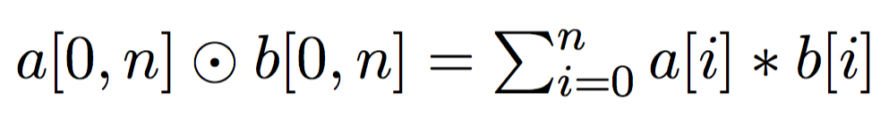
Inner Product Query
Setup:
2 sketches for vectors a and b : count_{a} and count_{b}

Slide 24
Inner Product Query: Update
Use the same update scheme as point query.
Say we want to make the update:
A[i] = A[i] + c
For each estimator in sketch count_{a}:
(i,c) : Hj(i) += c
h₁(i_{t})
c_{t}
h₂(i_{t})
0 0 0 0 0 0 0 0 0
c_{t}
0 0 0 0 0 0 0 0 0
h₃(i_{t})
0 0 0 0 0 0 0 0 0
c_{t}
0 0 0 0 0 0 0 0 0
h₄(i_{t})
c_{t}
0 0 0 0 0 0 0 0 0
c_{t}
h₅(i_{t})

Slide 25
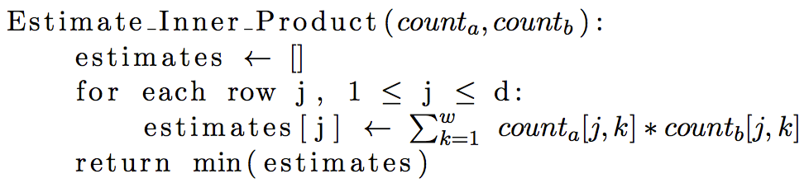
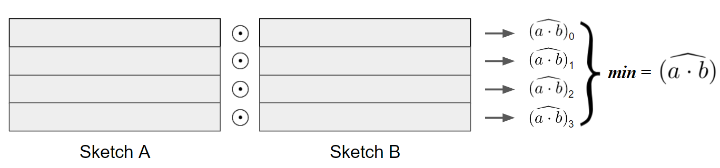
Inner Product Query: Estimation

Slide 26
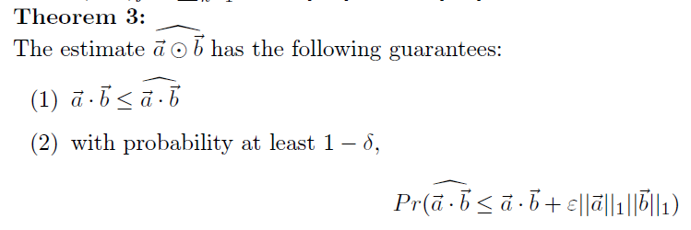
Inner Product Query: Bounds

Slide 27
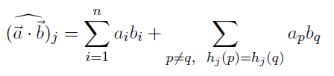

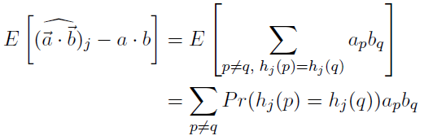
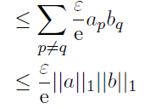
Inner Product Query: Proof

Slide 28
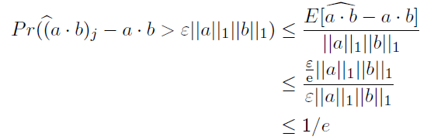
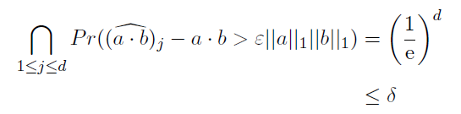
Inner Product Query: Proof
Use Markov to get the probability for a single estimator:
Over all estimators:

Slide 29
The Count-Min Sketch and Its Applications
Count-Min Sketch construction and updates
Point Queries: algorithm and bounds for the cash-register case
Inner Product Queries: algorithm and bounds
Range Queries: algorithm and bounds
Selected Application: Heavy-Hitters

Slide 30
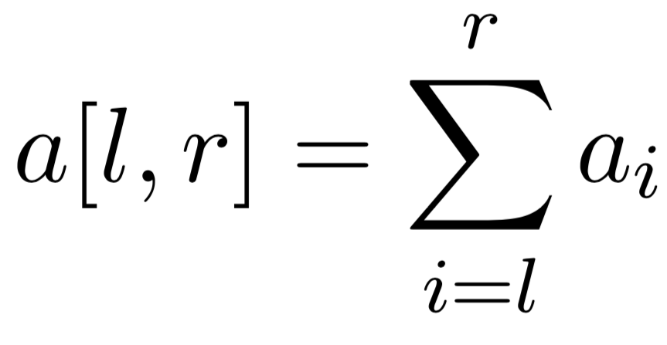
Range Query
Possible to estimate via a sum of individual point queries
Error with extra multiplicative term ||[l,r]||₁
Linear time operation
Dyadic ranges helps both of these problems

Slide 31
Dyadic Ranges
1 2 3 4 5 6 7 8
1 2 3 4
5 6 7 8
1 2
3 4
5 6
7 8
1
2
3
4
5
6
7
8

Slide 32
Use of Dyadic ranges
Keep log₂n CM sketches (one for every level in our tree)
Keys are now ranges
Sum of at most 2log₂n point queries

Slide 33
Dyadic Ranges
1 2 3 4
5 6 7 8
CM₁
1 2
3 4
5 6
7 8
CM₂
1
2
3
4
5
6
7
8
CM₃

Slide 34
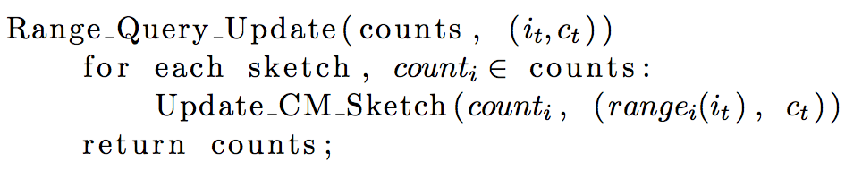
Range Queries Algorithm: updates

Slide 35
Range Query: Update
Insert 2
1 2 3 4
5 6 7 8
1 2
3 4
5 6
7 8
1
2
3
4
5
6
7
8

Slide 36
Range Query: Update
Insert 2
1 2 3 4
5 6 7 8
CM₁:Update r(1,4)
1 2
3 4
5 6
7 8
1
2
3
4
5
6
7
8

Slide 37
Range Query: Update
Insert 2
1 2 3 4
5 6 7 8
CM₁:Update r(1,4)
1 2
3 4
5 6
7 8
CM₂: Update r(1,2)
1
2
3
4
5
6
7
8

Slide 38
Range Query: Update
Insert 2
1 2 3 4
5 6 7 8
CM₁:Update r(1,4)
1 2
3 4
5 6
7 8
CM₂: Update r(1,2)
1
2
3
4
5
6
7
8
CM₃: Update r(2)

Slide 39
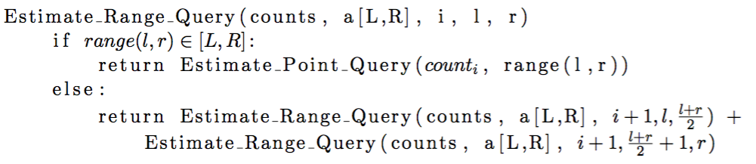
Range Queries Algorithm: Estimation

Slide 40
Range Query: Estimate
Estimate: a[2,7]
Estimate_Range_Query
(counts, a[2,7], 0, 1, 8)
1 2 3 4
5 6 7 8
1 2
3 4
5 6
7 8
1
2
3
4
5
6
7
8

Slide 41
Range Query: Estimate
Estimate: a[2,7]
(counts, a[2,7], 1, 1, 4)
(counts, a[2,7], 1, 5, 8)
1 2 3 4
5 6 7 8
1 2
3 4
5 6
7 8
1
2
3
4
5
6
7
8

Slide 42
Range Query: Estimate
Estimate: a[2,7]
1 2 3 4
5 6 7 8
(counts, a[2,7], 1, 1, 2)
(counts, a[2,7], 1, 5, 6)
1 2
3 4
5 6
7 8
(counts, a[2,7], 1, 3, 4)
(counts, a[2,7], 1, 7, 8)
1
2
3
4
5
6
7
8

Slide 43
Range Query: Estimate
Estimate: a[2,7]
1 2 3 4
5 6 7 8
1 2
3 4
5 6
7 8
(counts, a[2,7], 1, 1, 1)
(counts, a[2,7], 1, 7, 7)
1
2
3
4
5
6
7
8
(counts, a[2,7], 1, 2, 2)
(counts, a[2,7], 1, 8, 8)

Slide 44
Range Query: Estimate
Estimate: a[2,7]
1 2 3 4
5 6 7 8
1 2
3 4
5 6
7 8
CM₂[r(3,4)] + CM₂[r(5,6)] +
CM₃[r(2,2)] + CM₃[r(7,7)]
1
2
3
4
5
6
7
8

Slide 45
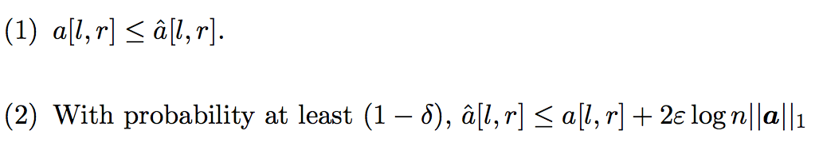
Error bounds: Theorem 4

Slide 46
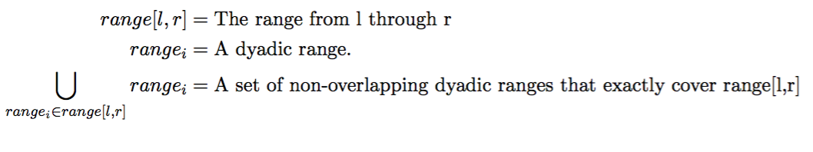
Error bounds proof: notation

Slide 47
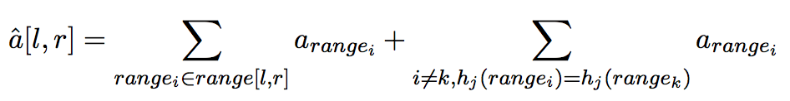


Error bounds proof

Slide 48
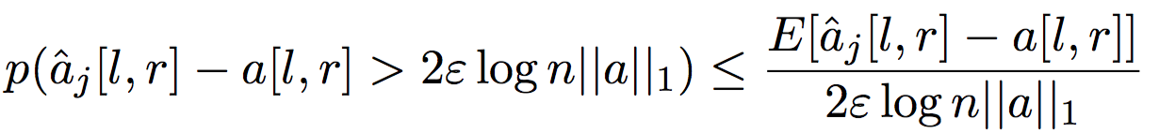
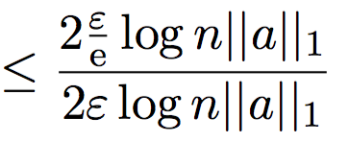
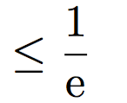


Error bounds proof

