Slide 2
The Count-Min Sketch and Its Applications
Introduction, Problem Statement, and Related Work
Count-Min Sketch construction and updates
Point Queries: algorithm and bounds for the cash-register case
Inner Product Queries: algorithm and bounds
Range Queries: algorithm and bounds
Selected Application: Heavy-Hitters

Slide 3

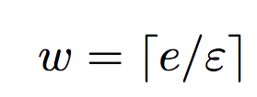
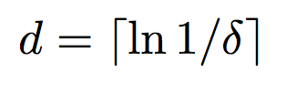
Count Min Sketch Construction
picked independently and uniformly from a 2-universal hash family
h₁
0 0 0 0 0 0 0 0 0
h₂
0 0 0 0 0 0 0 0 0
h₃
0 0 0 0 0 0 0 0 0
h₄
0 0 0 0 0 0 0 0 0
h₅
0 0 0 0 0 0 0 0 0

Slide 4
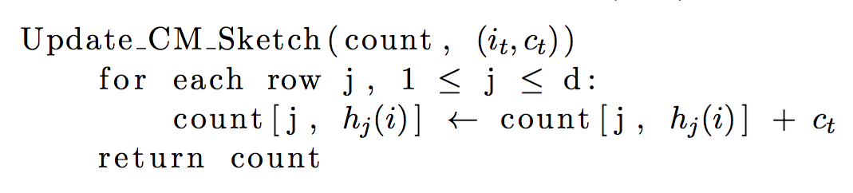
Count-Min Sketch Updates

Slide 5
Count-Min Sketch Updates
(i_{t} , c_{t})
h₁(i_{t})
c_{t}
h₂(i_{t})
0 0 0 0 0 0 0 0 0
c_{t}
0 0 0 0 0 0 0 0 0
h₃(i_{t})
0 0 0 0 0 0 0 0 0
c_{t}
0 0 0 0 0 0 0 0 0
h₄(i_{t})
c_{t}
0 0 0 0 0 0 0 0 0
c_{t}
h₅(i_{t})

Slide 6
The Count-Min Sketch and Its Applications
Introduction, Problem Statement, and Related Work
Count-Min Sketch construction and updates
Point Queries: algorithm and bounds for the cash-register case
Inner Product Queries: algorithm and bounds
Range Queries: algorithm and bounds
Selected Application: Heavy-Hitters

Slide 7
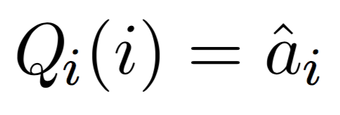
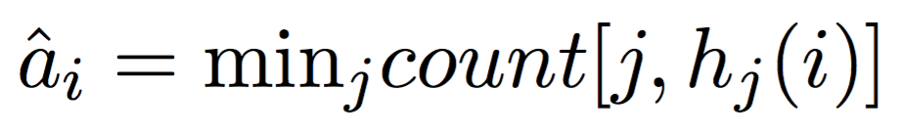
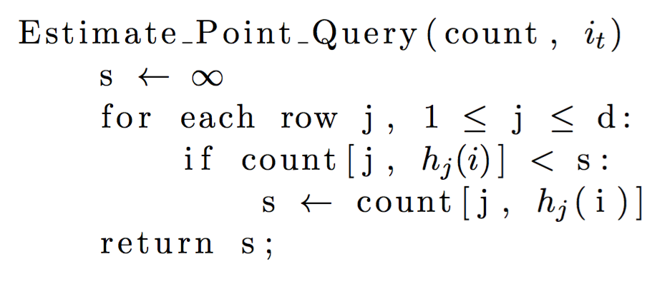
Point Queries Algorithm

Slide 8
Point Queries Algorithm
count[1, h₁(i)] = 35
count[2, h₂(i)]= 19
23 18 35 1 48 90 63 27 3
count[2, h₂(i)]= 19
35
19 20 73 15 19 9 84 36 11
19
count[3, h₃(i)] = 25
98 2 8 52 0 37 25 17 7
25
73 26 22 32 14 88 78 31 12
count[4, h₄(i)] = 12
12
19 21 68 66 42 80 95 4 18
21
count[5, h₅(i)] = 21

Slide 9
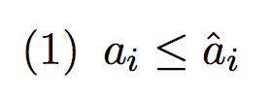
Point Queries Error Bounds

Slide 10
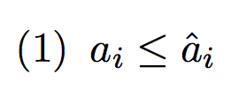
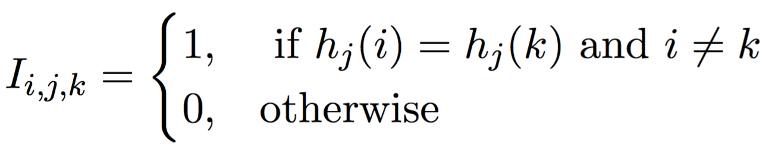
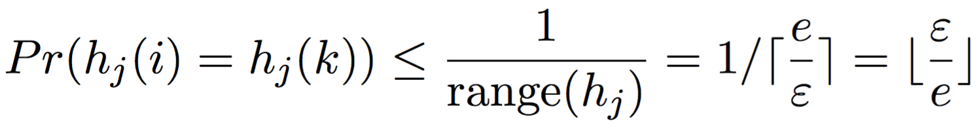
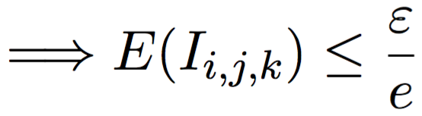
Point Queries Error Bounds

Slide 11
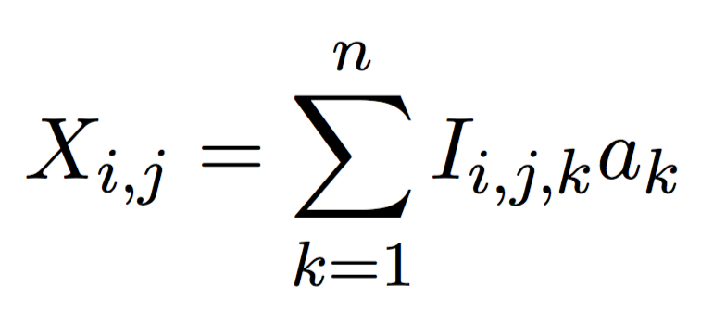
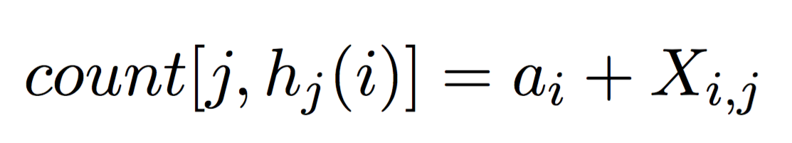
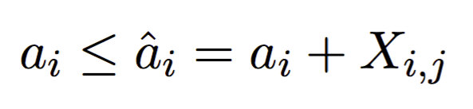
Point Queries Error Bounds

Slide 12
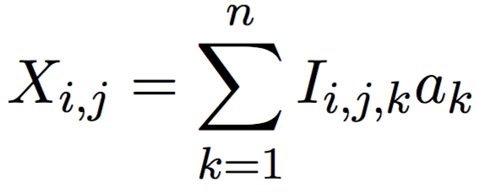
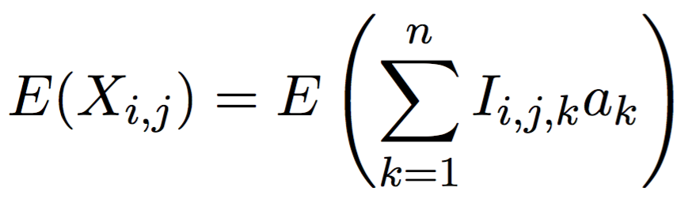
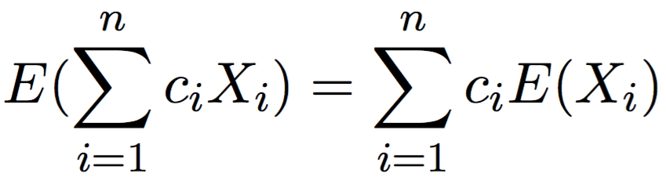
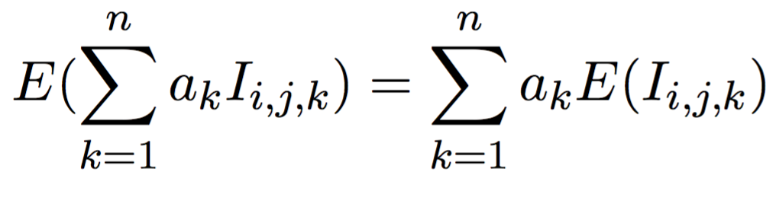
Point Queries Error Bounds

Slide 13
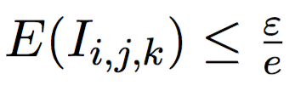
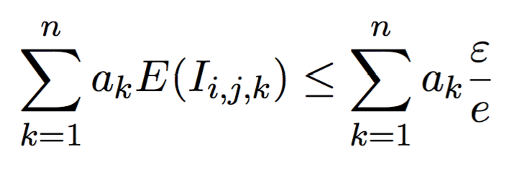

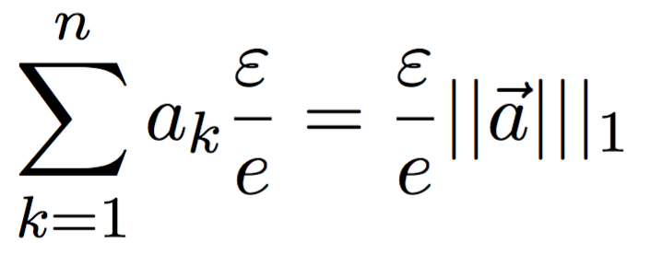
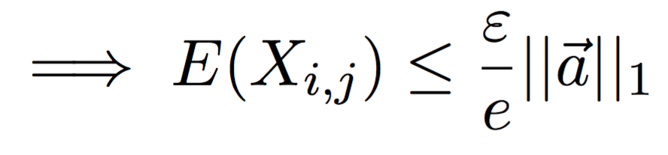
Point Queries Error Bounds

Slide 14
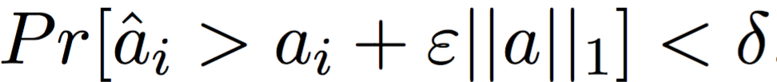
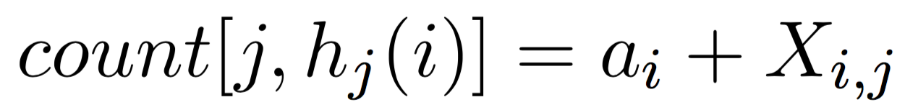
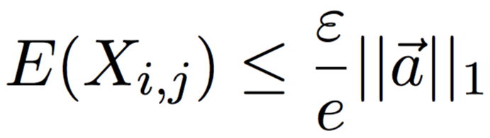
Point Queries Error Bounds
Want to show:

Slide 15
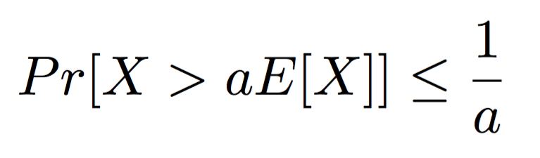
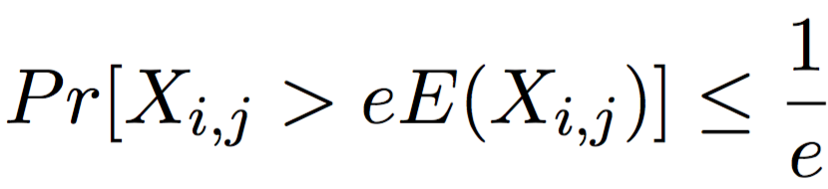
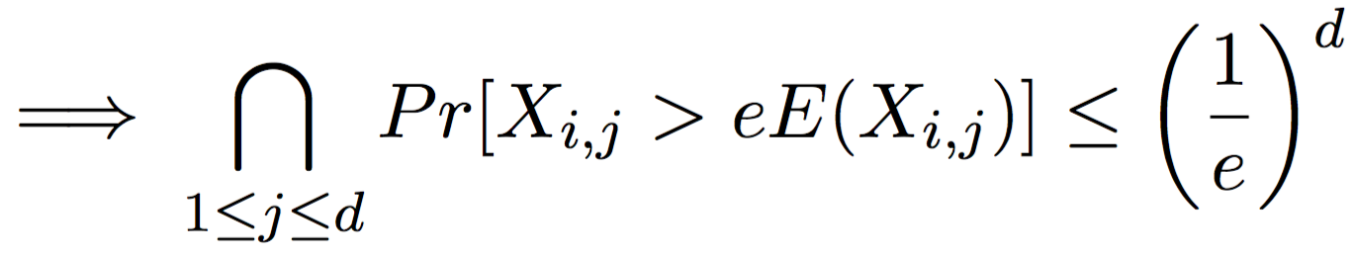
Point Queries Error Bounds

Slide 16
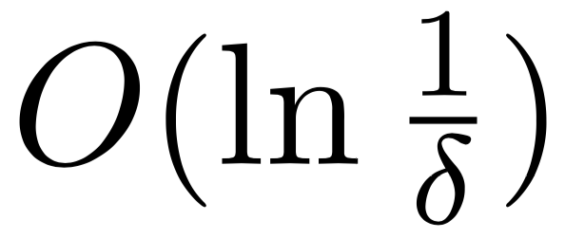
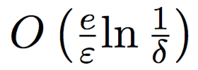
Point Queries Space and Time Complexity
Time complexity for CMS updates:
Time complexity for point queries:
Space complexity for CMS:
h₁
0 0 0 0 0 0 0 0 0
h₂
0 0 0 0 0 0 0 0 0
h₃
0 0 0 0 0 0 0 0 0
h₄
0 0 0 0 0 0 0 0 0
h₅
0 0 0 0 0 0 0 0 0

Slide 17
The Count-Min Sketch and Its Applications
Count-Min Sketch construction and updates
Point Queries: algorithm and bounds for the cash-register case
Inner Product Queries: algorithm and bounds
Range Queries: algorithm and bounds
Selected Application: Heavy-Hitters

Slide 18


Range Query
Possible to estimate via a sum of individual point queries
Dyadic ranges reduce time complexity and give appropriate error bounds

Slide 19
Dyadic Ranges
1 2 3 4 5 6 7 8
1 2 3 4
5 6 7 8
1 2
3 4
5 6
7 8
1
2
3
4
5
6
7
8

Slide 20
Dyadic Ranges
1 2 3 4
5 6 7 8
CM₁
1 2
3 4
5 6
7 8
CM₂
1
2
3
4
5
6
7
8
CM₃

Slide 21
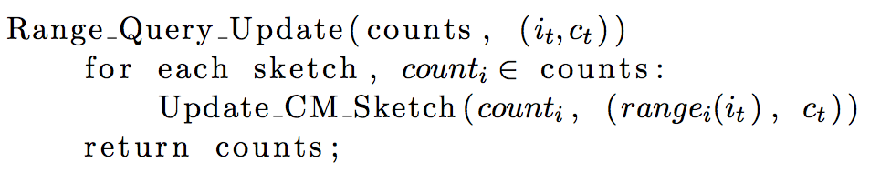
Range Queries Algorithm: updates

Slide 22
Range Query: Update
Insert 2
1 2 3 4
5 6 7 8
1 2
3 4
5 6
7 8
1
2
3
4
5
6
7
8

Slide 23
Range Query: Update
Insert 2
1 2 3 4
5 6 7 8
CM₁:Update r(1,4)
1 2
3 4
5 6
7 8
1
2
3
4
5
6
7
8

Slide 24
Range Query: Update
Insert 2
1 2 3 4
5 6 7 8
CM₁:Update r(1,4)
1 2
3 4
5 6
7 8
CM₂: Update r(1,2)
1
2
3
4
5
6
7
8

Slide 25
Range Query: Update
Insert 2
1 2 3 4
5 6 7 8
CM₁:Update r(1,4)
1 2
3 4
5 6
7 8
CM₂: Update r(1,2)
1
2
3
4
5
6
7
8
CM₃: Update r(2)

Slide 26
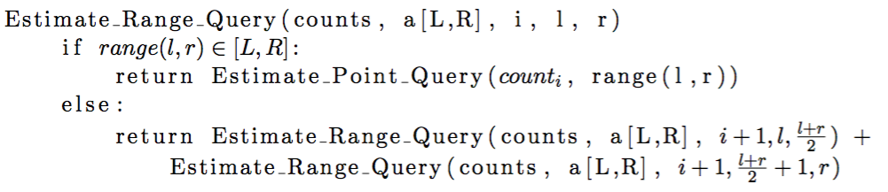
Range Queries Algorithm: Estimation

Slide 27
Range Query: Estimate
Estimate: a[2,7]
Estimate_Range_Query
(counts, a[2,7], 0, 1, 8)
1 2 3 4
5 6 7 8
1 2
3 4
5 6
7 8
1
2
3
4
5
6
7
8

Slide 28
Range Query: Estimate
Estimate: a[2,7]
(counts, a[2,7], 1, 1, 4)
(counts, a[2,7], 1, 5, 8)
1 2 3 4
5 6 7 8
1 2
3 4
5 6
7 8
1
2
3
4
5
6
7
8

Slide 29
Range Query: Estimate
Estimate: a[2,7]
1 2 3 4
5 6 7 8
(counts, a[2,7], 1, 1, 2)
(counts, a[2,7], 1, 5, 6)
1 2
3 4
5 6
7 8
(counts, a[2,7], 1, 3, 4)
(counts, a[2,7], 1, 7, 8)
1
2
3
4
5
6
7
8

Slide 30
Range Query: Estimate
Estimate: a[2,7]
1 2 3 4
5 6 7 8
1 2
3 4
5 6
7 8
(counts, a[2,7], 1, 1, 1)
(counts, a[2,7], 1, 7, 7)
1
2
3
4
5
6
7
8
(counts, a[2,7], 1, 2, 2)
(counts, a[2,7], 1, 8, 8)

Slide 31
Range Query: Estimate
Estimate: a[2,7]
1 2 3 4
5 6 7 8
1 2
3 4
5 6
7 8
CM₂[r(3,4)] + CM₂[r(5,6)] +
CM₃[r(2,2)] + CM₃[r(6,6)]
1
2
3
4
5
6
7
8

Slide 32
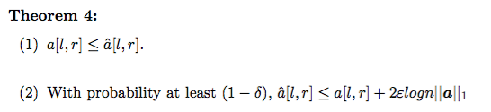
Range Query: Error bounds

Slide 33
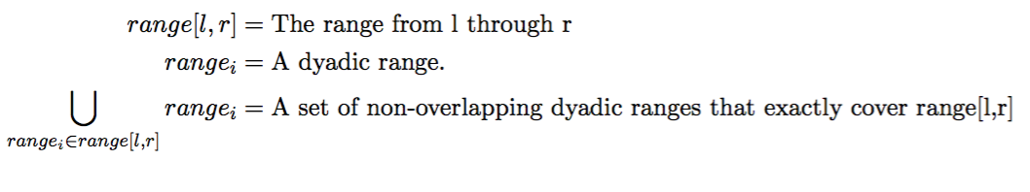
Error bounds proof: notation

Slide 34
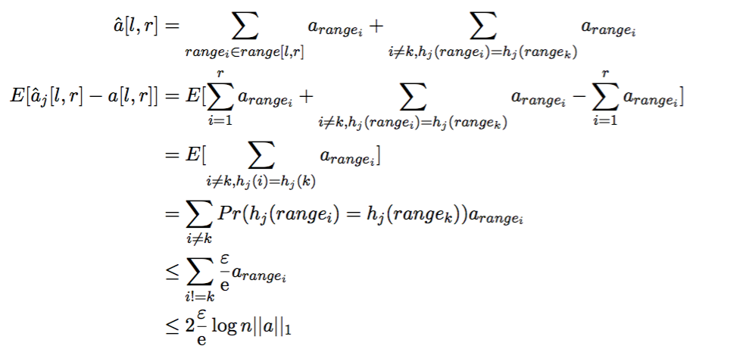
Error bounds proof

Slide 35
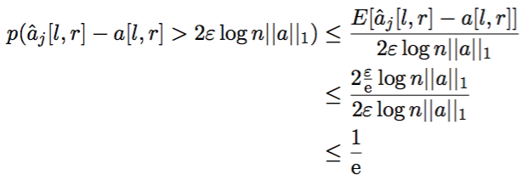
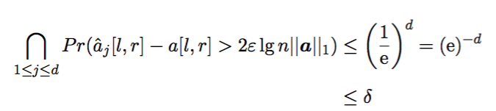
Error bounds proof

