Slide 1
The Count-Min Sketch and Its Applications
Graham Cormode and S. Muthukrishnan
Presented by Matthew ige, Ravi Gaddipati, and Emily Wagner

Slide 2
The Count-Min Sketch and Its Applications
Introduction, Problem Statement, and Related Work
Count-Min Sketch construction and updates
Point Queries: algorithm and bounds for the non-negative case
Inner Product Queries: algorithm and bounds for the non-negative case
Range Queries: algorithm and bounds for the non-negative case

Slide 3
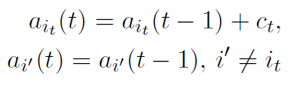
Problem
Suppose we have a vector a that evolves with time with updates:
(i_{t}, c_{t})
Then update the vector such that
We wish to represent this in polylogarithmic space, while supporting 3 main queries.

Slide 4
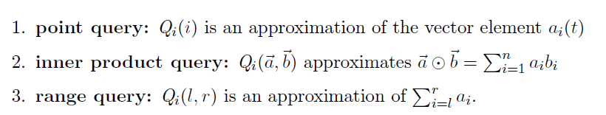
Problem: Query Types
Query Cases:
Cash Register: Only positive updates
Turnstile: Updates are allowed to be positive or negative
General: a[i] can become negative
Non-negative: Updates can be negative such that a[i] >= 0

Slide 5
Related Works
Sketches have been used to analyze large streams of data
Many sketches use order 1/ε² space (AMS sketch, Count sketch, Random subset-sums)
Linear, with respect to the size of the sketch, update times (AMS sketch, Random subset-sums)
Some require 4-wise independent hash functions (AMS Sketch)
Some sketches have analysis that hide large constants (Count Sketch has a constant 256)

Slide 6
Count-Min Sketch Improvement
Uses 1/ε space (log(n)/ε for range queries)
Update time independent from ε; O(log(1/δ)) update time
Pairwise independent hash functions

Slide 7
The Count-Min Sketch and Its Applications
Introduction, Problem Statement, and Related Work
Count-Min Sketch construction and updates
Point Queries: algorithm and bounds for the non-negative case
Inner Product Queries: algorithm and bounds for the non-negative case
Range Queries: algorithm and bounds for the non-negative case

Slide 8

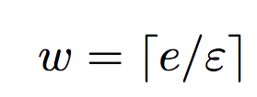
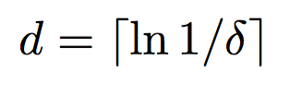
Count Min Sketch Construction
picked independently and uniformly from a 2-universal hash family
h₁
0 0 0 0 0 0 0 0 0
h₂
0 0 0 0 0 0 0 0 0
h₃
0 0 0 0 0 0 0 0 0
h₄
0 0 0 0 0 0 0 0 0
h₅
0 0 0 0 0 0 0 0 0

Slide 9
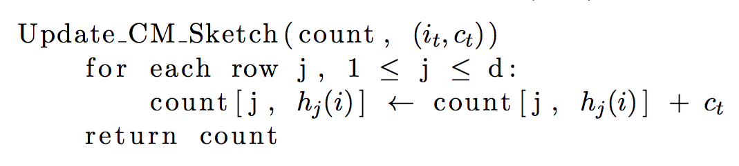
Count-Min Sketch Updates

Slide 10
Count-Min Sketch Updates
(i_{t} , c_{t})
h₁(i_{t})
c_{t}
h₂(i_{t})
0 0 0 0 0 0 0 0 0
c_{t}
0 0 0 0 0 0 0 0 0
h₃(i_{t})
0 0 0 0 0 0 0 0 0
c_{t}
0 0 0 0 0 0 0 0 0
h₄(i_{t})
c_{t}
0 0 0 0 0 0 0 0 0
c_{t}
h₅(i_{t})

Slide 11
The Count-Min Sketch and Its Applications
Introduction, Problem Statement, and Related Work
Count-Min Sketch construction and updates
Point Queries: algorithm and bounds for the non-negative case
Inner Product Queries: algorithm and bounds for the non-negative case
Range Queries: algorithm and bounds for the non-negative case

Slide 12
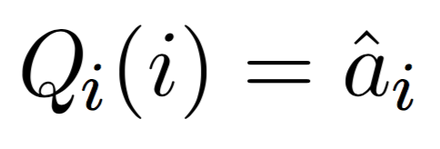
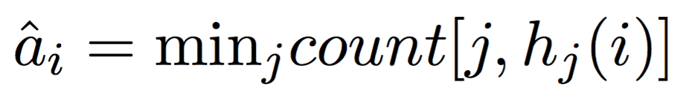
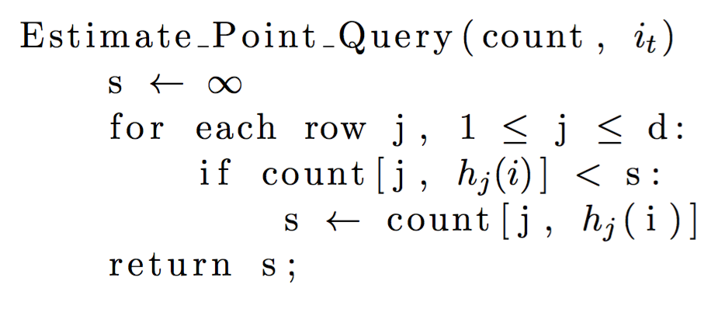
Point Queries Algorithm
Notes:
each row is a single estimators

Slide 13
Point Queries Algorithm
count[1, h₁(i)] = 35
count[2, h₂(i)]= 19
23 18 35 1 48 90 63 27 3
count[2, h₂(i)]= 19
35
19 20 73 15 19 9 84 36 11
19
count[3, h₃(i)] = 25
98 2 8 52 0 37 25 17 7
25
73 26 22 32 14 88 78 31 12
count[4, h₄(i)] = 12
12
19 21 68 66 42 80 95 4 18
21
count[5, h₅(i)] = 21

Slide 14
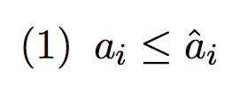
Point Queries Error Bounds

Slide 15
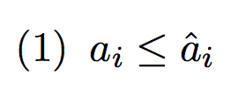
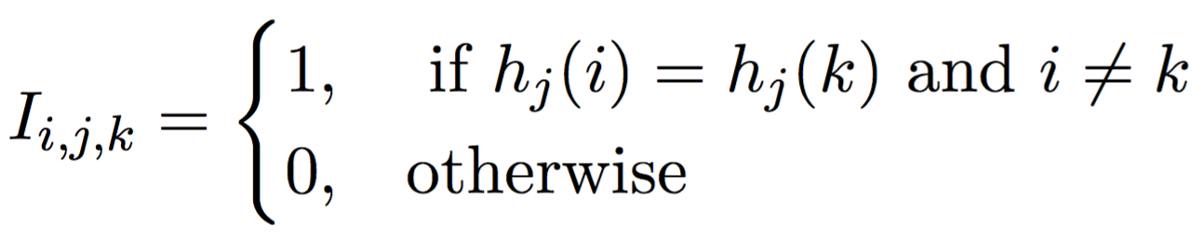
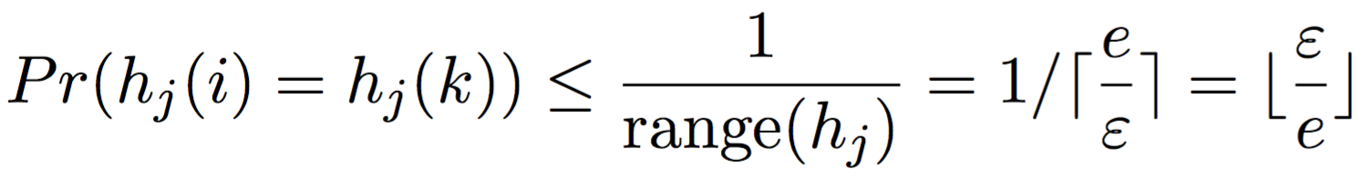
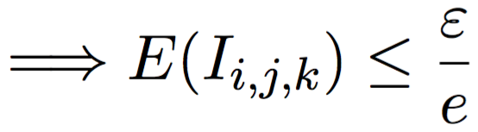
Point Queries Error Bounds
Notes:
lower bound on the estimate

Slide 16
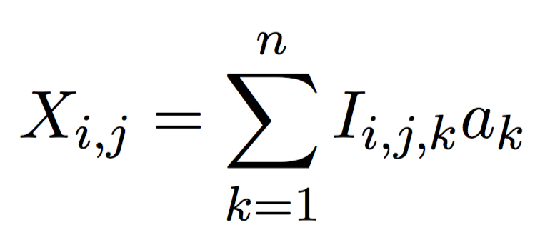
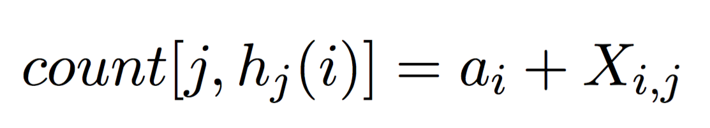
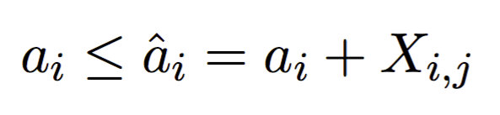
Point Queries Error Bounds
Notes:
x(i, j) is the sum of the values that collide with i in row J

Slide 17
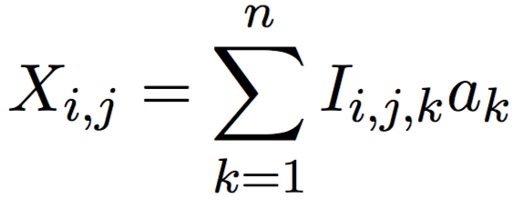
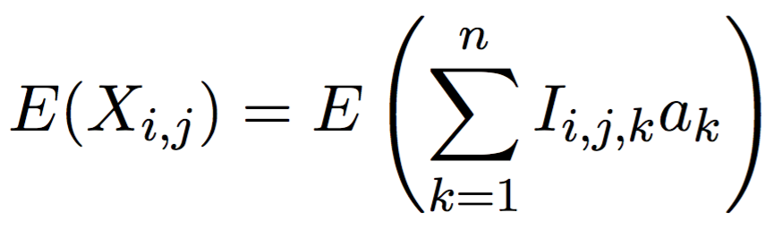
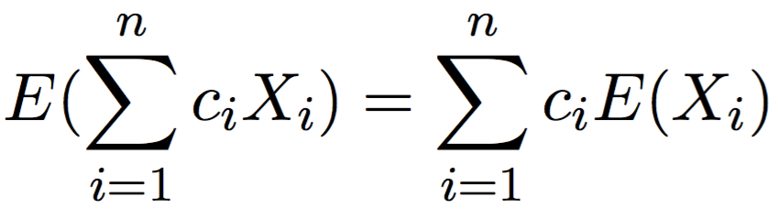
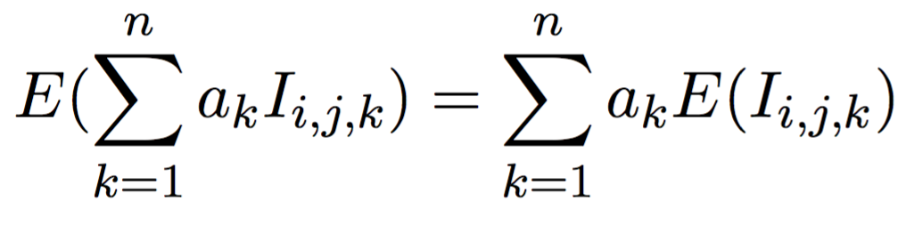
Point Queries Error Bounds
Notes:
x(i, j) is the sum of the values that collide with i in row J

Slide 18
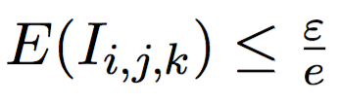
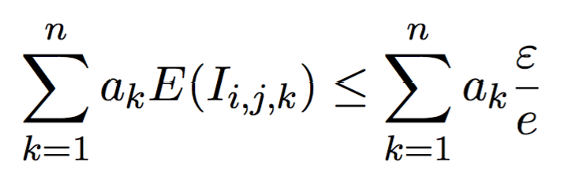

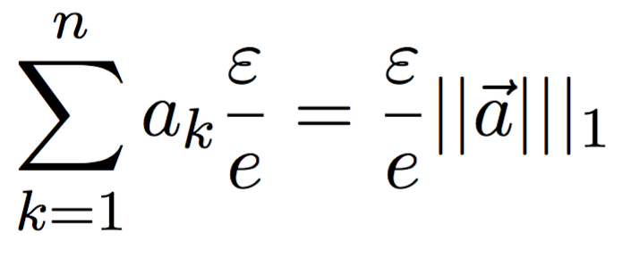
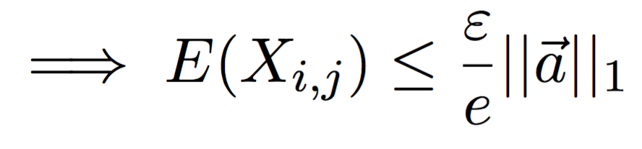
Point Queries Error Bounds

Slide 19
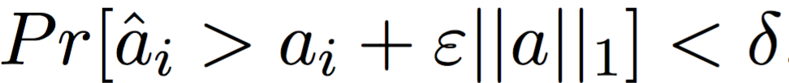
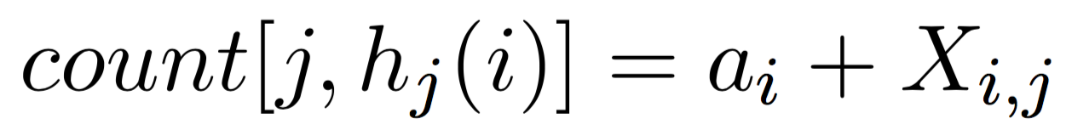
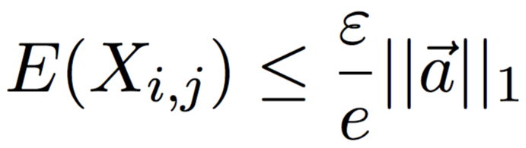
Point Queries Error Bounds
Want to show:

Slide 20
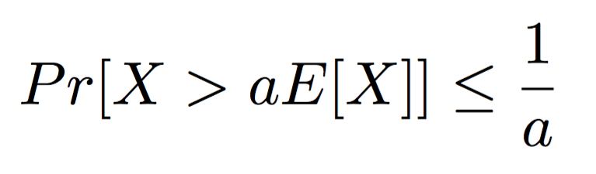
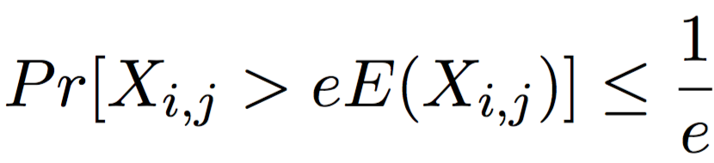
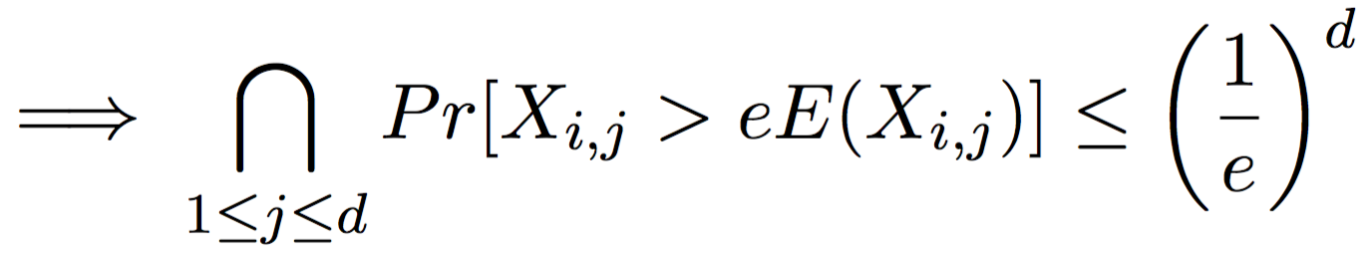
Point Queries Error Bounds

Slide 21
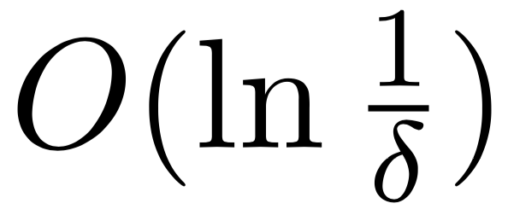
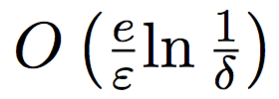
Point Queries Space and Time Complexity
Time complexity for CMS updates:
Time complexity for point queries:
Space complexity for CMS:
h₁
0 0 0 0 0 0 0 0 0
h₂
0 0 0 0 0 0 0 0 0
h₃
0 0 0 0 0 0 0 0 0
h₄
0 0 0 0 0 0 0 0 0
h₅
0 0 0 0 0 0 0 0 0

Slide 22
The Count-Min Sketch and Its Applications
Introduction, Problem Statement, and Related Work
Count-Min Sketch construction and updates
Point Queries: algorithm and bounds for the non-negative case
Inner Product Queries: algorithm and bounds for the non-negative case
Range Queries: algorithm and bounds for the non-negative case

Slide 23
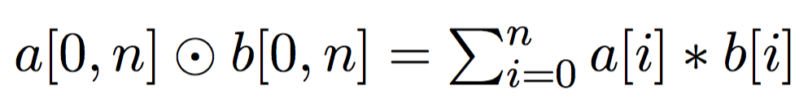
Inner Product Query
Setup:
2 sketches for vectors a and b : count_{a} and count_{b}

Slide 24
Inner Product Query: Update
Use the same update scheme as point query.
Say we want to make the update:
A[i] = A[i] + c
For each estimator in sketch count_{a}:
(i,c) : Hj(i) += c
h₁(i_{t})
c_{t}
h₂(i_{t})
0 0 0 0 0 0 0 0 0
c_{t}
0 0 0 0 0 0 0 0 0
h₃(i_{t})
0 0 0 0 0 0 0 0 0
c_{t}
0 0 0 0 0 0 0 0 0
h₄(i_{t})
c_{t}
0 0 0 0 0 0 0 0 0
c_{t}
h₅(i_{t})

Slide 25
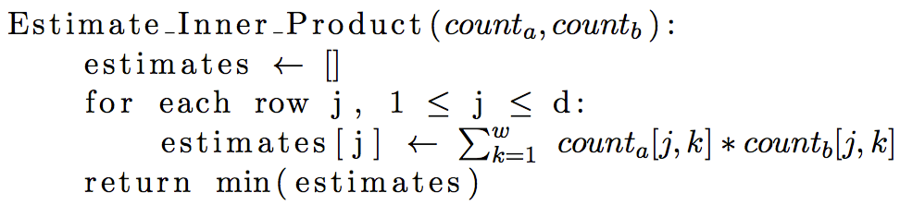
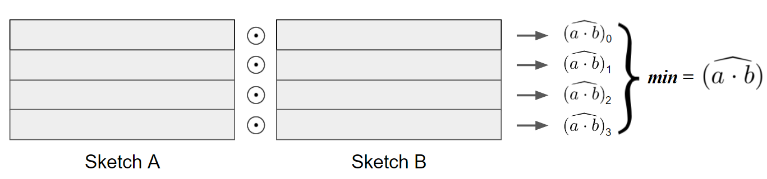
Inner Product Query: Estimation

Slide 26
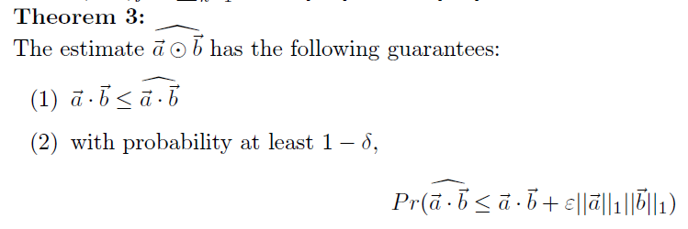
Inner Product Query: Bounds

Slide 27
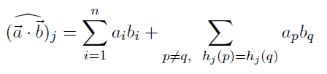

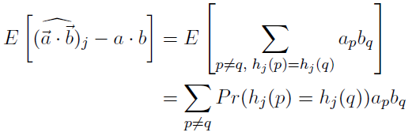
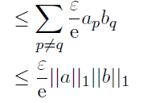
Inner Product Query: Proof

Slide 28
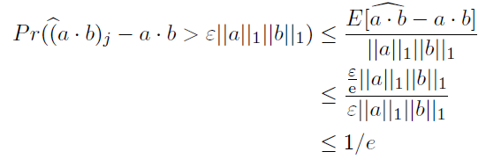
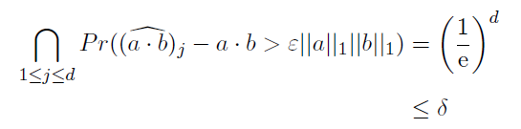
Inner Product Query: Proof
Use Markov to get the probability for a single estimator:
Over all estimators:

Slide 29
The Count-Min Sketch and Its Applications
Introduction, Problem Statement, and Related Work
Count-Min Sketch construction and updates
Point Queries: algorithm and bounds for the non-negative case
Inner Product Queries: algorithm and bounds for the non-negative case
Range Queries: algorithm and bounds for the non-negative case

Slide 30
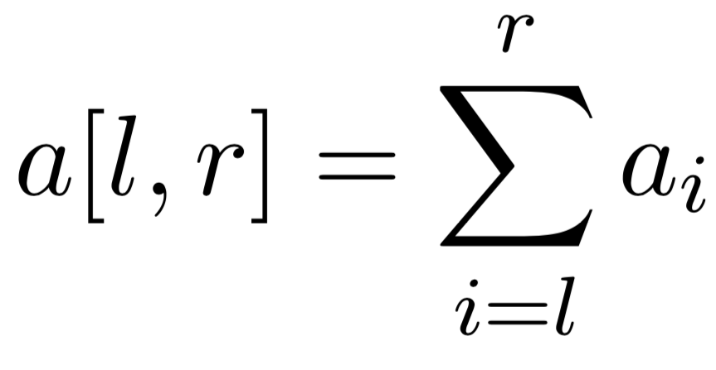
Range Query
Possible to estimate via a sum of individual point queries
Error with extra multiplicative term, (r – l)
Linear time operation
Dyadic ranges helps both of these problems

Slide 31
Dyadic Ranges
1 2 3 4 5 6 7 8
1 2 3 4
5 6 7 8
1 2
3 4
5 6
7 8
1
2
3
4
5
6
7
8

Slide 32
Use of Dyadic ranges
Keep log₂n CM sketches (one for every level in our tree)
Keys are now ranges
Sum of at most 2log₂n point queries

Slide 33
Dyadic Ranges
1 2 3 4
5 6 7 8
CM₁
1 2
3 4
5 6
7 8
CM₂
1
2
3
4
5
6
7
8
CM₃

Slide 34
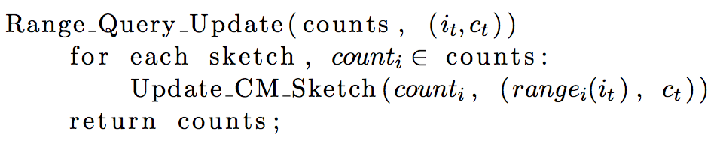
Range Queries Algorithm: updates

Slide 35
Range Query: Update
Insert 2
1 2 3 4
5 6 7 8
1 2
3 4
5 6
7 8
1
2
3
4
5
6
7
8

Slide 36
Range Query: Update
Insert 2
1 2 3 4
5 6 7 8
CM₁:Update r(1,4)
1 2
3 4
5 6
7 8
1
2
3
4
5
6
7
8

Slide 37
Range Query: Update
Insert 2
1 2 3 4
5 6 7 8
CM₁:Update r(1,4)
1 2
3 4
5 6
7 8
CM₂: Update r(1,2)
1
2
3
4
5
6
7
8

Slide 38
Range Query: Update
Insert 2
1 2 3 4
5 6 7 8
CM₁:Update r(1,4)
1 2
3 4
5 6
7 8
CM₂: Update r(1,2)
1
2
3
4
5
6
7
8
CM₃: Update r(2)

Slide 39
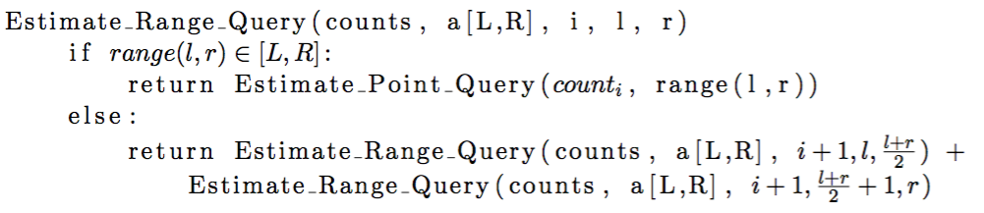
Range Queries Algorithm: Estimation

Slide 40
Range Query: Estimate
Estimate: a[2,7]
Estimate_Range_Query
(counts, a[2,7], 0, 1, 8)
1 2 3 4
5 6 7 8
1 2
3 4
5 6
7 8
1
2
3
4
5
6
7
8

Slide 41
Range Query: Estimate
Estimate: a[2,7]
(counts, a[2,7], 1, 1, 4)
(counts, a[2,7], 1, 5, 8)
1 2 3 4
5 6 7 8
1 2
3 4
5 6
7 8
1
2
3
4
5
6
7
8

Slide 42
Range Query: Estimate
Estimate: a[2,7]
1 2 3 4
5 6 7 8
(counts, a[2,7], 1, 1, 2)
(counts, a[2,7], 1, 5, 6)
1 2
3 4
5 6
7 8
(counts, a[2,7], 1, 3, 4)
(counts, a[2,7], 1, 7, 8)
1
2
3
4
5
6
7
8

Slide 43
Range Query: Estimate
Estimate: a[2,7]
1 2 3 4
5 6 7 8
1 2
3 4
5 6
7 8
(counts, a[2,7], 1, 1, 1)
(counts, a[2,7], 1, 7, 7)
1
2
3
4
5
6
7
8
(counts, a[2,7], 1, 2, 2)
(counts, a[2,7], 1, 8, 8)

Slide 44
Range Query: Estimate
Estimate: a[2,7]
1 2 3 4
5 6 7 8
1 2
3 4
5 6
7 8
CM₂[r(3,4)] + CM₂[r(5,6)] +
CM₃[r(2,2)] + CM₃[r(7,7)]
1
2
3
4
5
6
7
8

Slide 45
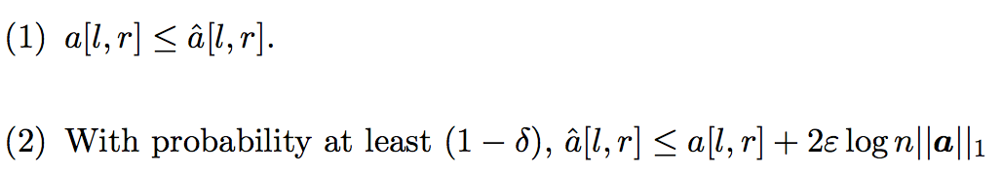
Error bounds: Theorem 4

Slide 46
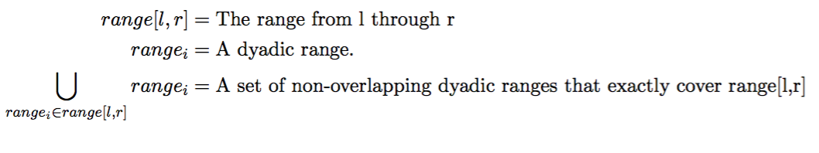
Error bounds proof: notation

Slide 47
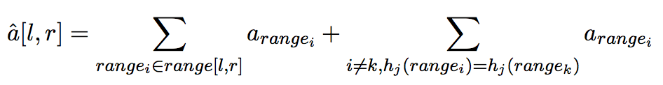


Error bounds proof

Slide 48
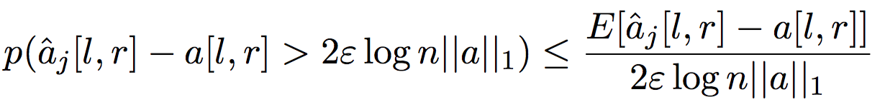
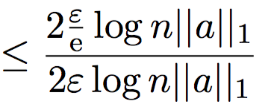
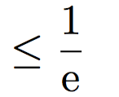


Error bounds proof

Slide 49
Questions?

