Slide 2
The Count-Min Sketch and Its Applications
Introduction, Problem Statement, and Related Work
Count-Min Sketch construction and updates
Point Queries: algorithm and bounds for the cash-register case
Inner Product Queries: algorithm and bounds
Range Queries: algorithm and bounds
Selected Application: Heavy-Hitters

Slide 3

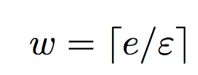
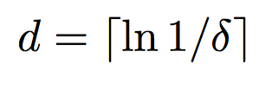
Count Min Sketch Construction
picked independently and uniformly from a 2-universal hash family
h₁
0 0 0 0 0 0 0 0 0
h₂
0 0 0 0 0 0 0 0 0
h₃
0 0 0 0 0 0 0 0 0
h₄
0 0 0 0 0 0 0 0 0
h₅
0 0 0 0 0 0 0 0 0

Slide 4
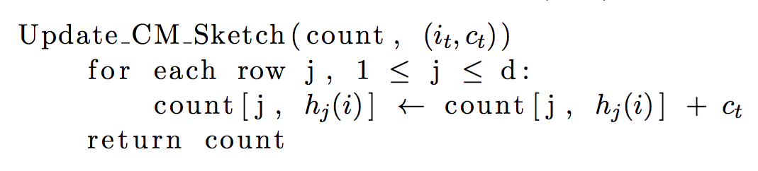
Count-Min Sketch Updates

Slide 5
Count-Min Sketch Updates
(i_{t} , c_{t})
h₁(i_{t})
c_{t}
h₂(i_{t})
0 0 0 0 0 0 0 0 0
c_{t}
0 0 0 0 0 0 0 0 0
h₃(i_{t})
0 0 0 0 0 0 0 0 0
c_{t}
0 0 0 0 0 0 0 0 0
h₄(i_{t})
c_{t}
0 0 0 0 0 0 0 0 0
c_{t}
h₅(i_{t})

Slide 6
The Count-Min Sketch and Its Applications
Introduction, Problem Statement, and Related Work
Count-Min Sketch construction and updates
Point Queries: algorithm and bounds for the cash-register case
Inner Product Queries: algorithm and bounds
Range Queries: algorithm and bounds
Selected Application: Heavy-Hitters

Slide 7
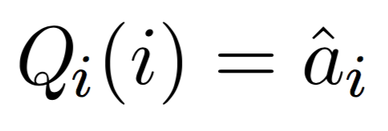
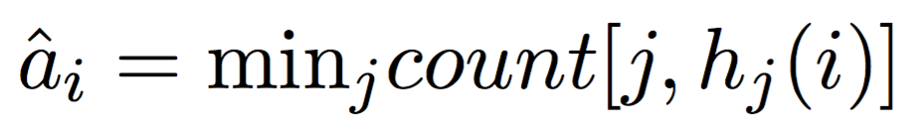
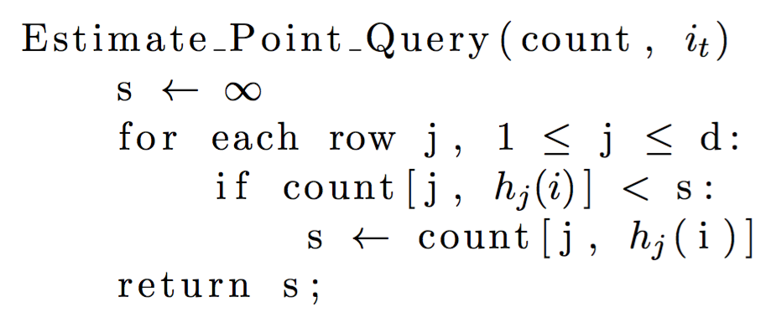
Point Queries Algorithm

Slide 8
Point Queries Algorithm
count[1, h₁(i)] = 35
count[2, h₂(i)]= 19
23 18 35 1 48 90 63 27 3
count[2, h₂(i)]= 19
35
19 20 73 15 19 9 84 36 11
19
count[3, h₃(i)] = 25
98 2 8 52 0 37 25 17 7
25
73 26 22 32 14 88 78 31 12
count[4, h₄(i)] = 12
12
19 21 68 66 42 80 95 4 18
21
count[5, h₅(i)] = 21

Slide 9
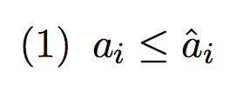
Point Queries Error Bounds

Slide 10
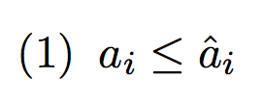
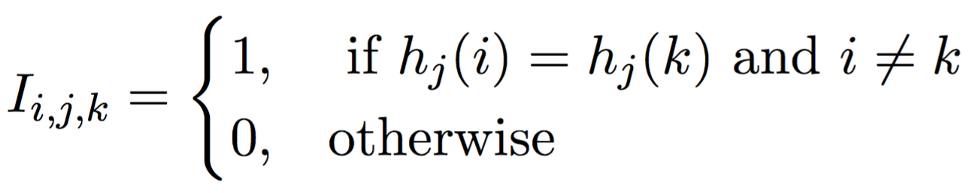
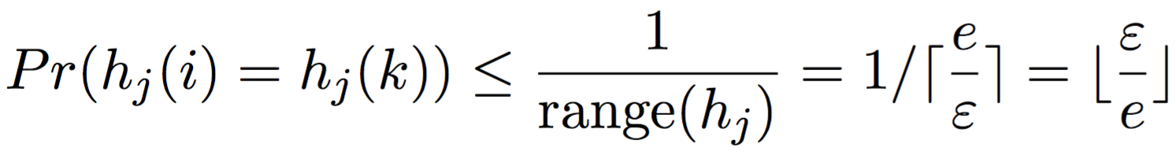
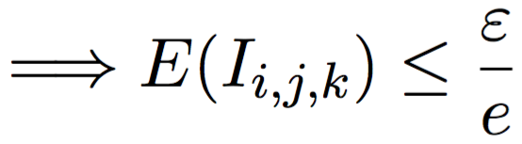
Point Queries Error Bounds

Slide 11
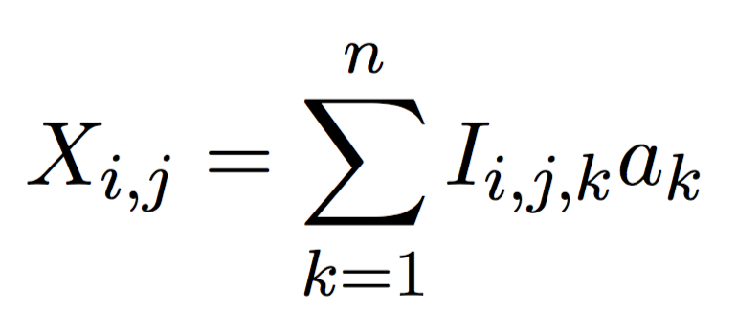
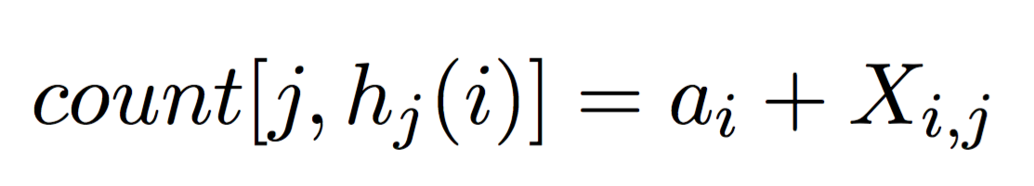
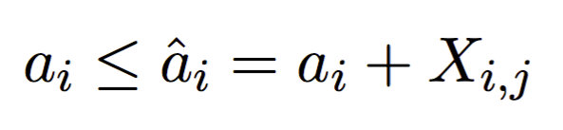
Point Queries Error Bounds

Slide 12
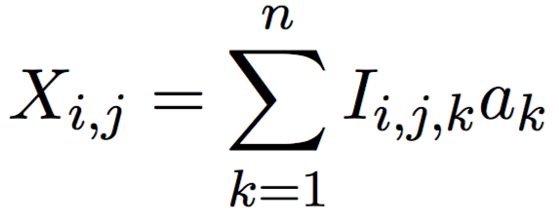
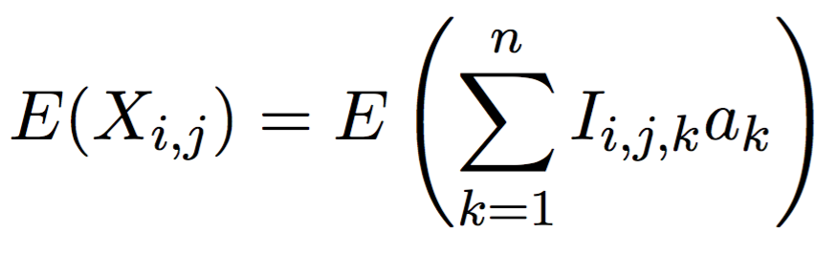
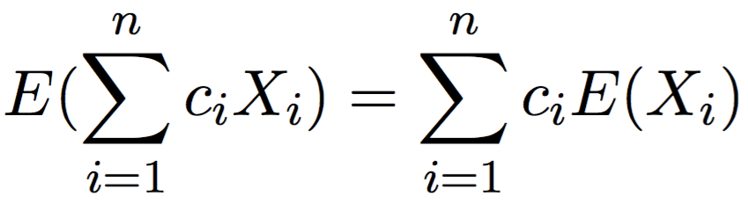
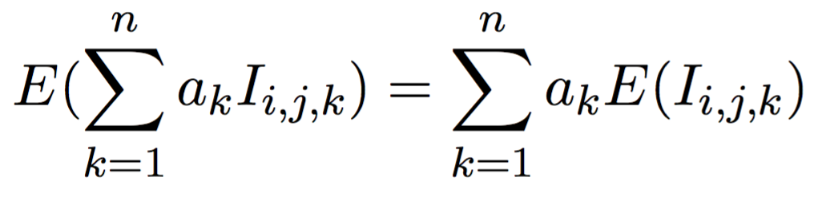
Point Queries Error Bounds

Slide 13
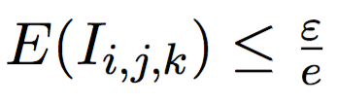
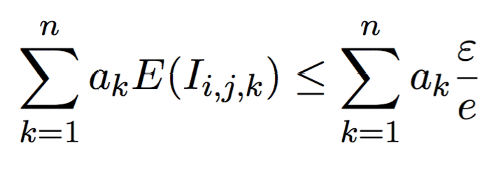

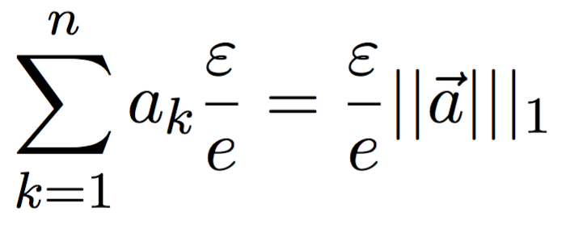
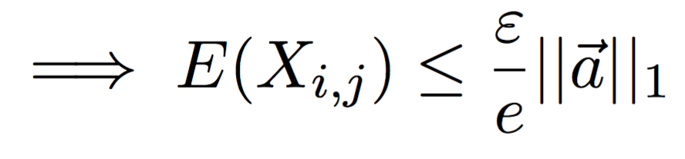
Point Queries Error Bounds

Slide 14
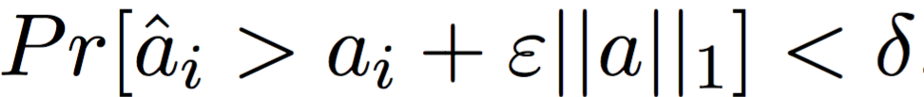
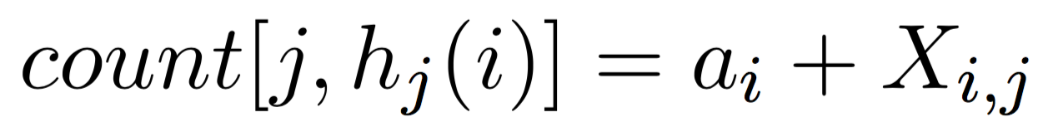
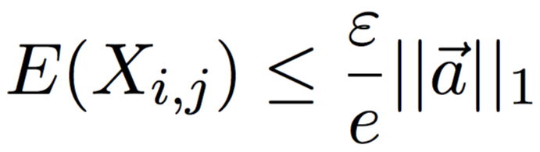
Point Queries Error Bounds
Want to show:

Slide 15
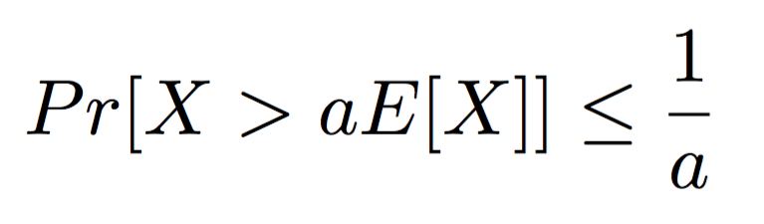
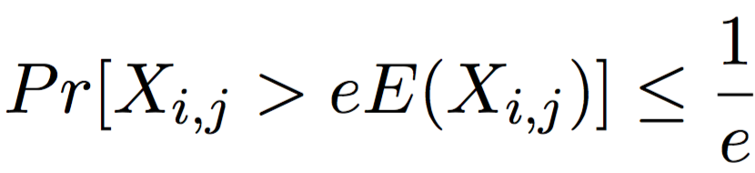
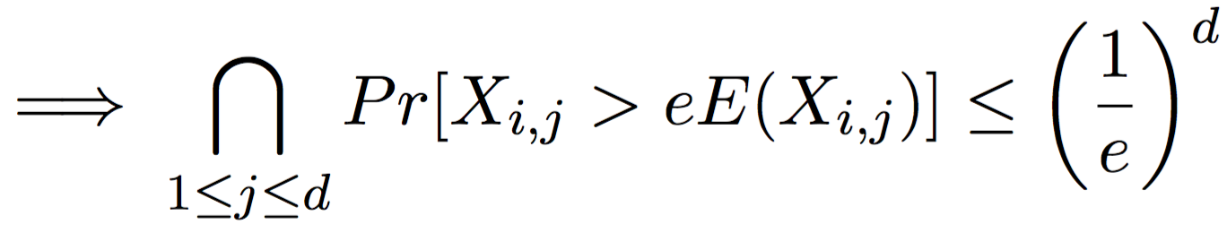
Point Queries Error Bounds

Slide 16
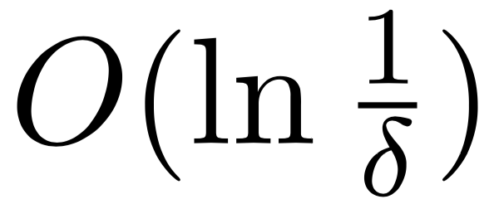
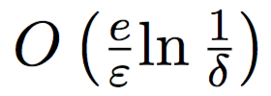
Point Queries Space and Time Complexity
Time complexity for CMS updates:
Time complexity for point queries:
Space complexity for CMS:
h₁
0 0 0 0 0 0 0 0 0
h₂
0 0 0 0 0 0 0 0 0
h₃
0 0 0 0 0 0 0 0 0
h₄
0 0 0 0 0 0 0 0 0
h₅
0 0 0 0 0 0 0 0 0

