Slide 1
Flavour Datasets: Yeast Making Bread
Edward Wallace
2023-01-19

Slide 2
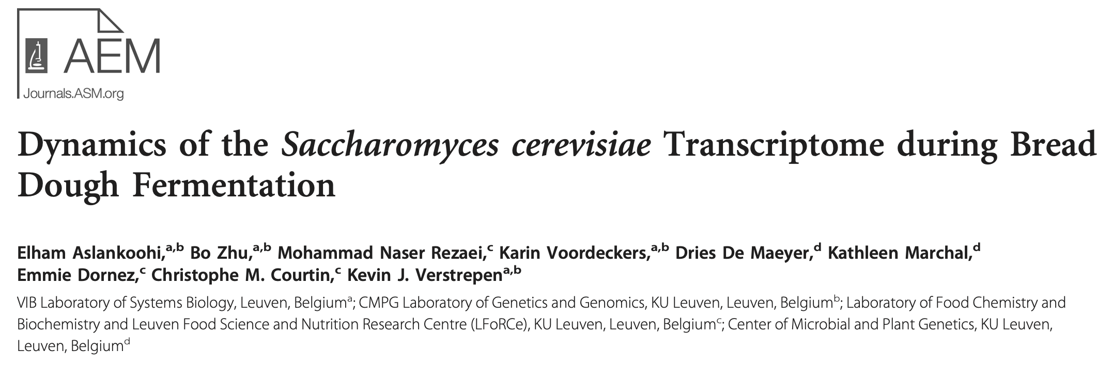
The paper: RNA-seq of yeast making bread
2013. http://dx.doi.org/10.1128/AEM.02649-13

Slide 3
How do yeast respond to fermenting bread dough?
3 yeast strains: bread, wine, bioethanol
4 timepoints: non-fermenting (0 min), 30, 60, 180 min
2 biological replicates
6000 genes
Data available at PRJNA212389 https://www.ncbi.nlm.nih.gov/bioproject/212389
To do: Need to re-align and quantify (normalised) counts per gene

Slide 4
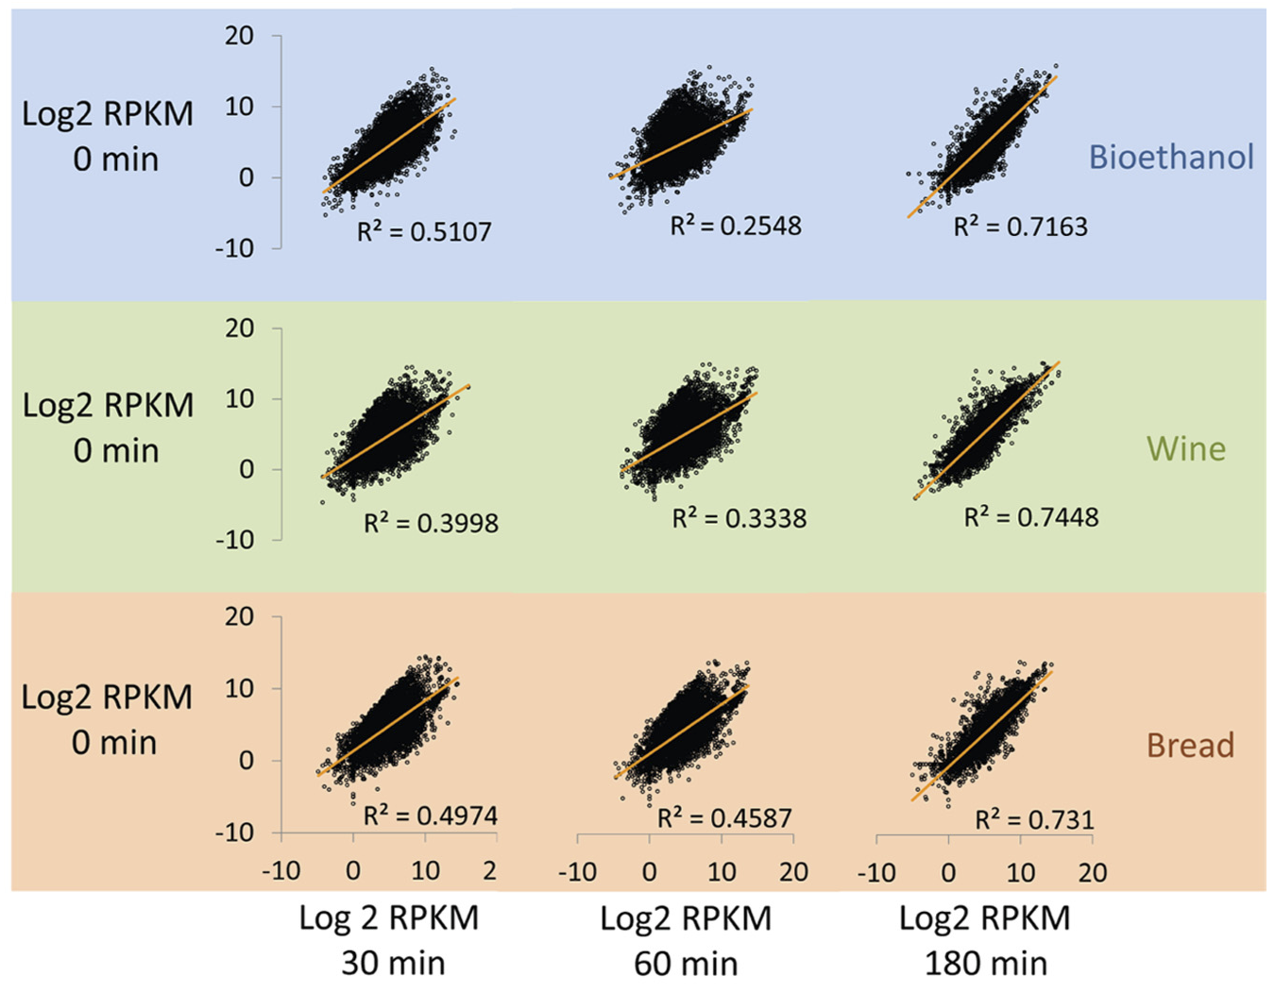
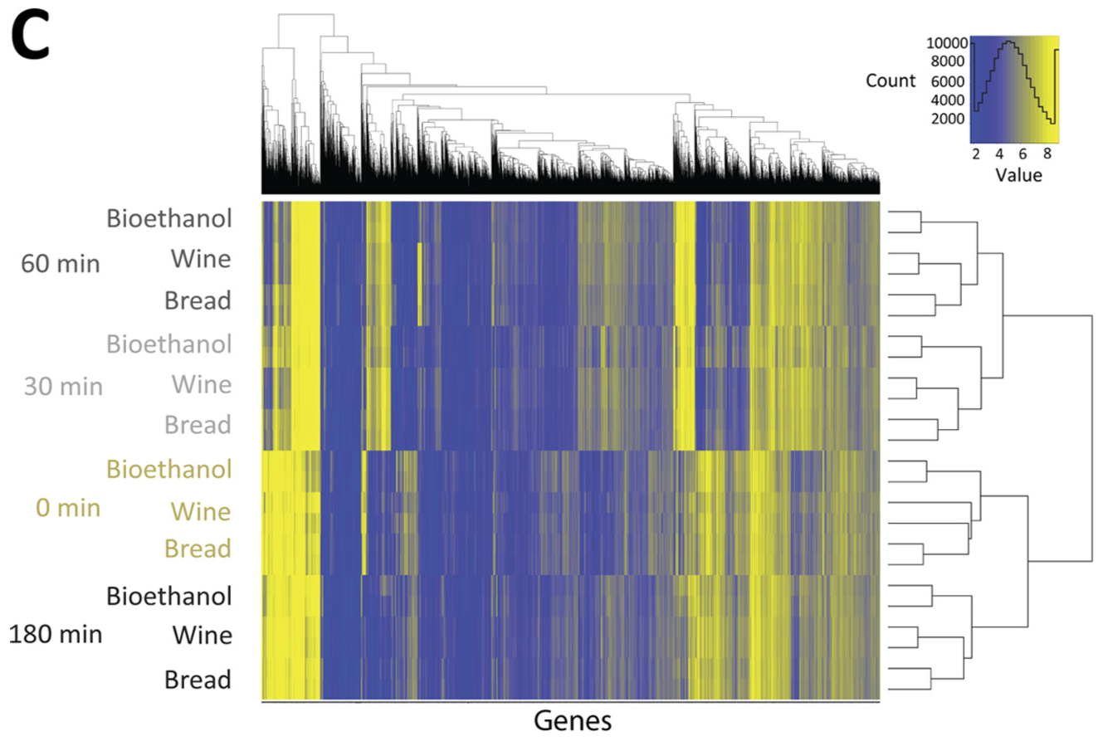
Opportunities for exploratory analysis

Slide 5
Opportunities to test individual pathways
“Genes involved in glycerol homeostasis, such as GPD1, GPP1, and STL1, are among the most upregulated genes in the beginning of fermentation in all 3 strains.”
Students can generate hypotheses e.g. other metabolic stress responses and pathways, plot individual gene trajectories
What else?
Could do statistical testing & multiple hypothesis testing with DESeq2 or similar???

