Slide 1

Poster presentation

Slide 2

Tell the truth
Tailor presentation to the audience
Choose the right graph
Emphasise important points
Form follows function

Slide 3
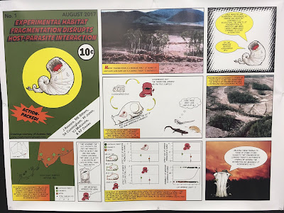

Poster presentation
What is your Story?
Nobody cares about your work.
Can you make them care?
Notes:
http://betterposters.blogspot.com/2017/08/

Slide 4
Level 1: At a Glance
Informative title
(maybe all that is read)
Readable at 1m
Engaging figures/pictures

Slide 5
Level 2: More detail on examination
Make the data show the story with minimum reading
Each figure should be self sufficient, labels, keys
Flow – obvious how to read through the poster
(not with numbers!)
Key points at eye level
Titles should be informative! NOT "results of the analysis"

Slide 6
Level 3: Leads to Questions
What questions do you want the reader to be asking as they read your poster?
Set up discussion points
Is all the data you need to discuss visable on the poster?

Slide 7

Hopefully your data will tell the story it self

Slide 8
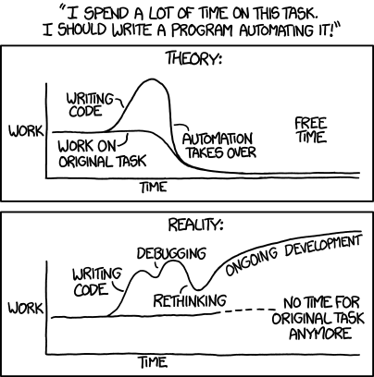
You WILL need to re-draw your figures. Make notebooks!

Slide 9
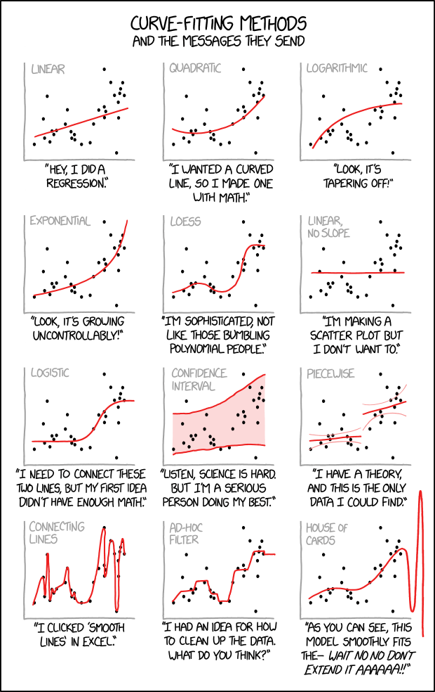
Don’t over interpret
you will have to justify what you’ve done in person!

Slide 10

http://betterposters.blogspot.com/
https://clauswilke.com/dataviz/

