Slide 1

Getting help
Ask the person next to you
Ask a demonstrator
Look online
Ask the CO

Slide 2
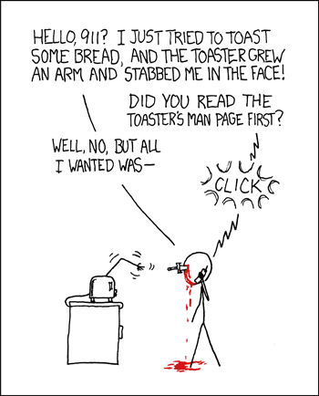
How to search for help 1.
Read the docs
https://pandas.pydata.org/docs/user_guide/10min.html
This is a short introduction to pandas, geared mainly for new users.
https://pandas.pydata.org/docs/user_guide/cookbook.html#cookbook
This is a repository for short and sweet examples and links for useful pandas recipes

Slide 3
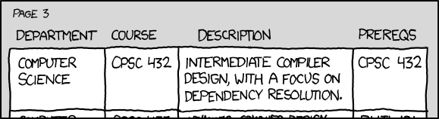
How to search for help 2.
Online courses
https://datacarpentry.org/python-ecology-lesson/
https://swcarpentry.github.io/python-novice-inflammation/

Slide 4
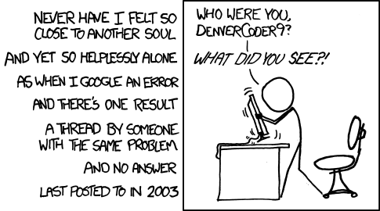

A good search strategy
Google the error message
(often surprisingly unhelpful with pandas)
Use the correct terms (the document pages are helpful here)
“make a change in part of a table depending on the rest”
“pandas new value conditional”
a common hit and can be useful
Can be misleading
Answers can be very old – refering to Python2.6
Can be wrong

Slide 5
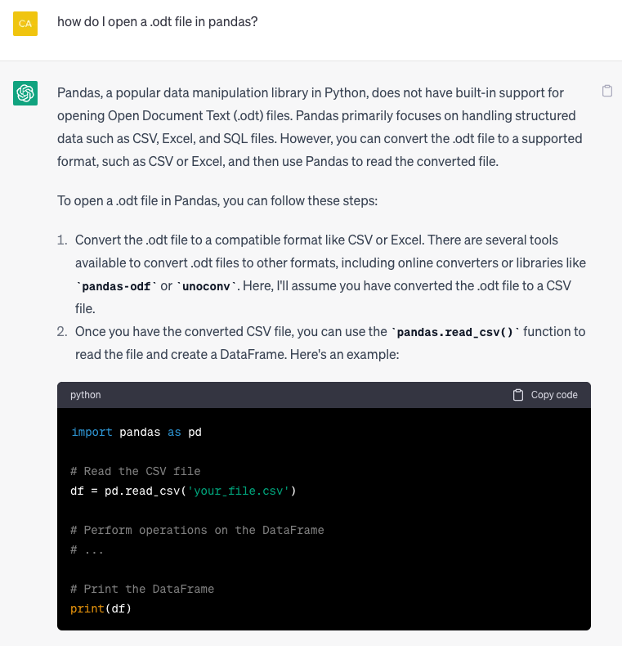
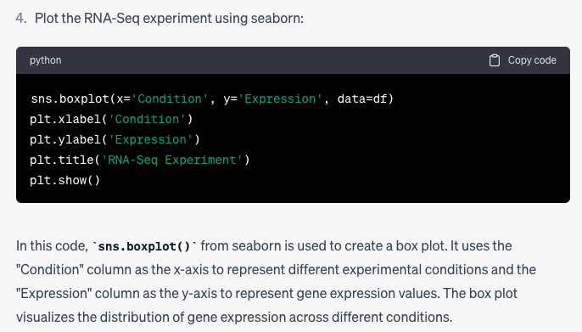
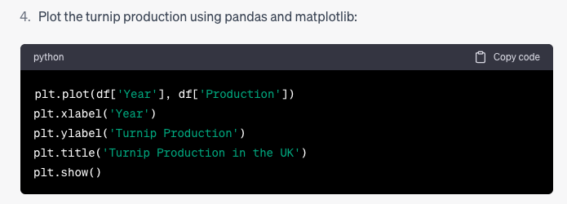
Chat GPT
Can be a good starting point. Be critical!

Slide 6
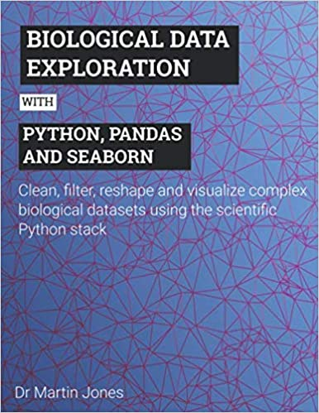
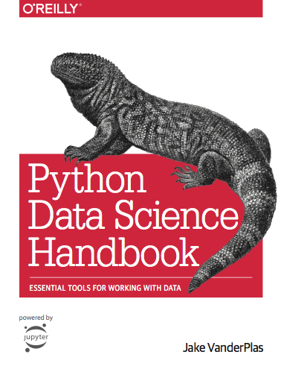
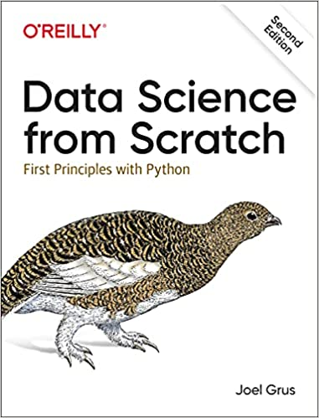
If you like a book to hand…
Assumes no python
(but some maths)
Modeling focus
Not free
For biologists
Assumes basic python
Clear examples
Not free
Programming focussed
https://jakevdp.github.io/PythonDataScienceHandbook/

Slide 7
