Slide 1
Tidy Data
"Tidy data" is a standardised format for dataframes which makes them easy to manage with standard approaches, and reduces the need to wrangle data into a new form for eaach new analysis/graph.
Wickham, Hadley. (August, 2014). “Tidy Data.” Journal of Statistical Software, 10(59). https://vita.had.co.nz/papers/tidy-data.pdf
“Tidy datasets are all alike, but every messy dataset is messy in its own way.” –– Hadley Wickham

Slide 2
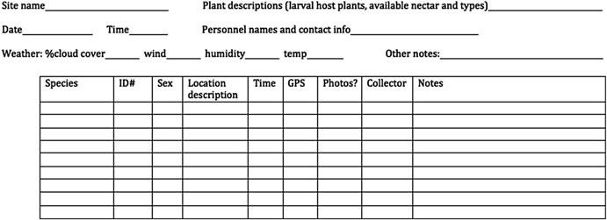
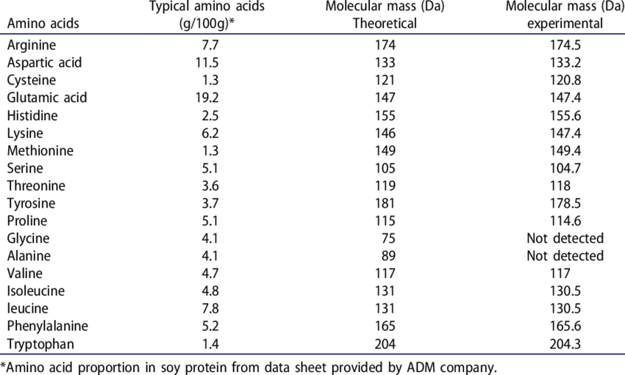
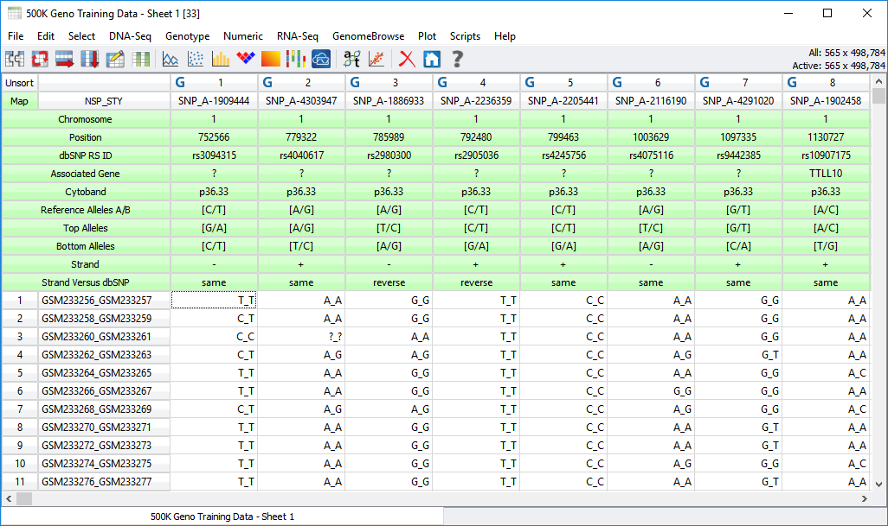
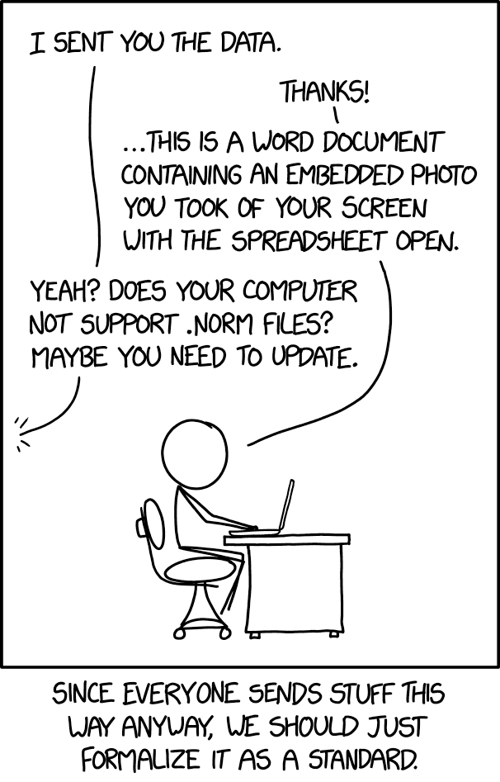

Slide 3
A dataset is a collection of
values, usually either numbers (if quantitative) or strings (if qualitative). Values are organised in two ways.
Every value belongs to a variable and an observation.
A value is a single piece of data (name of a gene, number of introns in a gene, expression level ina. specific experiment).
A variable contains all values that measure the same underlying attribute (like height, temperature, duration) across units.
An observation contains all values measured on the same unit (like a person, or a day, or a city) across attributes.

Slide 4
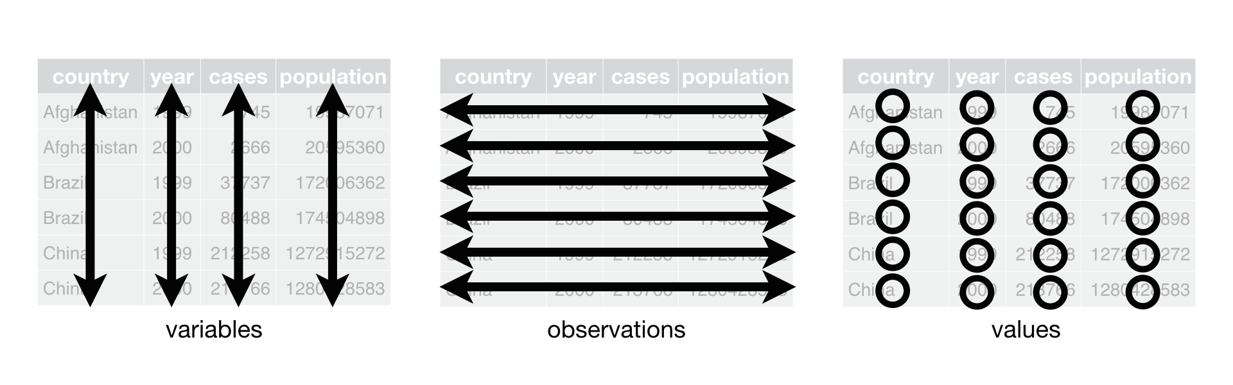
Each variable must have its own column.
Each observation must have its own row.
Each value must have its own cell.

