Slide 1
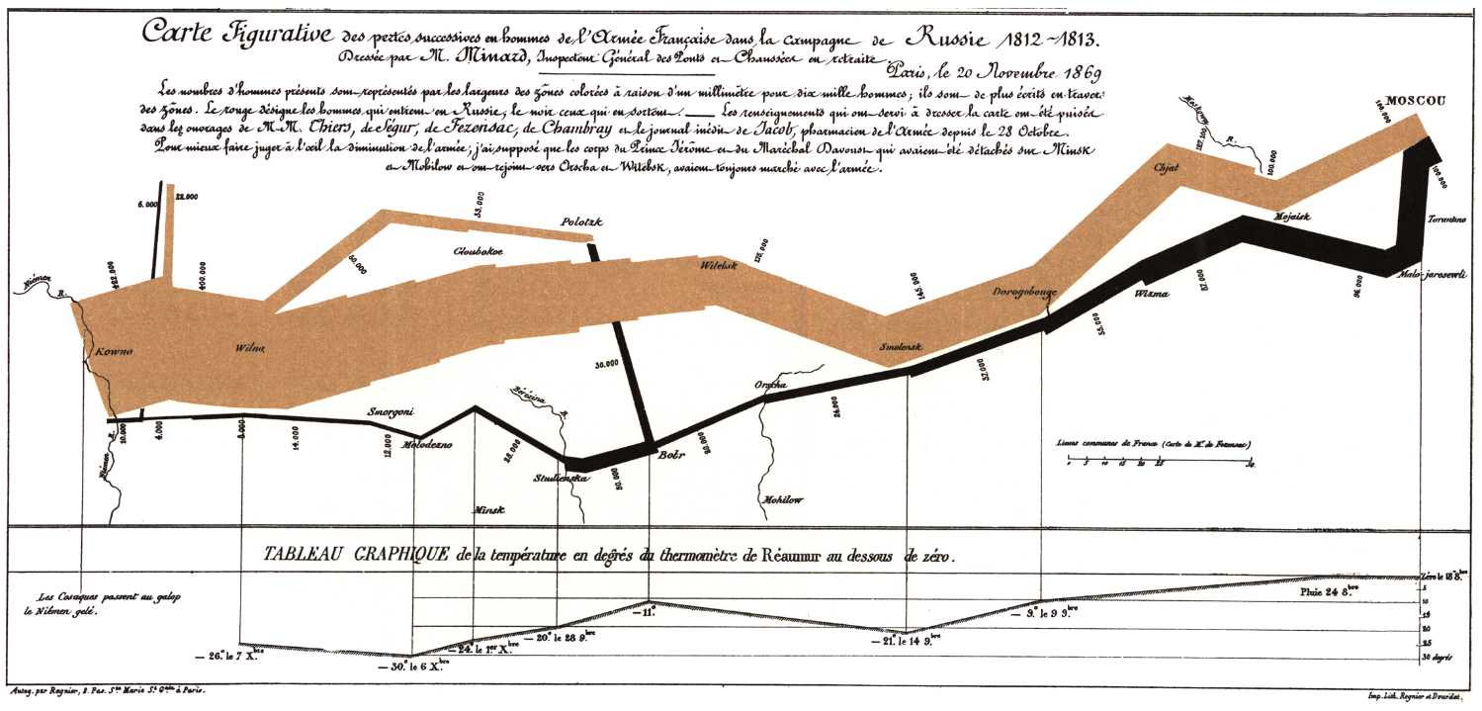
Multi-dimensional data can be graphed effectively (from 1869 – Napoleon’s Russian campaign):
see also Hans Rosling on Youtube
or Gapminder site.

Slide 2
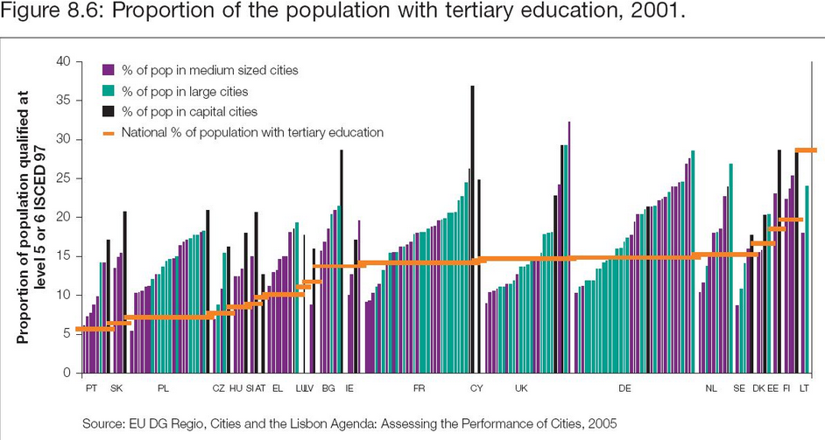
Alternatively it can be a mess – if in doubt, keep it simple
What point is this trying to support?
No data analysis, except mean for each country.

Slide 3
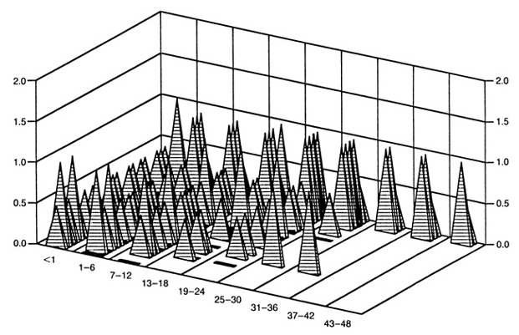
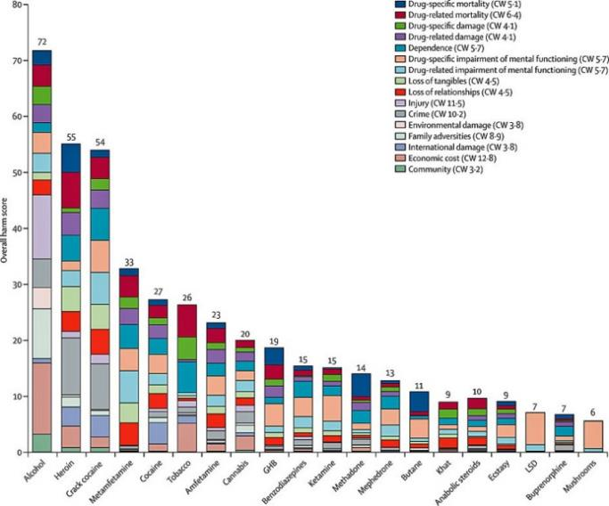
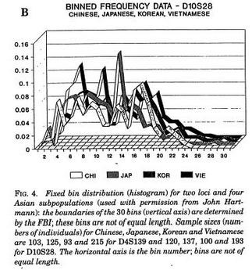
More over-complexity

Slide 4
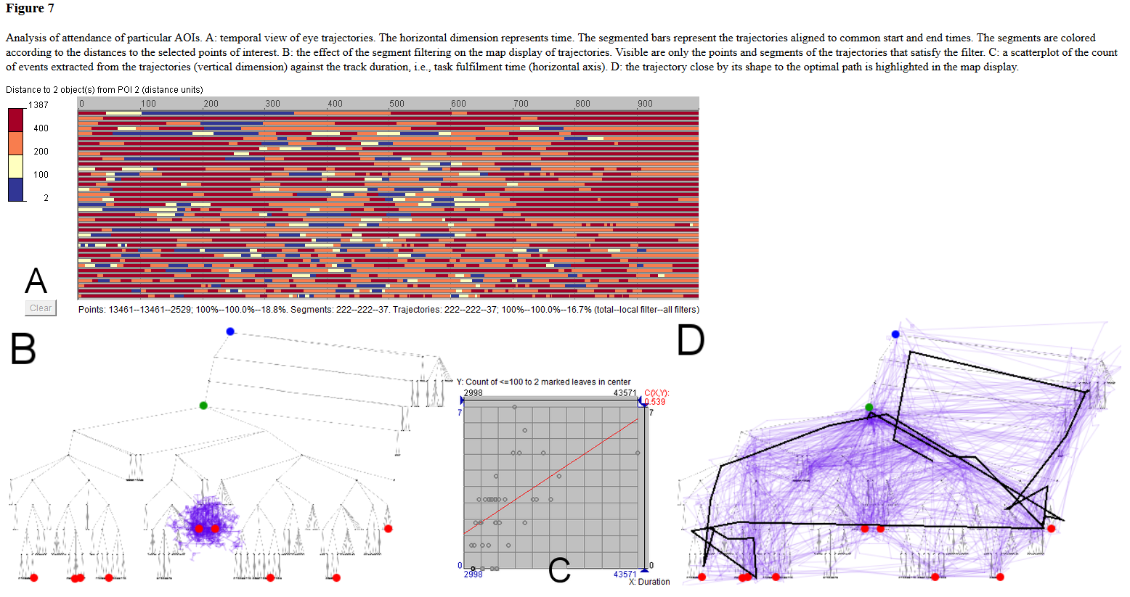
and yet more over-complexity

Slide 5
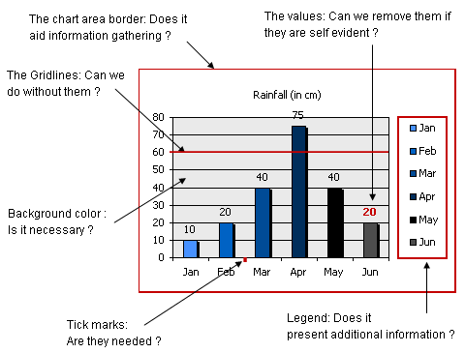
Chart-junk – if it adds nothing, leave it out
Why bars, not a line?
Why different coloured bars?
Why 3D bars?

