Slide 2
Rotor Speed (Ω_{rotor}),
Convection Speed Estimate
Plant Level Controller
De-rate Signal
Notes:
Also look at wake effects

Slide 3
Configuration #1: Turbine in Wake Test Case
Configuration #2: Offset Turbines Test Case
1.5 Rotor Diameters (189 m)
10 Rotor Diameters (1260 m)
Notes:
Also look at wake effects

Slide 4
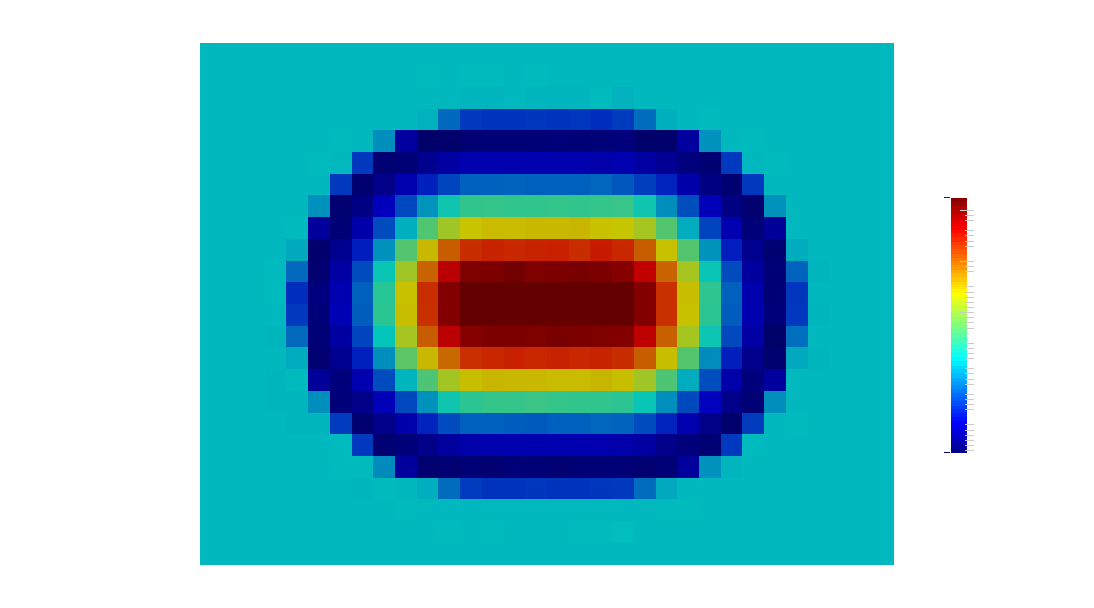

Slide 5
