Slide 1
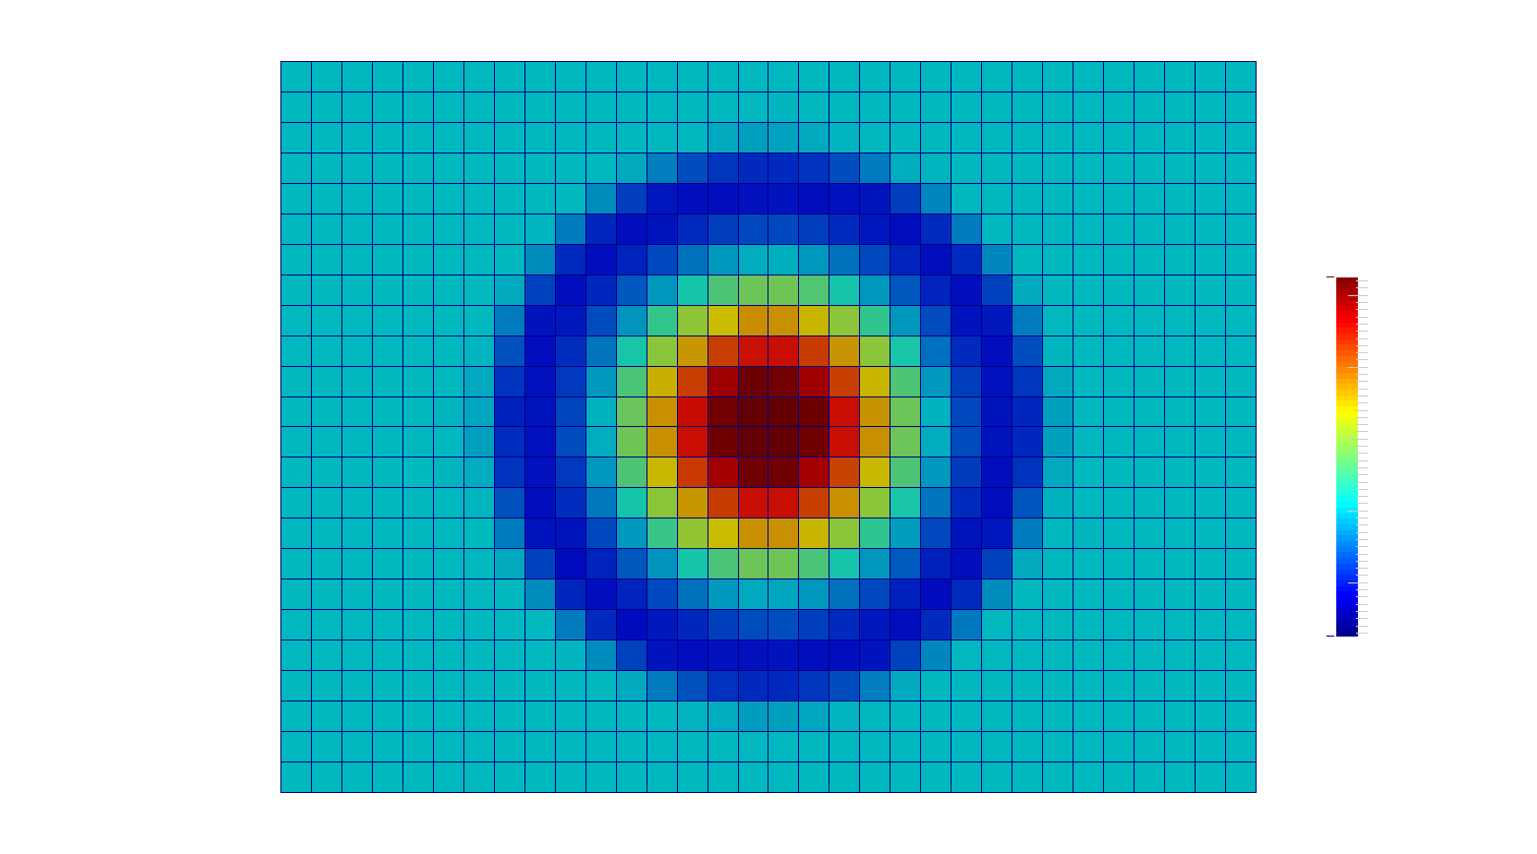
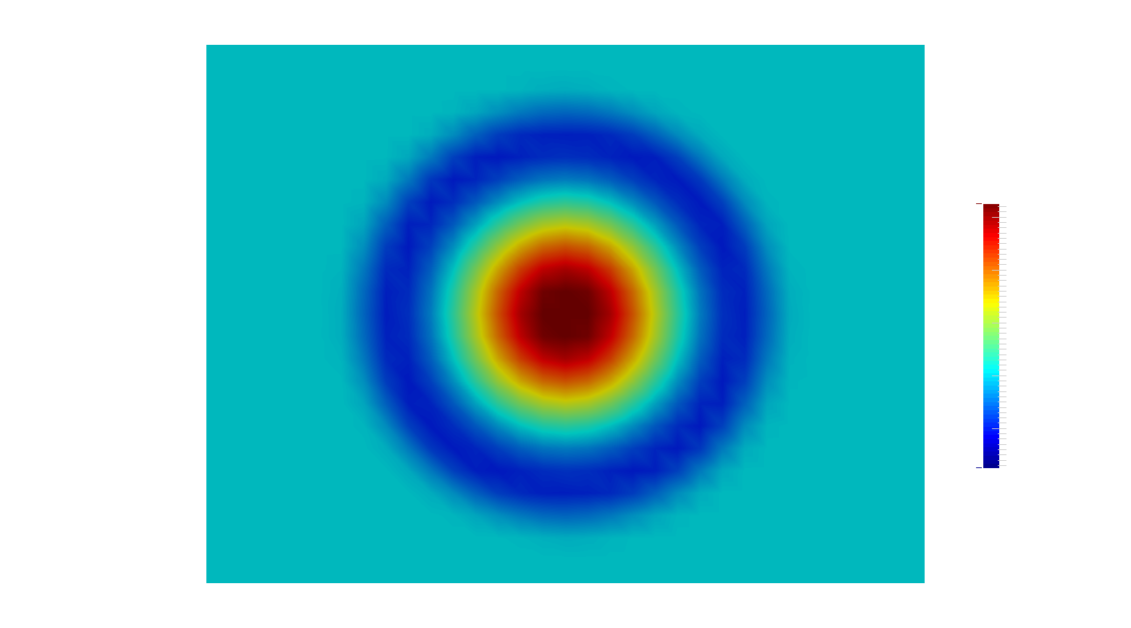
1008 m
Directly upwind of turbine rotors
-25 m/s
756 m
-12 m/s
-5 m/s

Slide 2
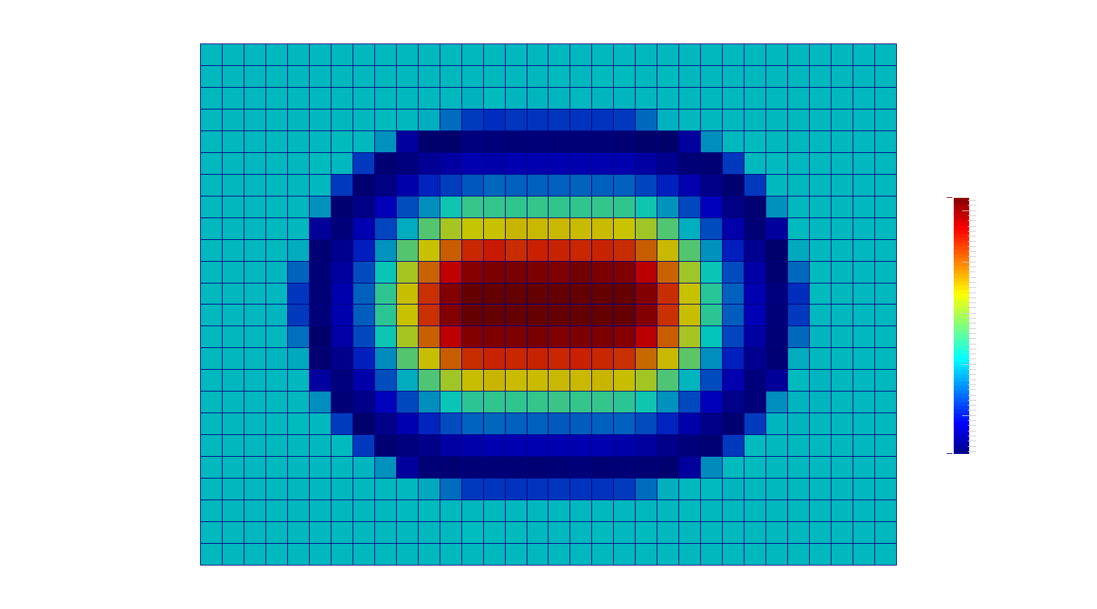
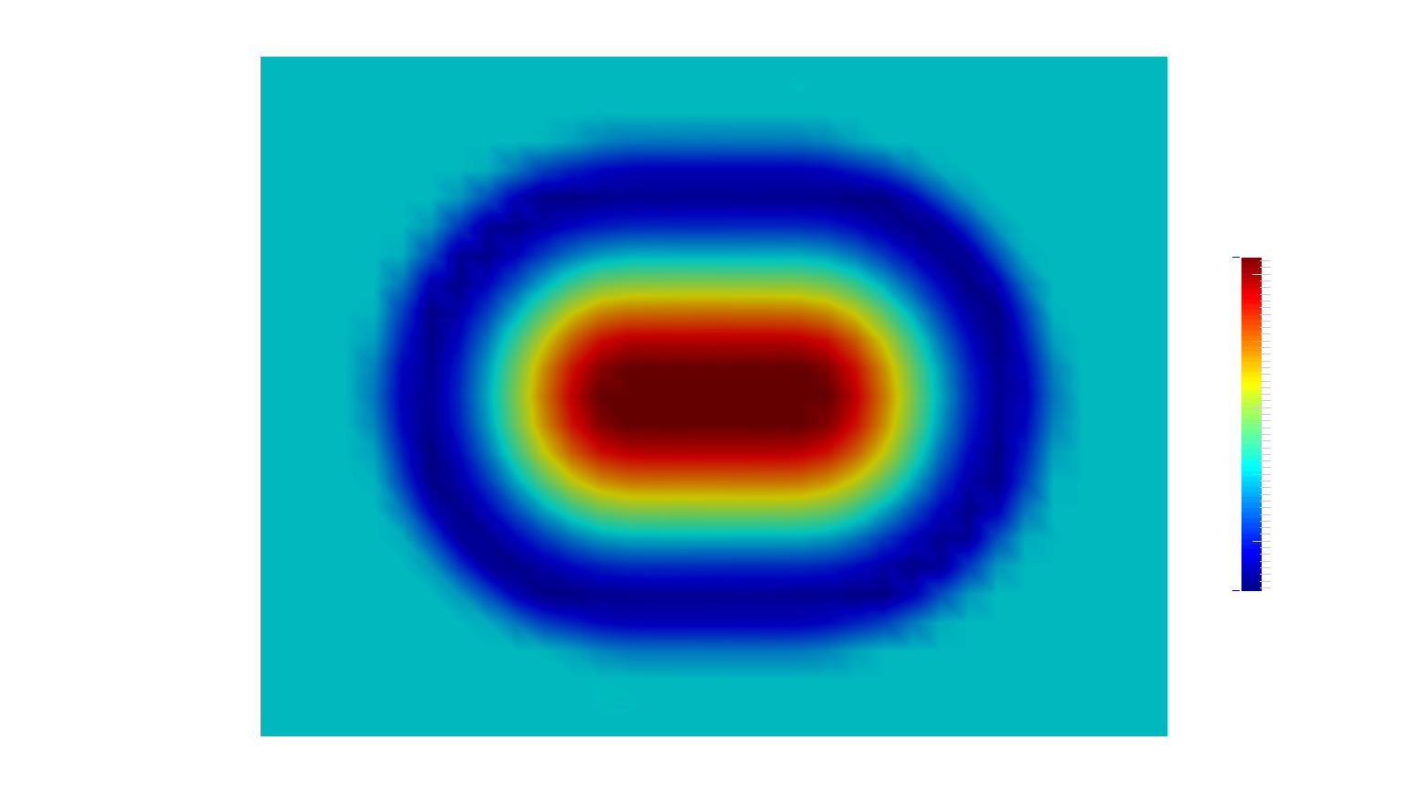
1008 m
Directly upwind of turbine rotors
-25 m/s
-25 m/s
756 m
-12 m/s
-12 m/s
-5 m/s
-5 m/s

