Slide 1
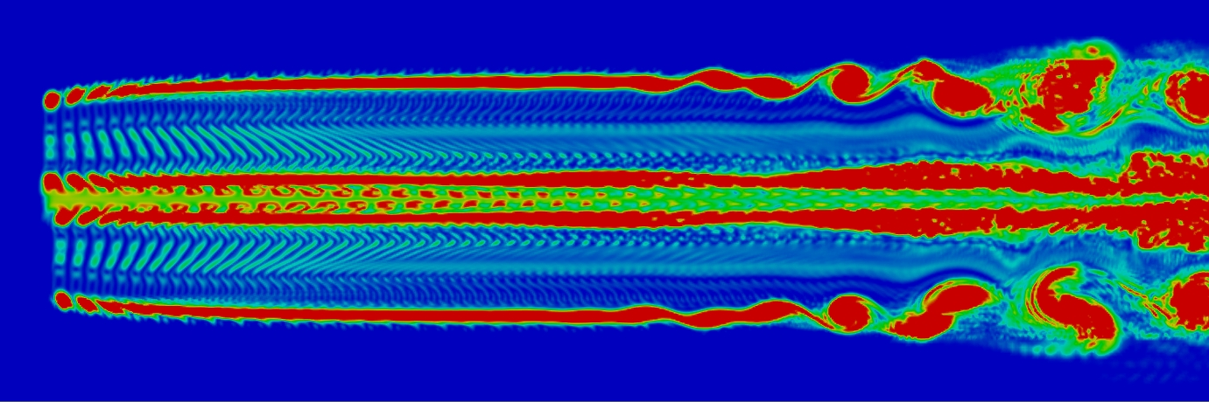
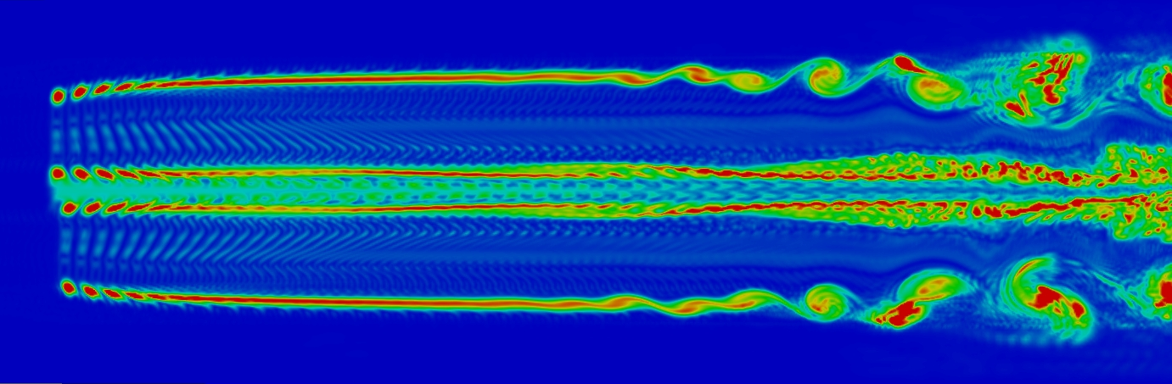
Rotor location
Nacelle location
Wind direction
0R |  | 2R |  | 4R |  | 6R |  | 8R |  | 10R

Slide 2
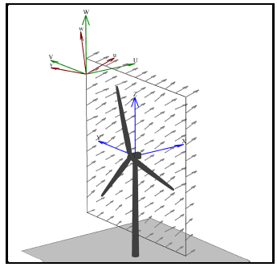
a)
b)

