Slide 1

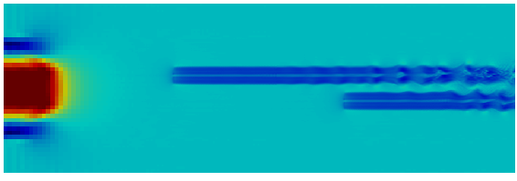

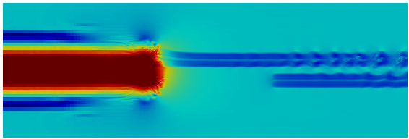
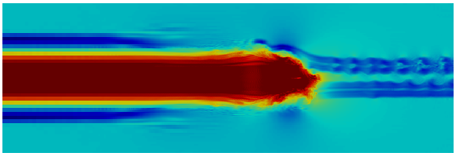
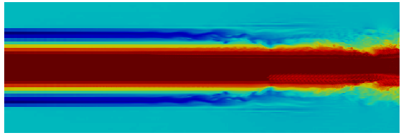
Upwind turbine location
Wind direction
t = 300 s
Downwind turbine location
Wind speed (m/s)
t = 420 s
- 25
- 20
t = 480 s
- 15
- 10
t = 540 s
- 5
t = 660 s

