Slide 1

HPCG Results on Archer2
CIUK Cluster Challenge 2025 – EPCC
Beariables Team

Slide 2
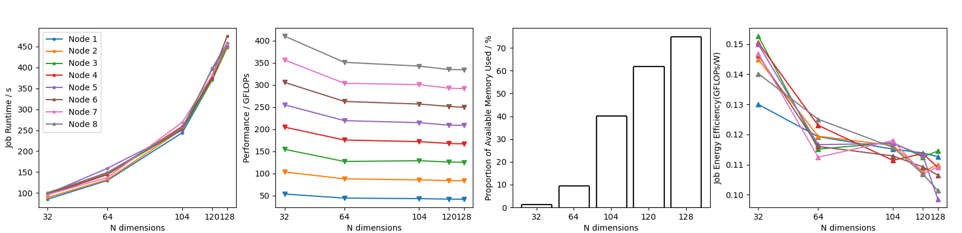
We found that as the problem size increased, runtime and memory usage increased, and did not vary depending on the number of nodes (in the case of memory usage, it did not vary at all). Performance, however, decreased and became invariant for greater problem sizes. Energy efficiency steadily decreased with problem size.
Problem Size (N Dimensions) in relation to core usage

Slide 3
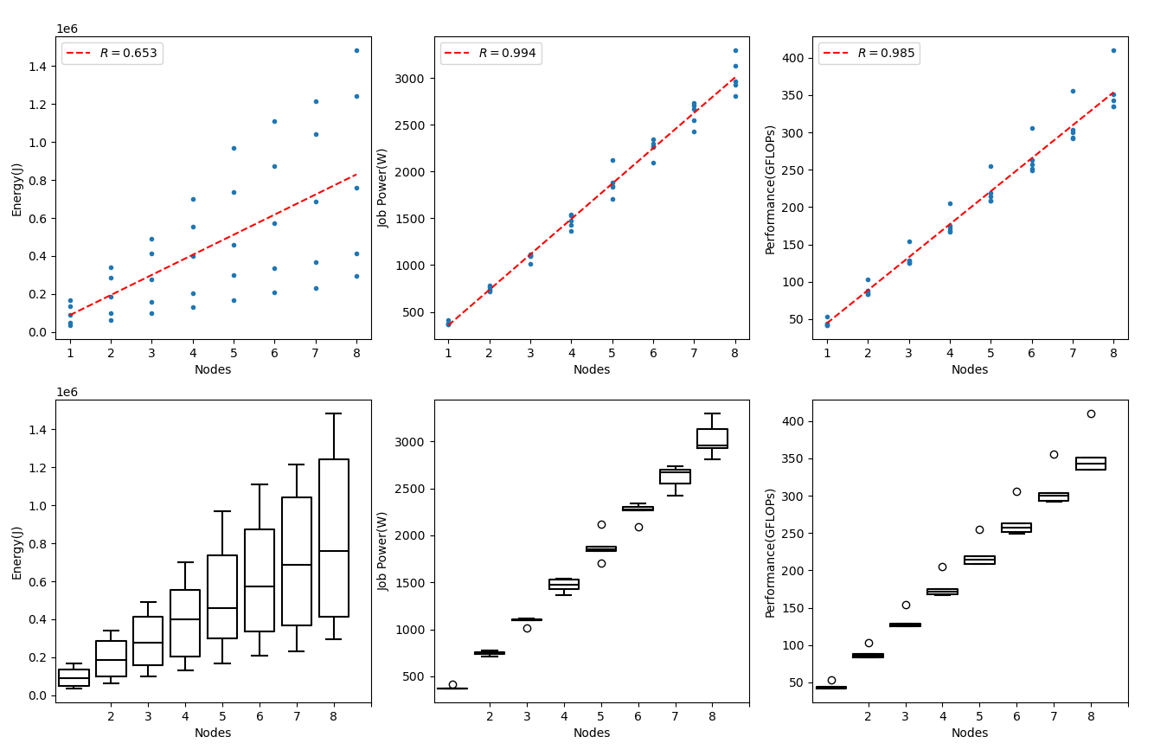
Energy, Power and Performance scaling with Nodes

Slide 4
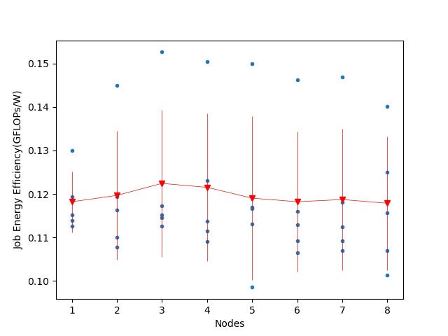
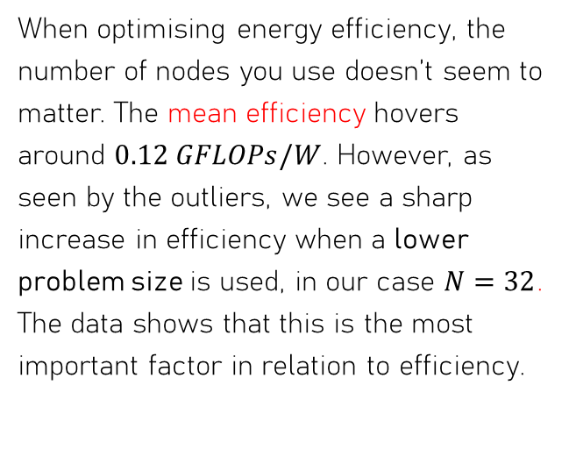
What affects efficiency?
When optimising energy efficiency, the number of nodes you use doesn’t seem to matter. The mean efficiency hovers around $0.12 GFLOPs/W$. However, as seen by the outliers, we see a sharp increase in efficiency when a lower problem size is used, in our case $N=32$. The data shows that this is the most important factor in relation to efficiency.

Slide 5
Best Results
Energy Efficiency: 0.153 GFLOPs/W, @:
3 Nodes
N=32 Problem Size
154.5 GFLOPs Performance
Performance: 410.3 GFLOPs, @:
8 Nodes
N=32 Problem Size
0.140 GFLOPs/W Energy Efficiency
For a good balance of performance and energy efficiency, use high nodes with low problem size.

Slide 6
Differences between compute-bound (HPL) and memory-bound (HPCG)
With HPCG, you can set the duration of the timed portion of the run, unlike HPL.
HPCG uses the exact same proportion of memory every time, dependent only on problem size. HPL memory usage is not set.
The definition of “problem size” is different for HPL and HPCG.

