Slide 1



ASCOT5 SPARC Simulation Results
Ewan Hallatt (CIUK/University of Birmingham Beariables) – ISC26 Virtual Challenge

Slide 2
Difficulties and Solutions
Running with MPI/OpenMP Initially.
  Running the executable without job parallelisation caused it to exceed the IRIS time limit of 4 hours. After trying multiple parallelisation commands I found only mpirun worked, as opposed to srun for example.
Not specifying GPUs per task causing failure on ROMEO.
  Running the executable without specifying the SLURM gpus-per-task parameter caused instant failure.
4-node runs on IRIS not allowing specification of both tasks per node and CPUs per task (i.e. OMP Threads per task).
  IRIS did not allow a SLURM configuration which specified 4 nodes and both ntasks-per-node and cpus-per-task.
Running out of disk space on IRIS towards the end of the challenge.
  I could not get simulations running with use of the scratch folder. Luckily, I had enough data to draw conclusions at that point.
Inability to plot wall loads due to H5 file errors.
  Initially created new output H5 files for each simulation, but I believe these omitted input data needed for plotting.

Slide 3
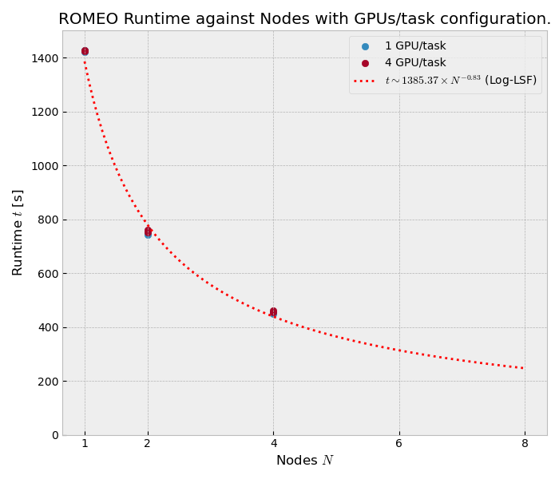
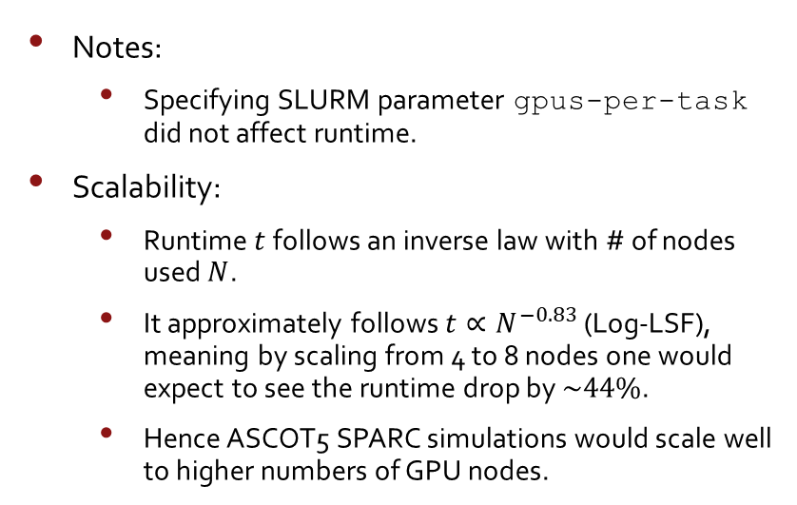
ROMEO Results
Notes:
  Specifying SLURM parameter gpus-per-task did not affect runtime.
Scalability:
  Runtime $t$ follows an inverse law with # of nodes used $N$.
  It approximately follows $t∝N^{−0.83}$ (Log-LSF), meaning by scaling from 4 to 8 nodes one would expect to see the runtime drop by $\sim 44\%$.
  Hence ASCOT5 SPARC simulations would scale well to higher numbers of GPU nodes.

Slide 4
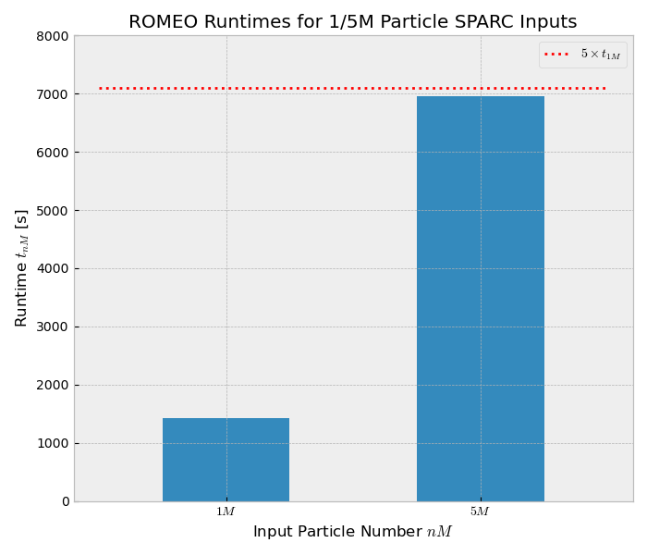
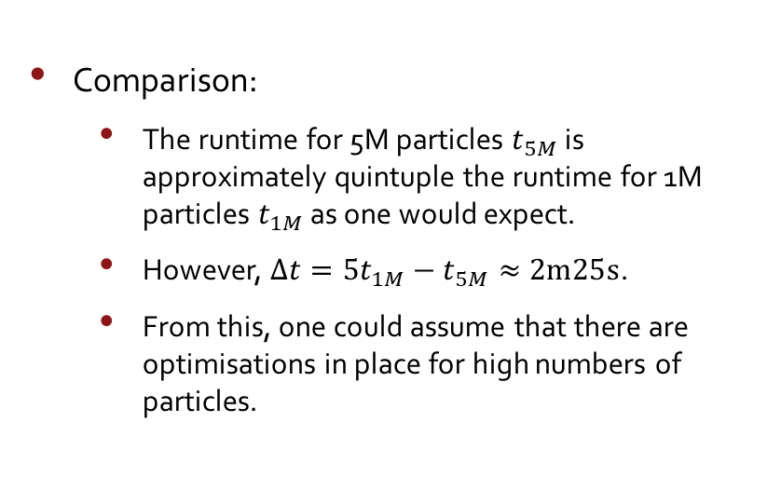
1M vs. 5M Results on 1 ROMEO GPU Node
Comparison:
  The runtime for 5M particles $t_{5M}$ is approximately quintuple the runtime for 1M particles $t_{1M}$ as one would expect.
  However, $Δt=5t_{1M}−t_{5M}≈2m25s$.
  From this, one could assume that there are optimisations in place for high numbers of particles.

Slide 5
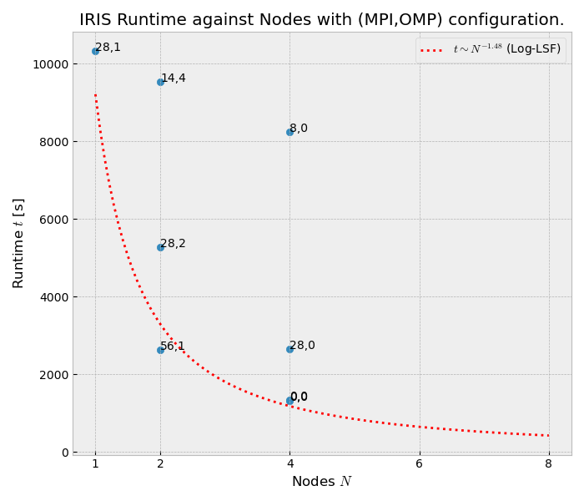
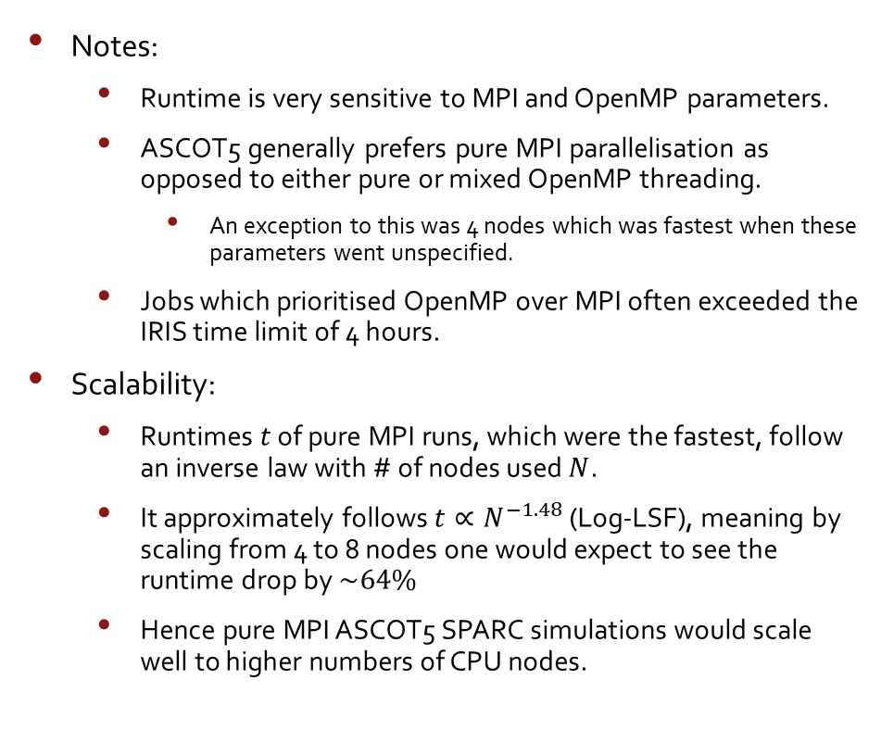
IRIS Results
Notes:
  Runtime is very sensitive to MPI and OpenMP parameters.
  ASCOT5 generally prefers pure MPI parallelisation as opposed to either pure or mixed OpenMP threading.
    An exception to this was 4 nodes which was fastest when these parameters went unspecified.
  Jobs which prioritised OpenMP over MPI often exceeded the IRIS time limit of 4 hours.
Scalability:
  Runtimes $t$ of pure MPI runs, which were the fastest, follow an inverse law with # of nodes used $N$.
  It approximately follows $t∝N^{−1.48}$ (Log-LSF), meaning by scaling from 4 to 8 nodes one would expect to see the runtime drop by $\sim 64\%$
  Hence pure MPI ASCOT5 SPARC simulations would scale well to higher numbers of CPU nodes.

Slide 6
Improvements
Given more time, I would have:
  Figured out installation and execution of an MPI Profiler.
  Tried to fix H5 outputs so wall loads could be plotted.
  Tried different build parameters.

Slide 7
Thank you for your time.
Questions?

