Slide 1
SLquoteCli
Full walk through
https://github.com/ewann/slquotecli
git checkout 4506e5d2ba1a085f6911e3b2f262ca094187cdaf
gets the code that matches these slides

Slide 2
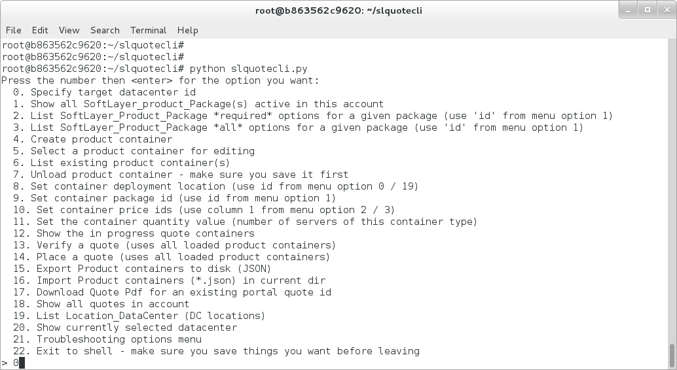
Option 0 - Choose target datacenter

Slide 3
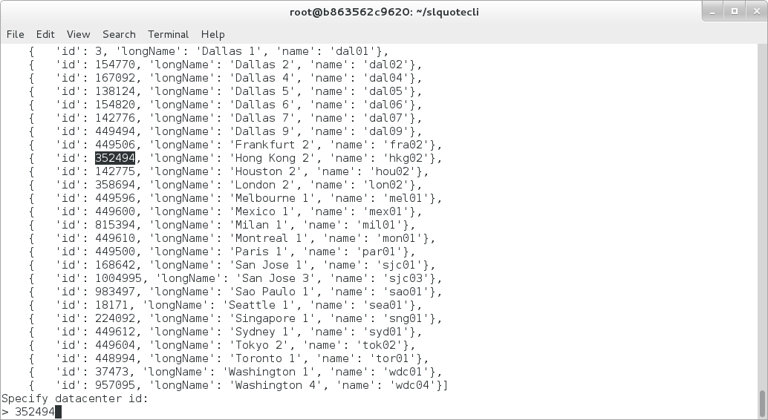
Choose a datacenter from the list

Slide 4
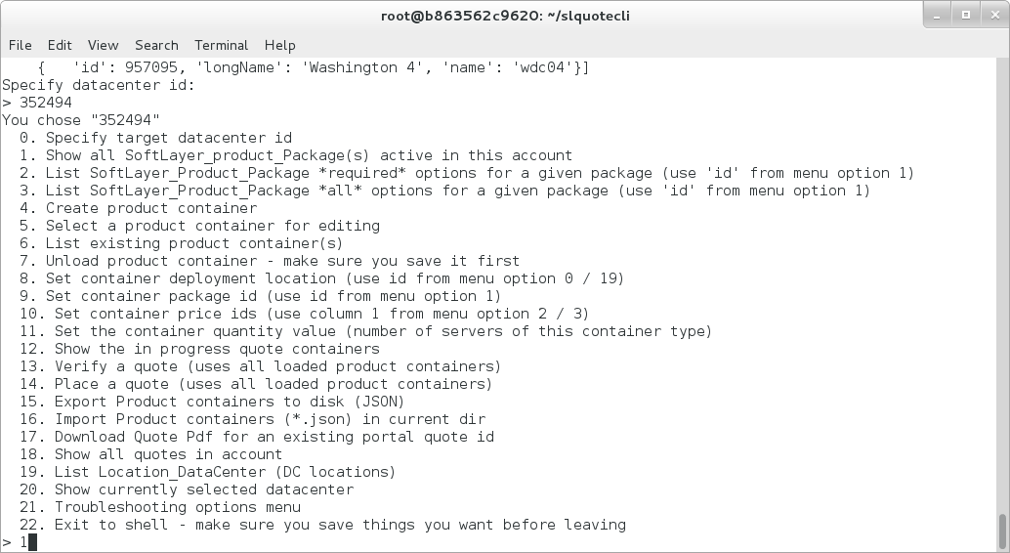
Option 1 - List available server “packages”

Slide 5
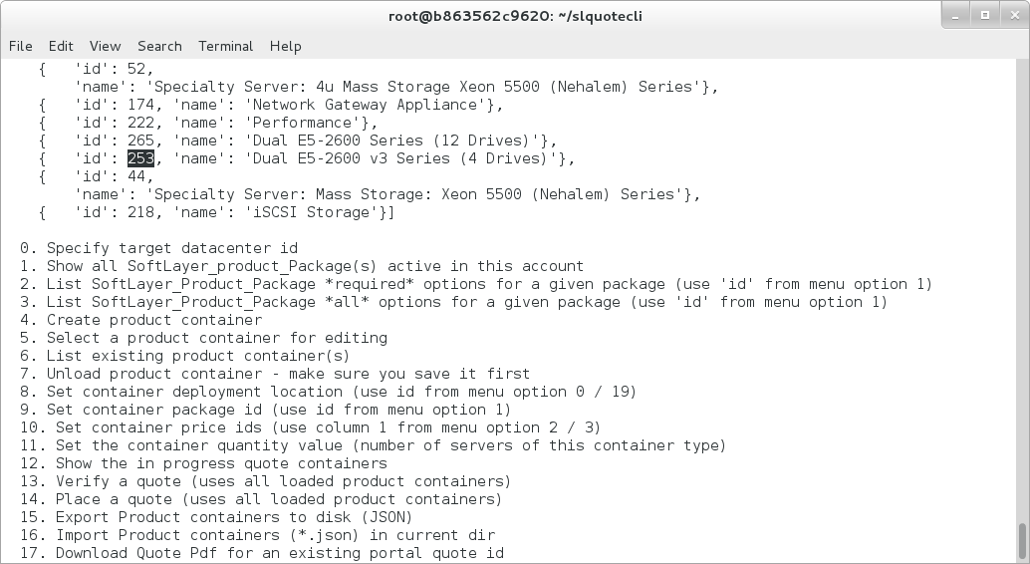
We'll use package 253 in this example

Slide 6
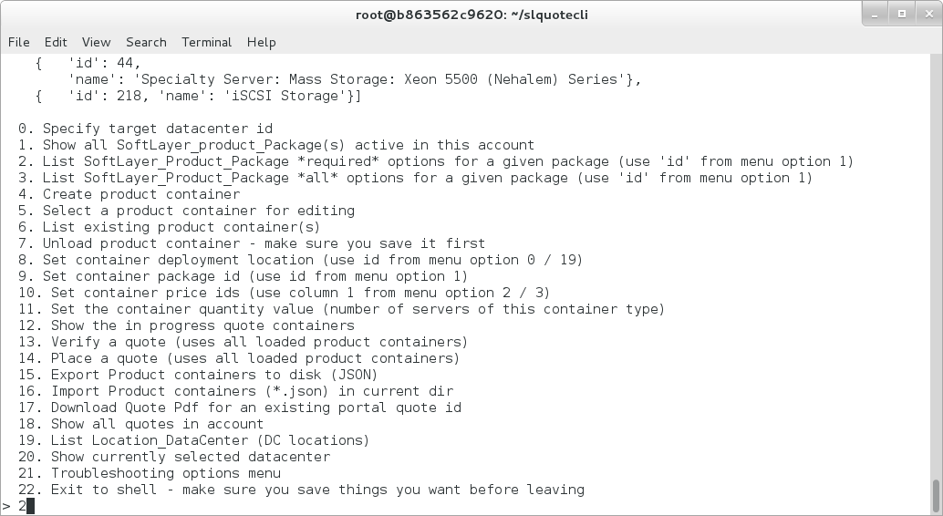
Option 2 - List all the components of a package

Slide 7
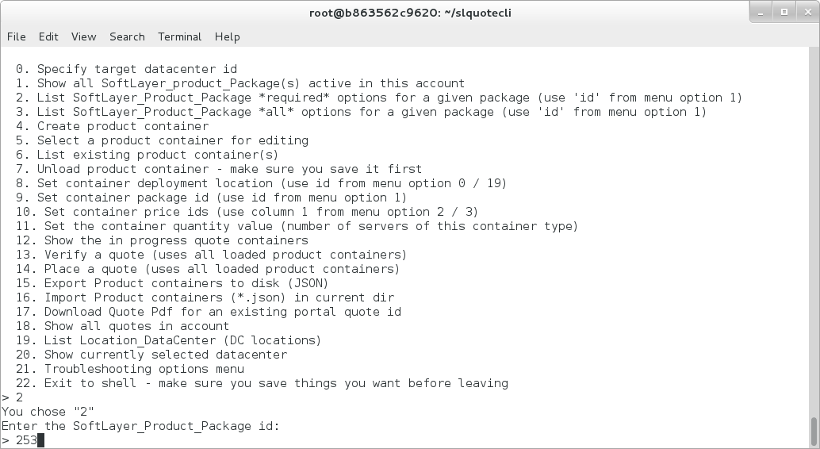
Specify server package 253

Slide 8
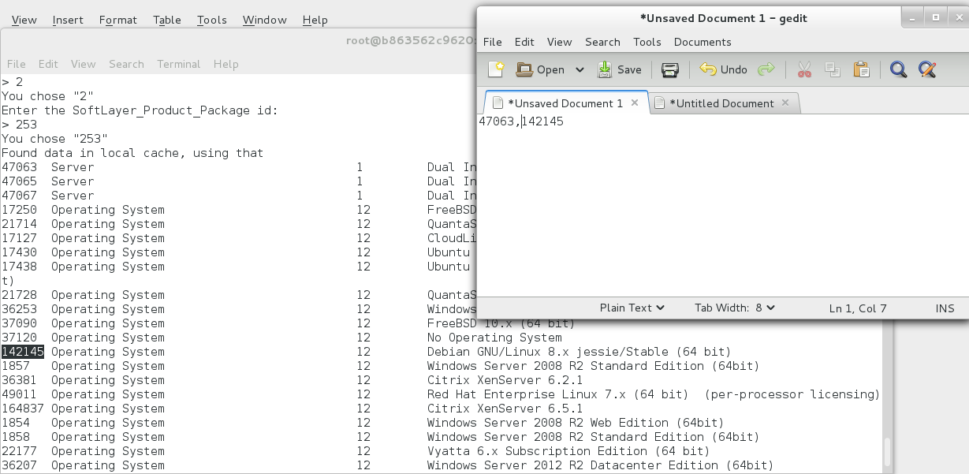
Build a list of mandatory options, one from each category

Slide 9
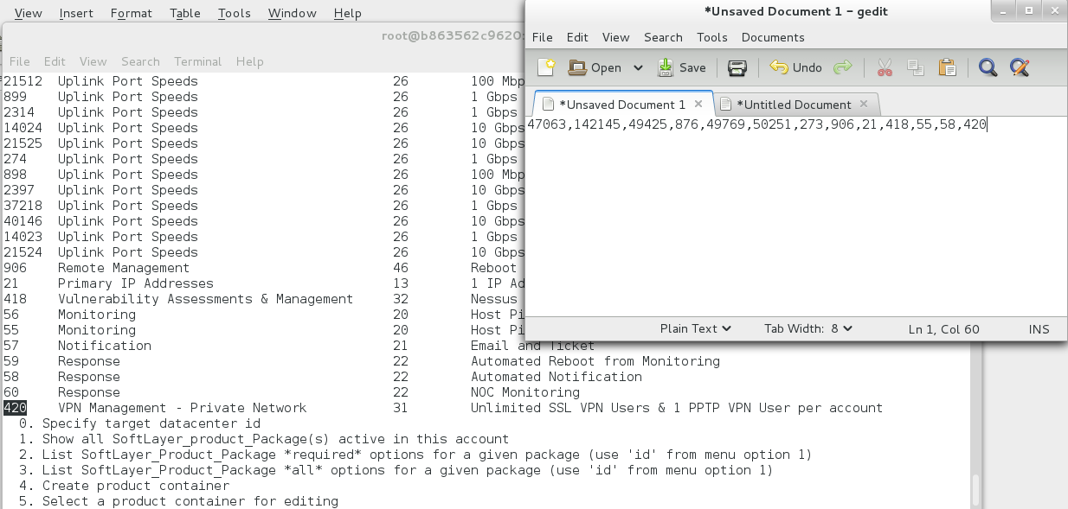
...continue down the list...

Slide 10
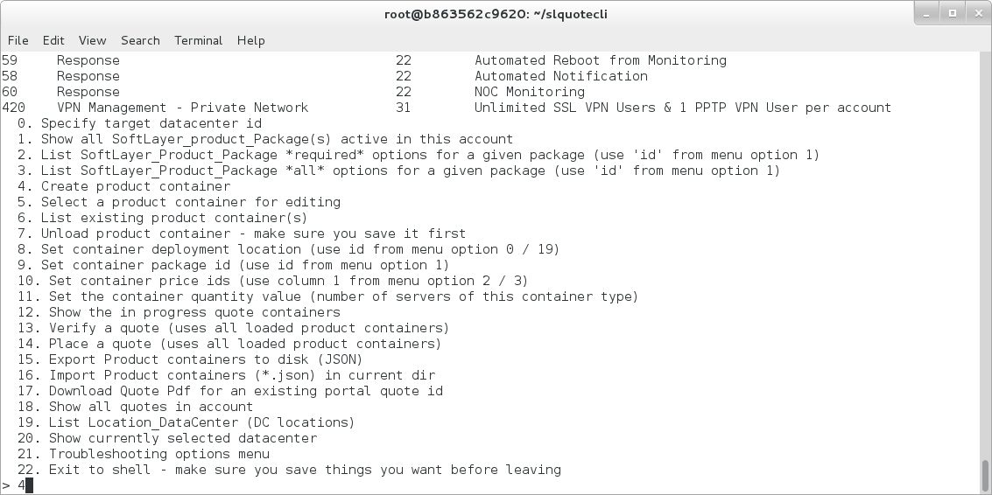
Option 4 - Create a product container

Slide 11
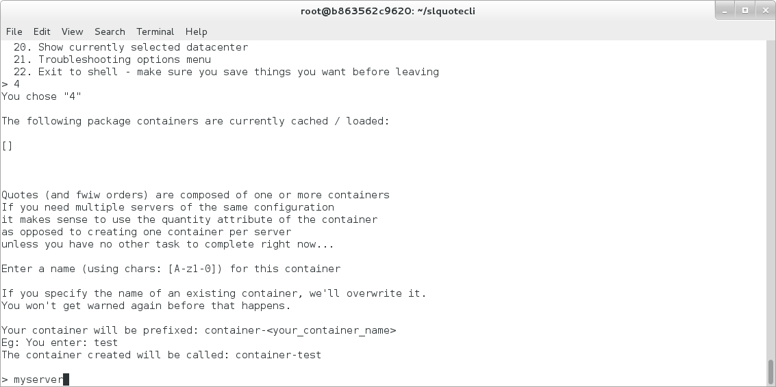
Name the container for later reference

Slide 12
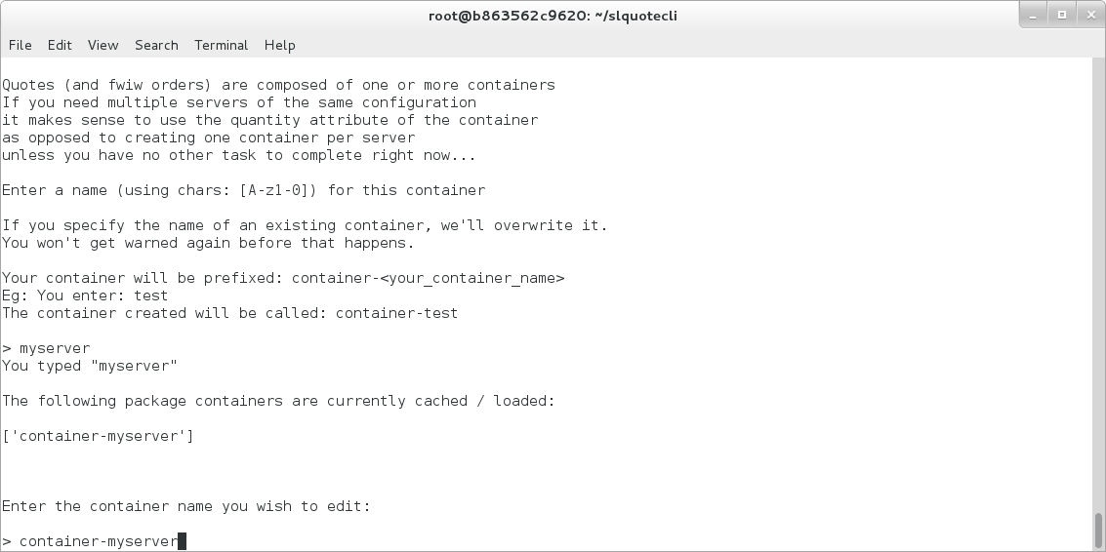
Specify the container for modification, using the full container name

Slide 13
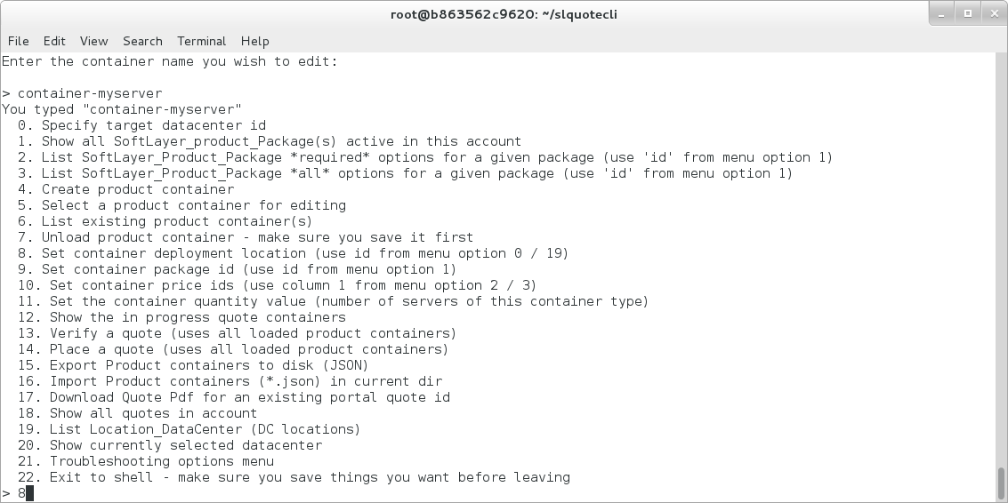
Option 8 – We'll specify the datacenter id where this server container should be deployed...

Slide 14
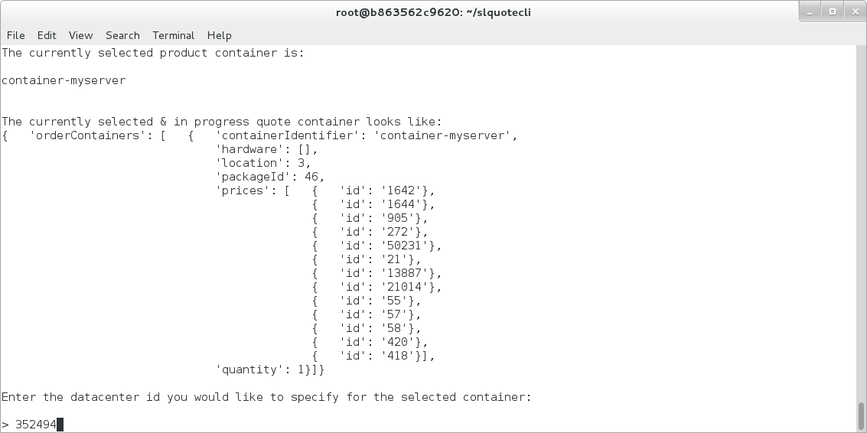
Enter the data center id we identified earlier...

Slide 15
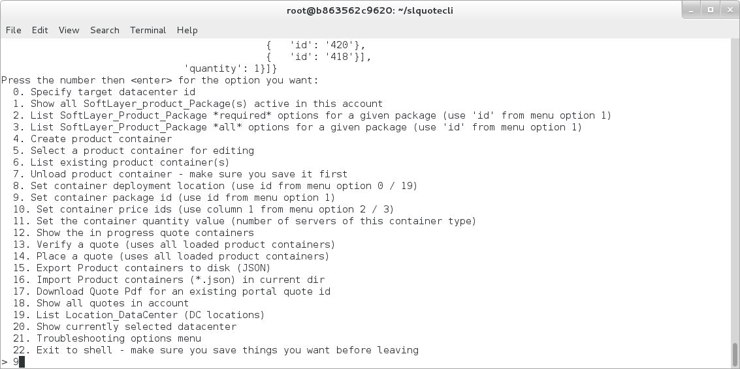
Option 9 - Set the package id for the server container...

Slide 16
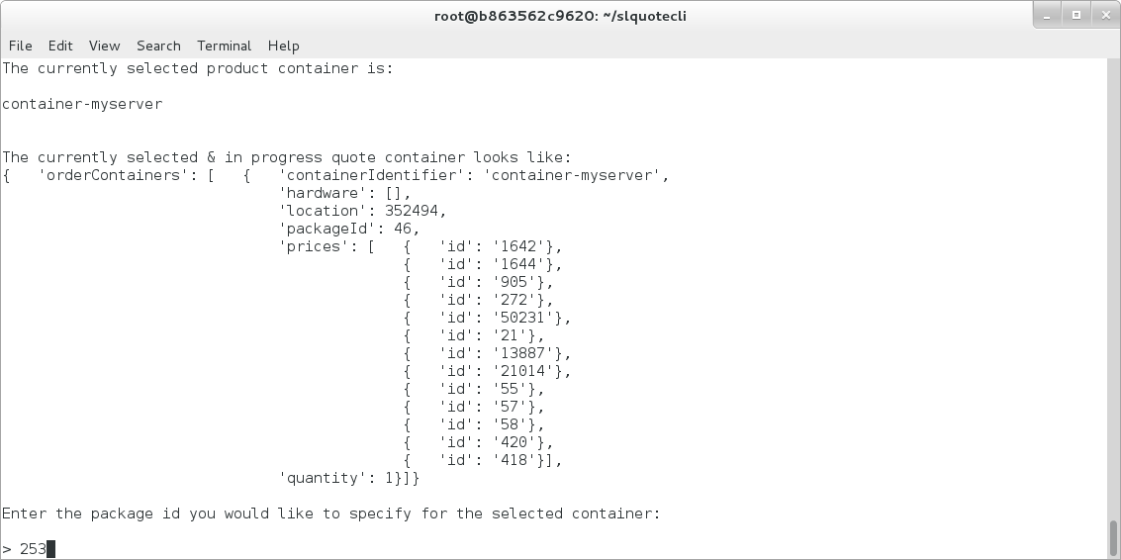
Id 253 – the one we chose earlier

Slide 17

Option 10 – input server components...

Slide 18
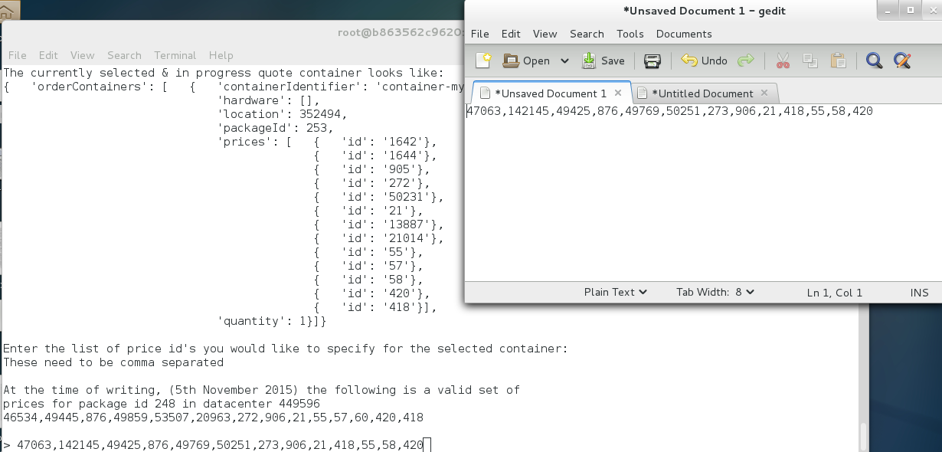
... using the list we built earlier
Hint:
Ctrl-Shft-V is paste in linux terminal

Slide 19

Option 13 – verify the quote...

Slide 20
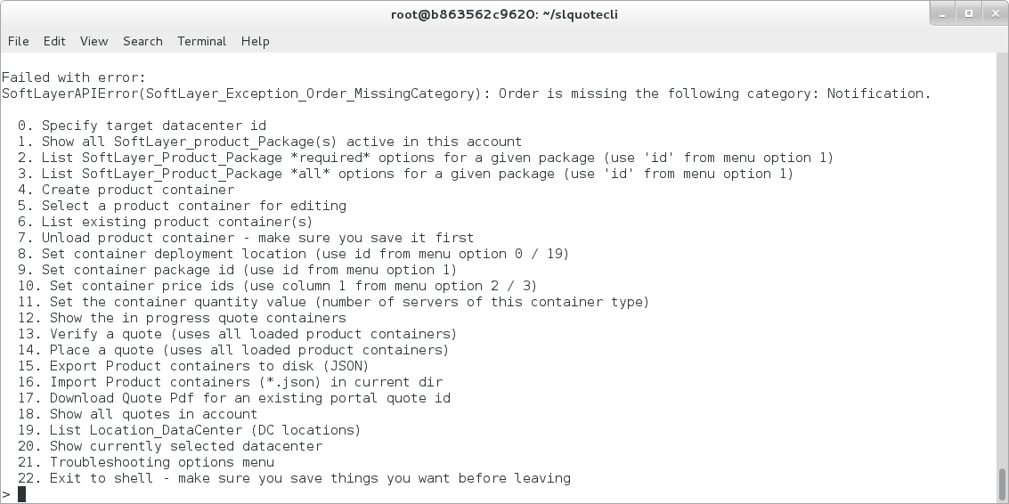
Verification failed! We didn't enter an item for the category “Notification”...

Slide 21
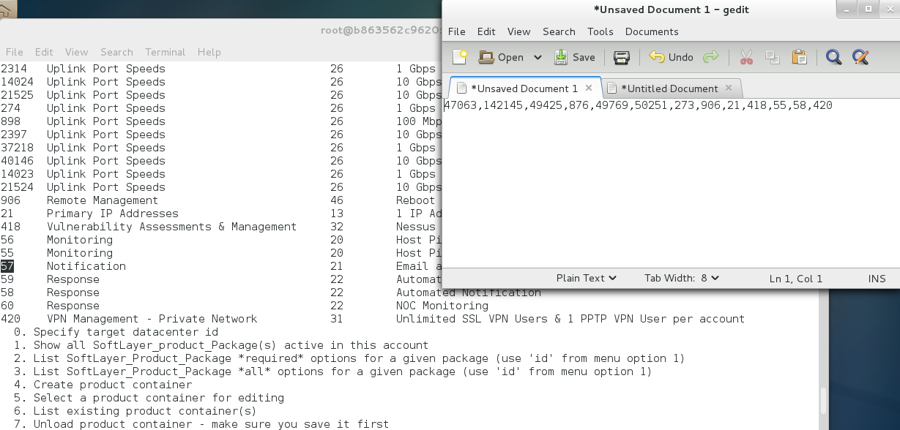
When we scroll back and check, its missing...

Slide 22

...so we add it to our list...

Slide 23
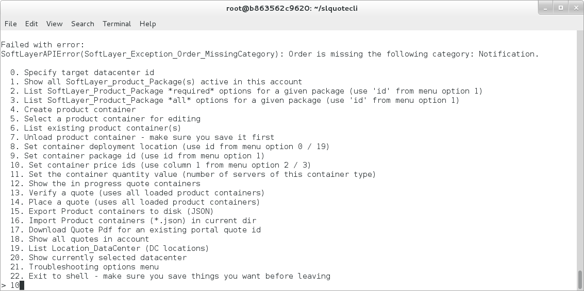
Option 10 – go back to the price / component submission

Slide 24
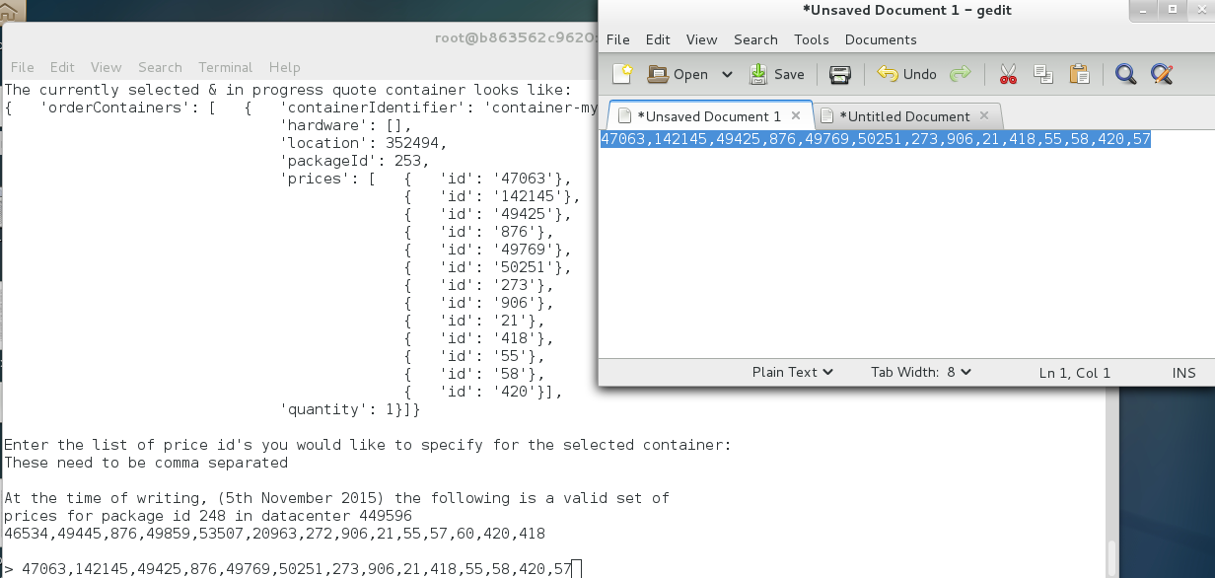
Paste again (Ctrl-Shft-V)

Slide 25

Option 13 – verify again...

Slide 26
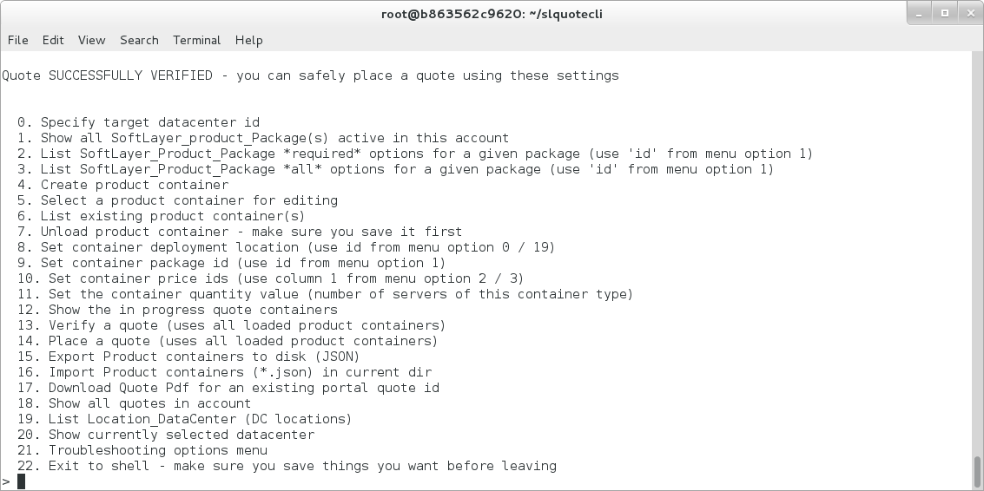
Success! The container is valid...

Slide 27
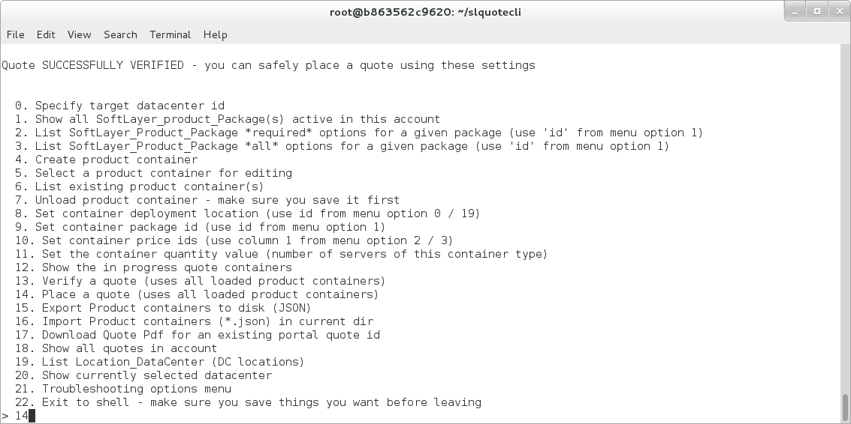
Option 14 – place the quote...

Slide 28
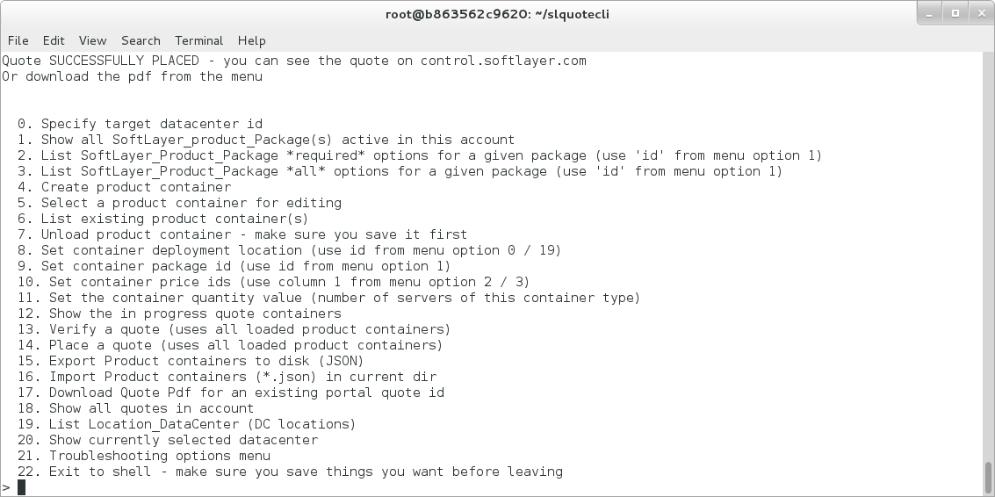
Success! Its still valid

Slide 29
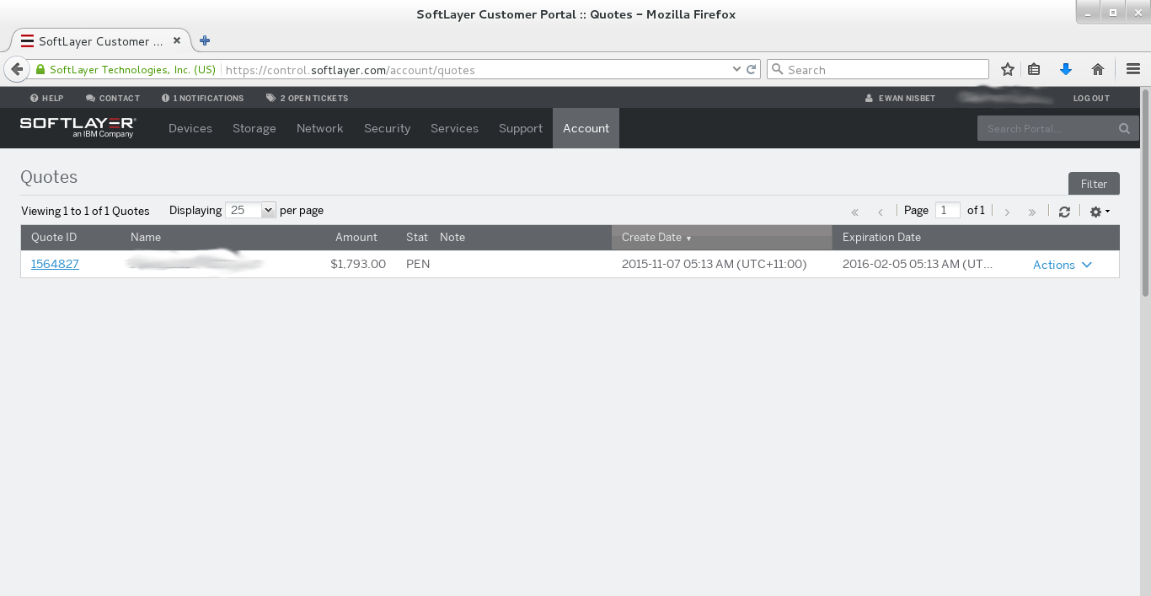
Don't believe it? Login to control.softlayer.com and check your quotes list

Slide 30

Lets save our container to disk using Option 15 (and notice Option 16 for another day)

Slide 31
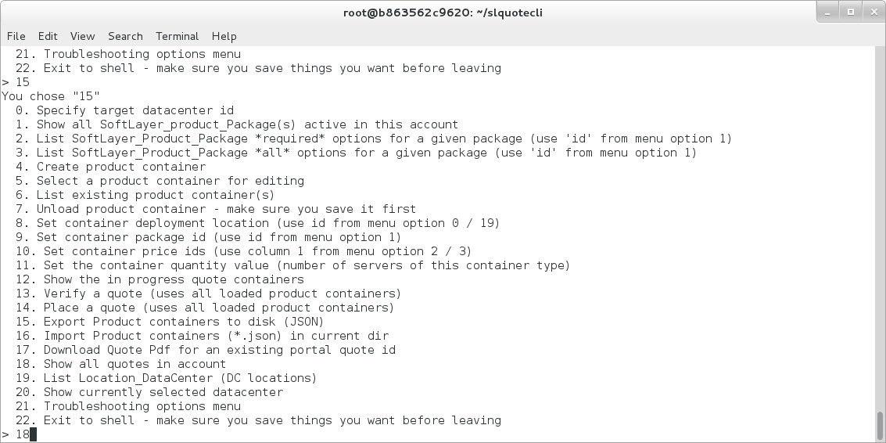
Now lets lookup that quote, without using the portal – Option 18:

Slide 32
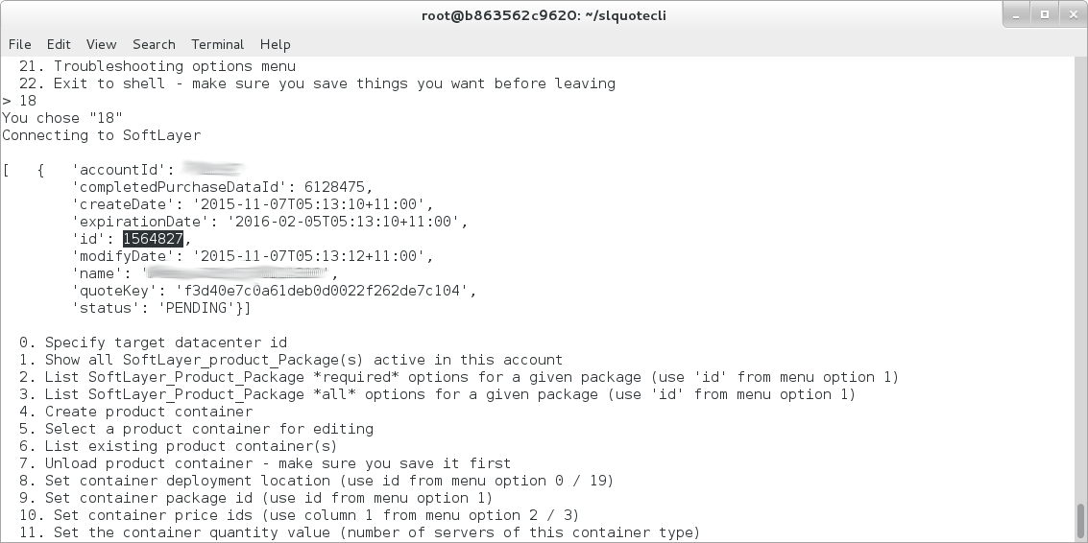
Look familiar?

Slide 33

Option 17 – Download a pdf of the quote from the portal...

Slide 34
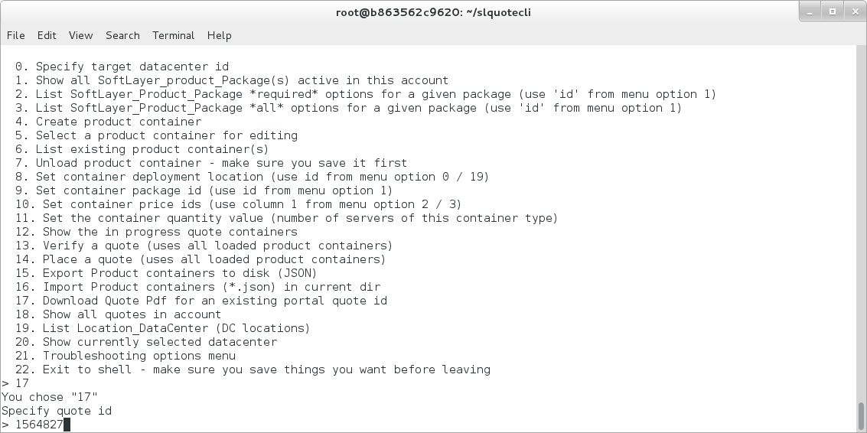
Enter that quote number again...

Slide 35
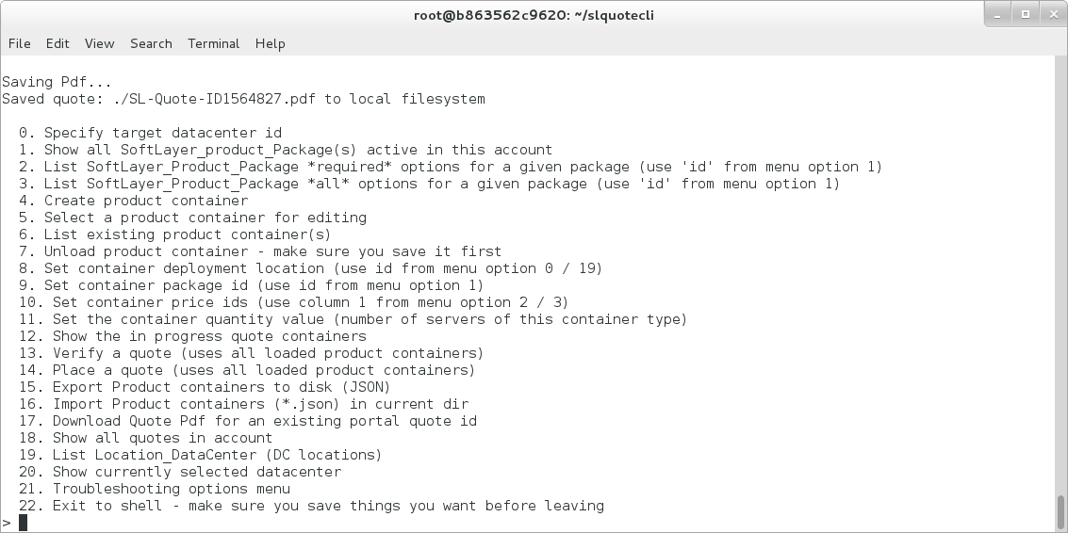
“Saved quote” - and the filename in the current / working directory...

Slide 36

We can close SLquoteCli now – Option 22:

Slide 37
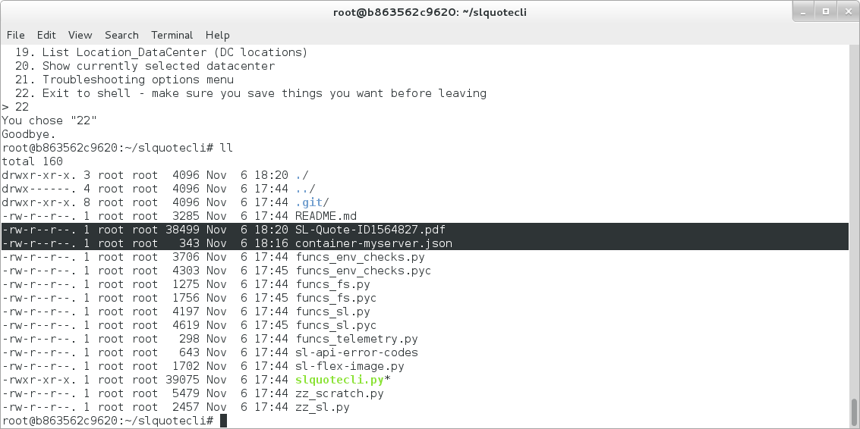
Files were created – the pdf and the json version of the product container

Slide 38
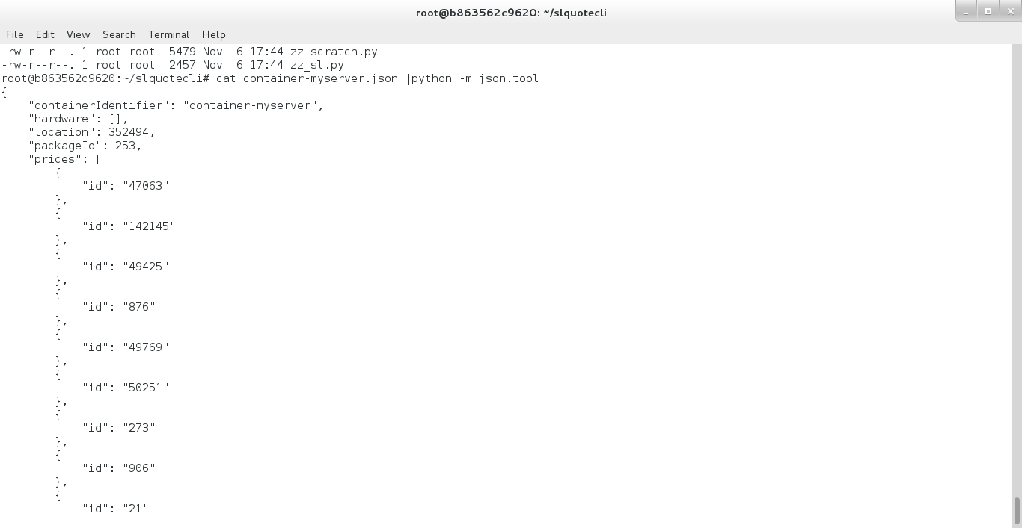
Need proof? Look familiar?

Slide 39
Pdf viewing on the command line? Well...
Apt-get install ghostscript
followed by:
gs \
-dBATCH \
-dNOPAUSE \
-sDEVICE=txtwrite \
-sOutputFile=- \
SL-Quote-ID1564827.pdf |less
Might result in...

Slide 40
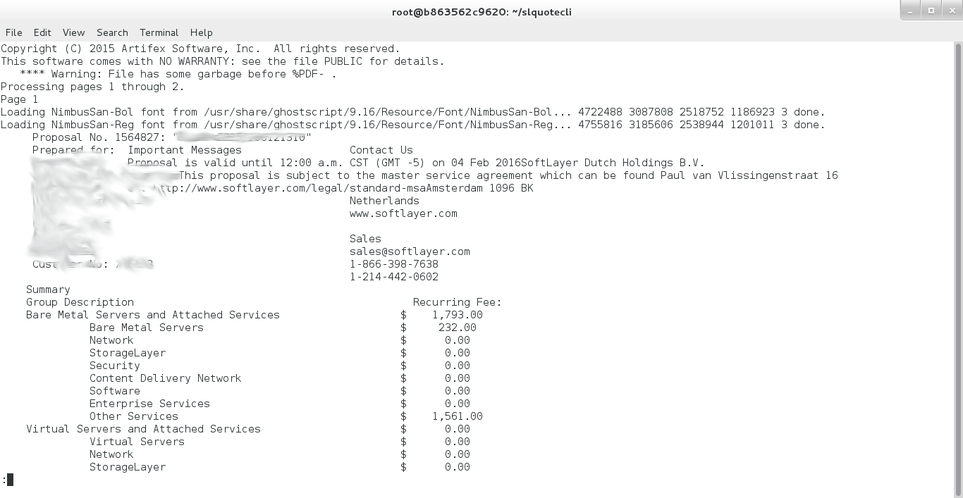
That Proposal No. looks familiar!

Slide 41
By now you're a quoting expert!

