Slide 1
SLquoteCli
Quick walkthrough
https://github.com/ewann/slquotecli

Slide 2
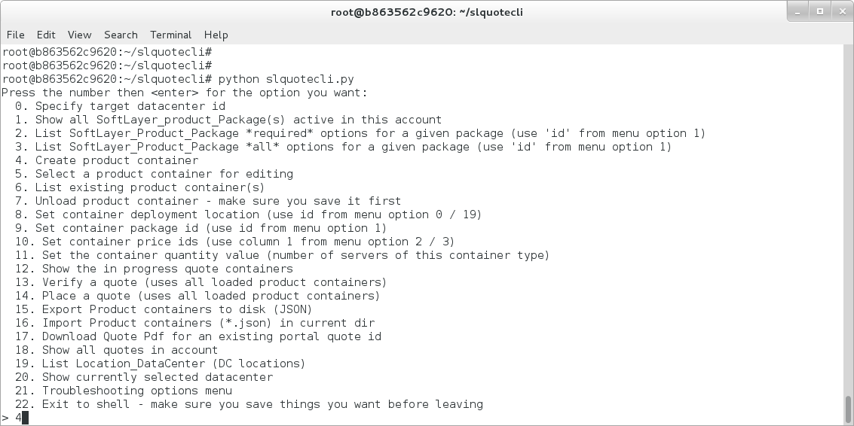
Start slquotecli.py and select option 4:

Slide 3
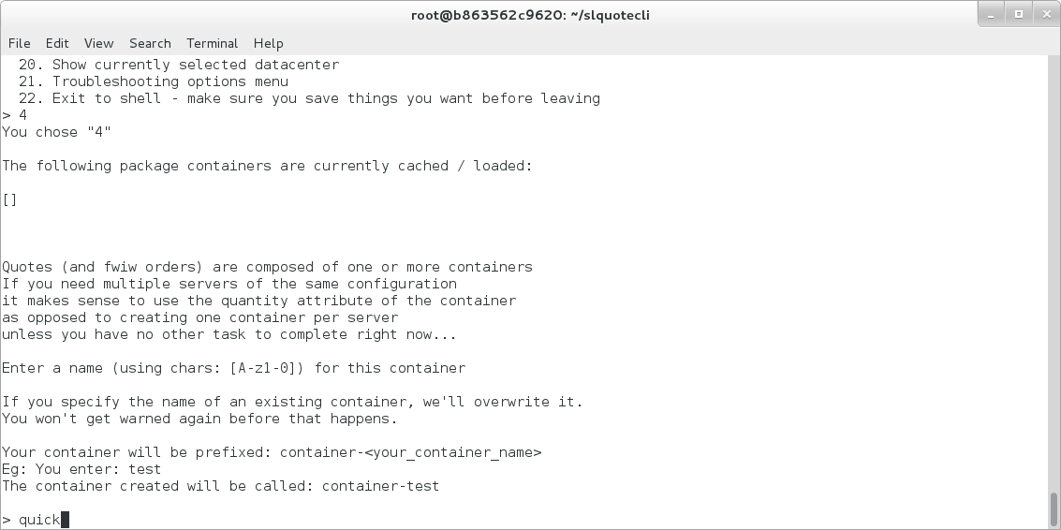
For a container name, enter “quick”:

Slide 4
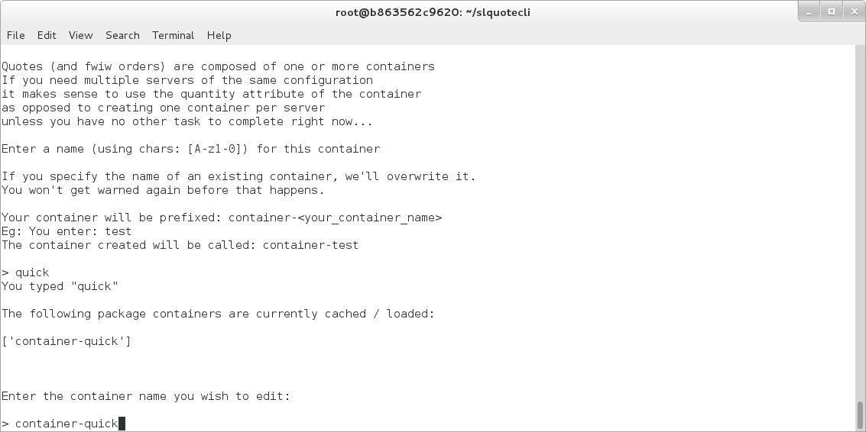
When asked which container you wish to work with, type: container-quick

Slide 5
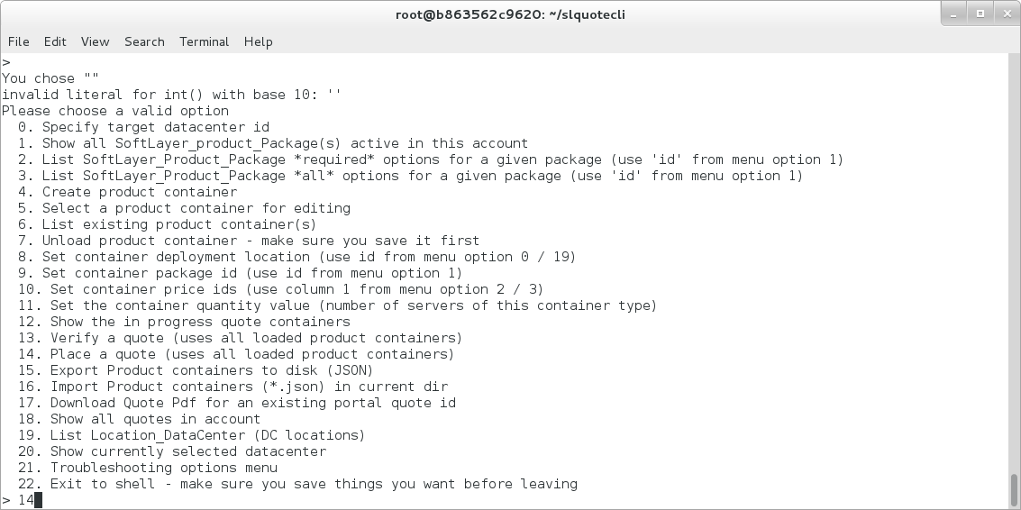
Choose option '14' – Place a quote

Slide 6
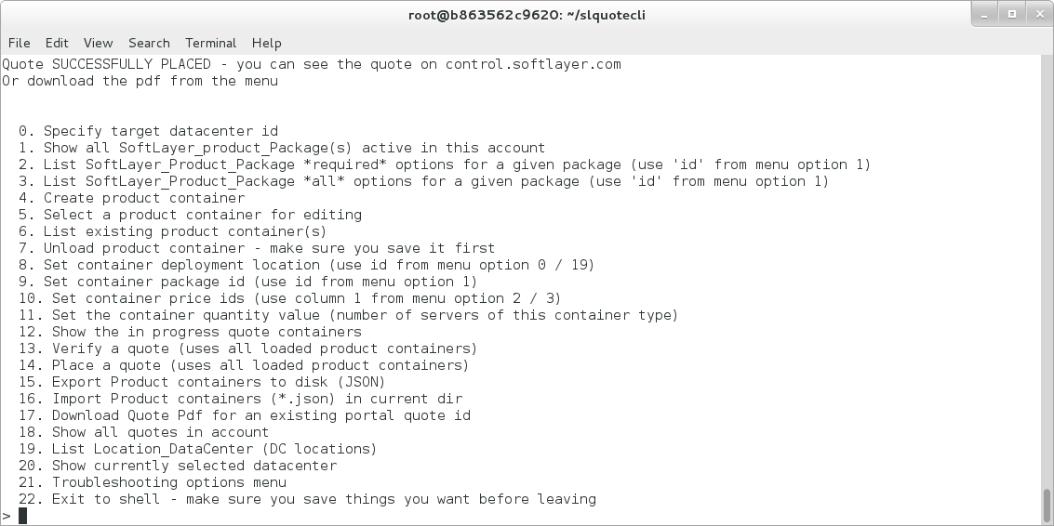
Receive confirmation the quote was placed:

Slide 7
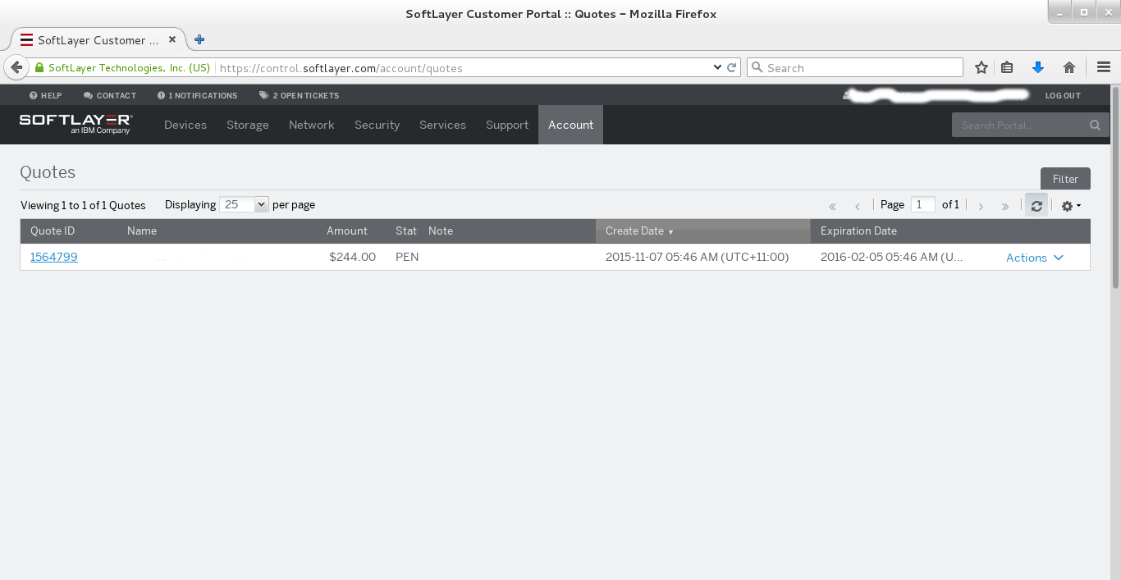
View the order in the portal

