Slide 1
Lecture 1.4: Theory-based approaches to reliability
In Lec. 1.2, we used the ANOVA model to define reliability in terms of the ratio of MS_{b}, variance between groups, to MS_{w}, variance within groups.
In the 1-way model with k obs per group, let σ_{a}² be the true variance between groups, and σ_{e}² be the error variance, or variance within groups. We defined:

Slide 2
In a 2-way ANOVA with n = 1 obs per cell, k raters (columns), each rating p objects (rows); let MS_{p} = MS for Objects, and MS_{res} = MS residual. Let the ‘true’ variance across Objects be σ_{p}².
We turn now to another, related definition of reliability in terms of certain correlations. The general approach is referred to as Test Theory.

Slide 3
Theory-based approaches to reliability
Consider two theory-based approaches within a very general model, Test Theory. First, assume observed, X, is the sum of a latent (or true) score, T, plus an error, e: X = T + e, X’ = T + e’. Second, assume that X is the sum of scores on n items.
Test-Retest reliability = corr(X, X’) across persons. I think of test-retest reliability as the most concrete form of the abstract concept. (See 2 displays below.)
These test-theoretic models allow us to separate ‘signal’ (= ‘structure’) from ‘noise’ (= measurement error) when estimating substantive models.

Slide 4
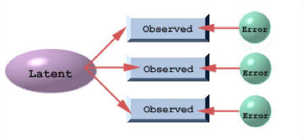
For a given object, Latent is fixed; successive measures
of Observed (e.g., X, X’, X’’) on this object are different
because of independent Error terms. Across objects, Latent varies, and this variation induces a correlation, r_{XX’},
between X and X’, known as the test-retest reliability.

Slide 5
Think of ‘test’ score,
X1 (or X) as Rater 1’s
score, and X2 (or X’)
as R2’s score; P is
the ‘object’ being
rated.
X = T + e
is a special case of
Y = a + bX + e,
i.e., simple regression.
So r² (= r(X,T)²) is the proportion of X-variance that is
explained by T. This links ‘correl’ to ‘reliability’.

Slide 6
In this 2nd case of low test-retest reliability, there is a
significant rater*object interaction. This links reliability to
ANOVA-type interactions.

Slide 7
Internal Consistency
In the second theory-based approach, a ‘test’ consists of n ‘items’, and test score, X, is the sum of the item scores, Y:
X = Y₁ + … + Y_{n}
(instead of the sum of true score plus error:
X = T + e)
Define reliability as internal consistency of a ‘test’, which is based on the correlations among Y_{i} and Y_{j} across participants.

Slide 8
Items Total, X
1 2 3 …
P1 8.0 6.2 8.4 22.6
P2 7.4 9.8 8.5 25.7
P3 10.4 7.5 9.1 …
P4 4.6 3.7 5.6
P5 9.5 9.7 9.9
P6 9.2 8.6 8.6
P7 5.3 4.7 5.5
P8 6.6 7.9 6.9
P9 4.2 6.9 3.6
P10 5.4 6.4 6.9
P11 6.9 6.9 10.2
P12 10.6 10.6 11.6
P13 11.5 11.6 11.3
P14 6.3 8.2 6.8
P15 7.5 9.7 9.0 26.2
The test is reliable
if cor(1, 2), cor(1,3),
etc. are high; i.e., if the items “hang together”.

Slide 9
Summary of Theory-based results
Test-retest reliability = var(T)/var(X), proportion of observed score variance explained by true score variance.
Reliability of a test increases with the length, n, and with the internal consistency, ρ, of the test (Spearman-Brown formula), where ρ is the correl between items across persons.
[To see the generality of this model, note we can replace ‘test’ by ‘method’, ‘item’ by ‘rater’, and ‘person’ by ‘object’.]

Slide 10
Summary (cont’d)
Reliability is reduced when we reduce the range (or variance) of X. The relevant formula allows us to answer questions like: If the reliability of a test is .7 for ‘all people’ (or all ‘hi-school seniors’), what is its reliability when used in a restricted population of ‘patients’ (or all ‘Stanford frosh’)?
The estimate, r_{XY}, of a model-based correlation, r_{AY}, between some ‘interesting’ observed variable, Y, and an ‘interesting’ latent construct, A, that is measured by X, increases as the reliability of X increases.

Slide 11
Comments on Causal Models
But before the theories, let us consider the purpose of causal models, e.g., Test Theory and SEM, and latent variables, given that ‘correlation doesn’t imply causation’?
We need causal models in theory and policy settings. This is partly because often we can’t do experiments (which allow for strong inferences), and we must be content with correlational data.

Slide 12
The case for SEM by Wiki
http://en.wikipedia.org/wiki/Structural_equation_modeling
SEM: A statistical technique for testing and estimating causal relations using a combination of statistical data and qualitative causal assumptions
Strengths include the inclusion of latent variables. These are variables which are not measured directly, but are estimated in the model from several measured variables, each of which 'taps into' the latent variables.
This allows separate estimation of unreliability of measurement (noise) in the model, and the structural relations among latent variables.

Slide 13
Caution: In Applied Multivariate Data Analysis (Chap 13), by BS Everitt and G Dunn (2001)
Causal models “are best seen as convenient mathematical fictions which describe the investigator’s belief about the causal structure of a set of variables. … Essentially, so-called causal models simply provide a parsimonious description of a set of correlations.”

Slide 14
“Latent variables are … hypothetical constructs invented by a scientist for the purpose of understanding some research area of interest, and for which there exists no operational method for direct measurement. … They serve to synthesize and summarize the properties of observed variables.
Latent variables are as real as their predictive consequences are valid. … The justification for postulating latent variables is their theoretical utility rather than their reality.”

Slide 15
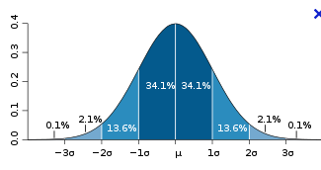
Model: “X has mean, μ, and s.d., σ” is equivalent to
“X = μ + ε, where ε has mean, 0, and s.d., σ”.
We can call μ the true score, T, of X, and ε the measurement
error in/of X. More typically,
X = T + ε,
where T varies across persons with some variance, σ_{t}².

Slide 16
An easy case: X is a Rater’s estimate of the length of an object. We have objective measures on this scale (ins, ft.), and can say: High rater reliability = Low σ². Can also define Rater bias as the difference between mean of X and objective length.
the meaning of ‘low variance’ depends on context.
A hard case: X is a person’s score on a personality test. Is the test reliable? We have no objective measures for this scale, and ‘reliability’ is more problematic.

Slide 17
X is modeled as the sum of the person’s true score, μ (typically written at t_{i} for i’th person), plus an independent error of measurement, ε: X_{i} = t_{i} + ε_{i}.
High reliability = Low σ_{e}², relative to the variance of the true scores across persons.
Var(t_{i}) = σ_{t}²; var(ε_{i}) = σ_{e}²;
Define Reliability as:

Slide 18
We can’t observe the true score or the error; so we cannot directly calculate the two variances. We need more data.
Let X and X’ be two measures from the same person on the test. r_{XX’} is the correl across persons, and can be calculated. Relating r_{XX’} to ‘reliability’ is the key insight of Test Theory.

Slide 19
Corr(X, X’) = u² ≡ r_{XX’} = Test-Retest reliability. u ≡ r_{Xt} ‘large’ implies ‘high’ reliability.
X
u
True Score, t
u
X’
u
X”

Slide 20
Theorem: If t → X and t → X’, then r_{XX’} = r_{tX}*r_{tX’} = u²
Proof: Assume that X, X’, t and e are standardized variables.
The regression of X on t, is X = ut + (1-u²)^{1/2}e.
The regression of X’ on t, is X’ = ut + (1-u²)^{1/2}e’.
Multiplying these 2 eqns, we get:
XX’ = u²t² + ut*(1-u²)^{1/2}e + …
On taking expected values,
E(XX’) = u²E(t²) + E[ut*(1-u²)^{1/2}e + …] = u²,
because E(t²) = 1, and the variables inside the [] brackets
all have expected value = 0.

Slide 21
Completion of Proof
Because X and X’ are standardized,
r_{XX’} = E(XX’) = u², as stated earlier.
This result will be used many times, e.g., in deriving correlations among observable variables in Factor Analysis.
Note that u = corr(t, X). Thus, in the ‘regression’,
X = bt + e’,
u² (i.e., “R²”) is the proportion of variance in X that is explained by t. Thus, reliability, r_{XX’}, is the ratio of true score variance to total observed variance in X.
Another proof follows.

Slide 22
X = t + ε; X’ = t + ε’.
True score is the same, but error of meas differs across testing occasions. To simplify, assume
E(t) = 0. This implies E(X) = 0, var(t) = E(t²), and var(X) = E(X²).
var(X) = var(X’) = var(t) + var(ε);
XX’ = t² + tε + tε’ + εε’. So
Cov(X, X’) = E(XX’) = E(t²) = var(t) = σ_{t}²

Slide 23
This shows that, even if we can’t observe true scores and errors, we can estimate the reliability if we have test and re-test data.
The various definitions of ‘reliability’ can all be related to this fundamental definition.
Next we turn to the issue of attenuation of reliability (cf. attenuation of a correlation).

Slide 24
Two examples of Attenuation
Restricting the ‘range’, e.g., ‘variance’, of X reduces (‘attenuates’) the reliability, r_{XX’}.
Suppose X measures a latent trait, A, that varies across persons. We have a theory that predicts a positive correl between A and some other variable, Y, i.e., r_{AY} > 0. The observable, r_{XY}, is less than the unobservable, r_{AY} . This is attenuation.

Slide 25
Restricting the range of X reduces r_{XX’} . To model this effect, assume σ_{e}², is the same whether the range (e.g., variance) of X is small or large.
Let σ_{x}² denote the variance of X, which is equal to the variance of X'. From the formula above,
Hence, if σ_{x}² is reduced, (1 – r_{XX’}) must increase, and, therefore, r_{XX’} must decrease.

Slide 26
Example.
In one sample (e.g. admitted students), it was found that r_{XX’} = 0.8, and the variance of X was 10.5.
In a second sample (e.g., all who took the admissions test), the variance of X is known to be 18.5.
What is the estimated reliability of the test for the second sample, assuming that the error of measurement is the same in the two samples?

Slide 27
Restricting the range of X reduces r_{XX’} .
Ans. Let r₁ and r₂ be the reliability for the 1st and 2nd samples. Then
Restricting the range from a variance of 18.5 to a variance of 10.5 reduces the reliability from 0.886 to 0.800.

Slide 28
Reliability & Validity: Impact of Attenuation
A test, X, measures an underlying construct, A (e.g., ‘anxiety’). To establish the external validity of X, find an important real-world manifestation, Y, of A. ‘Validity’ is indexed by r_{XY} = cor(X, Y); is it at least moderate?
r_{XY} decreases as the reliability of X, r_{XX’}, decreases. This too is ‘attenuation.’

Slide 29
Attenuation and Disattenuation of a correlation
We want corr(Y, A), but we cannot measure A perfectly. E.g., Y = ‘ideal affect’, A = ‘cultural orientation’.
Our best measure, X, of A has a reliability, r_{XX’}. E.g., X = ‘interdependence’ or ‘influence’. We can observe X, not A, so we calculate r_{XY}, and we wish to use r_{XY} to estimate r_{AY}, the quantity in which we are really interested.
r_{XY} is called an attenuated correlation, and replacing it by r_{AY} is called disattenuating the observed correlation.

Slide 30
Consider the following causal diagram in which A is a latent variable, and X, X’ and Y are observable, and the path coefficients are as shown.
r(A, Y)
A
Y
r(A, X)
r(A, X)
X
X’

Slide 31
A
r(A, Y)
Y
r(A, X)
r(A, X)
X
X’
This is the disattenuated correlation, and, because r_{XX’} is less than 1, r_{AY} > r_{XY}. That is, the disattenuated correlation is always larger than the observed correlation.

Slide 32
Attenuation in the measurement of brain adaptation
fMRI-Adaptation and Category Selectivity in Human Ventral Temporal Cortex, by Kevin S. Weiner, Rory Sayres, Joakim Vinberg, and Kalanit Grill-Spector. In J Neurophysiol 103: 3349–3365, 2010.
“When stimuli are repeated, cortical responses in high-level visual cortex generally decrease. When the responses are measured with fMRI, this reduction in activation is labeled fMRI-Adaptation (fMRI-A).”

Slide 33
“This reduction, fMRI-A, has been observed in many spatial and temporal scales, … and is thought to be a marker of experience-dependent changes in high-level visual cortex.”
“Results show that repetition produces proportional fMRI-A. Thus, in the regression analysis of repeated response, Y, on non-repeated response, X, a slope equal to one indicates no fMRI-A, a slope less than one indicates fMRI-A, and a slope more than one indicates response enhancement. However, noise (i.e., measurement error) can produce a bias in the slope estimation, making it lower; i.e., attenuating it (Frost and Thompson 2000).”
Thus, fMRI-A is a substantively interesting attenuation (pun intended!). But to estimate it accurately (i.e., without bias), we need to ‘control for’ measurement-related attenuation!

Slide 34
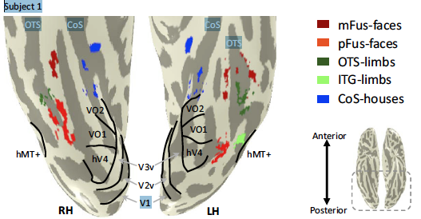
Category-selective regions of interest (ROIs)

Slide 35
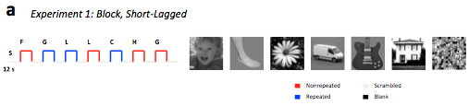
Stimuli
A block of different Faces (non-repeated), followed by a
block of Guitars with repetitions (repeated), followed
by a block of Limbs with repetitions (repeated), …
At each voxel, obtain average response, N, to non-
repeated stimuli, and that, R, to repeated stimuli.

Slide 36
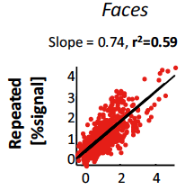
This plot of R against N has a slope less than 1, which
is defined as fMRI-A. The line goes through the
origin, showing proportional fMRI-A, within an ROI.
This slope is attenuated by measurement error in R & N.
Non-repeated, N

Slide 37
Study details
Define regions of interest (ROI) in ventral occipito-temporal cortex for which category selectivity is seen in (a) regional preferences for particular object categories, e.g., faces, limbs, flowers, etc., and (b) distributed patterns of activity across regions.
Some stimuli are presented once (non-repeated). For repeated stimuli, the interval between stimuli is varied from .5-3 secs (short-lagged), in one condition, to 1-174 secs (long-lagged) in another.

Slide 38
Study details
For each ROI, each category (e.g., ROI = face-selective area, category = faces or limbs), and each voxel (= 1.5x1.5x3 mm of tissue), measure the BOLD response amplitude for non-repeated (N) and repeated (R) objects.
Regress R on N and test if slope = 1. Compare slopes (= fMRI-A) between ‘interesting’ conditions, e.g., ‘faces’ vs. ‘limbs’ in face-area.
But slope differences might be due to differences in noise, not in category selectivity! How to dispel this possibility?

Slide 39
Split-Half approach
Divide expt into ‘even’ runs, with measures N and R for each voxel, and ‘odd’ runs, with measures N’ and R’ for each voxel.
Noise in both variables attenuates the regression slope, m, of R on N, “as measured by comparing the slope with 1.0. To show that 1.0 is the appropriate standard, regress N on N’ and show that this slope, m_{SH}, equals 1.”
Note, however, that noise also causes m_{SH} < 1, so that 1.0 is not the appropriate standard. The relevant test is whether m < m_{SH}, as can be seen in the following causal model.

Slide 40
SEM approach (see HW-2)
α
Z_{N}
Z_{R}
u
u
v
v
N
N’
R
R’
r_{NN’} = u², r_{RR’} = v²; r_{NR} = uαv. Hence,
α = r_{NR} /uv = r_{NR} /√[r_{NN’}r_{RR’}], which can be estimated.
Ex: Category 1: r_{NN’} = .62, r_{RR’} = .51, and r_{NR} = .36. Category 2: r_{NN’} = .12, r_{RR’} = .11, and r_{NR} = .07.

Slide 41
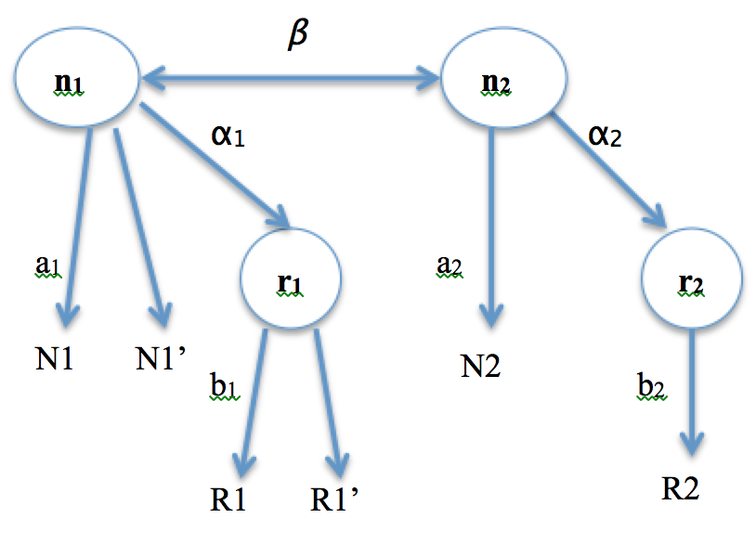
Ex. Correlations between Categories 1 & 2:
corr(N1, N2) = .25, and corr(R1, R2) = .085.
Corr(N1, N2) = a₁*β*a₂; corr(R1, R2) = …

Slide 42





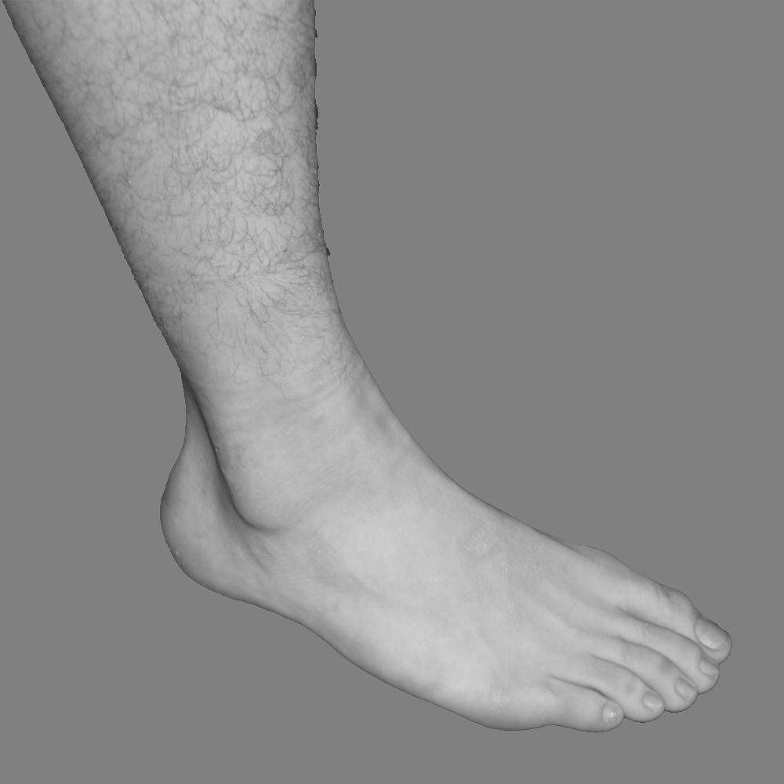
a
Faces
Limbs
Cars
Houses
Slope = 0.74, r²=0.59
Repeated
[%signal]
4
3
3
2
2
1
1
0
0
0
2
4
-1
0
2
4
Nonrepeated [% signal]
b
Limb-selective
c
Face-selective
1
ITG
1
pFus
.5
.5
OTS
mFus
0
0
fMRI-adaptation ratio
fMRI-adaptation ratio
1
ITG
1
pFus
.5
.5
OTS
mFus
0
0
H
Category
Category
anterior
posterior

Slide 43
a
Faces
Limbs
Cars
Houses
short-lagged
Slope = 0.61, r²=0.54
0.64, 0.71
0.72, 0.60
0.57, 0.80
4
6
4
8
3
4
6
2
2
4
1
2
-
0
0
0
2
1
0
Repeated [%signal]
0
2
4
0
2
4
6
0
2
4
0
2
4
6
8
long-lagged
2
0.24, 0.05
2
0.29, 0.17
2
0.39, 0.39
2
0.54, 0.60
1
1
1
1
0
0
0
0
0
1
-
1
0
1
0
1
2
0
1
2
Nonrepeated [% signal]
b
1
short-lagged
long-lagged
fMRI-A ratio
.5
0
Category
Exp 2: Demonstration of fMRI-A in different conditions

Slide 44
Test Construction
In constructing a test made up of n items, which items from the preliminary studies to include, which to exclude?
Look at inter-item correls, and item-total correls; also, whether items are too easy or too difficult.
How large should n be so that the test is reliable? Larger n = higher reliability.
‘Tests’ inter-correlate more highly than do ‘items’. Use artificial data set to show this.

Slide 45
Data: Create set of latent ‘True’ scores. q1, q2,… are observed ‘item’ scores. Xn.1, Xn.2 are 2 different scores on an n-item test. ‘Critern’ is score on a ‘criterion’. ‘Normscr’ is a normed test score with mean = 100 and sd = 15:
True q1 q2 .. q6 Critern Normscr
69 75 62 86 8.2 117
.. ..
Test and re-test scores on 2-item and 3-item tests:
X2.1 X2.2 X3.1 X3.2
159 165 240 251
.. ..

Slide 46
Correlations among scores on q1, q2, q3, q4, q5, q6, are modest (Median = .4)
q1 q2 q3 q4 q5
q2 0.60**
q3 0.04 0.09
q4 0.31 0.36 0.33
q5 0.45* 0.41 0.22 0.40
q6 0.36 0.50* 0.56* 0.42 0.36

Slide 47
For n = 1, median corr(qi, qj) = 0.4.
For n = 2, corr(X2.1, X2.2) = 0.514.
For n = 3, corr(X3.1, X3.2) = 0.71.
Substantive item analysis: face and construct validity; difficulty; reverse coding
Statistical item analysis in SPSS: Analyze > Scale > Reliability Analysis.
Test validity. This is the correlation between test and criterion. Here, corr(Normscr, Critern) = 0.477 (p = 0.033).

Slide 48
Reliability & Test Length
The variance-covariance matrix, V, for {Y₁, Y₂, …, Y_{n}}
A pretext for a digression on the positive definiteness of a square matrix, very important in iterative procedures
Use V to calculate var(X), where X = Y₁ + Y₂ + … + Y_{n}
Use the resulting expressions for var(X) and E(XX’) to derive Spearman-Brown formula

Slide 49
Dependence of reliability on test length: ‘n-item test model’
To study the effect of test length, we use a more ‘superficial’ model involving only observable test and item scores. A test consists of n items; Y_{j} is the score on the j’th item, X = test score, X’ = retest score. r_{XX’} is the test-retest reliability.
The item scores are correlated with each other, so var(X) is not the sum of the item score variances; it depends on the correlation between the item scores. This inter-item correlation is expected to be positive if the items ‘hang together’, as we expect.

Slide 50
Dependence of reliability on test length
Rescale all variables to have a mean of 0. Then
We now express E(X²), i.e., var(X), and E(XX’) in terms
of var(Y_{i}) and cov(Y_{i}, Y_{j}). [Note that cov(Y_{i}, Y_{i}) = var(Y_{i}),
showing that ‘covariance’ is a generalisation of
‘variance’ to the case of 2 variables.]

Slide 51
The variance-covariance matrix, V
Consider a set of random variables, {Y₁, Y₂, …, Y_{n}}. V is [note that σ_{ij} = σ_{ji} = cov(Y_{i}, Y_{j})]:
 | Y₁ | Y₂ | … | Y_{n}
Y₁ | σ₁² | σ₁₂ | … | σ_{1n}
Y₂ | σ₂₁ | σ₂² | … | σ_{2n}
… | … | … | … | …
Y_{n} | σ_{n1} | σ_{n2} | … | σ_{n}²

Slide 52
Positive definite matrix
Matrices have many properties that are analogous to those of real numbers, and one such property is ‘positivity’. Positive numbers are special (e.g., they can be interpreted as ‘size’ indices). Positive definite matrices are also special, and play an important role in Statistics and Optimization problems.
A matrix, A, is positive definite iff its determinant is positive, i.e., iff
det(A) ≅ |A| > 0.

Slide 53
Positive definite matrix
A square matrix, A, has an inverse, A⁻¹, iff |A| ≠ 0.
Many computations, e.g., parameter estimation (say, of MLE’s), are iterative, such that the ‘adjustment’ at each iteration depends on inverting some matrix, A.
If A is defined so that it is always positive definite, then, a fortiori, we know that |A| ≠ 0 and that matrix inversion is always possible, and our iterative process will not ‘blow up’.
In ML estimation, the step-size at each iteration requires the inversion of a var-covar matrix.

Slide 54
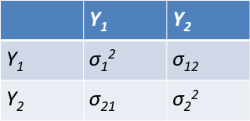
The variance-covariance matrix, V, is positive definite
In the simple case of 2 variables, V is a 2x2 matrix, and r = σ₁₂ /σ₁σ₂.
|V| = σ₁²σ₂²- (σ₁₂)² = σ₁²σ₂²[1 - (σ₁₂ /σ₁σ₂)²]
= σ₁²σ₂²[1 – r²] > 0. QED
Conversely, any positive definite matrix is the variance-covariance matrix for some multivariate distribution.

Slide 55
If X = Y₁ + Y₂ + … + Y_{n}, var(X) = sum(V)
This is a very useful approach to finding the variance of the sum of correlated random variables.
The proof is included in the derivation of the Spearman-Brown formula below.

Slide 56
Spearman-Brown formula:
All variables have mean = 0

Slide 57
recalling that var(X) = E(X²).

Slide 58
Dependence of reliability on test length
ρ is the inter-item correlation, the degree to
which items ‘hang together’, and n is the
number of items comprising the test. This is the
general form of the Spearman-Brown formula.

Slide 59
Dependence of reliability on test length.
Example. ρ = 0.1 (small), n = 20 (long),

Slide 60
Spearman-Brown formula (cont’d)
Regard Y_{j} as the score on a test of “unit” length. Then X is the score on a test of length n, and ρ = corr(Y_{j} , Y_{k}) becomes the test-retest reliability of a test of unit length. Let us denote ρ by r₁₁, and r_{XX} by r_{nn}. Then

Slide 61
Spearman-Brown formula (cont’d)
Split-half reliability. Now let Y be the total score on “even” items, and Y’ be the total score on “odd” items. Then r_{YY’} is the test-retest reliability of a “test” of some length, say, 1. X = Y + Y’ is then the score on a test of length 2. That is, if r_{YY’} ≡ r₁₁, then

Slide 62
Spearman-Brown formula (cont’d)
Cronbach’s alpha, for a 1-item test, is defined as:
Cronbach’s alpha, for an n-item test, can then be found from the Spearman-Brown formula above.
SPSS gives coefficient alpha, as shown in Chap. 36 of the SPSS manual. (Analyze > Scale > Reliability Analysis, etc.)

Slide 63
Alternative definition of alpha
Suppose there are n items on a test; and p persons take the test. The scores, Y_{i}, on item i have some variance, var(Y_{i}), between persons. The total score, X (X = Y₁ + Y₂ + … + Y_{n}), has variance, var(X), between persons.
Cronbach’s alpha for the n-item test is defined as:

Slide 64
A brief digression - from HW-2 Reliability of 1- vs k-item tests
What motivates this distinction?
Consider a reliability analysis based on a p (patients) x k (raters) matrix of scores. After this analysis, the rating method is applied to ‘many’ patients. Is a patient to be rated by 1 clinician? OR, is a patient rated by k = 2 or 4 clinicians, whose ratings are ‘pooled’ to assess the patient’s status?
The former leads us to report the reliability of a 1-item test; the latter that of a k-item test.

Slide 65
Using SPSS Output:
The ratio, {∑var(Y_{i})}/var(X), in the expression for alpha can be computed by requesting item statistics and the ANOVA table in SPSS:
{∑var(Y_{i})}/var(X) = {Mean of Item Variances}/{Mean Square Between Persons}
Other formulae give slightly differing values.

Slide 66
Corollary: ρ has a lower bound!
Consider the model in which all pairs of {Y_{j}}, j = 1, 2, …, n, have the same intercorrelation, ρ.
The variance of the sum, X, of the {Y_{j}} has to be positive, because all variances are positive. But we just proved that
Dividing by nσ_{Y}², we get: 1 + (n -1)ρ > 0.
Thus ρ > -1/(n – 1). ρ cannot be too large negative! (The enemy of my enemy is my friend!)

Slide 67
An application
For a voxel in the face area, we have N₀ and R₀, the responses to non-repeated and repeated faces. Suppose N₁ and R₁ are that voxel’s responses to non-repeated and repeated houses.
In Weiner et al., cor(N₀, N₁) < 0.
According to our Corollary above, if all n correls, cor(N_{i}, N_{j}) = ρ, then ρ cannot be less than -1/(n-1)! This puts a mild constraint on our models.

