Slide 1


Project Meeting
September 24, 2013

Slide 2

Tonight’s Agenda
Introductions
Admin Business
Arduino Introduction
502 Report & Assignments

Slide 3
EWB-USA NY Professionals:
Come join us…
Admin Business
Starting a Program:
501 & 502 Report
502 – due Oct. 15th
Delegating sections of 502
Office Hours:
ENG1 #144
M/W/F 9:00 – 10:00 am
Tu 10:30 – 11:45 am
Th 10:30 am – 1:00 pm (occasional)
Dues:
Pay Dues to Jorge (Treasurer)
$15/semester or $20/year
Conference:
SE Regional Conference
Oct. 4th – 6th at Georgia Tech
Talk to Maya for details
Project Website:
Create Accounts
project.ewbucf.org
Web Development
If interested, talk to me after meeting.
EWB-USA:
Sign Up for EWB-USA
www.ewb-usa.org
Access to open programs list
EWB documents & resources

Slide 4
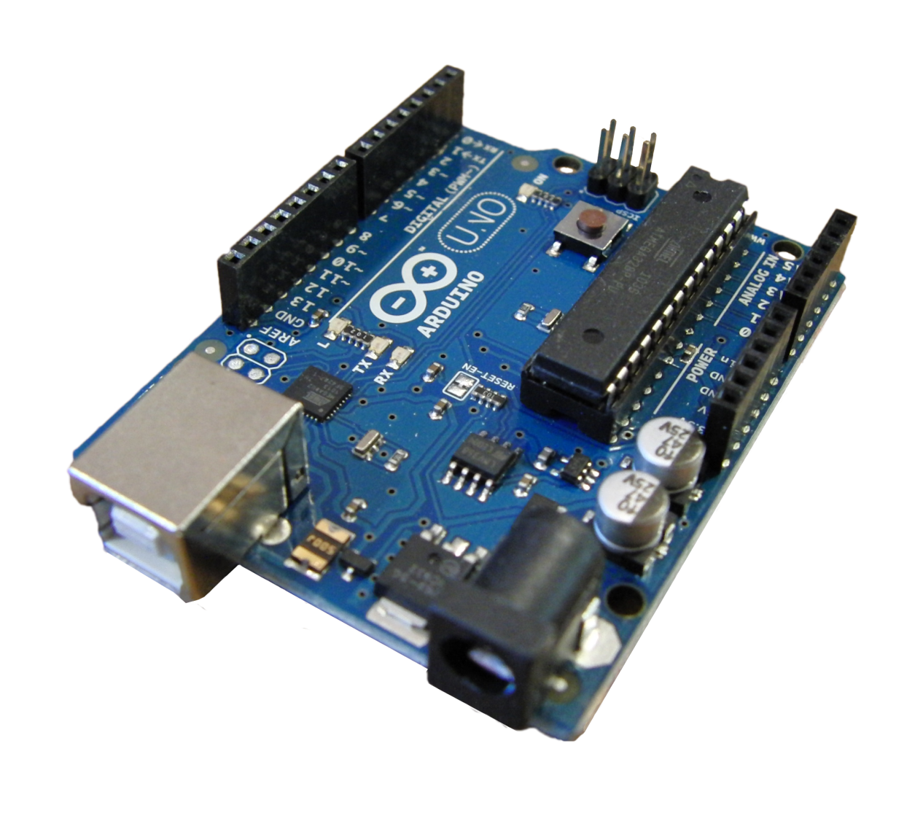
Arduino Uno
Microcontoller
Input/Output
Programmed in C
Why Arduino?
Cheap
Easy
Open Source

Slide 5
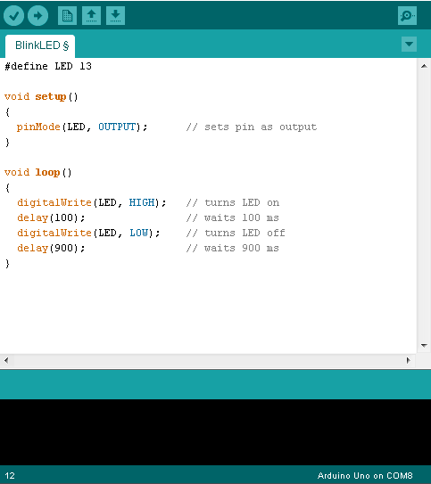
Blinking LED
Setup & Loop
#define
Functions
pinMode
digitalWrite
Delay
Constants
HIGH = 255
LOW = 0

Slide 6
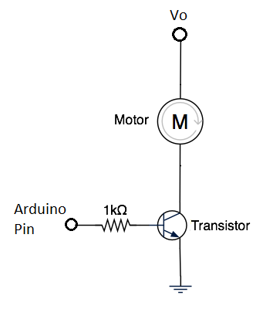
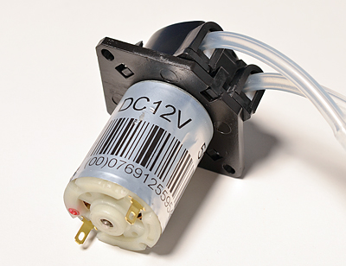
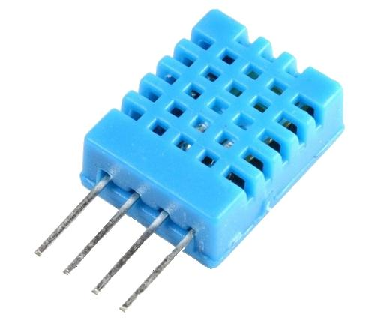
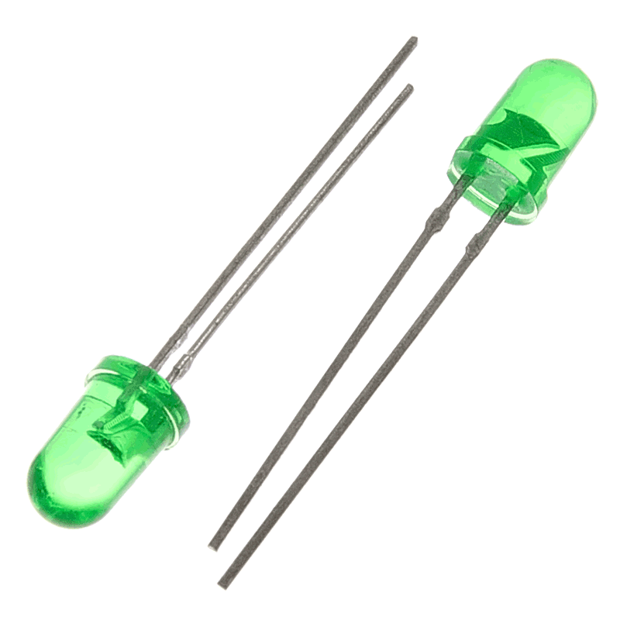
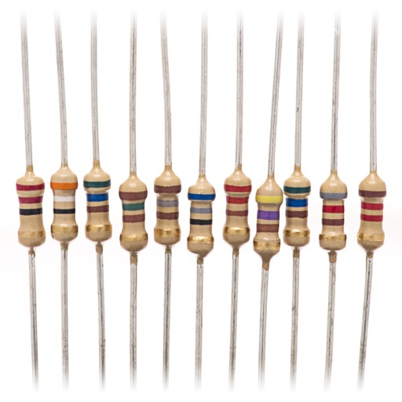
Arduino Assignments
Team #1:
Tasneem
Samon
Rebecca
Travis
Team #2:
Maya
Kristen
Alexis
Joel
Team #3:
Sebastien
Ivan
Natalie
David

Slide 7

502 Report
Section Assignments (due 10/8)
Kristen & Travis
1.0 Program Summary
Tasneem & Natalie:
6.1 Education & Training
Sebastien & McKinnley:
6.2 Cultural Training
David, Maya, & Rebecca:
6.3 Health & Safety Preparation
6.4 Language & Translation
Samon & Ivan:
6.5 Education Lead ?
6.6 Fundraising
Alexis & Joel:
7.0 – 7.3 Quality Management ?

Slide 8
Questions?
http://www.collegehumor.com/video/6905817/every-tech-commercial

