Slide 1


Node.js/Express
An introduction to the MEAN stack
Part I
Summit for Software Engineers
May 18th, 2015
Kit Ewbank
Lead Software Engineer
Notes:
Introduce myself.
1

Slide 2
Code samples
http://summitserver.local/ewbankkit/sfse-2015
https://github.com/ewbankkit/sfse-2015
Notes:
Code samples available on github

Slide 3
Agenda
JavaScript Recap/QuickStart
Node.js QuickStart
Express
Notes:
Enough JavaScript to get everyone on the same page
Motivation for and introduction to Node.js
Motivation for and introduction to Express

Slide 4
JavaScript
The world’s most misunderstood language
It’s not Java…

Slide 5
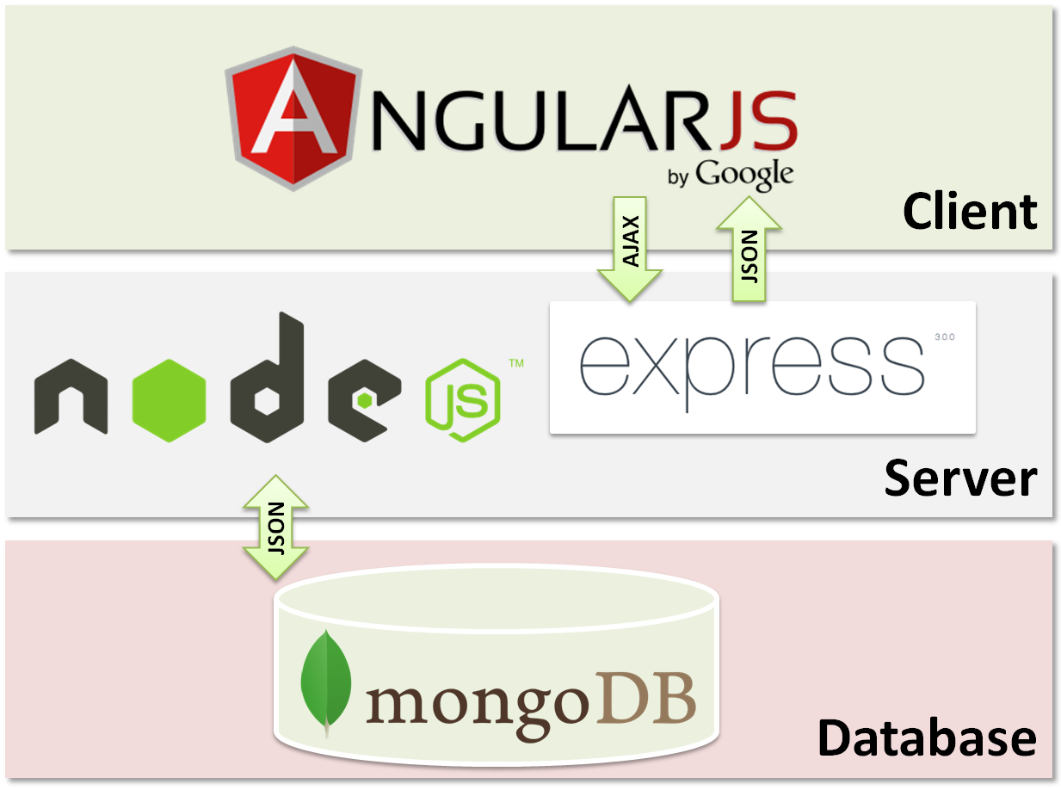
The MEAN Stack
Notes:
MEAN stack
MongoDB
Node.js
Express
Angular

Slide 6
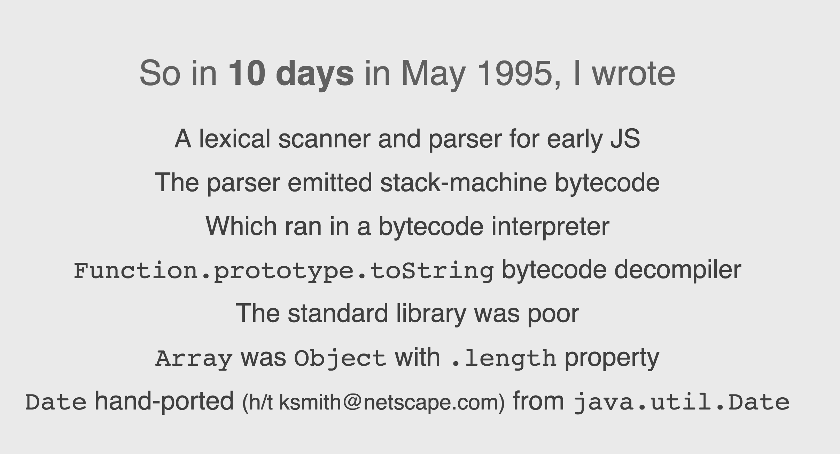
JavaScript
Created by Brendan Eich at Netscape in 1995:
Notes:
20 years old this month
http://brendaneich.github.io/ModernWeb.tw-2015

Slide 7
JavaScript
Released on December 4th, 1995 in Netscape browser version 2.0B3
Notes:
Mocha -> LiveScript -> JavaScript (because Java was the cool new thing). Now the official name is ECMAScript
The Open, Cross-Platform Object Scripting Language for Enterprise Networks and the Internet
In those days Java was seen as the language and runtime for applications running in the browser – Applets. JavaScript was a way of scripting the interaction between the browser and the applet

Slide 8
JavaScript
1996 MS includes JS in IE 3.0
1997 ECMAscript standard
1998 Mozilla Project
1999 IE5 introduces XMLHttpRequest
2001 IE6 released with Windows XP, 5 year IE hiatus starts
2007 Douglas Crockford, JavaScript The Good Parts
2008 Chrome and v8 released
2009 Node.js, ES5, Angular
2010 NPM, Backbone etc.
2015 ES6
Notes:
Key dates

Slide 9
JavaScript
C family
{};
if, switch, etc.
for, while, etc.
Notes:
From the C family (C/C++/Go/Java etc.)
Has all the “usual” syntax elements

Slide 10
JavaScript
Load and go delivery
Loose typing
Objects as general containers
Prototypal inheritance
Notes:
Key ideas
Load and go delivery - No compilation phase
Loose typing - Has types but variables can change types
Prototypal inheritance - Object oriented but classless

Slide 11
JavaScript
Values
Number (64-bit floating-point)
String (Immutable)
Boolean
null
undefined
Object (everything else) {}
Notes:
Number
String
Boolean
undefined
null
Object - Everything else is an object (mutable key/value collection, addressable via dot-notation or index notation)

Slide 12
JavaScript
Functions
First-class values (lambdas)
Variables are function scoped
Closure
Array []
RegExp //
Notes:
"Special" objects:
Function - First-class; Treated as variables
Lambdas
Variables are function scoped
Closures - Variables captured from enclosing scopes
Array Syntax
RegExp

Slide 13
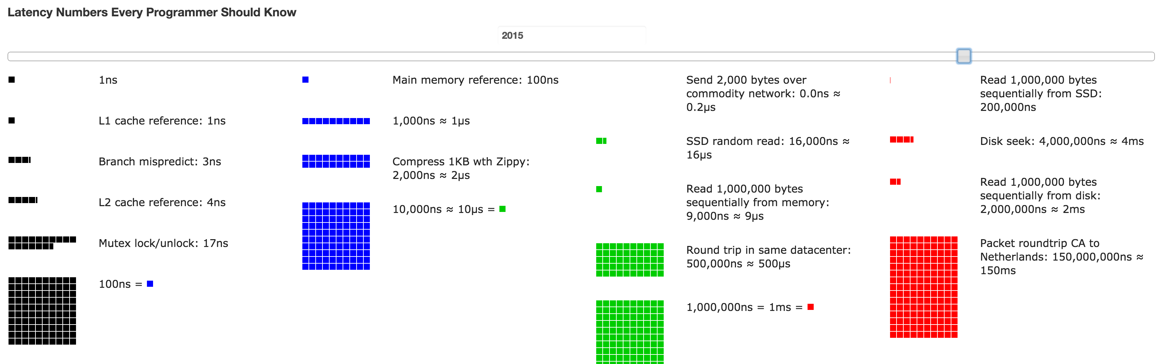
Node.js
Notes:
JS ran just in browser
Event-driven
Most of time spent waiting for something to happen
What has this got to do with server-side JS?
How slow is I/O?
http://www.eecs.berkeley.edu/~rcs/research/interactive_latency.html

Slide 14
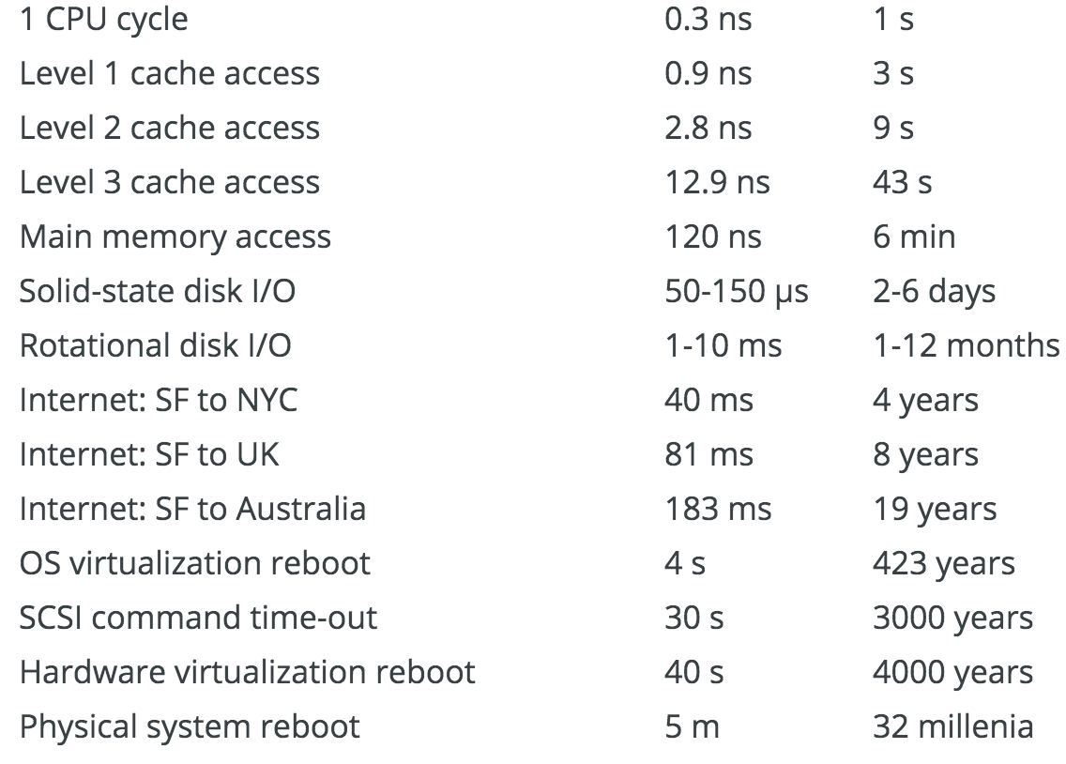
Node.js
Notes:
Systems Performance: Enterprise and the Cloud by Brendan Gregg

Slide 15
Node.js
To provide an easy way to build scalable network programs
Notes:
Server-side JavaScript

Slide 16
Node.js
Create by Ryan Dahl and others at Joyent in 2009, released on May 27th
December 2014, Fedor Indutny starts io.js, an open governance alternative fork of Node.js with a separate technical committee
Current Node.js release (at time of writing) is 0.12.3
Current io.js release (at time of writing) is 2.0.2 - Stated goal is weekly release
Last week plans announced to merge io.js into Node.js
Notes:
A brief history

Slide 17
Node.js
I/O Models
Blocking vs. Non-Blocking (Synchronous vs. Async)
Threads vs. Events/Callbacks

Slide 18
Node.js
Server-side JavaScript
Built on Google v8 and libuv
Provides a purely evented, non-blocking infrastructure to script highly concurrent programs
No function should directly perform I/O
To receive data from disk, network etc. there must be a callback
Notes:
Elements of Node.js

Slide 19
Node.js
Implements CommonJS module system
Tiny core of global functions and objects - require(), setTimeout(), process
Limited set of built-in modules - util, fs, http
HUGE 3rd party open-source module community
Package management using npm
Notes:
“Batteries not included”

Slide 20
Node.js
Pseudo-code for Node.js Event Loop
while there are still events to process:
get the next event
if there is a callback associated with the next event:
call the callback
Notes:
Event loop
Every turn around the event loop is a tick

Slide 21
Node.js
EventEmitter - require('events')
All objects that emit events are instances of events.EventEmitter
on (AKA addListener) adds a listener callback for the specified event
emit emits the specified event

Slide 22
Node.js
Stream
A sequence of data elements made available over time; Think conveyor belt
Readable (Input), writable (output) or duplex (input and output)
Extends EventEmitter
Handle events data and end for reading
Call methods write and end for writing
Notes:
Streams are an I/O concept in many languages/frameworks
Also transform streams

Slide 23
Node.js
Examples

Slide 24
Express
A minimal and flexible Node.js web application framework that provides a robust set of features for web and mobile applications
Notes:
Express, a fast, unopinionated, minimalist web framework for node.: http://expressjs.com/
Created by TJ Holowaychuk in 2009, legendary Node.js hacker (now defected to Go)
Currently stewardship is with StrongLoop, a Node.js corporate sponsor

Slide 25
Express
npm install express
npm install express-generator
express myapp
Notes:
To install

Slide 26
Express
Adds the idea of routes, the definition of end points (URIs) to an application and how it responds to client requests
A route is a combination of a URI, a HTTP request method (GET, POST, etc.), and one or more handlers for the endpoint

Slide 27
Express
Examples

Slide 28
Questions?
Notes:
Thanks and enjoy the rest of the summit

