Slide 1
Introduction to Microcontrollers LAB!
Sit with a partner :)

Slide 2
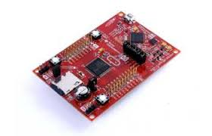
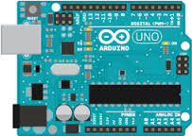
What is a microcontroller?
Microcontrollers are small processing units
Include all necessary peripherals
Memory
Clock
Timers
Analog to Digital Converters
Allow for an easy interface between software and hardware

Slide 3
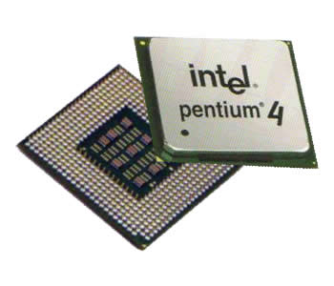
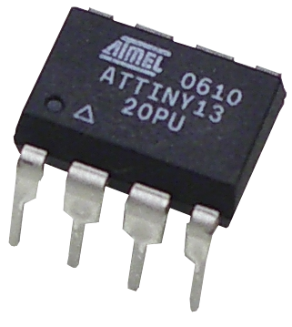
Microcontroller vs Processor
On board RAM/ROM/Flash
Slow (upto 200MHz)
Small number of pins
Low power
Low Cost
No Memory on board
Fast (upto 3.5GHz)
Large number of pins
High power
Expensive

Slide 4

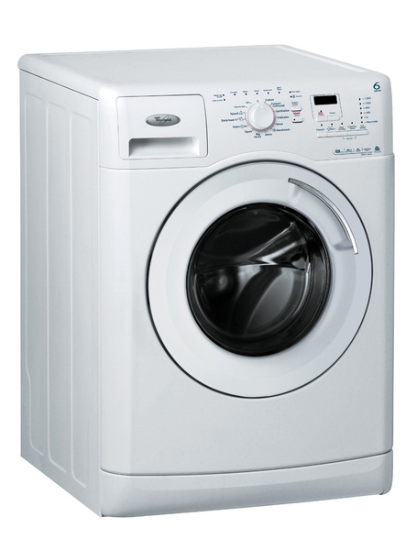
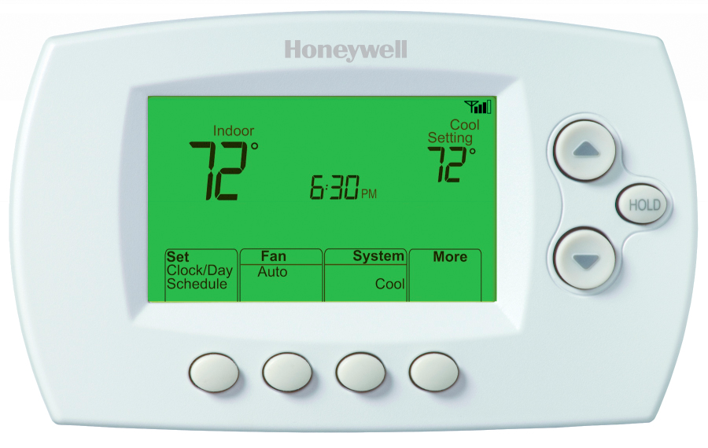

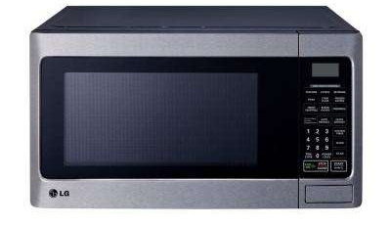
Where are Microcontrollers used?
Everywhere!
The average household has about 3 dozen or more microcontrollers
The average midsize vehicle has about 30 microcontrollers in it

Slide 5
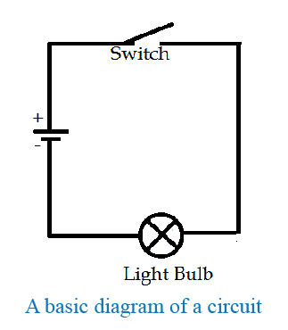
A quick intro to Circuits
A circuit is one or more closed loops for current flow through
Current is like water flowing through pipes
Voltage is like height, it creates a force to push current through a circuit

Slide 6
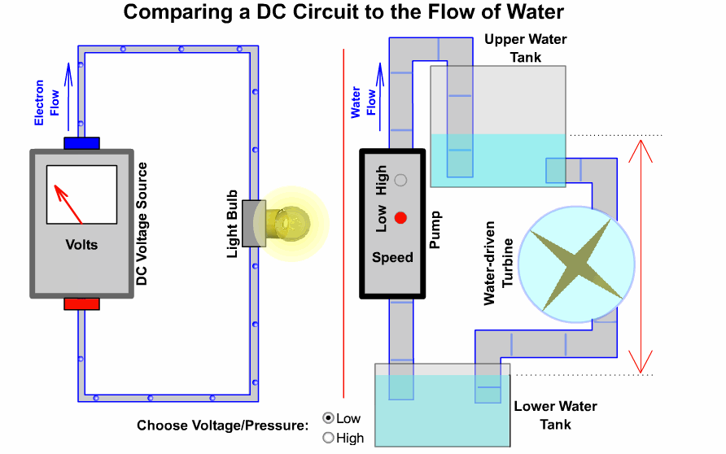
A quick intro to Circuits

Slide 7
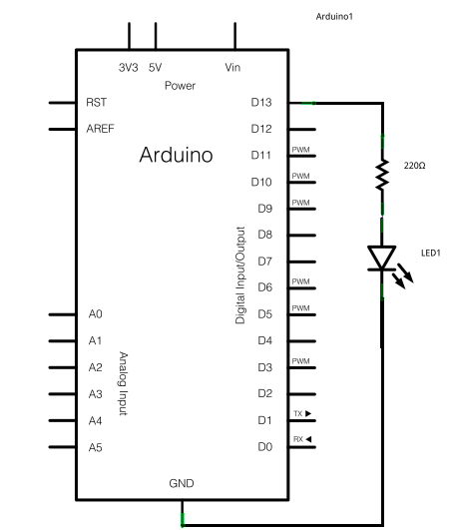
A quick intro to Circuits
Our Microcontrollers can create a voltage on all of their pins
We control when the microcontroller creates this voltage using programming
We use this voltage to power elements in the circuit

Slide 8
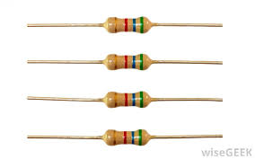

Resistors
Resist the flow of current, create a voltage drop.
We use them to control how much current is in an element

Slide 9
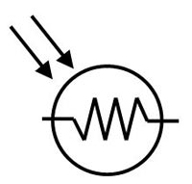
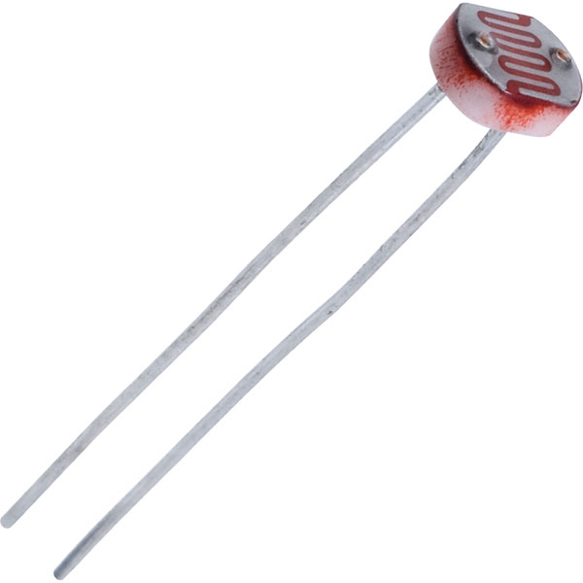
Photoresistors
Photoresistors change their resistance based on how much light is on them

Slide 10
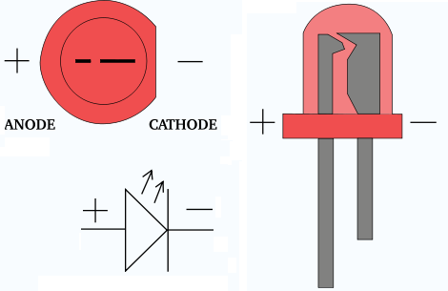
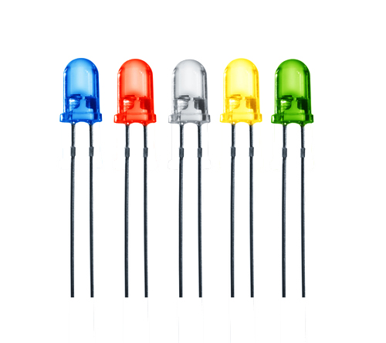
LED’s
LED stands for Light Emitting Diode
When current flows through and LED, they emit light
LED’s are polarized, they have a + and a -

Slide 11
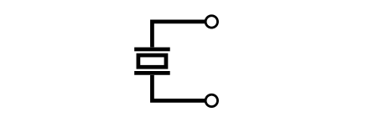
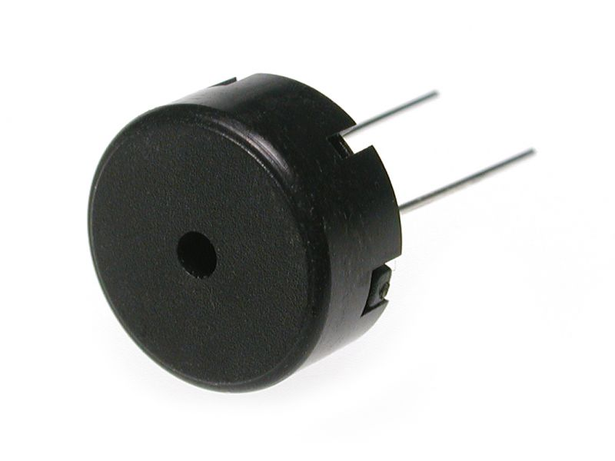
Buzzers
Piezoelectric Buzzers or Buzzers make a sound when a voltage is across them

Slide 12
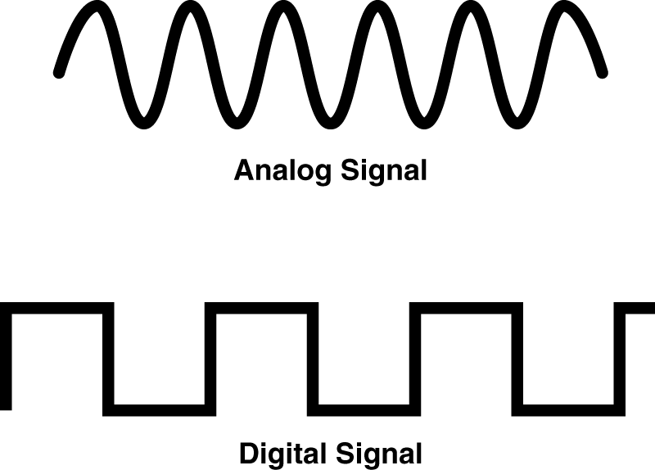
A quick note on Digital vs Analog
Digital implies two states, ON or OFF, (LOW or HIGH, 1 or 0).
Analog implies a changing voltage, some decimal number

Slide 13
Programming
MSP430s are programmed using Energia
Set a pin as input or output : pinMode([pinNumber],[INPUT,OUTPUT])
Turn a pin ON or OFF: digitalWrite([pinNumber],[HIGH, LOW])
Wait: delay([Time [ms]])
Read an analog voltage : analogRead([pinNumber])
Write an analog voltage : analogWrite([pinNumber])

Slide 14
The Labs
Link: hkn.mu/mc_workshops
Link: hkn.mu/workshop_guide

Slide 15
The Labs
Debugging Tips:
Lab 1: When programming your pin values, “LOW” and “HIGH” are keywords you can use in Energia
If running the solution file, make sure to uncomment all the code
To uncomment code remove the two “/” before the code
Lab 4 has a small error in the circuit schematic. GND and the buzzer should be connected
Individual station problems: 17, 11; come ask for help for setting your pins

Slide 16
Feedback!
hkn.mu/mc_feedback

