Slide 1
Raymond Lei
2025-0414 CAI-CVR 001
Homework 8
06/06/2-25
rl3460@columbia.edu

Slide 2
Fitness function
The fitness function evaluates how well the robot can chase and reach a fixed red cube. It's designed as a chase-and-catch task with two possible outcomes:
Fitness = 1.0 / time_to_reach
The faster the robot reaches the cube, the higher the fitness
Units: 1/seconds (inverse time)

Slide 3
Fallback Fitness (Distance-based)
When the robot fails to reach the cube within the time limit:
Fitness = 1.0/ final_distance_to_cube
The closer the robot gets to the cube, the higher the fitness
Units: 1/meters (inverse distance)

Slide 4
Evolutionary Algorithm Implementation
Algorithm Type
Steady-State Genetic Algorithm with elitism and tournament selection
Population Structure
Each individual represents a complete parameter set for all controllable joints:

Slide 5
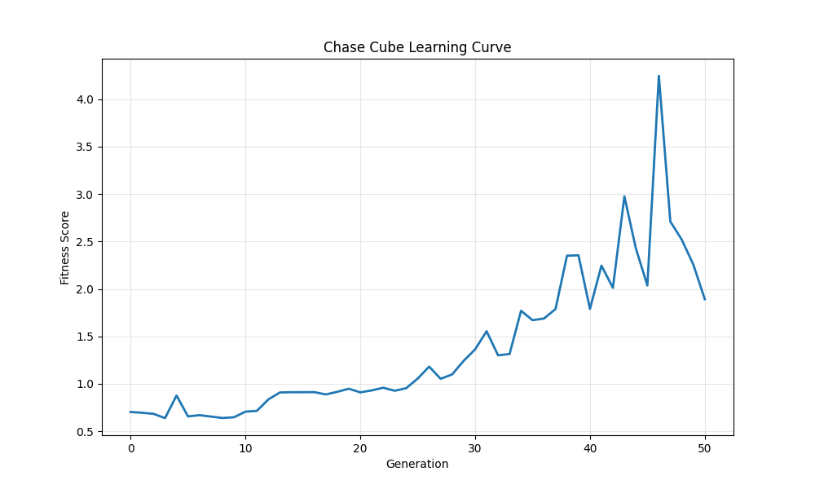
Learning Curve

