Slide 1
11-9-2021 Updates

Slide 2
Progress
Changed how gradient is turned into a binary vector
Draw sample (Bernoulli) from absolute value of gradient (scaled)
Repair sample (about diagonal)
Multiple sample by sign of gradient
Add sample to original edge matrix
Clamp edge matrix to (0,1)

Slide 3
Progress
Added outer loop (minimize loss of model weights, minimize loss of adj. matrix)
Which to minimize first? Does it matter? Experimental success: minimize model weights first (makes sense?)
Try to maximize loss of adj. matrix i.e. Topology Paper (see results)
Try to minimize loss of adj. matrix (see results)

Slide 4
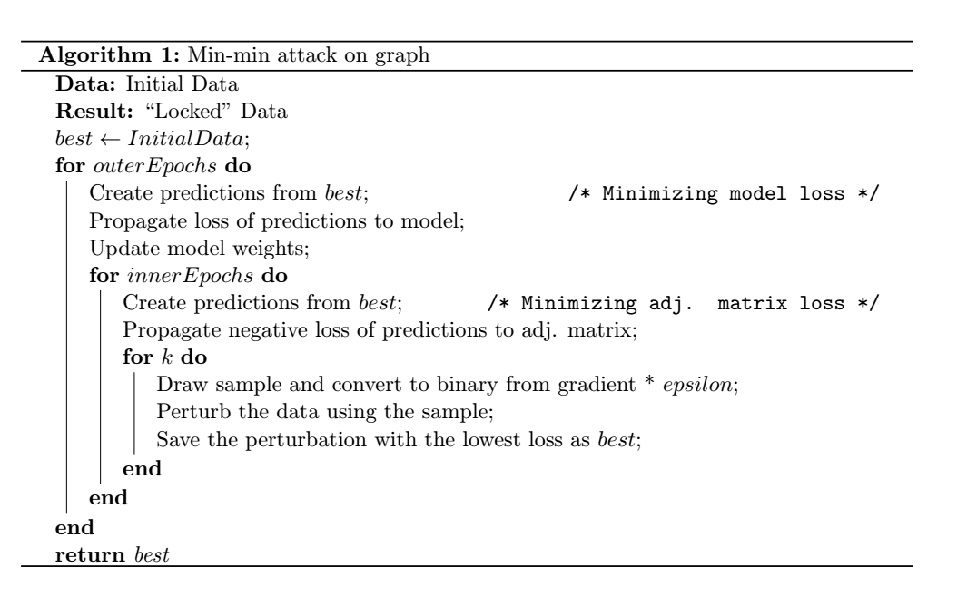
Progress

Slide 5
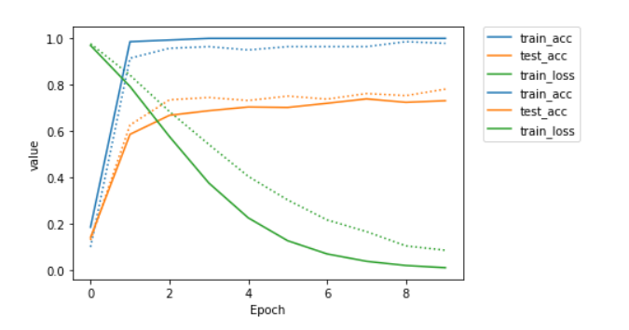
Minimize loss of adj. matrix
Trained on perturbed data, tested on clean data
Outer loops: 3
Inner loops (loss over adjacency matrix): 3
K = 3 (sample of Bernoulli drawn)
Epsilon: 0.2
0.10% edges altered
Grad = grad * 1/grad.max() * epsilon
Minimize model loss, then minimize adj. matrix loss

Slide 6
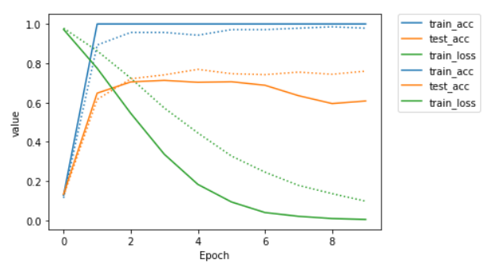
Minimize loss of adj. matrix
Trained on perturbed data, tested on clean data
Outer loops: 5
Inner loops (loss over adjacency matrix): 5
K = 3 (sample of Bernoulli drawn)
Epsilon: 0.2
0.11% edges altered
Grad = grad * 1/grad.max() * epsilon
Minimize model loss, then minimize adj. matrix loss

Slide 7
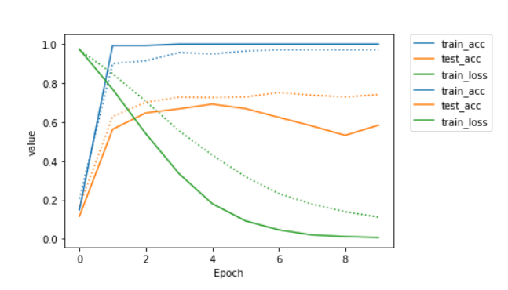
Minimize loss of adj. matrix
Trained on perturbed data, tested on clean data
Outer loops: 3
Inner loops (loss over adjacency matrix): 3
K = 3 (sample of Bernoulli drawn)
Epsilon: 0.5
0.13% edges altered
Grad = grad * 1/grad.max() * epsilon
Minimize model loss, then minimize adj. matrix loss

Slide 9
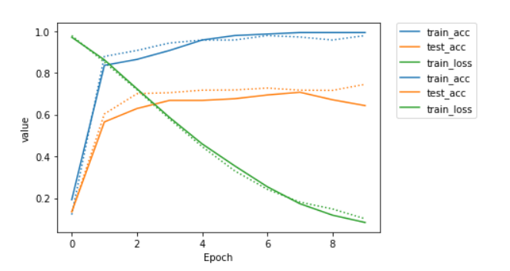
Minimize loss of adj. matrix
Trained on perturbed data, tested on clean data
Outer loops: 3
Inner loops (loss over adjacency matrix): 5
K = 3 (sample of Bernoulli drawn)
Epsilon: 0.2
0.36% edges altered
Grad = grad * 1/grad.max() * epsilon
Minimize adj. matrix loss, then minimize model loss

Slide 10
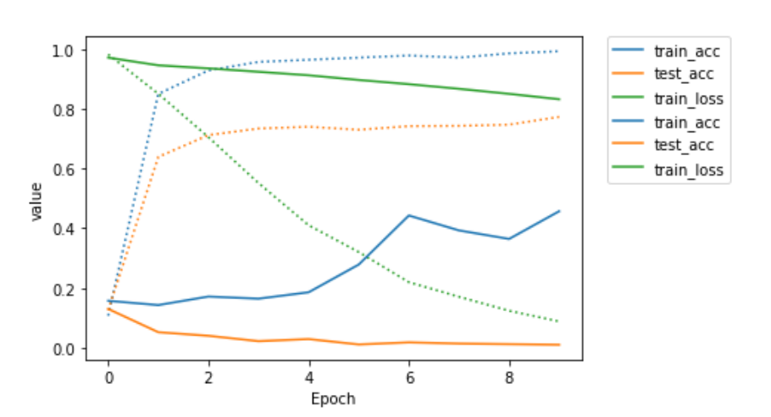
Maximize loss of adj. matrix
Trained on perturbed data, tested on clean data
Outer loops: 4
Inner loops (loss over adjacency matrix): 3
K = 3 (sample of Bernoulli drawn)
Epsilon: 0.3
2.02% edges altered
Grad = grad * 1/grad.max() * epsilon
Minimize model loss, then maximize adj. matrix loss

Slide 11
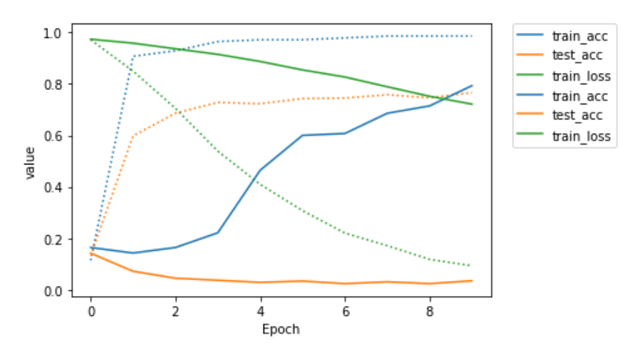
Maximize loss of adj. matrix
Trained on perturbed data, tested on clean data
Outer loops: 3
Inner loops (loss over adjacency matrix): 3
K = 3 (sample of Bernoulli drawn)
Epsilon: 0.1
0.53% edges altered
Grad = grad * 1/grad.max() * epsilon
Minimize model loss, then maximize adj. matrix loss

Slide 12
Takeaways
Adding a value to gradient doesn’t work well
Acts just like random noise
Presumable because low-priority edges start getting altered
Doing too many outer loops (model training) makes it not very effective…
Beyond around 5, the attacked model learns as if the new data is just “noisy”, loss does not converge quickly
Only really need 3 inner loops for descent on the adj. matrix
One performs terribly, two slightly better, anything beyond 3 is about the same. Has to do with learning rate of the model.

Slide 13
Takeaways
Minimize model loss, then minimize adj. matrix loss
Why?
Adding a constant to epsilon (budget) is not effective…
Allows for control, but attack is essentially ineffective and behaves like random noise
Used previous approach still

Slide 14
Further…
Cannot get the test accuracy of the model trained on perturbed data to be very deteriorated (not getting very good results with our method)
Currently is still 50-70%, true random would near 14% (1/7)
Once this works, will work on progressing towards the subgraph
Otherwise cannot tell if the attack works…

Slide 15
Further…
Should the models be tested on the perturbed data (G + S)? Since the attacker has only the “locked” data… (yes)
Train | Test| Val split? What should the attacker’s model train on?
How do I select a group to attack?
Do we know beforehand the subgraph the attacker uses as the training set?
Train over the whole graph?
How to select a subgraph in PyTorch
Just random nodes? Connected nodes?
Should they be similar ones to begin with?

Slide 16
Further…
Do I need to be considering the optimizer of the models?
Everything is cross-entropy loss… Is that ideal?
Tuning other hyperparameters
Learning rate, weight decay, hidden layers
Help with access to CS Dept. Server
Nested training loops getting slow…
Is it like a Jupyter kernel?

