Slide 1
11-23-2021 Updates

Slide 2
Progress
Fixed the implementation of the gradient discretizing algorithm
Borrow from DGL implementation
Moved everything onto a GitHub Repo: https://github.com/ewei2406/AAGNN
Also transitioned into a library-like format
Can now run the model as an executable
Ran 6 combinations
Potentially do more loops on server?

Slide 3
Results
All tests used:
Cora dataset (Should work with other datasets now, just change –dataset flag)
20 regular training epochs
20 perturbation/attack epochs
0.5 perturb rate (0.005% edges altered, this was 2640 +/- 5 edges each time. Reliable comparison!)
Loss of gradient | Train surrogate/perturb adj | With/without model reset
Minimize - | In parallel | Without reset
Minimize - | In parallel | With reset
Maximize + | In parallel | Without reset
Maximize + | In parallel | With reset
Minimize - | In series | N/A
Maximize + | In series | N/A

Slide 4
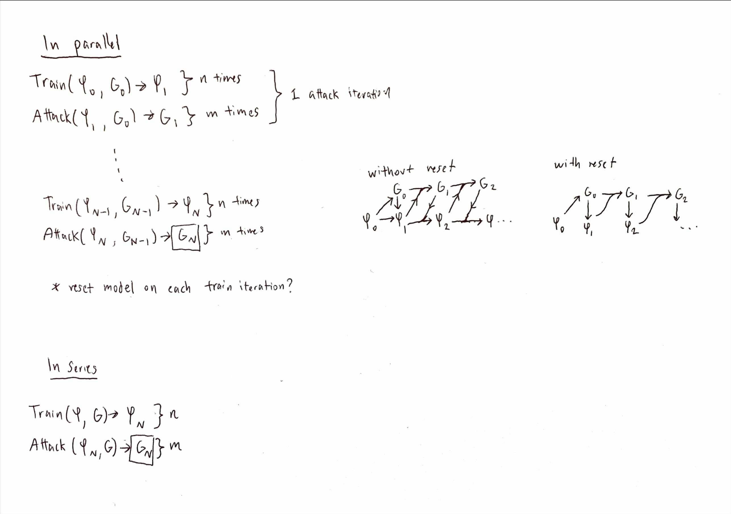

Slide 5
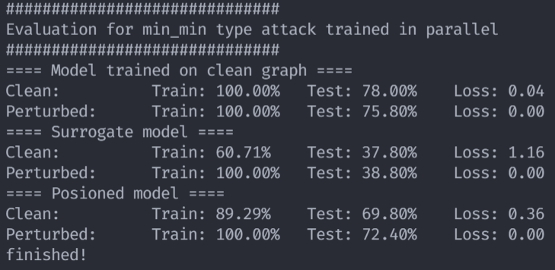
Min-min, in parallel
20 attack epochs:
1 attack model train epoch
1 attack adj perturb epoch
Model is not reset each loop

Slide 6
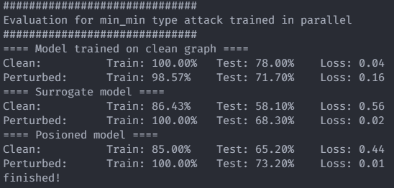
Min-min, in parallel
Pretrained for 20 epochs

Slide 7
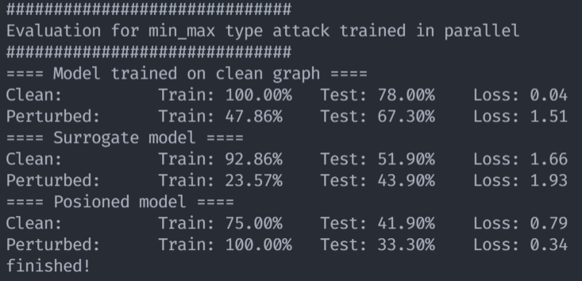
Min-max, in parallel
20 attack epochs:
1 attack model train epoch
1 attack adj perturb epoch
Model is not reset each loop

Slide 8
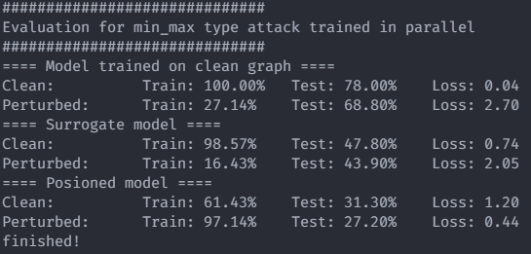
Min-max, in parallel
20 pretrain epochs

Slide 9
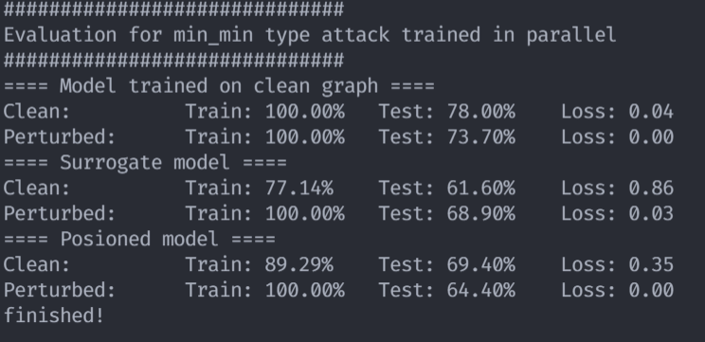
Min-min, in parallel
20 attack epochs:
10 attack model train epoch
3 attack adj perturb epoch
Model is reset each loop

Slide 10
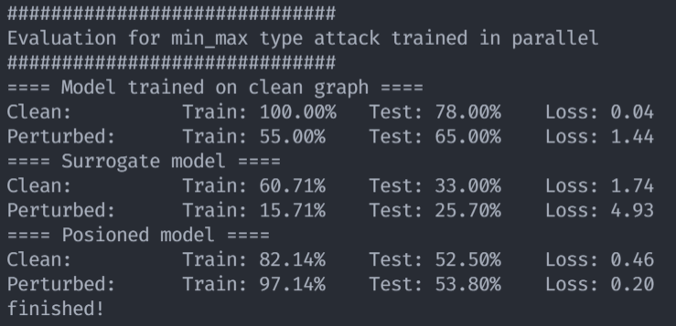
Min-max, in parallel
20 attack epochs:
10 attack model train epoch
3 attack adj perturb epoch
Model is reset each loop

Slide 11
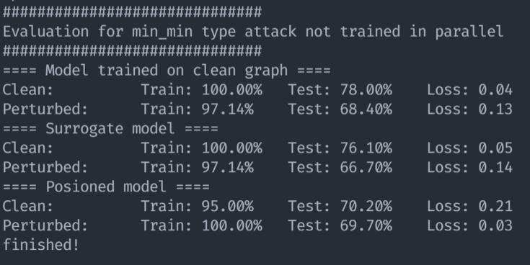
Min-min, in series
Train surrogate 20 epochs
Perturb adj 20 epochs

Slide 12
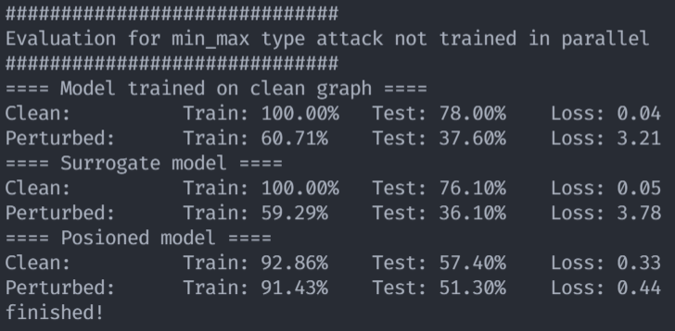
Min-max, in series
Train surrogate 20 epochs
Perturb adj 20 epochs

Slide 13
Baseline accuracy: 78.00%
Poisoned model accuracy on poisoned dataset, trained in parallel
 | Min-min | Min-max
Without resetting | 72.40% | 33.30%
With resetting | 64.40% | 53.80%
Poisoned model accuracy on poisoned dataset, trained in series
Min-min | Min-max
69.70% | 51.30%

Slide 14
Takeaways
Model resetting is questionably effective
Improves min-min, worsens min-max
Extremely computationally expensive (i.e. effective training loops is total attack epochs * atk train epochs).
Possible reason: inefficient in determining ideal path to perturb?

Slide 15
Takeaways
Seems like min-min just isn’t as effective (at least for all tests tried)
Could try doing more training loops, other hyperparams, etc.
In line with previous testing
Some possible other combinations to try:
“Pretrain” the model for a few epochs before doing training in parallel without resetting. (hybrid series and parallel)
Increase epochs of attack train and adj perturbations per attack epoch.

Slide 16
Further…
Should continue work on examining min-min?
0.5 perturb rate is high (compared to number of existing edges). Perhaps min-min will perform better when the perturb rate is low?

